Slide 1
CSCI 1103 CS 1 Honors
Meeting 39: Friday 12/4
Abstract Data Types in Ocaml & Java

Slide 2
t₁ -> t₂
unit
string
char
int
float
t₁ * t₂
{a₁:t₁; …; a_{n}:t_{n}}
bool
type state = Stop | Go

Slide 3
How are strings represented?

Slide 4
String.t

Slide 5
String.t
That’s it!

Slide 6
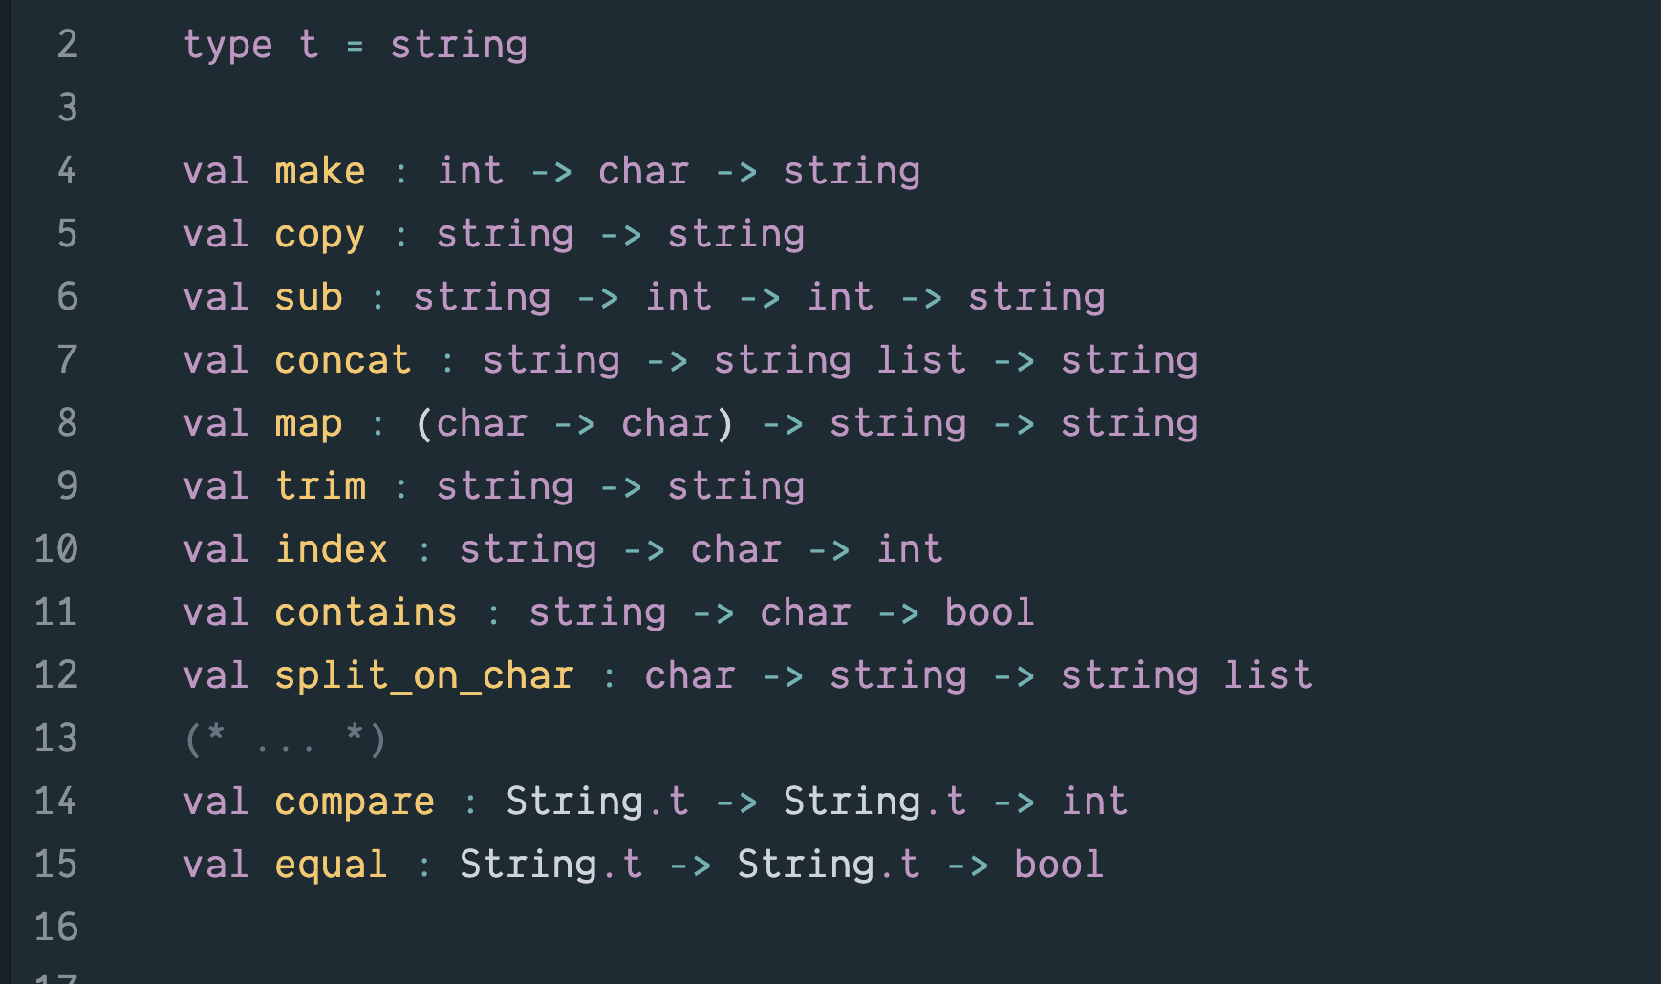

Slide 7

Barbara Liskov

Slide 8
A New Type is like a Product or Service
Client Code 1
My new Widget Type
Client Code 2
Client Code 3

Slide 9
When Introducing a new Type
Implementation 1
Name of the Type
Type signatures of all of the related operations
The API
Implementation 2

Slide 10
When Introducing a new Type
Implementation 1
Name of the Type
Type signatures of all of the related operations
The API
Implementation 2
Specification

Slide 11
An implementation will have one or more secret representation types used only within the implementation.
Implementation 1
Name of the Type
Type signatures of all of the related operations
The API
Implementation 2

Slide 12
This implementation may have a fast find operation.
Implementation 1
Name of the Type
Type signatures of all of the related operations
The API
Implementation 2

Slide 13
Implementation 1
Name of the Type
Type signatures of all of the related operations
The API
Implementation 2
This one may have a small memory footprint.

Slide 14
If you’re using a typed PL the type checker can confirm the fit
Implementation 1
Name of the Type
Type signatures of all of the related operations
The API
Implementation 2

Slide 15
I.e., the implementation has a well-formed definition for everything required by the specification
Implementation 1
Name of the Type
Type signatures of all of the related operations
The API
Implementation 2

Slide 16
Information Hiding
Client Code 1
API
Client Code 2
Client Code 3
Client code knows only what is in the specification.

Slide 17
In Java ADTs can be built using classes and interfaces
In Ocaml ADTs are built using modules

Slide 18
ADTs in OCaml

