Slide 1
CSCI 1103 CS 1 Honors
Meeting 40: Monday 12/7
Abstract Data Types in Ocaml & Java

Slide 2
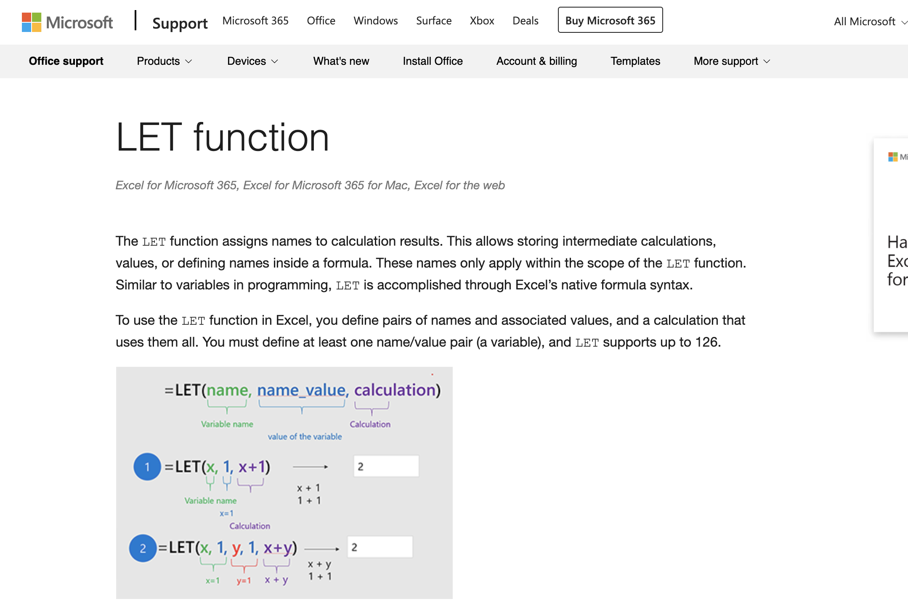

Slide 3
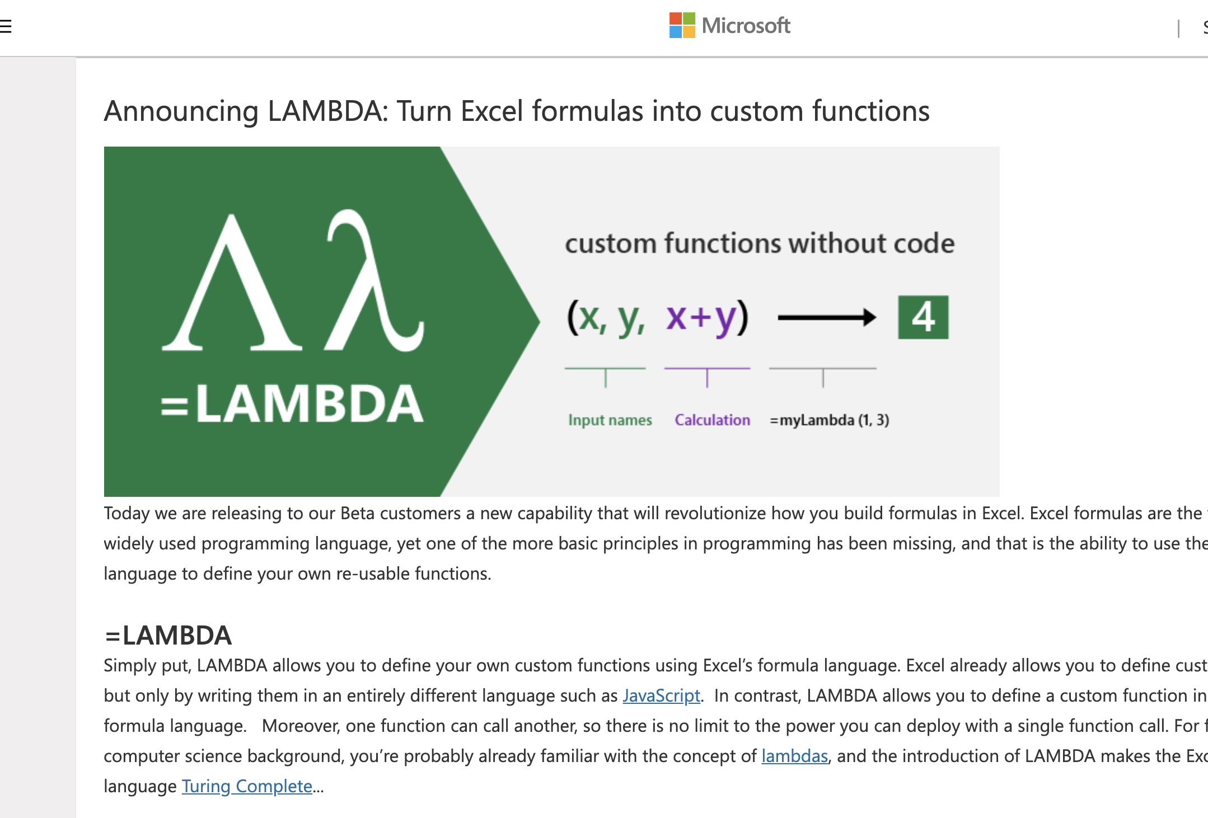

Slide 4
Procedural & Message Passing Styles
 | Empty | Not Empty
add | --- | ---
find | --- | ---

Slide 5
Procedural Style
 | Empty | Not Empty
add | --- | ---
find | --- | ---
add & find discriminate between Empty or Not Empty

Slide 6
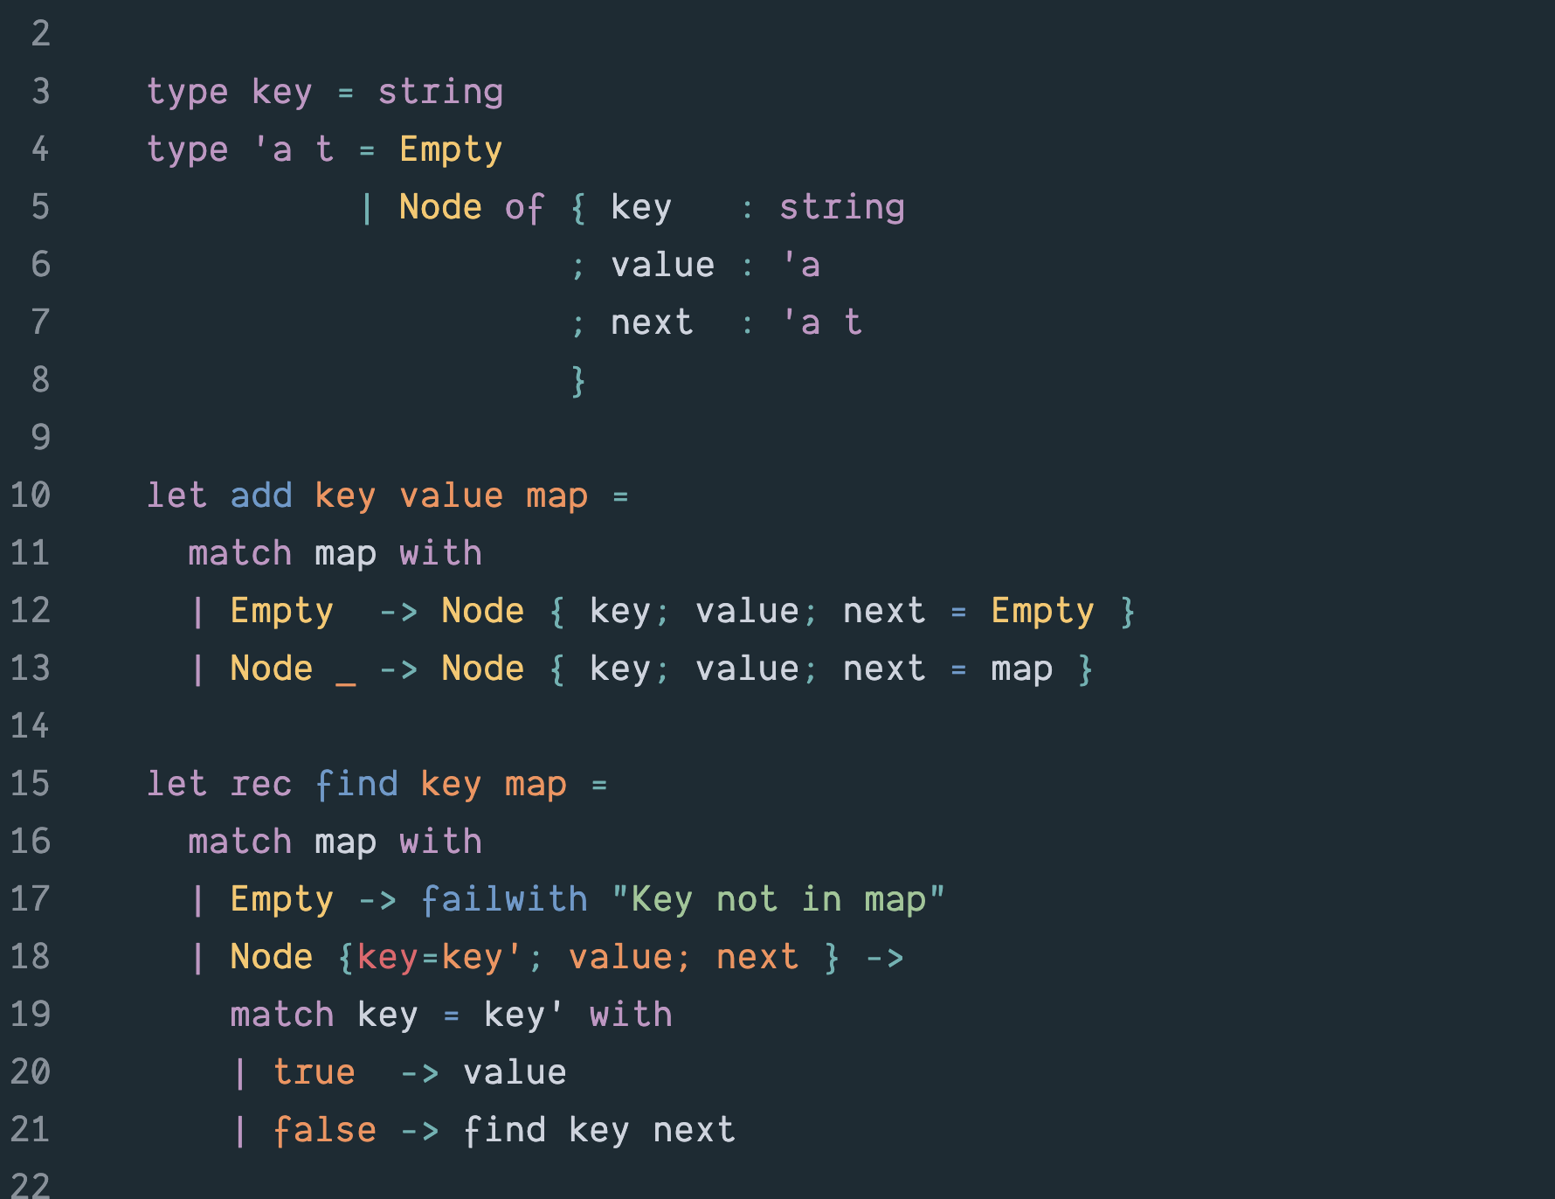

Slide 7
Message Passing Style
Empty & Not Empty can field both add and find messages
 | Empty | Not Empty
add | --- | ---
find | --- | ---

Slide 8
Java has no Either/Or Types

Slide 9
Can Simulate Either/Or but it’s not native Java Style

