Slide 1





Slide 2



start

Slide 3
ethereum
yellowpaper.io : whitepaper : wiki
secp256k1 : EVM : devp2p : patricia trie : ethash : JSON RPC

Slide 4
part 1: low level basics

Slide 5
secp256k1
Nethermind.Secp256k1.Test
building secp256k1 : Bouncy Castle
private key : public key
http://www.secg.org/sec1-v2.pdf
https://hackernoon.com/what-is-the-math-behind-elliptic-curve-cryptography-f61b25253da3
https://medium.com/@VitalikButerin/exploring-elliptic-curve-pairings-c73c1864e627

Slide 6
0x reminder
0x|3a|66|
|3 * 16^1 + 10 * 16^0|6 * 16^1 + 6 * 16^0|
|3 * 16 + 10 * 1|6 * 16 + 6 * 1|
|58|102|
|0011 1010|0110 0110|

Slide 7
private key
32 bytes (random)
0x|3a|10|76|bf|45|ab|87|71|2a|d6|4c|cb|3b|10|21|77|37|f7|fa|ac|bf|28|72|e8|8f|dd|9a|53|7d|8f|e2|66|

Slide 8
public key
64 bytes (or 65 bytes with 0x04)
3a1076bf45ab87712ad64ccb3b10217737f7faacbf2872e88fdd9a537d8fe266
0x3a1076bf45ab87712ad64ccb3b10217737f7faacbf2872e88fdd9a537d8fe266
0x|3a|10|76|bf|45|ab|87|71|2a|d6|4c|cb|3b|10|21|77|37|f7|fa|ac|bf|28|72|e8|8f|dd|9a|53|7d|8f|e2|66
|3 * 16 + 10 = 58| … |6 * 16 + 6 = 102|
|00000011 00001010| … |00000110 00000110|

Slide 9
public key formats
https://bitcointalk.org/index.php?topic=42384.0
SEC (Standards for Efficient Cryptography) defines three types: 0x00 = point at infinity, 0x02 and 0x03 = compressed, 0x04 = uncompressed
02 basically means even y-point, 03 means odd y-point, thus:
uncompressed pubkey = chr(4) + 32-byte x + 32-byte y
compressed pubkey = chr(1 + (y & 1)) + 32-byte x

Slide 10
Keccak (pronounced [kɛtʃak], like “ketchak”)
32 bytes
0xc5d2460186f7233c927e7db2dcc703c0e500b653ca82273b7bfad8045d85a470
https://keccak.team/keccak_specs_summary.html

Slide 11
Keccak
where is the name coming from?

Slide 12

http://www.ghmhotels.com/ghmjourneys/balis-best-dances/

Slide 13
address
20 bytes
private Address ComputeAddress() { byte[] hash = Keccak.Compute(Bytes).Bytes; byte[] last160Bits = new byte[20]; Buffer.BlockCopy(hash, 12, last160Bits, 0, 20); return new Address(last160Bits); }

Slide 14
EIP
Ethereum Improvement Proposal
https://github.com/ethereum/EIPs

Slide 15
address
20 bytes
0x5a4eab120fb44eb6684e5e32785702ff45ea344d
(EIP-55) 0x5A4EAB120fB44eb6684E5e32785702FF45ea344D

Slide 16
RLP
value 0 -> 128
value lt 128 -> value
empty byte array -> 128
length 1 byte array -> first byte value
length lt 56 byte array -> (128 + length) + byte array
length gt 56 byte array -> (183 + length of serialized length) + (serialized length) + byte array

Slide 17
RLP of a sequence
RLP-encode each element and concatenate, then:
length lt 56 -> (192 + length) + content
length gt 56 -> (247 + length of serialized length) + (serialized length) + content

Slide 18
endianness
big-endian

Slide 19
RLP examples
0x|80|
0x|94|01|02|03|04|05|06|07|08|09|0a|0b|0c|0d|0e|0f|10|11|12|13|14|
0x|a0|01|02|03|04|05|06|07|08|09|0a|0b|0c|0d|0e|0f|10|11|12|13|14|15|16|17|18|19|1a|1b|1c|1d|1e|1f|20|
0x|b9|01|00|...
0x|c0|
0x|f8|42|a0|...

Slide 20
part 2: state

Slide 21
account
nonce : balance : code hash : storage root

Slide 22
storage
int256 -> int256

Slide 23
nibble
half-byte | hex digit

Slide 24
patricia tree
branch : extension : leaf
tree root

Slide 25
hex prefix
isLeaf + nibble[] -> byte[]
0 + |1|2|3|4|5|6|7|8|9|a| -> 0x|00|12|34|56|78|9a|
0 + |1|2|3|4|5|6|7|8|9|a|b| -> 0x|11|23|45|67|89|ab|
1 + |1|2|3|4|5|6|7|8|9|a| -> 0x|20|12|34|56|78|9a|
1 + |1|2|3|4|5|6|7|8|9|a|b|-> 0x|31|23|45|67|89|ab|

Slide 26
DBs
RocksDB : LevelDB : SSD

Slide 27
exercise
add 0x0eea = 100
add 0x0eeb = 100
add 0x1eea = 100
add 0x1eeb = 100
add 0x1ee1 = 100
update 0x0eea = 80
delete 0x1eeb

Slide 28
pruning
full archive : fast sync

Slide 29
part 3: EVM

Slide 30
stack
stack size

Slide 31
int256

Slide 32
gas
gas cost : gas limit : gas price

Slide 33
memory
memory cost

Slide 34
call stack
env : stack : memory : return data : call depth

Slide 35
opcodes
arithmetic : bitwise : SHA3 : env : block : memory : flow : stack : logs : calls

Slide 36
precompiles
private void InitializePrecompiledContracts() { _precompiles = new Dictionary<Int256, IPrecompiledContract> { [1] = EcRecoverPrecompiledContract.Instance, [2] = Sha256PrecompiledContract.Instance, [3] = Ripemd160PrecompiledContract.Instance, [4] = IdentityPrecompiledContract.Instance, [5] = Bn128AddPrecompiledContract.Instance, [6] = Bn128MulPrecompiledContract.Instance, [7] = Bn128PairingPrecompiledContract.Instance, [8] = ModExpPrecompiledContract.Instance }; }

Slide 37
zkSNARKs
https://blog.ethereum.org/2016/12/05/zksnarks-in-a-nutshell/

Slide 38
internal calls
CREATE : CALL : CALLCODE : DELEGATECALL : STATICCALL

Slide 39
exceptions
out of gas : stack overflow : stack underflow : invalid op : invalid jump : static call violation

Slide 40
gas golf
https://g.solidity.cc/

Slide 41
part 4: transactions

Slide 42
chain ID
network ID

Slide 43
signing
public void Sign(PrivateKey privateKey, Transaction transaction, BigInteger blockNumber) { if(_logger.IsDebugEnabled) _logger.Debug($"Signing transaction: {transaction.Value} to {transaction.To}"); bool isEip155Enabled = _specProvider.GetSpec(blockNumber).IsEip155Enabled; Keccak hash = Keccak.Compute(Rlp.Encode(transaction, true, isEip155Enabled, _chainIdValue)); transaction.Signature = Sign(privateKey, hash); if (isEip155Enabled) { transaction.Signature.V = (byte)(transaction.Signature.V + 8 + 2 * _chainIdValue); } if(_logger.IsDebugEnabled) _logger.Debug("Transaction signed"); }

Slide 44
recovery
public Address RecoverAddress(Transaction transaction, BigInteger blockNumber) { bool isEip155Enabled = _specProvider.GetSpec(blockNumber).IsEip155Enabled; bool applyEip155 = isEip155Enabled && (transaction.Signature.V == _chainIdValue * 2 + 35 || transaction.Signature.V == _chainIdValue * 2 + 36); Keccak hash = Keccak.Compute(Rlp.Encode(transaction, true, applyEip155, _chainIdValue)); return RecoverAddress(transaction.Signature, hash); }
public Address RecoverAddress(Signature signature, Keccak message) { return RecoverPublicKey(signature, message)?.Address; }

Slide 45
account nonce

Slide 46
eth units
public static class Unit { public static BigInteger Wei = 1; public static BigInteger GWei = 1000000000; public static BigInteger Szabo = 1000000000000; public static BigInteger Finney = 1000000000000000; public static BigInteger Ether = 1000000000000000000; public const string EthSymbol = "Ξ"; }

Slide 47
transfer
21000 gas
---
at 20 GWei
and ETHUSD at 400
---
transfer cost?

Slide 48
contract creation
init : code deposit

Slide 49
refunds
destroy : sclear

Slide 50
call
data

Slide 51
bloom

Slide 52
receipts : logs
https://codeburst.io/deep-dive-into-ethereum-logs-a8d2047c7371

Slide 53
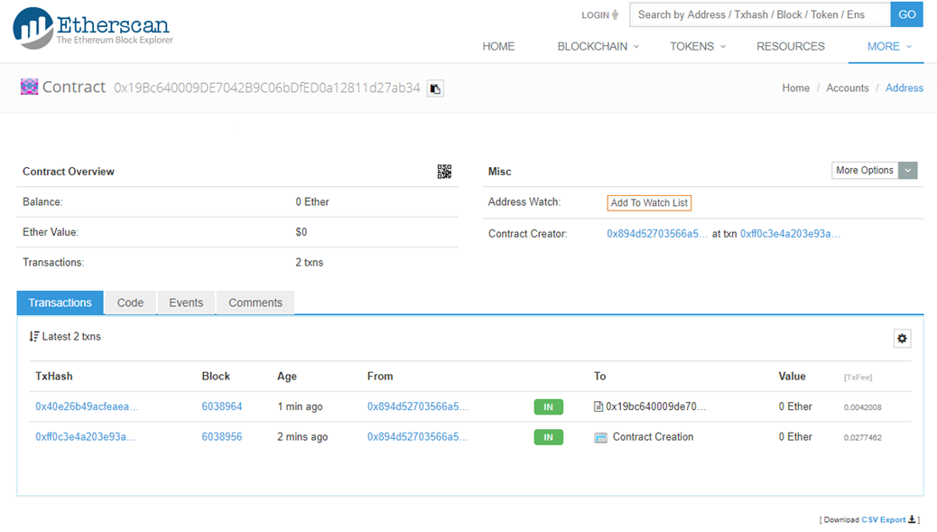
solidity contracts

Slide 54
part 5: blockchain building blocks with screenshots from etherscan.io

Slide 55
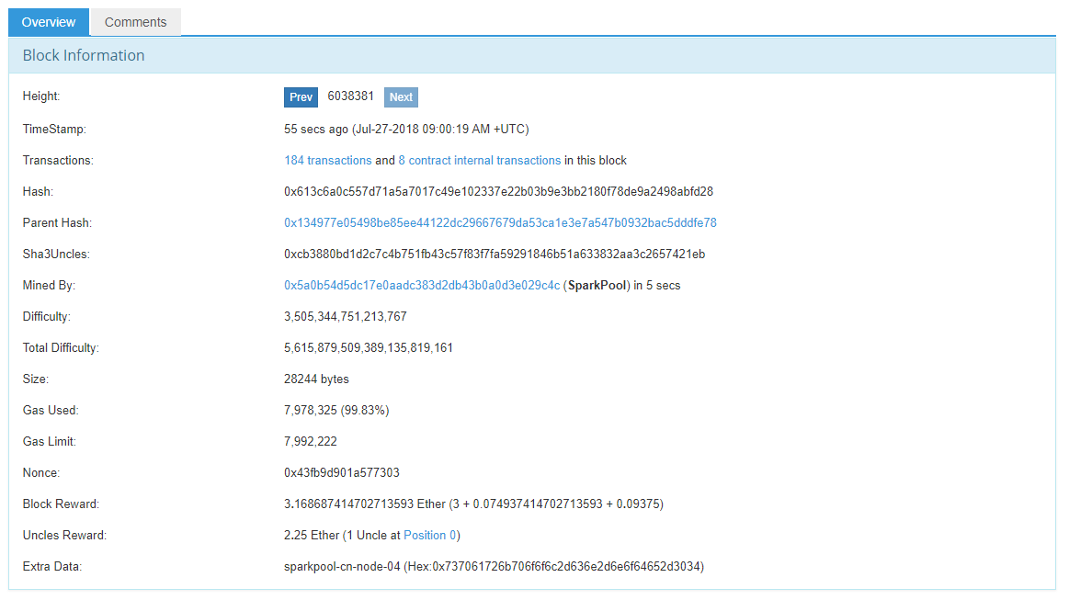
block

Slide 56
block header

Slide 57
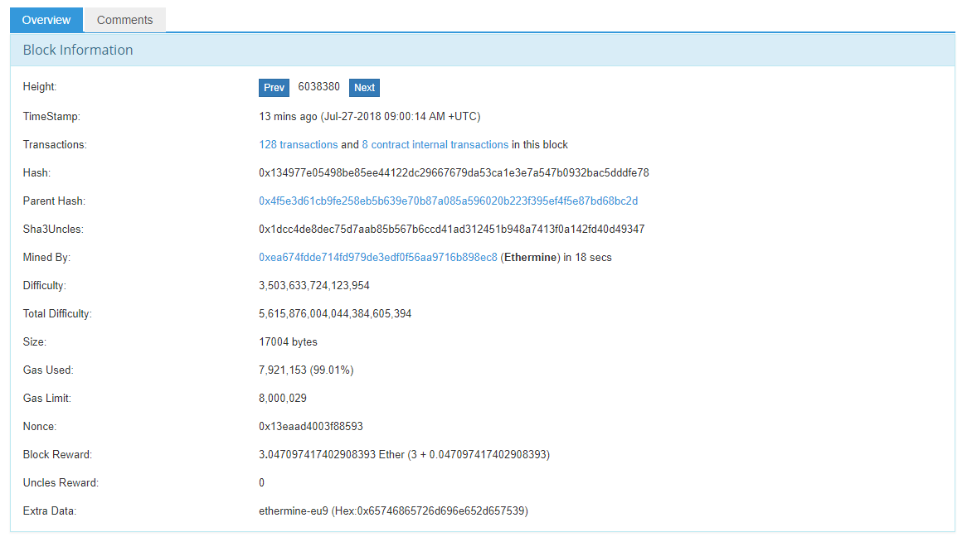
block parent

Slide 58
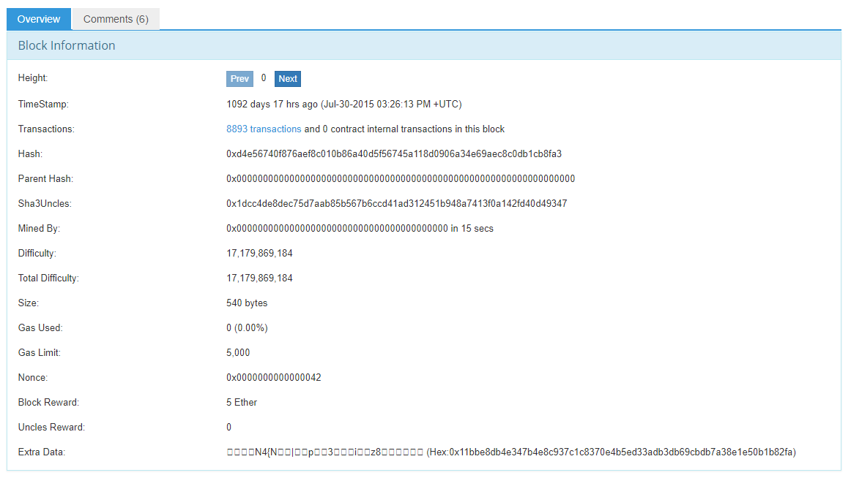
genesis block

Slide 59
allocs
genesis block preallocations

Slide 60
difficulty

Slide 61
ommer : uncle
last block effect : network security : economics

Slide 62
blockchain : block tree
reorganization

Slide 63
forks
0 000 000 Frontier
1 150 000 Homestead
1 920 000 DAO
2 463 000 Tangerine Whistle
2 675 000 Spurious Dragon
4 370 000 Byzantium
6 000 000 now

Slide 64
DAO
Ethereum Classic

Slide 65
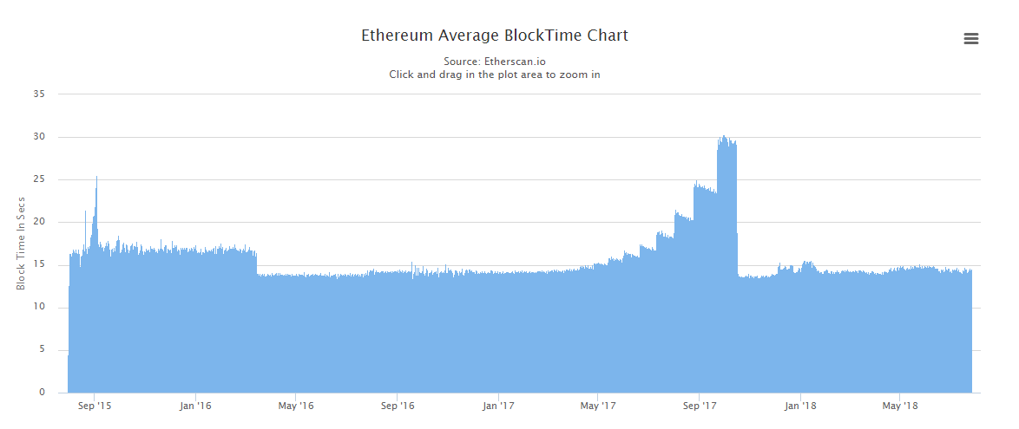
ice age
private BigInteger TimeBomb(IReleaseSpec spec, BigInteger blockNumber) { if (spec.IsEip649Enabled) { blockNumber = blockNumber - 3000000; } return blockNumber < 200000 ? BigInteger.Zero : BigInteger.Pow(2, (int)(BigInteger.Divide(blockNumber, 100000) - 2)); }

Slide 67
next ice age block?

Slide 68
block validation
exercise

Slide 69
part 6: mining

Slide 70
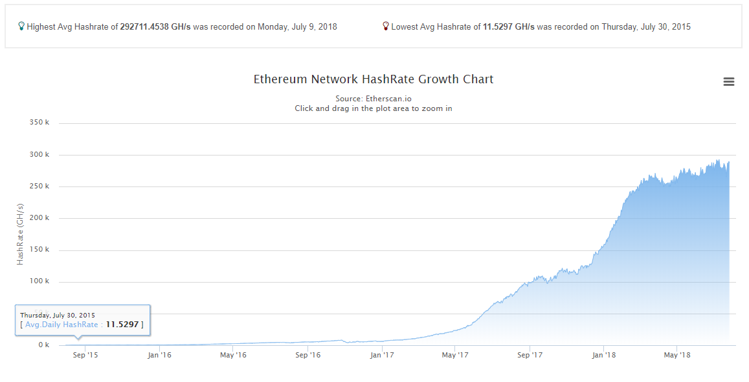
ethash

Slide 71
verification
public bool Validate(BlockHeader header) { uint epoch = GetEpoch(header.Number); IEthashDataSet cache = GetOrAddCache(epoch); ulong fullSize = GetDataSize(epoch); Keccak headerHashed = GetTruncatedHash(header); (byte[] _, byte[] result) = Hashimoto(fullSize, cache, headerHashed, header.MixHash, header.Nonce); BigInteger threshold = BigInteger.Divide(BigInteger.Pow(2, 256), header.Difficulty); return IsLessThanTarget(result, threshold); }

Slide 72
mempool

Slide 73
part 7: devp2p

Slide 74
discovery
nodeID : kademlia : v5
https://pdos.csail.mit.edu/~petar/papers/maymounkov-kademlia-lncs.pdf

Slide 75
RLPx
handshake

Slide 76
p2p
status : subprotocols

Slide 77
eth62, eth63
full archive : fast sync

Slide 78
les
light client : bloom bits

Slide 79
par
warp sync

Slide 80
shh
Whisper

Slide 81
bzz
SWARM : IPFS

Slide 82
part 8: the future

Slide 83
constantinople
EIP210 (blockhash in state) : EIP145 (shifts – SHL, SHR, SAR)
EIP1014 (CREATE2) : EIP1052 (EXTCODEHASH)
time bomb delay

Slide 84
sharding
quadratic : phases : exponential : 100

Slide 85
plasma

Slide 86
Casper
PoS : RNG

Slide 87
eWASM
sentinel contract : WASM : EEI (eth env interface) : transpiler : metering

