Slide 1

异构计算集群调度与资源管理系统
Yanjie Gao

Slide 2
课程概览
异构计算集群管理系统简介
作业，镜像与容器
调度
代表性异构计算集群管理系统

Slide 3


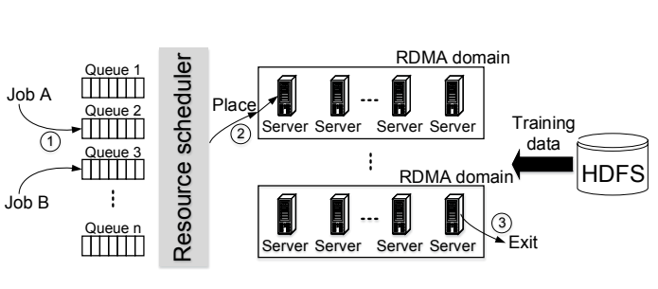

在多租(Multi-Tenant) GPU 集群运行作业(Job)
拥有 20 GPU 配额
拥有 10 GPU 配额
提交TF Job
多用户共享多GPU服务器
多作业(Job)，多用户
作业环境需求多样
作业资源需求多样
服务器软件环境单一
服务器空闲资源多样
提交PyTorch Job
拥有 100 GPU 配额
GPU集群
提交MXNet Job

Slide 4
调度与资源管理系统重要性
提供人工智能基础架构支持
深度学习作业(Job)调度(Scheduling)与管理
异构硬件管理
提升生产力
用户专注于模型创新，无需关注系统部署，管理
模型，代码和数据共享，加速研究与创新

Slide 5

深度学习作业(Job)的生命周期
1. 作业提交与排队
2. 作业资源分配与调度
3. 作业执行完成与释放
GPU集群
如何提交作业与解决环境依赖问题？
如何高效调度作业并分配资源？
如何将启动的作业运行时资源与命名空间隔离？
Notes:
https://www.microsoft.com/en-us/research/uploads/prod/2018/05/gpu_sched_tr.pdf

Slide 6
作业，镜像与容器
深度学习作业
镜像
容器

Slide 7
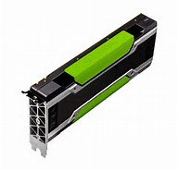
独占服务器执行深度学习作业
GPU服务器
独占环境，无需考虑环境，资源隔离问题
环境依赖路径: 本地/anaconda3
GPU环境依赖: 本地/usr/local/cuda
数据路径: 本地/data
直接执行启动脚本:
python train.py --batch_size=256 --model_name=resnet50
P100

Slide 8
作业提交到平台
{
"jobName": "restnet",
"image": "example.tensorflow:stable",
"dataDir": "/tmp/data",
"outputDir": "/tmp/output",
...
"taskRoles": [
{
...
"taskNumber": 1,
"cpuNumber": 8,
"memoryMB": 32768,
"gpuNumber": 1,
"command": "python train.py --batch_size=256 \
--model_name=resnet50"
}
]
}
P100
环境依赖
数据与代码
提交作业
GPU集群
任务数量
资源占用
作业启动命令

Slide 9
作业环境依赖问题
问题：
服务器上没有预装好所需要的个性化环境?
不同作业需要的框架，依赖和版本不同，安装繁琐且重复？
部署服务器上可能会有大量重复安装的库，占用空间？
深度学习特有问题：
深度学习作业需要安装CUDA依赖和深度学习框架等
目标：
复用整体安装环境并创建新环境
层级构建依赖，复用每一层级的依赖

Slide 10
作业运行时资源隔离问题
问题：
集群资源被共享，如何保证作业互相之间不干扰和多占用资源？
如何能够让不同作业可以运行不同的操作系统和命名空间？
如何保证隔离的同时，作业启动的越快越好?
深度学习特有问题：
GPU和GPU memory如何隔离
目标：
资源隔离
轻量级启动

Slide 11

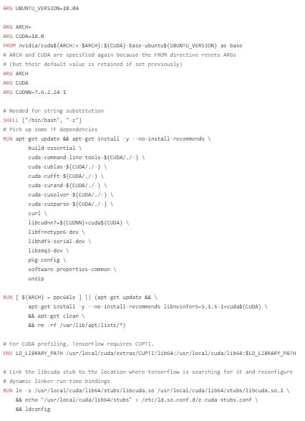
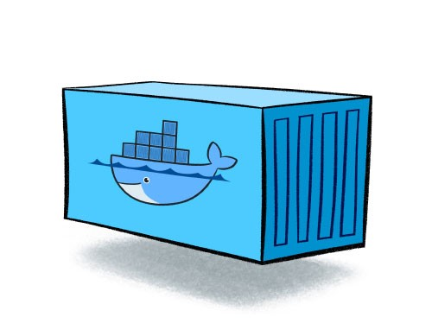

镜像与容器 - Docker
Docker Registry
Image
打包作业环境依赖
Registry
共享镜像
Container
运行时作业资源管理与隔离
pull
push
build
run
Dockerfile
Docker Image
Docker Container

Slide 12
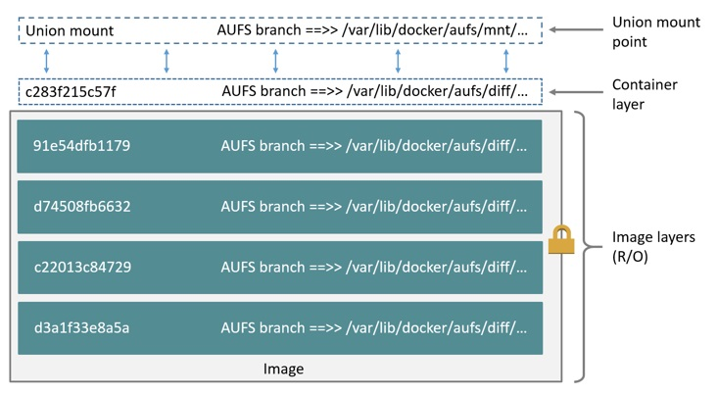
镜像 (Image)
含有可读和读写层
union mount
支持多种文件系统
AUFS
OverlayFS
…
容器镜像层级关系
Notes:
https://medium.com/@jessgreb01/digging-into-docker-layers-c22f948ed612
https://ilearnedhowto.wordpress.com/2018/01/15/how-to-deal-with-the-union-file-systems-that-use-docker-overlayfs-and-aufs/
https://docs.docker.com/storage/storagedriver/aufs-driver/
https://en.wikipedia.org/wiki/Aufs
https://blog.tendenci.com/aufs-and-docker-deployment-developer-track/
OverlayFS is a modern union filesystem that is similar to AUFS, but faster and with a simpler implementation. Docker provides two storage drivers for OverlayFS: the original overlay, and the newer and more stable overlay2.
https://docs.docker.com/storage/storagedriver/overlayfs-driver/

Slide 13
Dockerfile实例
FROM nvidia/cuda:10.0-cudnn7-devel-ubuntu16.04
ARG PYTHON_VERSION=3.6
…
RUN apt-get update && apt-get install -y --no-install-recommends \
…
RUN curl -o ~/miniconda.sh
…
/opt/conda/bin/conda install -y -c pytorch magma-cuda100 && \
…
WORKDIR /opt/pytorch
COPY . .
…
WORKDIR /workspace
RUN chmod -R a+w .
…
https://github.com/pytorch/pytorch/blob/build/1.3.0/docker/pytorch/Dockerfile

Slide 14
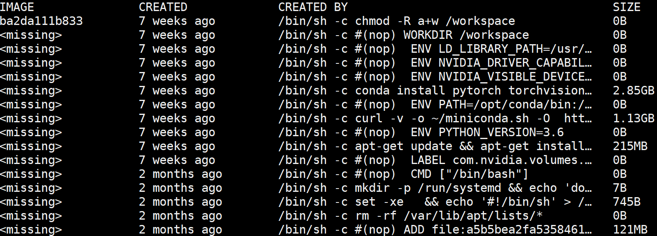
PyTorch Docker Image 实例
Notes:
sudo docker run pytorch/pytorch:1.3-cuda10.1-cudnn7-runtime
https://github.com/pytorch/pytorch/blob/build/1.3.0/docker/pytorch/Dockerfile

Slide 15
镜像文件系统实例
Container top layer
file 1
file 2
file 3
file 4
Image layer 2
file 1
file 4
Image layer 1
file 2
Image base layer
file 3
file 4
AUFS 存储驱动实例

Slide 16
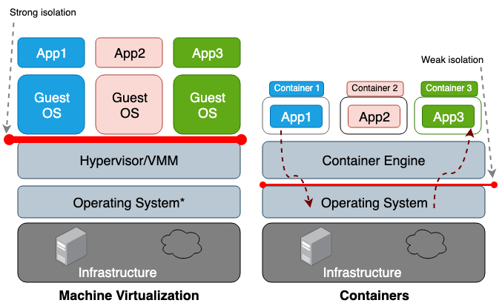
容器 (Container)
Wiki定义:
Linux containers are implementations of operating system-level virtualization for the Linux operating system.
支撑技术：
cgroup, namespace
DL Job1
DL Job2
DL Job3
DL Job1
DL Job2
DL Job3
DL Job1
Notes:
https://unit42.paloaltonetworks.com/making-containers-more-isolated-an-overview-of-sandboxed-container-technologies/

Slide 17
命名空间(Namespace)
Root PID Namespace
命名空间隔离
类型
pid
net
mnt
ipc
user
...
pid 1 (pid 1)
PID Namespace x
pid 3 (pid 1)
pid 2 (pid 2)
pid 5 (pid 3)
pid 4 (pid 2)
black: Real PID
blue: getid() to get this PID
Notes:
https://medium.com/@tomdeore/docking-a-docker-container-part-2-c1206e7c6677

Slide 18
控制组(Control Group)
Linux通过cgroup对进程组的资源：
控制 (control)
计数 (accounting)
隔离 (isolation)
类型：
cpu
memory
block i/o
network
…
CPU
Memory
Network
Storage
IO
CGOUP 1
CGOUP 4
CGOUP 2
CGOUP 3
Notes:
https://www.igvita.com/2016/03/01/control-groups-cgroups-for-the-web/
https://access.redhat.com/documentation/en-us/red_hat_enterprise_linux/6/html/resource_management_guide/sec-cpu

Slide 19
容器资源分配与隔离子系统实例
Subsystem | Type | Description
cpuset | isolation | Confine processes to processor and memory node subsets
ns | isolation | For showing private view of system to processes in cgroup
cpu | control | Share CPU bandwidth between groups
cpuacct | accounting | The CPU Accounting (cpuacct) subsystem generates automatic reports on CPU resources
memory | control | The memory controller supports reporting and limiting of process memory, kernel memory, and swap used by cgroups.
devices | isolation | This supports controlling which processes may create (mknod) devices as well as open them for reading or writing.
rdma | control | The RDMA controller permits limiting the use of RDMA/IB-spe‐cific resources per cgroup.
blk_io | control | The blkio cgroup controls and limits access to specified block devices by applying IO control
Notes:
http://man7.org/linux/man-pages/man7/cgroups.7.html

Slide 20
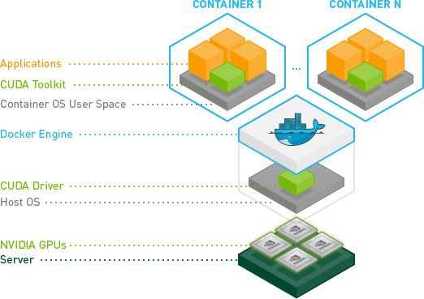
GPU资源分配与隔离 - Nvidia Docker
功能：GPU粒度的隔离
问题：
无法像传统OS对CPU时分复用隔离
GPU内存无法隔离
潜在解决方法：
Nvidia MPS ，当前还未集成进行nvidia docker
Notes:
https://devblogs.nvidia.com/gpu-containers-runtime/
https://github.com/NVIDIA/nvidia-docker

Slide 21
Nvidia Docker实例
# Test nvidia-smi with the latest official CUDA image
$ docker run --gpus all nvidia/cuda:9.0-base nvidia-smi
# Start a GPU enabled container on two GPUs
$ docker run --gpus 2 nvidia/cuda:9.0-base nvidia-smi
# Starting a GPU enabled container on specific GPUs
$ docker run --gpus '"device=1,2"' nvidia/cuda:9.0-base nvidia-smi

Slide 22
小结与讨论
容器与镜像解决了环境依赖，资源隔离进而奠定未来调度系统多租的基石
相比传统OS，在GPU技术栈还不完善的功能是？

Slide 23
调度
群调度 (Gang Scheduling)
DRF调度 (Dominant Resource Fairness Scheduling)
容量调度 (Capacity Scheduling)
抢占 (Preemption)
前沿调度算法

Slide 24
调度性能指标(metrics)
针对一批作业调度，常常考虑以下指标 :
吞吐(Throughput)
完工时间(Makespan) / 平均响应时间(Average Response Time）
公平(Fairness)
利用率(Utilization)
服务等级协议(SLA）
Notes:
How to measure fairness metrics: https://www.sigops.org/s/conferences/sosp/2009/papers/isard-sosp09.pdf

Slide 25
调度并行或分布式作业会有哪些问题?
Job A Task
Job B Task
GPU
问题：并行作业可以同时执行多个任务，如果有依赖任务没启动，已启动任务会在同步点忙于等待或者频繁上下文切换 (如右图)：
无法训练：等待不能启动的任务
资源浪费：已启动的任务造成资源浪费
深度学习训练特点：
深度学习作业任务需要同步梯度
GPU软件栈无法支持任务上下文切换
目标：High Throughput, High Utilization and Short Response Times
Node 1
Node 2
1
2
3
4
5
6
7
8
t₁
a₁
a₂
a₃
a₄
b₁
b₂
b₃
b₄
Time
t₂
a₁
a₂
a₃
a₄
b₁
b₂
b₃
b₄
资源浪费
无法启动，Job A无法训练
a₅
b₅
…
Pending Task Queue
Notes:
https://www.infoq.cn/article/PH7xwdf-qAUE3yTADsrV
https://www.microsoft.com/en-us/research/uploads/prod/2018/05/gpu_sched_tr.pdf

Slide 26
群调度 (Gang Scheduling)
Wiki定义：
A scheduling algorithm for parallel systems that schedules related threads or processes to run simultaneously on different processors.
策略：
同时启动深度学习任务进程
Job A Task
Job B Task
Job C Task
Node 1
Node 2
1
2
3
4
5
6
7
8
t₁
a₁
a₂
a₃
a₄
a₅
a₆
Time
t₂
a₁
a₂
a₃
a₄
a₅
a₆
t₃
C₁
C₂
C₃
C₄
b₁
b₂
b₃
b₄
t₄
b₁
b₂
b₃
b₄

Slide 27
异构资源如何公平(Fairness)调度?
GPU Cluster Job Queue
问题：包含异构资源类型的系统中如何进行多作业公平(Fairness)的资源调度？
挑战：相比传统单资源公平调度，深度学习作业也需要使用多种异构资源 (CPU, Host memory, etc.)，并且需要调度GPU及GPU memory
设计目标：吞吐(Throughput)与公平(Fairness)
Job 1
1 GPU
4GB RAM
Task 1
1 GPU
4GB RAM
Task 2
Job 2
2 GPU
2GB RAM
Task 3
3 GPU
2GB RAM
Task 4
Cluster Resources: [10 GPU, 20GB RAM …]
Notes:
https://github.com/volcano-sh/volcano/blob/master/docs/design/drf.md

Slide 28
Dominant Resource Fairness (DRF)
Queue 1
优化目标：
DRF 尝试最大化系统中的最小主导份额(smallest dominant share)
策略：
通过同类型资源在集群整体资源中的份额确定主导资源 (dominant resource)
基于最大最小公平（max-min fairness）的针对多资源类型（e.g. GPU, CPU）的调度算法
Job 1
_{Job 1:}
_{Total GPU 1+1 = 2 GPU}
_{GPU Share = 2/10 = 0.2}
_{Total Memory 4+4 = 8GB}
_{Memory Share = 8/20 = 0.4}
SHARE = 0.4 [Dominant resource is Memory]
1 GPU
4GB RAM
Task 1
1 GPU
4GB RAM
Task 2
Job 2
_{Job 2:}
_{Total GPU 2+3 = 5 GPU}
_{GPU Share = 5/10 = 0.5}
_{Total Memory 2+2 = 4GB}
_{Memory Share = 4/20 = 0.2}
SHARE = 0.5 [Dominant resource is GPU]
2 GPU
2GB RAM
Task 3
3 GPU
2GB RAM
Task 4
Cluster Resources: [10 GPU, 20GB RAM]
Job 1 has higher priority than Job 2 as Job 1 share 0.4 is less than Job2 share 0.5
Notes:
https://github.com/volcano-sh/volcano/blob/master/docs/design/drf.md

Slide 29
如何让多个小组共享集群？
Wasted free resources
问题：
能否为多个组织共享集群资源？
共享集群资源的同时，如何同时为每个组织提供最小容量保证?
空闲资源能否弹性为其他组织利用？
挑战：相比传统容量调度调度，深度学习作业也需要考虑调度GPU及GPU memory
设计目标：Utilization, Fairness and SLA
User1
45%
_{Team A}
Used Capacity
45%
Free Capacity
45%
User1
5%
User2
5%
_{Team B}
Used Capacity
10%
U1
U2
U3
U4
_{Team C}
No free resources, job can not be scheduled
Notes:
https://blog.cloudera.com/yarn-capacity-scheduler/
A method called Dominant Resource Fairness (DRF) is used to decide what resource type to weight the utilization as: DRF takes the most used resource and treats you as using the highest percent for scheduling.
https://blog.cloudera.com/yarn-capacity-scheduler/
User Limit Factor is a way to control the max amount of resources that a single user can consume. User Limit Factor is set as a multiple of the queues minimum capacity where a user limit factor of 1 means the user can consume the entire minimum capacity of the queue. If the user limit factor is greater than 1 it’s possible for the user to grow into maximum capacity and if the value is set to less than 1, such as 0.5, a user will only be able to obtain half of the minimum capacity of the queue. Should you want a user to be able to also grow into the maximum capacity of a queue setting the value greater than 1 will allow the minimum capacity to be overtaken by a user that many times.

Slide 30
容量调度 (Capacity Scheduling)
目的：
支持多租(Multi-tenant）资源共享
策略：
Utilization:
虚拟集群 (Virtual Cluster）
Bonus Resource
Fairness:
Dominant Resource Fairness (DRF)
User Limit Factor：控制单用户的可以消耗的最大资源
SLA
Preemption
User1
30%
_{Queue A}
_{User Limit Factor = 3}
Min Capacity
10%
Max Capacity
30%
User1
5%
User2
5%
_{Queue B}
_{User Limit Factor = 1}
Min Capacity
10%
Max Capacity
30%
U1
2%
U2
2%
U3
3%
U4
4%
_{Queue C}
_{User Limit Factor = 0.25}
Min Capacity
10%
Max Capacity
30%
Notes:
https://blog.cloudera.com/yarn-capacity-scheduler/
A method called Dominant Resource Fairness (DRF) is used to decide what resource type to weight the utilization as: DRF takes the most used resource and treats you as using the highest percent for scheduling.
https://blog.cloudera.com/yarn-capacity-scheduler/
User Limit Factor is a way to control the max amount of resources that a single user can consume. User Limit Factor is set as a multiple of the queues minimum capacity where a user limit factor of 1 means the user can consume the entire minimum capacity of the queue. If the user limit factor is greater than 1 it’s possible for the user to grow into maximum capacity and if the value is set to less than 1, such as 0.5, a user will only be able to obtain half of the minimum capacity of the queue. Should you want a user to be able to also grow into the maximum capacity of a queue setting the value greater than 1 will allow the minimum capacity to be overtaken by a user that many times.

Slide 31
虚拟集群 (Virtual Cluster) 映射
虚拟集群根据小组的配额进行定义
将虚拟集群映射到物理集群
Virtual Clusters
Tenant A
Tenant B
VPC View
VPC View
VC Layer
Third-party scheduler operates on VC view
……
……
Physical Layer
Allocate and deallocate physical resources
Physical Cluster
Free Cell
Allocated Cell
Cell Binding

Slide 32
虚拟集群实例
Rack
资源被分配给租户(Tenants)
每个Tenant构成了一个虚拟集群(VC)
8-GPU
Node
8-GPU
Node
8-GPU
Node
8-GPU
Node
1
2
3
4
1
CPU
QPI
CPU
8-GPU Node
1
2
3
4
5
6
7
8
2
CPU
QPI
CPU
8-GPU Node
1
2
3
4
5
6
7
8
Tenant A
Tenant B
Tenant C
Notes:
Each tenant has a VPC which is constructed by the cells that are assigned to this tenant. Here is an example, there are three tenants, they share the 4-node cluster. Similar to quota, cells should be preassigned to tenants. Tenant A has three cells spanning from level1 to level3. To satisfy this demands, we unfold node1, and assign 7 gpus like this. Tenant B has the same cell requirement as tenant A. We unfold node 2 and assign the three cells. At last, tenant C has 2 level 4 cells and 1 level 2 cell. The rest of gpus are assigned to tenant C as three cells. The VPC of tenant A is shown on the left, one gpu cell, two gpu cell and four gpu cell.

Slide 33
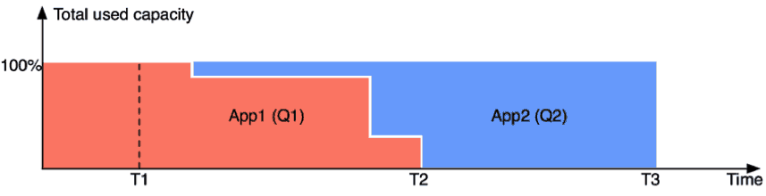
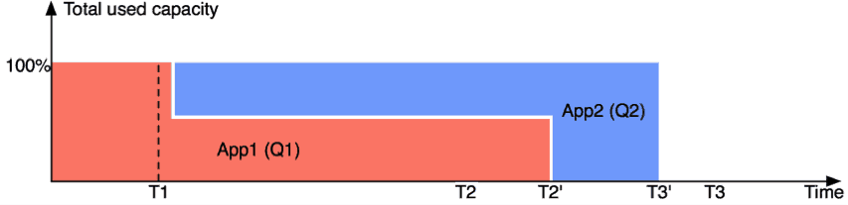
如何让调度兼顾SLA？
不使用抢占调度
问题：
共享集群资源被其他组织占用提升了资源利用率但是无法保证SLA?
挑战：
在深度学习作业下，被抢占的作业当前只能失败，无法像传统OS上下文切换
设计目标：
兼顾有限资源利用和服务等级协议（SLA）
使用抢占调度
App2更快结束
App1的变慢可接受，因初始已经获得更多资源
Notes:
https://blog.cloudera.com/better-slas-via-resource-preemption-in-yarns-capacityscheduler/
App2 usually finishes faster (than when preemption was not enabled) – T3’ < T3. It is possible though that App1 now finishes slower – T2’ > T2. This is acceptable though given App1 originally got much more resources than was originally guaranteed.

Slide 34
YARN抢占 (Preemption) 实例
策略：
Step 1: 从过度使用的队列中获取需要被抢占的容器
Step 2: 通知ApplicationMasters即将触发抢占
Step 3: 等待直到被抢占终止运行
Queue: A
Configured = 10
Used = 30
Pending = 0
Queue: C
Configured = 20
Used = 0
Pending = 20
App1
App3
C5
C6
C7
App1的容器C6, C7 被标记为可以被抢占
Notes:
https://blog.cloudera.com/better-slas-via-resource-preemption-in-yarns-capacityscheduler/
https://blog.cloudera.com/yarn-fairscheduler-preemption-deep-dive/

Slide 35
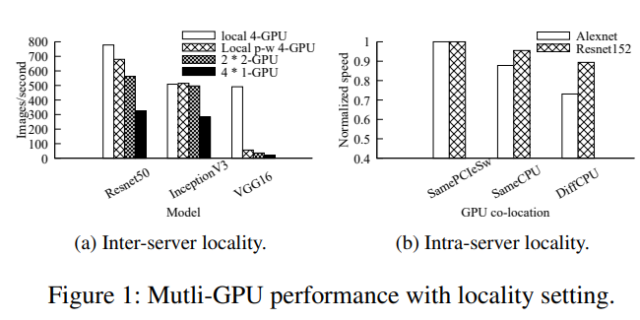
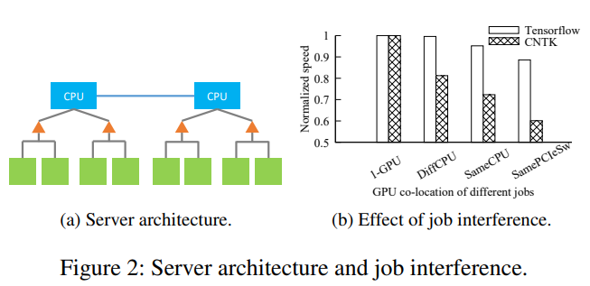
GPU的拓扑结构影响多GPU作业性能?
多GPU深度学习作业问题与挑战：
受到GPU拓扑结构影响
受到服务器上同时运行作业的干扰
目标：Makespan, Response Time
Notes:
https://www.sigops.org/src/srcsosp2017/sosp17src-final35.pdf

Slide 36
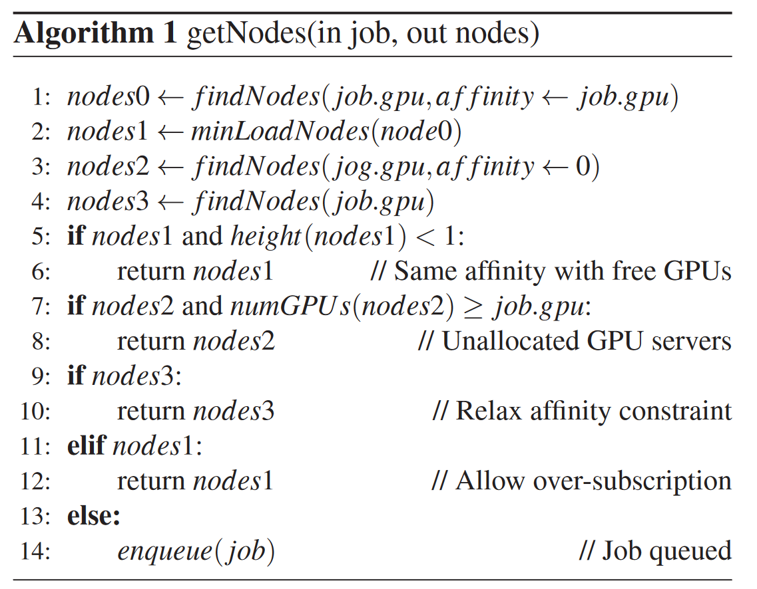
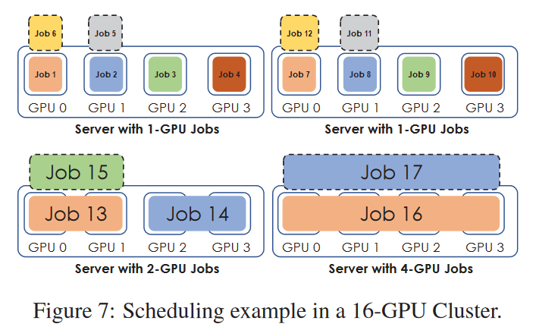
Gandiva 拓扑感知调度
考虑GPU 拓扑（topology）和亲和性（affinity）的调度算法
CPU
QPI
CPU
8-GPU Node
1
2
3
4
5
6
7
8
Notes:
https://www.usenix.org/system/files/osdi18-xiao.pdf
https://www.microsoft.com/en-us/research/uploads/prod/2018/05/gpu_sched_tr.pdf
Failure analysis of platform; https://www.microsoft.com/en-us/research/uploads/prod/2018/05/gpu_sched_tr.pdf

Slide 37
深度学习还有其他问题影响调度？
深度学习作业特点：
超参调优等多作业同时运行，希望能及早获得反馈
作业资源占用多样，造成资源分配后容易形成碎片
挑战：GPU软件栈对GPU状态备份，资源隔离做的不够完善，无法很好的支持时分复用(time slicing)，装箱(packing)等传统OS方式达到早反馈和高利用率
目标：Response Time, Utilization
Notes:
https://www.sigops.org/src/srcsosp2017/sosp17src-final35.pdf

Slide 38
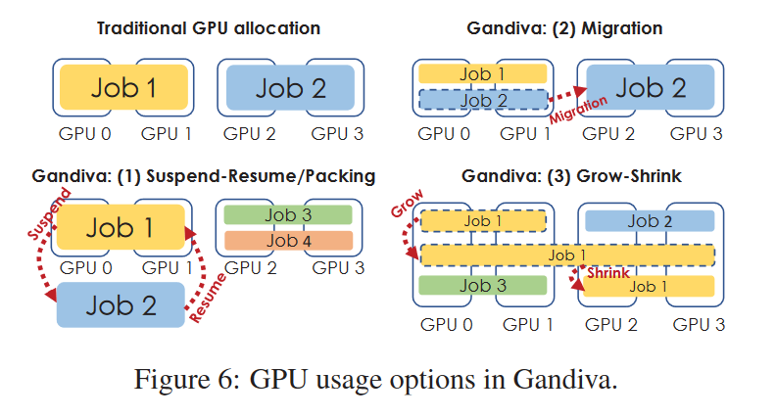
Gandiva目标与策略
早反馈(Early feedback):
支持时分复用
over-subscription
suspend-resume
高效集群(Cluster efficiency):
支持装箱(packing)
migration
grow-shrink

Slide 39
小结与讨论
不同调度算法为解决不同的问题和目标而优化，对比不同算法的侧重点
如果在异构集群环境下，管理员倾向于组间的资源使用的公平性，会倾向于选择哪种调度算法？

Slide 40
代表性异构计算集群管理系统简介
Kubeflow
OpenPAI
…

Slide 41
OpenPAI
开源
利用YARN可扩展性强，成熟度高
利用K8s 当前流行的服务部署模式
可扩展: 支持所有 Deep Learning frameworks, GPU/FPGA/ASIC​
模块化: 微服务，组件模块化 (Storage, Scheduler)​
高效: 细粒度GPU 调度, 支持 IB/RDMA​
可管理：作业和平台的监控，部署和升级
鲁棒性: 容错​
云原生: 支持本地和云部署
Web Portal
PAI Runtime
PAI Runtime
PAI Runtime
VS (Code), Jupyter Notebook,
DLWorkspace, etc.
DL Jobs
Big Data Jobs
AutoML Jobs
REST Server
Launcher
YARN+AI
HDFS
PAI Monitor
Managed by Hadoop+AI
Kubernetes Cluster Management
Managed by Kubernetes
Docker / Ubuntu
https://github.com/Microsoft/pai

Slide 42
OpenPAI 生态系统
PAI 市场(Marketplace）
共享代码，模型等
PAI 协议(Protocol)
Data, Code, Docker Image
硬件需求
作业启动器
理解PAI协议并执行作业
可以支持更多类型的负载
可以部署到多种环境
Single-box, Cloud, On-Prem, Hybrid

Slide 43
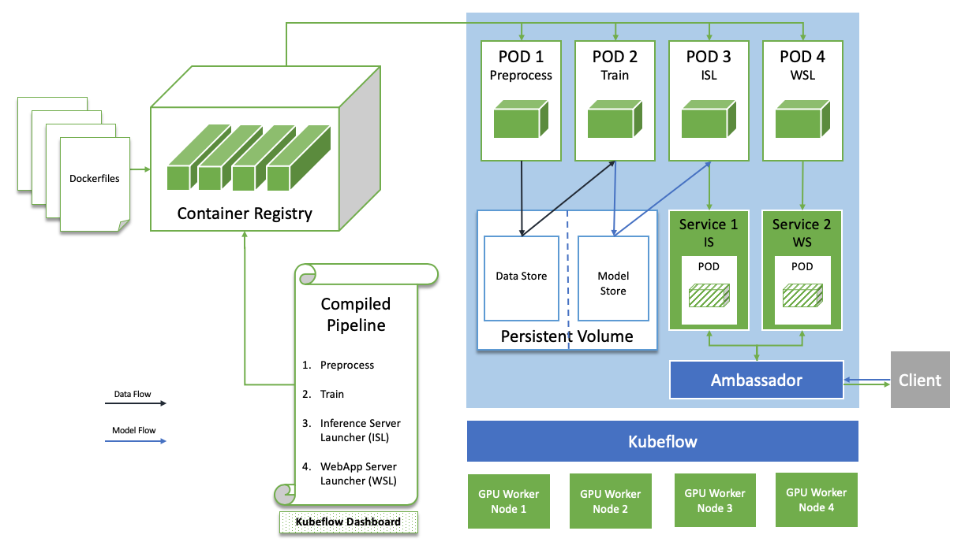
Kubeflow
k8s原生支持的AI平台
通过k8s管理作业
支持多种机器学习框架:
TensorFlow, PyTorch等
支持多种硬件:
GPU, TPU等
https://github.com/kubeflow/kubeflow
Notes:
https://myslide.cn/slides/13064
https://medium.com/better-programming/kubeflow-pipelines-with-gpus-1af6a74ec2a
The Kubeflow team uses Ambassador as a central point of authentication and routing for their services.

Slide 44
小结
异构资源管理系统构建了分布式训练环境下的操作系统
异构硬件资源支持，灵活多样的作业，功能不完善的软件栈支持，造成系统设计挑战较大

Slide 45
参考文献
Multi-tenant GPU Clusters for Deep LearningWorkloads: Analysis and Implications
Gandiva: Introspective Cluster Scheduling for Deep Learning
Dominant Resource Fairness: Fair Allocation of Multiple Resource Types
All You Need to Know about Scheduling Deep Learning Jobs
https://github.com/microsoft/pai
https://www.kubeflow.org/
Kubeflow Pipelines With GPUs
YARN – The Capacity Scheduler
Better SLAs via Resource-preemption in YARN’s Capacity Scheduler
Kube-Batch: Dominant Resource Fairness (DRF)
Linux Programmer's Manual CGROUPS(7)
https://github.com/NVIDIA/nvidia-docker
Use the AUFS storage driver
Making Containers More Isolated: An Overview of Sandboxed Container Technologies

Slide 46
谢谢！

