Slide 1
程序设计II
Notes:
程序设计实习2007

Slide 2
课程信息
2020 年春季课程内容分为三个部分。
  C 语言进阶（50%）
    位运算、字符串、高精度数、递归、枚举
  程序设计语言 (40%)
    Python
    Scheme（函数式语言）
  编程实践方法和工具(10%)

Slide 3
课程信息
Composing Programs（UC Berkeley CS61A）
    http://composingprograms.com/
参考教材有两本，分别是MIT和Princeton的编程课程教材。有中文翻译版、电子版。
  Introduction to Computation and Programming Using Python, 2nd Edition，by John V. Guttag，MIT Press，2013
  Introduction to Programming in Python: An Interdisciplinary Approach, by Robert Sedgewick, Kevin Wayne and Robert Dondero, Addison-Wesley Professional，2015

Slide 4
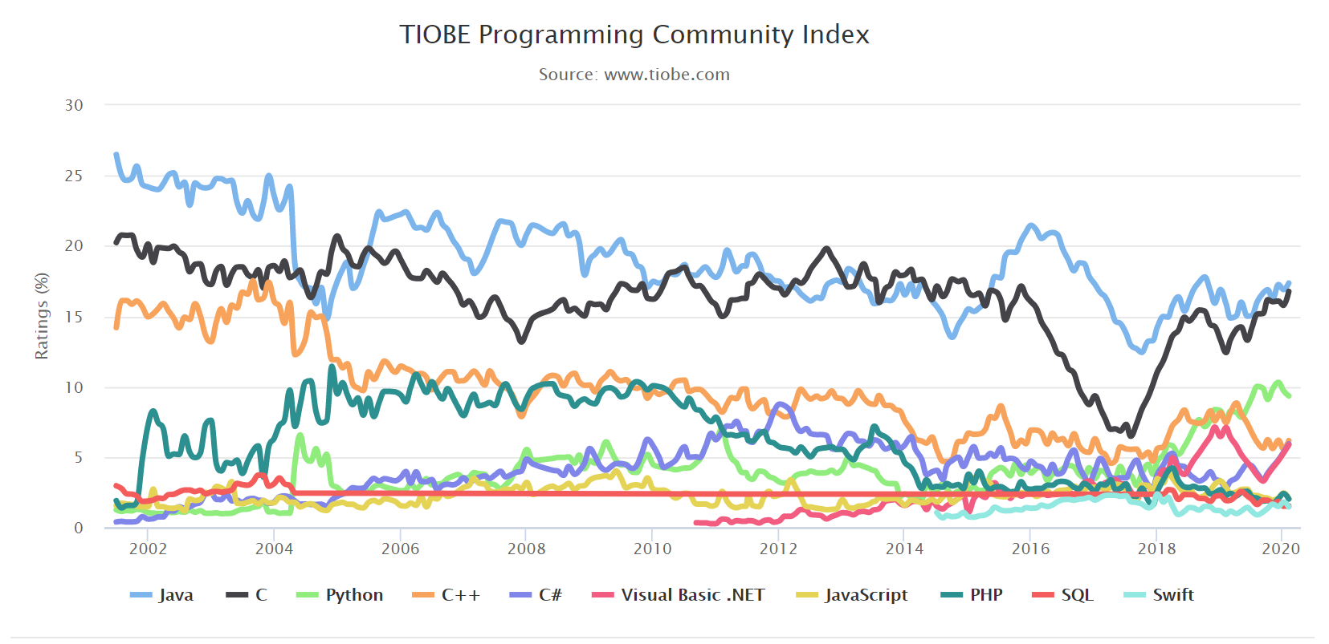
https://www.tiobe.com/tiobe-index/
The index can be used to check whether your programming skills are still up to date or to make a strategic decision about what programming language should be adopted when starting to build a new software system.

Slide 5
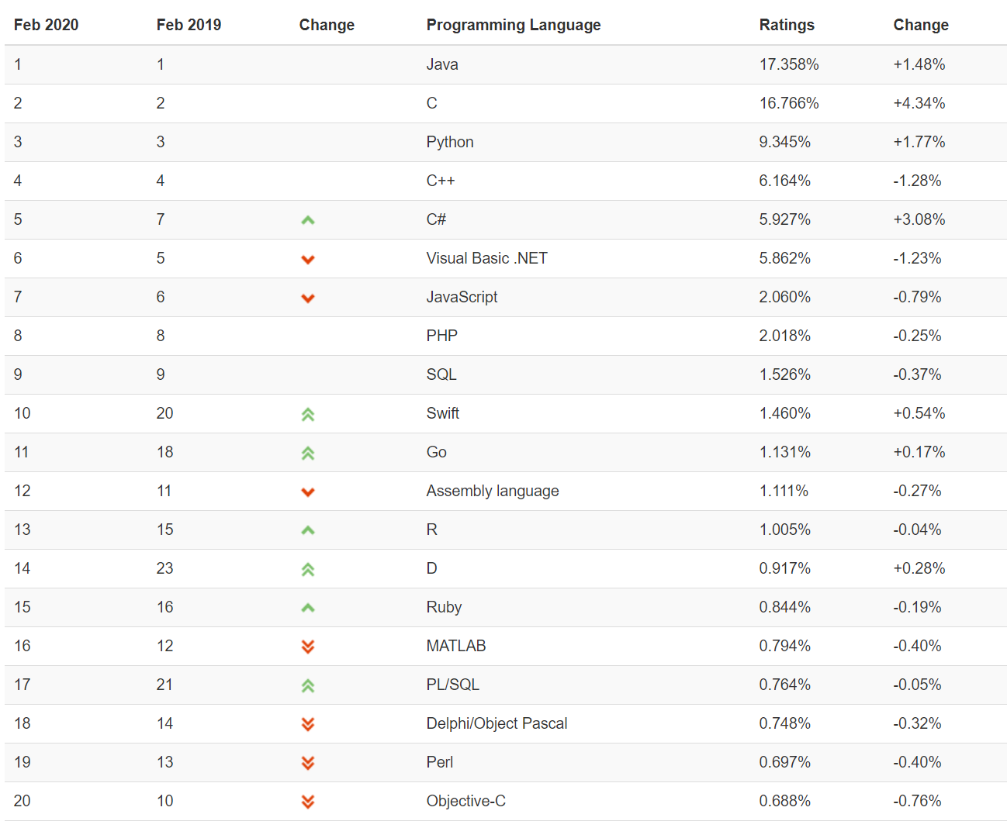

Slide 6
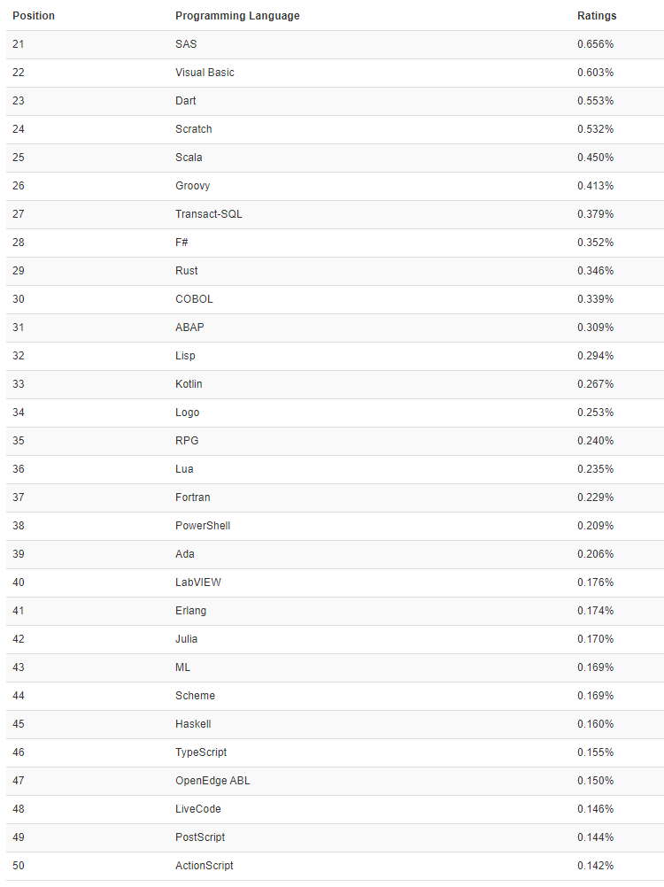
#51 to #100
(Visual) FoxPro, Apex, ATLAS, Awk, Bash, bc, Bourne shell, C shell, cg, CL (OS/400), Clojure, Common Lisp, Crystal, cT, Curl, Elixir, Emacs Lisp, Forth, Hack, Icon, Inform, Io, J, JScript, Korn shell, Ladder Logic, Maple, MEL, Mercury, MQL4, NATURAL, OpenCL, Oz, PL/I, Programming Without Coding Technology, Prolog, Pure Data, Q, Raku, Red, Ring, S, Smalltalk, SPARK, Stata, Tcl, VBScript, Verilog, VHDL, WebAssembly

Slide 7
面向对象编程
Object Oriented Programming（OOP）
  Smalltalk、C++、Java、Python ...
OOP philosophy: Software is a simulation of the real world.
  We know (approximately) how the real world works.
  Design software to model the real world.

Slide 8
面向对象编程
Procedural programming [verb-oriented]
  Tell the computer to do this / do that.
OOP [noun-oriented]
  Programming paradigm based on data types.
  Identify objects that are part of the problem domain or solution.
  Identity: objects are distinguished from other objects (references).
  State: objects know things (instance variables).
  Behavior: objects do things (methods).

Slide 9
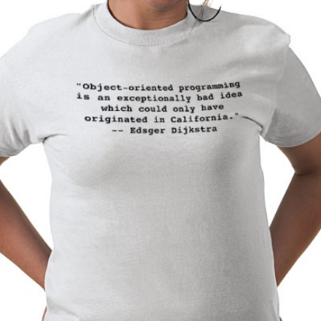
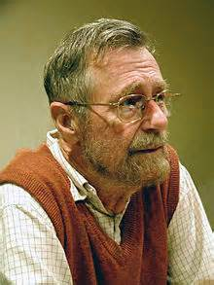
面向对象编程
"Object-oriented programming is an exceptionally bad idea which could only have originated in California."
"Computer science is no more about computers than astronomy is about telescopes."
—— Edsger Dijstra(1930—2002)

Slide 10

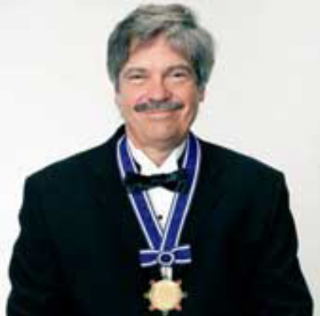
面向对象编程
"The computer revolution hasn't started yet."
"The best way to predict the future is to invent it."
"If you don't fail at least 90 percent of the time,you're not aiming high enough. "
—— Alan Kay(1940 — )

Slide 11
Encapsulation（封装）
Data type
Set of values and operations on those values.
  Ex. int, float, char, String, Complex, Vector, Document, …
Encapsulated data type.
  Hide internal representation of data type.

Slide 12
Encapsulation（封装）
Separate implementation from design specification.
  Class provides data representation and code for operations.
  Client uses data type as black box.
  API specifies contract between client and class.
Bottom line. You don't need to know how a data type is implemented in order to use it.

Slide 13
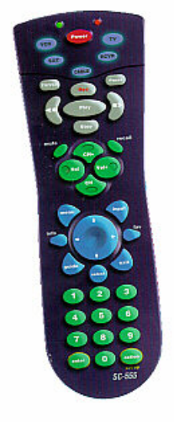

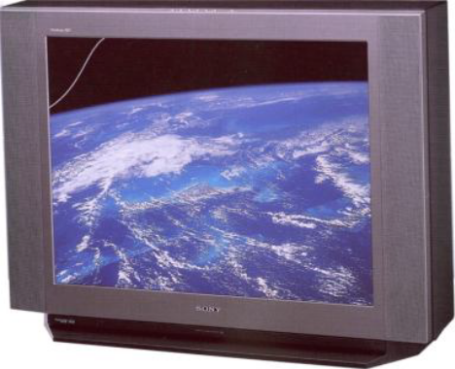
Encapsulation（封装）
Client
  (needs to know how to use API)
API
Implementation
  (needs to know what API to implement)
Implementation and client need to agree on API ahead of time.

Slide 14
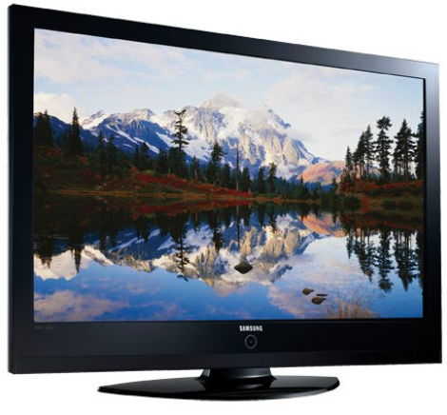
Encapsulation（封装）
Client
  (needs to know how to use API)
API
Implementation
  (needs to know what API to implement)
Substitute better implementation
without changing the client.

Slide 15
Time Bombs
Internal representation changes.
  [Y2K] Two digit years: January 1, 2000.
  [Y2038] 32-bit seconds since 1970: January 19, 2038.
Lesson.
  By exposing data representation to client, might need to sift through millions of lines of code in client to update.

Slide 16
"Ask, don't touch."
Encapsulated data types.
  Don't touch data and do whatever you want.
  Instead, ask object to manipulate its data.
Lesson.
  Limiting scope makes programs easier to maintain and understand.
  "principle of least privilege"

Slide 17

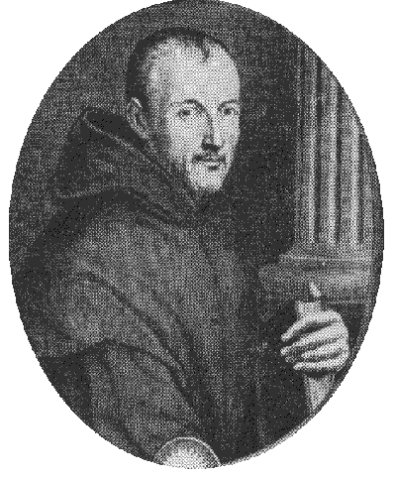
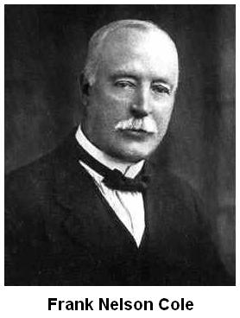
梅森质数(2^{p}-1)
In 1903 Frank Nelson Cole famously made a presentation to a meeting of the American Mathematical Society where he identified the factors of the Mersenne number . During Cole’s so-called “lecture”, he approached the chalkboard and in complete silence proceeded to calculate the value of M₆₇, with the result being 147,573,952,589,676,412,927. Cole then moved to the other side of the board and wrote 193,707,721 × 761,838,257,287, and worked through the tedious calculations by hand. Upon completing the multiplication and demonstrating that the result equaled M₆₇, Cole returned to his seat, not having uttered a word during the hour-long presentation. His audience greeted the presentation with a standing ovation. Cole later admitted that finding the factors had taken “three years of Sundays”.

Slide 18
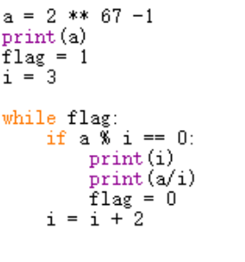


Slide 19

Python
Python是一种计算机程序设计语言。是一种面向对象的动态类型语言，最初被设计用于编写自动化脚本(shell)，随着版本的不断更新和语言新功能的添加，越来越多被用于独立的、大型项目的开发。
1991年至今
https://www.python.org/

Slide 20
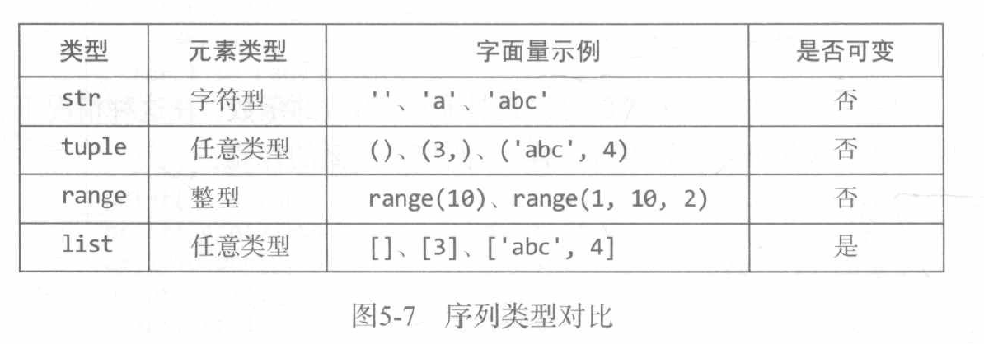
序列类型对比

Slide 21
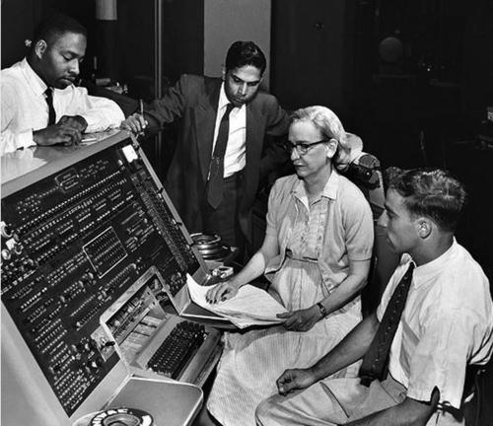
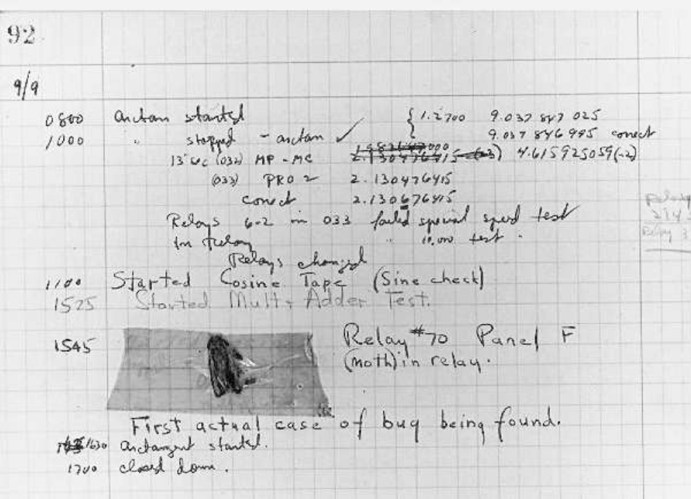
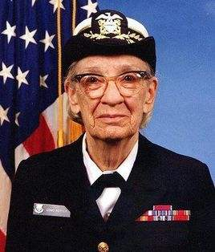
Bug!
Grace Murray Hopper
（1906—1992）

