Slide 1
程序设计II
Notes:
程序设计实习2007

Slide 2

Python
Python是一种计算机程序设计语言。是一种面向对象的动态类型语言，最初被设计用于编写自动化脚本(shell)，随着版本的不断更新和语言新功能的添加，越来越多被用于独立的、大型项目的开发。
1991年至今
https://www.python.org/

Slide 3
Encapsulation（封装）
Separate implementation from design specification.
  Class provides data representation and code for operations.
  Client uses data type as black box.
  API specifies contract between client and class.
Bottom line. You don't need to know how a data type is implemented in order to use it.

Slide 4
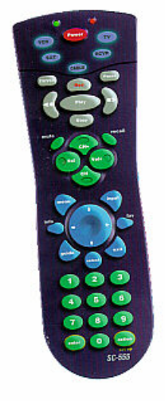


Encapsulation（封装）
Client
  (needs to know how to use API)
API
Implementation
  (needs to know what API to implement)
Implementation and client need to agree on API ahead of time.

Slide 5

Encapsulation（封装）
Client
  (needs to know how to use API)
API
Implementation
  (needs to know what API to implement)
Substitute better implementation
without changing the client.

Slide 6
Time Bombs
Internal representation changes.
  [Y2K] Two digit years: January 1, 2000.
  [Y2038] 32-bit seconds since 1970: January 19, 2038.
Lesson.
  By exposing data representation to client, might need to sift through millions of lines of code in client to update.

Slide 7
"Ask, don't touch."
Encapsulated data types.
  Don't touch data and do whatever you want.
  Instead, ask object to manipulate its data.
Lesson.
  Limiting scope makes programs easier to maintain and understand.
  "principle of least privilege"

Slide 8
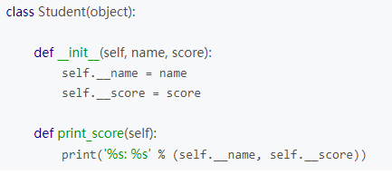
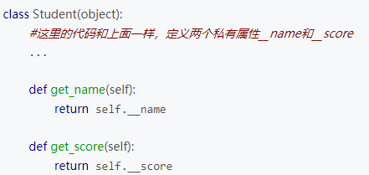
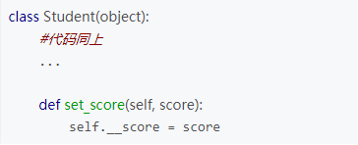
Encapsulation（封装）

Slide 9
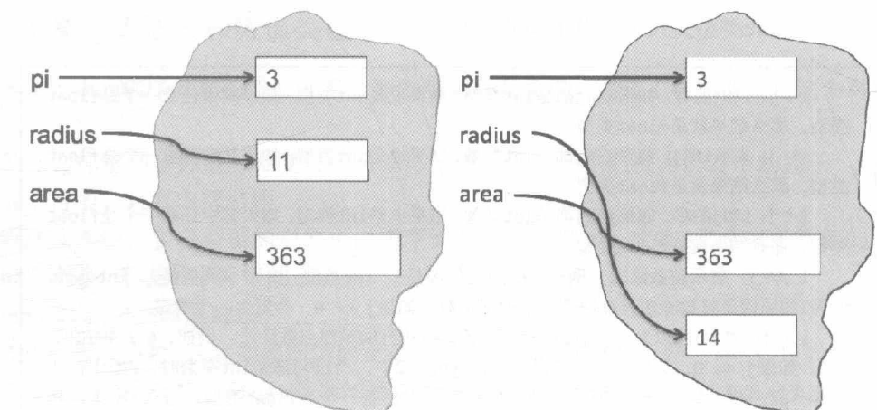
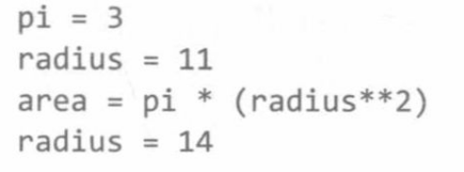
类（Class）和对象（Object）
所有元素都是对象，都有类别（type）
  标量：int，float，bool，None
  序列：str，tuple，range，list
  函数, …,
  Introduction to Computation and Programming Using Python, 2nd Edition，by John V. Guttag，MIT Press，2013

Slide 10
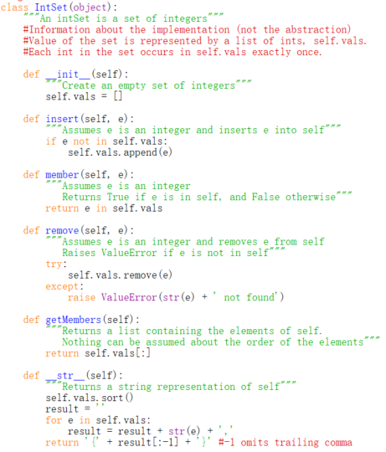
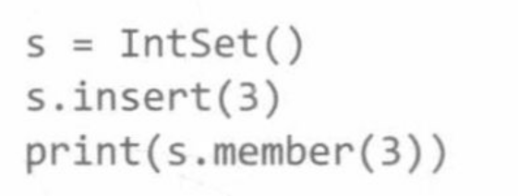
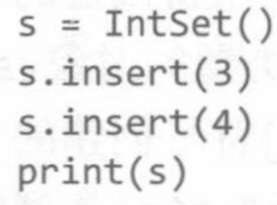
整数集合IntSet

Slide 11
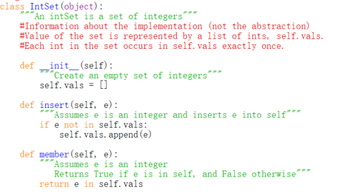

Slide 12
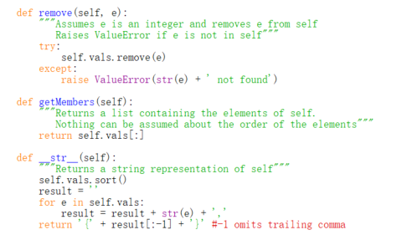

Slide 13
设计程序
以“对象”为设计的中心，而不是“函数”
两种编程机制：分解和抽象
  分解：结构化
  抽象：隐藏细节
示例：大学中学生和教师的信息处理

Slide 14
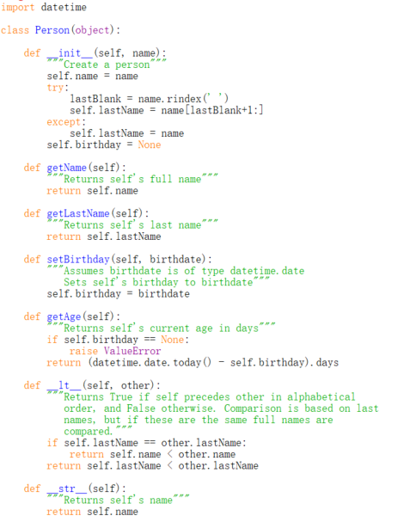
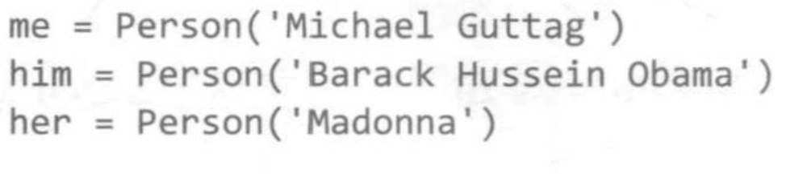
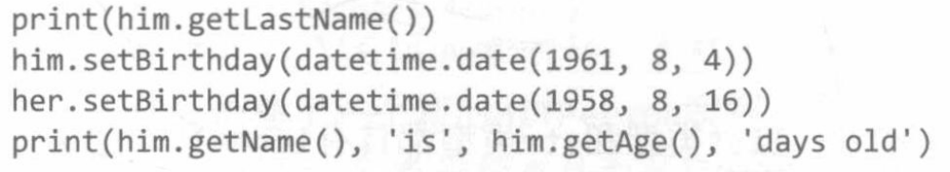
人
Person

Slide 15
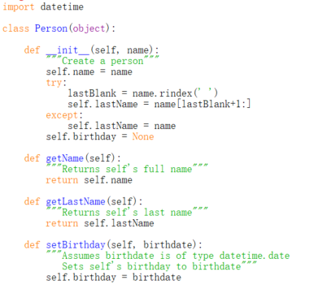

Slide 16
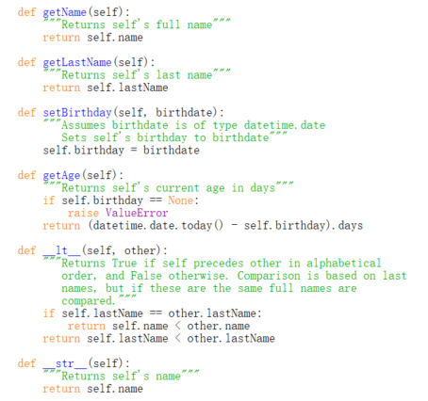

Slide 17


Slide 18
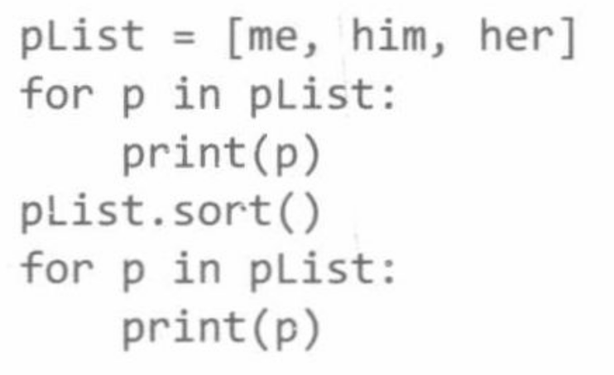
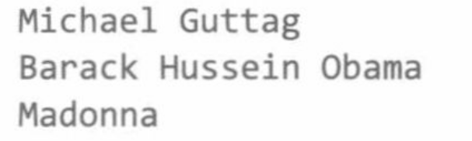
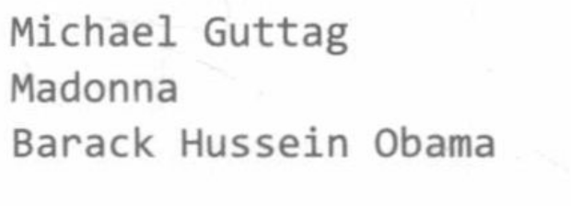

Slide 19
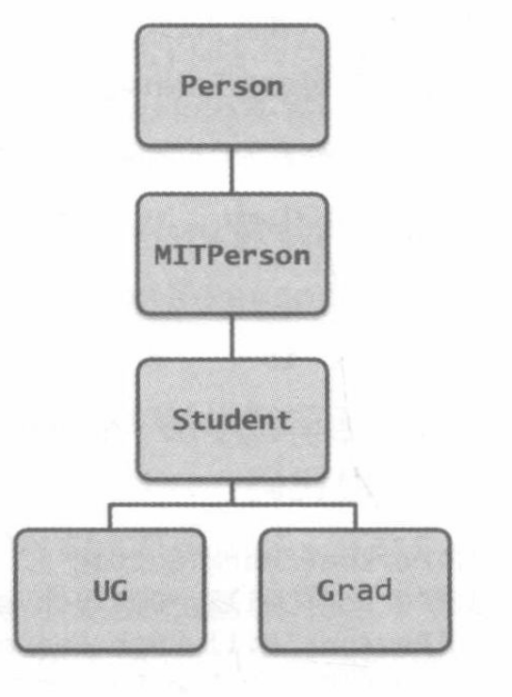
继承
Python中，存在于运行时的一切都是对象
  可以将一个变量绑定到Person实例
  可以将Person实例添加到一个列表中
基于Person类进行新的设计子类
  子类可以继承所有属性
  子类可以增加新的属性
  可以替换（覆盖）超类的属性

Slide 20
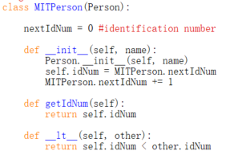

Slide 21
