Slide 1

INDIGENOUS COMMUNITY FOR LEADERSHIP & DEVELOPMENT

Slide 2
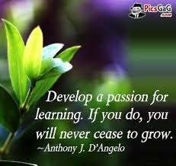
Notes:
I want to thank you for sharing your time with me this morning. As you know from my bio I am the CEO of ICLD which standards for Indigenous Community for Leadership & Development.
What you don’t know is that I am the first female from a long list of family members to be educated…..first to do many things – and a few bad…just one or two);
I have witnessed first hand the difficulty my parents and older sibling faced with it came to comprehending documents and large amounts of information. I still to this day am learning ways to translate the information given into way that my family can understand and relate to.
I use the word relate – relevancy is critical (if there is no history or a concept there is no way to for one to fully comprehend a concept).
I have seen their frustration and many times I see them just surrender to the idea of fully understanding – and that truly breaks my heart. Yes breaks my heart but yet inspires me to continue down the path of providing relevant training that is practical and engaging.
In fact I actually test some many of my ideas and exercises on my parents (but they don’t know that). My parents who have instilled a story in my head and this quote is very similar to a story my dad tells.
Dad speaks of bud and how it blooms into a beautiful flower, this flower stays green because its constantly growing, developing and move towards the sun. He says we are like the flower and need to continue learning in order to grow and flourish. Flourish as a person as a community.
Today both my parents are in the mid 80’s – constantly learning, wanting to learning and fully engaged in 3 generations of children, grand-children and great grand children.
And as you know the nut doesn’t fall from the tree; so here I am teaching, developing and delivering programs to encourage people to want to learn, progress and continue growing.
In the last 20 years I have worked with the unemployed, under-employed, the over-employed. From at risk youth to senior executives.
The one thing I have noticed is that everyone wants to grow and develop and flourish.
Everyone!!! So why is this not happening?

Slide 3

TODAY’S TRAINING
FOR OUR COMMUNITY MEMBERS
INCOMPATIBLE LEARNING SYTLES
LACK OF PREREQUISITE KNOWLEDGE
POORLY MOTIVATED STUDENTS
Notes:
So why are we not all growing, moving forward and flourishing? I am constantly asking why?? Why?
When there hundreds of programs available today from job readiness to career planning and leadership development.
But many of these programs struggle to meet their own desired outcomes. We are told the reasons for this are is because our community members:
Have a different learning styles than the what the curriculum was designed for
They lack the prerequisite knowledge/skills and abilities to participate in the courses or program
The students are not motivated

Slide 4
TODAY’S TRAINING..
IS FAILING OUR COMMUNITY MEMBERS
POORLY DESIGNED- DATA DRIVEN, LECTURE, & “WATCH THEN DO”
UNSUITABLE DELIVERY FORMAT – LONG DAYS, RIGID ENVIRONMENT, ON-LINE LEARNING& LECTURE STYLE
NOT Accessibility - TO REMOTE COMMUNITIES & LACK OF FUNDING
Notes:
So why are we not all growing, moving forward and flourishing?
I believe our training programs are failing us and not us failing to meet the program objectives. Programs are:
Poorly designed
Unsuitable Delivery formats
Not Accessible to those who really need them

Slide 5
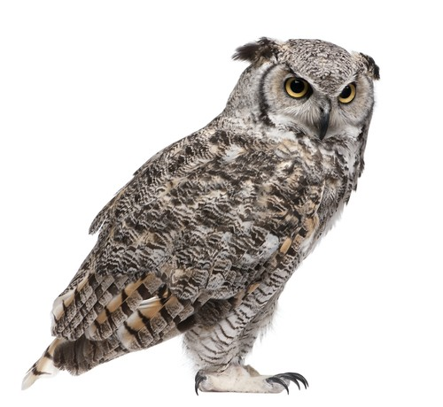
KNOWING & UNDERSTANDING OUR LEARNERS
IS ESSENTAILS
Cultural differences & history
Literacy and education RANGES
Self-esteem & CONFIDENCE
FACTORS THAT IMPACT LEARNING:
Poverty and sub-standard housing
Lack of driver’s license, Transportation
Guidance & Support
Child care for young parents
Notes:
Our student have lower Literacy/Numeracy levels: Aboriginal youth in Canada is 24% of 15 to 24-year-olds, compared with 84% in the non-native population
Cultural differences: employers and co-workers may not understand or respect the unique cultural differences
Literacy and education: high school and basic literacy skills are requirements for nearly all jobs. The graduation rate of Aboriginal youth in Canada is 24% of 15 to 24-year-olds, compared with 84% in the non-native population;
Cultural differences: employers and co-workers may not understand or respect the unique cultural differences of Aboriginal people which can create a worksite atmosphere of disrespect, resentment or distrust;
Racism/discrimination/stereotypes: this is one of the fundamental barriers to Aboriginal people getting a job and remaining in the job, and it is directly related to the attitudes passed down since European settlers arrived in North America. There are a number of myths and misconceptions about Aboriginal people and perceived special treatment that some non-Aboriginal people still believe are truths;
Self-esteem: poverty, broken families, racism, stereotypes, discrimination, few role models all contribute to low self esteem. It’s hard to present well in a job interview when one is struggling with low self-esteem.
Poverty and poor housing: fifty percent of First Nations children, living on-reserve, start each day in an overcrowded, inadequate home that likely is in need of repairs, has asbestos, mould, and may not have drinking water. Unhealthy living conditions affect a person’s mental and physical well being.
Lack of driver’s license: a real stumbling block in remote communities; just getting to the nearest office to write the initial test can be challenging; taking driver’s training is similarly a challenge as there may not be easily accessed training providers or, for that matter, a vehicle on which to learn;
Transportation: few remote communities are serviced by public transit; vehicle insurance is expensive and out of reach for many in pre-employment situations; again, owning a vehicle or having access to a vehicle is frequently not a reality;
Child care: safe, affordable child care is a challenge for mainstream Canadians - it is even more of a challenge for parents in Aboriginal communities.

Slide 6
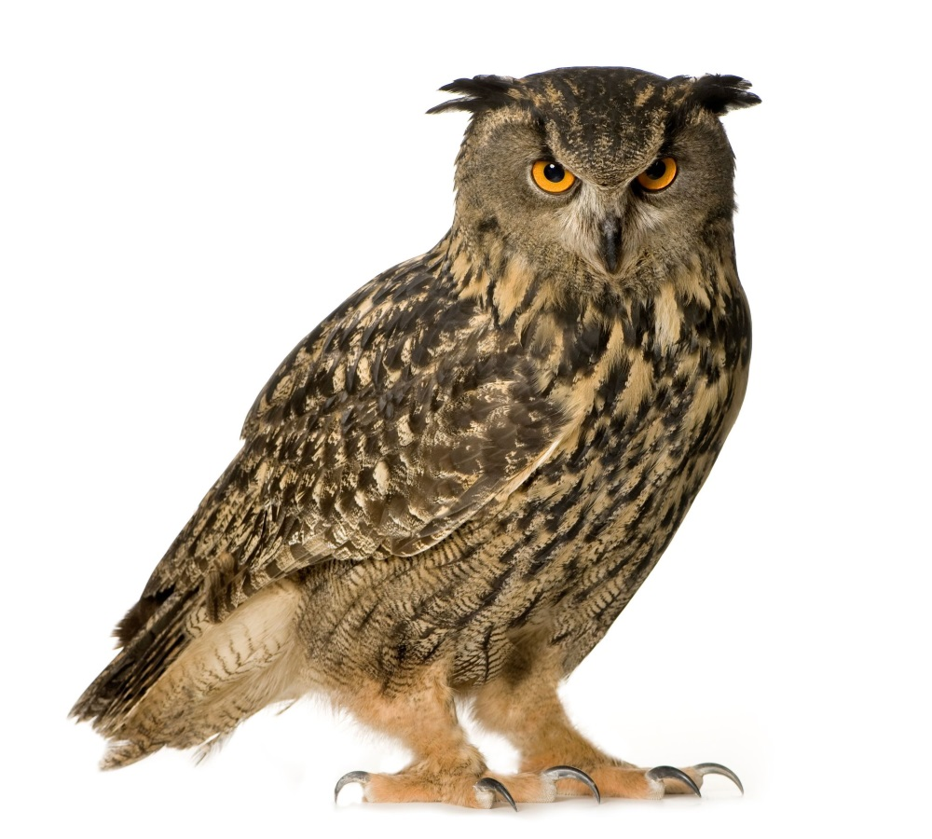
ICLD PUTS COMMUNITY FIRST.
SUBSTANCE ABUSE
WORKING ON ANGER ISSUES
DOMESTIC VILOLENCE
SINGLE PARENTS
CUSTODY ISSUES
intimidated BY OTHERS
LACK EXPERIENCE
LIMITED RESOURCES
REPEATING CYCLE
Notes:
Our programs understand our audience and support them individually and in a group environment. Our learners range from single moms, unemployed, those returning to work, band leaders, councilors and chiefs.
We are human and we all strengths, preferences and needs – your position in a community does not matter.
These students are some of our most committed and successful

Slide 7
A DIFFERENT WAY OF LEARNING THAT PUTS COMMUNITY FIRST.
Sharing of Wise Practices.
Incorporate Elders
Varied Deliver Methods
Cultural Story Telling
On Reserve Training
Incorporate Family
Self Reflection & Awareness
On-Going Connection

Slide 8
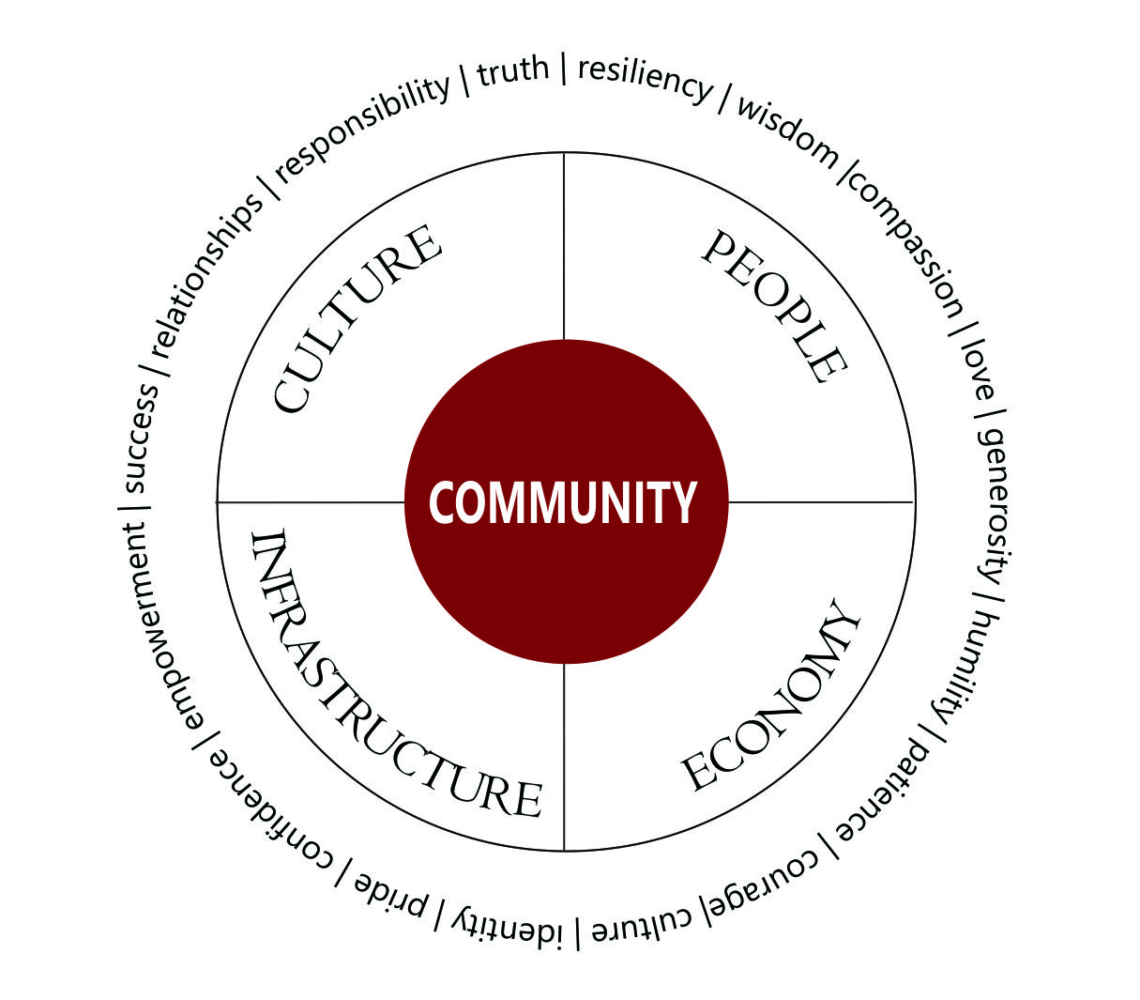
GUIDING PRINCIPLES TO
INSPIRE AND NURTURE THE HUMAN SPIRIT- ONE PERSON,ONE COMMUNITY AT A TIME.
As a community owned venture we are mindful of our Indigenous cultural values, which guide the conduct of our business at every level:
Honesty in everything we do
Respect for all cultures and peoples
Equality of opportunity for everyone
Creativity and learning in an innovative and open environment
Collaboration between ICLD, facilitators, students, and communities.
Continuous learning aftercare programs through mentoring, sharing and social sites.

Slide 9
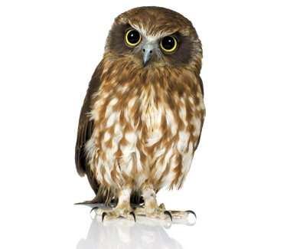
HOW MANY OF YOU HAVE OR HAD EDUCATION
PROGRAMS DELIVERED IN YOUR COMMUNITY.
HOW MANY OF YOU BELIEVE YOUR EDUCATION
PROGRAMS DELIVERED THE DESIRED OUTCOMES.

Slide 10
HOW MANY OF YOU ALIGN YOUR EDUCATION
PLANS WITH YOUR ECONOMIC GROWTH PLAN?.
Notes:
Discussion?
Why not?
Know your community – listen to them. They tell us they don’t want to leave reserves

Slide 11
WE ARE COMMITED TO SHARING
WISE PRACTICES,SKILLS AND KNOWLEDGE.
Through the use of multi-platforms, we collaborate and share the wisdom gathered for all students to utilize.
We incorporate lessons and custom programs based on their unique, individual needs and desired outcomes.

Slide 12

WHO WE ARE
ICLD is a joint venture between Naut’sa mawt Resources Group and Com-Tech Learning Solutions. We have created a legacy of trust an confidence by treating our suppliers, customers and partners with dignity, honesty and respect.

Slide 13
OUR EXPERIENCE
We provide training, CONSULTING, MENTORSHIP PROGRAMS FOR HUMAN CAPACITY DEVELOPMENT (COMMUNITY AND LEADERSHIP) including BUSINESS & ECONOMIC DEVELOPMENT
We work with over 38 different government departments across Canada.
We provide learning services to over 3 dozen First Nations Communities IN BC AND SOON ALBERTA.

Slide 14
OUR TRAINING SERVICES
Supervisory Skills
Management Development
Sales & Marketing
Financial Management
Personal Development
Human Resources
Administration
Information Technology
Project Management
Project Management
Risk Management
Change Management
Communication Planning
Business Case Development
Strategic Planning
Facilitation Skills
Training and Mentorship

Slide 15
OUR COMMUNITY BUILDING SERVICES
Feasibility Studies
Business Plan Development
Business Case Development
Policy & Process Design
Information Risk Analysis
Project Management
Risk Management
Governance
Strategic Plan Development
Business Architect Design
Information Management
Data Security Policy
Economic Development
HR Planning Development
Community Planning

Slide 16
PARTNER WITH US & ALIGN YOUR HUMAN CAPACITY
DEVELOPMENT WITH YOUR ECONOMIC GROWTH PLANS

Slide 17
Indigenous Community for Leadership and Development
330-6165 Highway 17A Delta, BC Canada V4K 5B8
604.899.2400
www.icld.ca

