Slide 1

Investing in First Nations in BC
BCAAFC Funding Conference
September 22, 2016

Slide 2
About New Relationship Trust
The New Relationship Trust (NRT) is an independent non-profit organization dedicated to strengthening First Nations in BC through capacity building.
NRT invests in BC First Nations by supporting them in five key capacity development areas:
      Governance capacity,
      Education,
      Language & Culture,
      Youth & Elders,
      Economic development.

Slide 3
NRT - Priorities
2016/17 –Year 11 :
Governance ‘capacity’ | $2.40M
Economic Development | $1.00M
Education | $1.10M
Language & Culture | $1.00M
Youth & Elders | $0.50M
TOTAL | $6.00M

Slide 4
2016-17 - Governance
Direct Support – approve up to $1.5M to BC First Nations for policy/governance projects;
Policy Development – approve up to $250K to BC First Nation Organizations that have provincial mandates;
Nations Council Policy – approve up to $250K to Nations Councils and Tribal Councils for policy development work at Nation level;

Slide 5
2016-17 - Economic Development
Economic Development Support Team (3yr pilot) Partnership with Western Diversification to support FN economic development by providing Advisors to support capacity building at community level.
Entrepreneur Equity Match Initiative
NRT support First Nation entrepreneurs by providing cash equity matching funds up to $5K; and FN community businesses up to $25K.

Slide 6
2016-17 - Education
Through our NRT Foundation, offering scholarships, bursaries, and kindergarten to grade12 support:
Scholarships:
          Undergraduate - $5,000 (40)
          Masters - $10,000 (13)
          Doctorate - $20,000 (6)
Bursaries:
          Trades, Diplomas, Certificates - $2,000 (75)
K-12:
          English, Math and Science focus - $5,000 (100)

Slide 7
2016-17 - Language
  In partnership with First Peoples Cultural Council to support language archiving & revitalization in BC; NRT provides $750K per year for this initiative;
  This fiscal year, NRT will provide an additional $250K for the First Voices (archiving) initiative.
Notes:
Best Practices project - $250,000BP – Tools, Templates, etc. - $100,000Resource Centre Website - $100,000Revenue Gaming Initiative - $100,000Policy Development Initiative - $500,000 (new)Direct Support - $750,000 (new)FN Proposal Writing Initiative - $250,000 (new)Information Sharing Sessions - $200,000 (new)

Slide 8
2016-17 – Youth & Elders
Youth - $2,000 available to BC First Nation youth groups for projects. ($250K)
Elders - $2,000 available to BC First Nation Elder groups for projects. ($250K)
NRT will provide funding to support the 40th Annual Elders Gathering in Williams Lake from July 11 - 14, 2016 ($50K)

Slide 9
2016-17 – Other Services
Community Navigator – serving the FN communities in the north – providing skills, training labour market capacity assistance; seven navigators serving 40+ communities;
West Coast Energy Fund – loan fund for BC entrepreneurs, communities to access loans for energy sector – partnership with AFIs in BC;
Clean Energy – newly proposed – a fund to access feasibility related funding for communities to enter into a clean energy business venture;

Slide 10
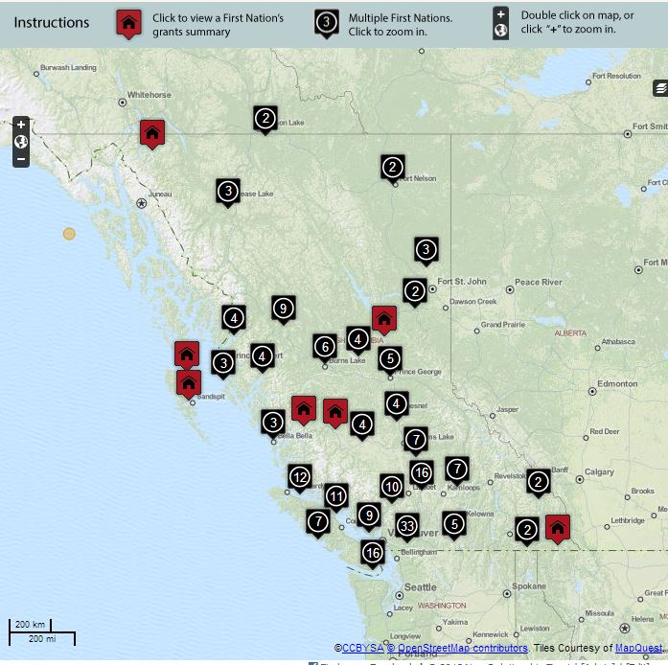
Funding Map: Transparency & Accountability

Slide 11
YES 2016 – Nov 28 - Dec 1, 2016
Young Entrepreneurs Symposium (YES) brings young aspiring aboriginal entrepreneurs (19 to 30 years) together with business leaders and role models to help foster the skills, knowledge and networks they need to be leaders of tomorrow.
A three-day business challenge competition with cash prizes for the winning teams.
NRT will be awarding all expense paid trips to BC First Nations young people in the fall of 2016; before the national event in November in Toronto, ON.

Slide 12
NRT Board of Directors
Appointments (3 year terms):
    2 – Leadership Council; Kory Wilson David Jimmie
    2 – Province of BC; Terry Kuzma Angela Wesley
    1 – BC AFN; Ken Rea
    1 – FN Summit; and Hugh Braker
    1 – UBCIC. Byron Louis
November 30, 2016 – NRT Board members terms expire – appointments are required from:
          BC FN Leadership Council

Slide 13




Thanks! Find us on…
facebook.com/NewRelationshipTrust
@NRT_BC
NewRelationshipTrust
www.NewRelationshipTrust.ca

