Slide 1

Success By 6 Aboriginal Engagement Funding
Joseph Dunn – Provincial Director

Slide 2

Who is Success By 6?
Success By 6 is a partnership of United Ways, Credit Unions of BC, the BC Government through the Ministry of Children and Family Development and Aboriginal and community leaders.
Success By 6’s provincial mission is that every child succeeds for life by focusing on ensuring, through leadership, leveraging and linkages, that all communities in BC are better served in supporting healthy childhood development.

Slide 3
Success By 6 Funding Streams
Success By 6 allocates funding to all regions of BC through three funding streams:
Community Capacity Building
Providing coordination of Early Years planning to build community capacity, increase Early Childhood Development public awareness and to strengthen community collaboration.
Strategic Implementation
Funding free or low-cost, quality childhood development programs, projects and resources for families with young children across the province.
Aboriginal Engagement
Supporting Aboriginal community identified Early Years priorities.

Slide 4
Success By 6 Aboriginal Engagement
Success By 6 recognizes the importance of self‐determination, self‐government, culture, language and traditions to Aboriginal people, and is committed to engaging in a manner that respects the protocols and diversity of Aboriginal communities in BC.
The Aboriginal Engagement Strategy was developed in the Fall of 2006 and outlines 4 key priorities:
Increase Aboriginal participation and representation in the initiative
Work with Aboriginal communities to strengthen community capacity building
Increase cultural awareness within the context of Aboriginal ECD
Promote and increase awareness of the importance of ECD

Slide 5
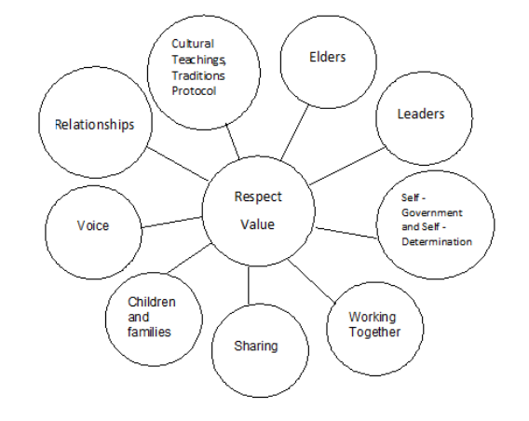
Success By 6 Aboriginal Engagement

Slide 6
Funding Model
Provincial Success By 6 Aboriginal Engagement funding stream granted to Regional and Community Early Childhood Development (ECD) Strategic Planning Tables across BC
Each ECD Strategic Planning Table identifies local needs
Each initiative, in consultation with area Aboriginal communities, determines where and how the funds will be used; therefore, how Aboriginal community agencies can access the dollars varies and depends on the initiative. The underlying approach for use of the funds is to promote greater collaboration across sectors and across communities.

Slide 7
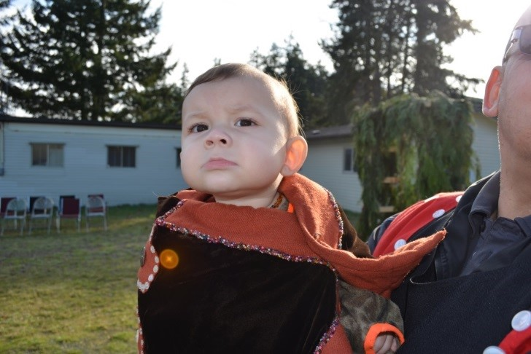
Examples of past funded projects
Aboriginal Cultural Learning and Healthy Nutrition
Laichwiltach Family Life Society’s goal is to empower and promote healing, from a First Nations perspective, for all people of Native Ancestry in Unity. Success By 6 funding allows Laichwiltach Family Life Society and the community to come together on a weekly basis and enjoy healthy traditional meals. It’s an opportunity for 50 families to participate in cultural workshops including: story-telling, the game “lahal”, dancing, drumming, singing, cedar weaving and traditional crafts.
— North Vancouver Island Region

Slide 8
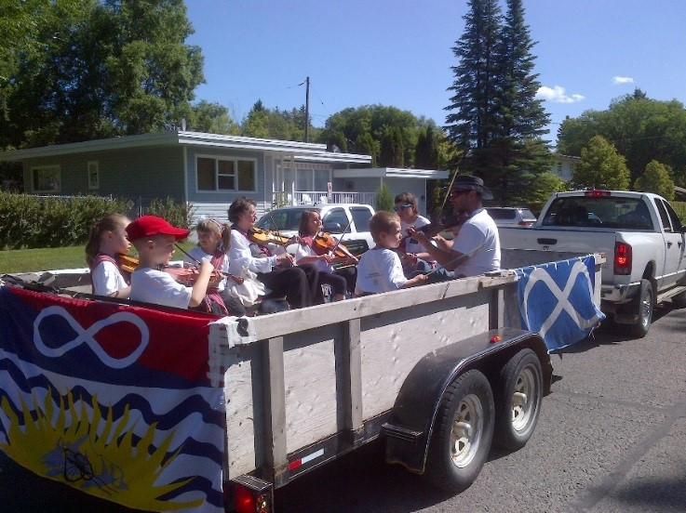
Examples of past funded projects
Cross-Generational Aboriginal Early Learning: Kitoochikun Project
The Success By 6 funded Kitoochikun Project is a cultural program that teaches Métis children to read and write music at an early age. Prince George Métis Elders provide guidance and teach children about the Métis culture by telling stories, playing music and serving snacks. The program sets children on the path to success by giving them the tools they need to gain confidence and by teaching them to express themselves. Because of the Kitoochikun Project, families embrace their Métis heritage and children get the opportunities they need to thrive.
— North Central Region

Slide 9
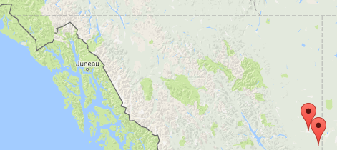
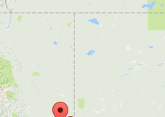
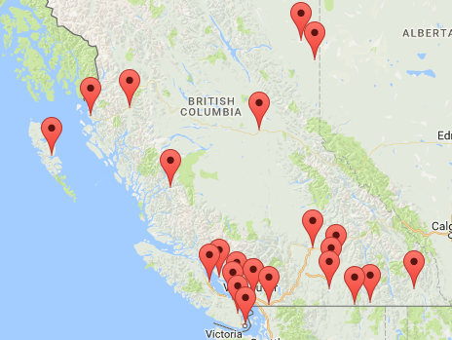
Contact
Find out who coordinates the ECD Strategic Planning Table in your community by visiting www.successby6bc.ca/your-community
Having trouble identifying the coordinator for your region?
Contact the Success By 6 Provincial office: info@successby6bc.ca

