Slide 1


Training for Indigenous Agencies
Canada – B.C. Job Grant
September 2016

Slide 2
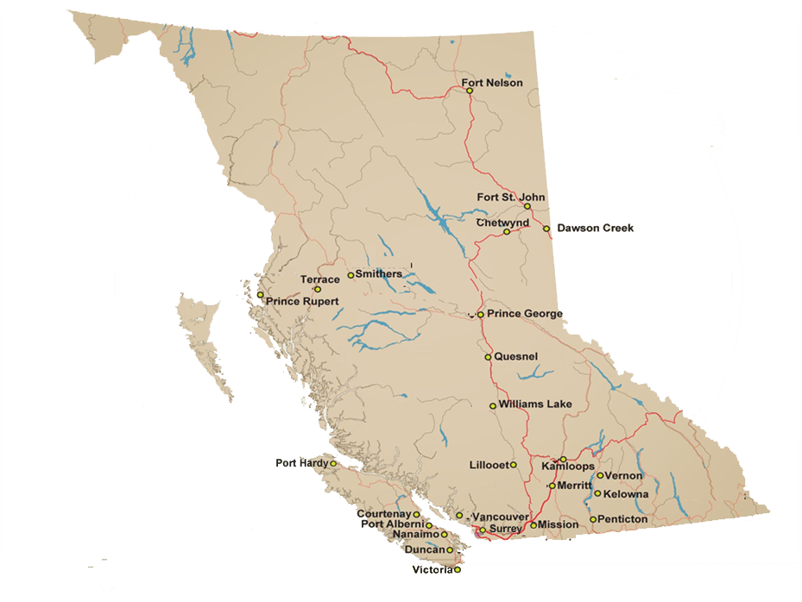
Local Friendship Centres in BC
25 Friendship Centres in BC.
Their mission…To improve the quality of life for urban Aboriginal people
Friendship Centres in BC serve up to 1,300 people on a daily basis.
429 programs and services.
Notes:
About Local Friendship Centres…
There are 25 Friendship Centres located around BC.
Friendship Centres’ overall mission is to improve the overall quality of life for urban Aboriginal people. In the 1950’s, Indigenous People began moving to urban areas in search of housing, employment and supports. By 1972 the Migrating Native Peoples Program and work of our Centres was recognized by the federal government.
Friendship Centres in BC today serve up to 1,300 people daily, delivering 429 culturally responsive programs and services in the province.
(source: 2015-2016 Friendship Centre annual reports)

Slide 3
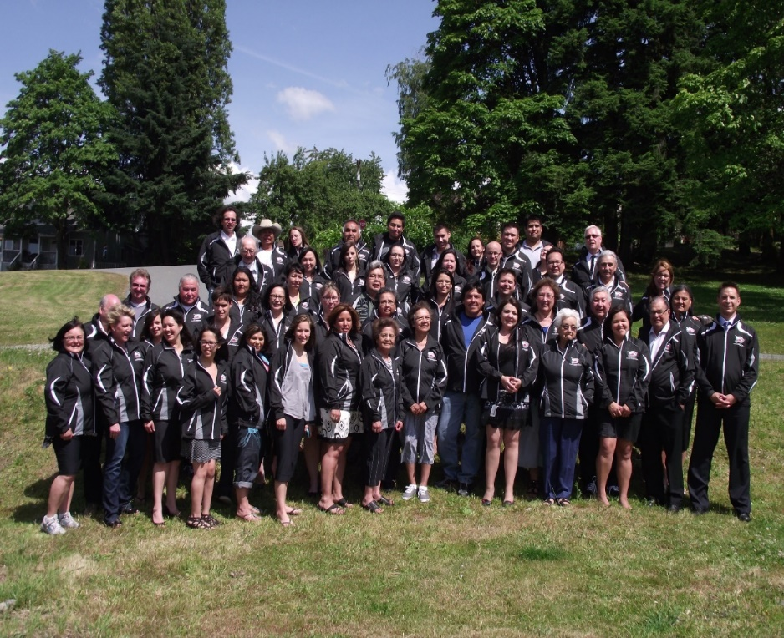
BC Association of Aboriginal Friendship Centres
BCAAFC’s mission is:
“To improve the quality of life for Aboriginal Peoples by supporting the activities of Friendship Centres in BC.”
Notes:
BCAAFC, The Provincial Office...
Located in Victoria, BC, the BC Association of Aboriginal Friendship Centres is the umbrella association for the 25 Friendship Centres throughout the Province of British Columbia.
Our organization works to accomplish our overall mission “To improve the quality of life for Aboriginal Peoples by supporting the activities of Friendship Centres in BC.”
Our mandate is to promote the betterment of Aboriginal Friendship Centres in the Province of British Columbia; to establish and maintain communications BC Friendship Centres and other Provincial Associations and the National Association of Friendship Centres; to act as a unifying body for BC Friendship Centres; to provide an association for Government Agencies to communicate through and obtain information from; and to advise the Government, when requested by the collective centres, on how and what programs may assist Aboriginal Friendship Centres, in the development of programs to better the lives of Aboriginal people in BC.

Slide 4

Training Indigenous Peoples
Indigenous Youth are about to enter their PRIME working years
Retain your *STAR *
employees
Invest in Aboriginal workers
Notes:
Training Indigenous Peoples
-232,000 Indigenous People in BC represent 5.4% of BC’s overall population
-The Indigenous population in BC doubled from 1996 and 2011
-Aboriginal Youth are one of the fastest growing populations in Canada -half are
under 28 years…they are about to enter into their PRIME working years
Training is Needed for Indigenous Peoples
-60% of Indigenous People have Grade 12 or less
-Indigenous People face multiple barriers to employment, including:
*lack of basic education
*insufficient job related skills
*required access to specialized training/certification)
*living in remote areas
*lack of transportation
*lack of support for families
*access training and support once employed
Training Indigenous Peoples is an investment!
(source: BCAAFC 5x5 Strategy)
Retain your STAR employees
-employees who are supported will show long term commitment to your
organization

Slide 5
Training Indigenous Peoples
Train employees who are underemployed *increase job security
*increase skills
*promotion Support Training for those unemployed *support local economy *employers build capacity *individuals gain self sufficiency
Notes:
Training Indigenous Peoples
Train employees who are underemployed *increase job security
*increase skills
*promotion Support Training for those unemployed *support local economy *employers build capacity *individuals gain self sufficiency

Slide 6

Training Indigenous Peoples is an Investment!
Notes:
Develop your PEOPLE
Indigenous organizations are often under resourced in many areas and rely on annualized funding.
Reductions in funding may require employees to take on additional work without having formalized training.
Employers now have access to the Canada-B.C. Job Grant to train existing employees AND support individuals currently unemployed whom could fill a position in their organization.

Slide 7
What is the Canada-BC Job Grant??
Assists BC employers to invest in training
Online applications to be pre-approved
Training costs paid by employers:
2/3 of pre approved training is reimbursed (up to $10,000 per participant)
100% covered for those previously unemployed (up to $15,000 per participant)
Notes:
What is the Canada-BC Job Grant??
The Canada-B.C. Job Grant is a program that assists BC employers to invest in employee training, with the total training cost between the employer and the government. This helps employers and makes keeping jobs easier for British Columbians by encouraging work skills development. The funding made available by the Government of Canada and the Province of British Columbia reimburses 2/3 (two-thirds) of employee training costs, with a maximum of $10,000 for each participant trained per fiscal year, providing the budget, training capacity and hiring and retention strategy you need to advance your business.
In addition, employers may qualify for reimbursement for up to 100% of eligible training costs if the training will result in the employer hiring a previously unemployed person, up to a maximum of $15,000 for each future employee.
Indigenous Peoples are a priority in BC’s Jobs Plan as a key economic sector: http://engage.gov.bc.ca/bcjobsplan/economy/aboriginal-peoples-first-nations/

Slide 8
Canada-BC Job Grant – Eligible Training
Soft skills (personal mgmt. i.e. goal setting, working as a team, time mgmt. etc.)
Essential skills (skill development for work: literacy, digital technology, continuous learning etc.)
Specialized or technical skills (training to operate machinery, computers, certificates, training to improve job performance)
Management and Business skills (strategic planning, evaluating, HR, supervisory, management)
Notes:
Canada-BC Job Grant – Eligible Training
Soft skills (personal mgmt. i.e. goal setting, working as a team, time mgmt. etc.)
Essential skills (skill development for work: literacy, digital technology, continuous learning etc.)
Specialized or technical skills (training to operate machinery, computers, certificates, training to improve job performance)
Management and Business skills (strategic planning, evaluating, HR, supervisory, management)

Slide 9

Eligible Training Costs:
Canada-BC Job Grant – Eligible Training Costs
Tuition fees
Mandatory student fees
Exam fees
Textbooks and software
Required training materials
Will consider travel to access training
Notes:
Canada-BC Job Grant – Eligible Training Costs
Includes…
Tuition fees
Mandatory student fees
Examination fees
Textbooks and software
Other required materials
In some circumstances, travel to access training.

Slide 10
Priority Areas:
Canada-BC Job Grant – Eligible Participant
Underrepresented Groups in the Workforce, including:
Indigenous Peoples
Women in Trades and Natural Resource Sectors
Youth (age 15-24)
Persons with disabilities
New Canadians : refugees landed in Canada, protected persons entitled to work in Canada, or landed immigrants to Canada within the past five years or less
Refugee Fund
Unemployed Stream
Notes:
Canada-BC Job Grant
Applications Are Now Open!
Applications are being accepted for training that starts on or before March 31, 2017 if the participant being trained qualifies under one of the following streams:
Underrepresented Groups in the Workforce
-Indigenous Peoples
-Women in Trades and Natural Resource Sectors
-Youth (age 15-24)
-Persons with disabilities
-New Canadians who are refugees landed in Canada, protected persons entitled to work in Canada or landed immigrants to Canada within the past five years or less
Refugee Fund
Unemployed Stream

Slide 11
Apply for training starts on or before March 31, 2017
Canada-BC Job Grant – Priority Sectors
Priority Sectors:
Aboriginal Peoples and First Nations
Agrifoods
Construction, Forestry
Manufacturing
Mining and Energy, Natural Gas
Non-profit Health and Social Services
Small Business, Tourism
Technology and Green Economy, Transportation
Notes:
(FOR INFO SESSION ONLY)
Canada-BC Job Grant –Training Priority by Sector
Applications for the CJG Priority stream sectors listed below are being accepted for training that starts on or before March 31st, 2017 The Priority Sectors stream includes 10 of the BC Jobs Plan sectors (http://engage.gov.bc.ca/bcjobsplan/categories/bc-jobs-plan-sectors/) identified as critical to B.C.’s labour market and economic development, which include:
Aboriginal Peoples and First Nations
Agrifoods
Construction
Forestry
Manufacturing
Mining and Energy
Natural Gas
Non-profit Health and Social Services
Small Business
Technology and Green Economy
Tourism
Transportation

Slide 12
Review the Canada-BC Job Grant
Canada-BC Job Grant – How to Apply
www.bcaafc.com/initiatives/5x5
www.workbc.ca/Employer-Resources/Canada-BC-Job-Grant.aspx
Step 1:Review Eligibility
Step 2: Contact BCAAFC
Step 3: Submit Your Application
Step 4: Get Approved and Send in Agreement
Step 5: Start Training!
Step 6: Apply for Reimbursement
Notes:
Canada-BC Job Grant
How Do I Apply?
Review the Canada-BC Job Grant online:
BCAAFC’s website: www.bcaafc.com/initiatives/5x5
Work BC’s website:www.workbc.ca/Employer-Resources/Canada-BC-Job-Grant.aspx
Step 1: Check Your General Eligibility
Step 2: Contact BCAAFC
If you’re eligible or have questions about your eligibility, contact BCAAFC via email employment@bcaafc.com to discuss grant criteria, requirements and the application process.
Step 3: Submit Your Application
You will receive an email with your application reference number 1-2 weeks after your application has been submitted.
Step 4: Get Approved and Send in Agreement
If you’re approved, you will be notified as soon as the decision is made. Processing time for applications is normally within 60 business days of receipt. Along with your acceptance email are agreement documents that you must sign and send back to the government within 3 business days.
Step 5: Start Training!
Step 6: Apply for Reimbursement
Once your application is approved and within 30 business days of your employee starting training, you can apply for reimbursement. If you are training individuals on Income Assistance (IA) or Employment Insurance (EI), a Participant Information Form is required no less than 5 business days prior to the start of training.

Slide 13
Current Intake Open Now: Priority Sector Stream Apply July 18 - Dec 31, 2016 for training that starts on/before Dec 31, 2016 Underrepresented/Unemployed/Refugee for training until December 31, 2016 Intake Opening October 1, 2016: All Funding Streams Apply Oct 1 - Dec 31, 2016 for training that starts on/before Mar 31, 2017
Canada-BC Job Grant
Notes:
Canada-British Columbia JOB GRANT
Visit the Work BC’s website for current updates and information here:
https://www.workbc.ca/Employer-Resources/Canada-BC-Job-Grant/What-is-the-Canada-B-C-Job-Grant.aspx
Current Intake…
Open – Now: Priority Sector Stream
Accepting Applications July 18 - Dec 31, 2016 (Training that starts on/before Dec 31, 2016)
Underrepresented/Unemployed/Refugee (Training until December 31, 2016)
Opens October 1, 2016: All Funding Streams
Accepting Applications Oct 1 - Dec 31, 2016 (Training that starts on/before Mar 31, 2017)
Starting January 1, 2017
CJG Fiscal Intakes
Intake 1
Accepting Applications Jan 1 - Mar 31, 2017 (Training to start Apr 1- Aug 31, 2017)
Intake 2
Accepting Applications Apr 1 - June 31, 2017 (Training to start Sept 1- Dec 31, 2017)
Intake 3
Accepting Applications Oct 1 - Dec 31, 2017 (Training to start Jan 1- Mar 31, 2018)

Slide 14



Slide 15
Contact Us
Help us Promote the Canada-B.C. Job Grant
BCAAFC Contact: Lisa Mercure
Phone: 1-800-990-2432 ext 223
Email: employment@bcaafc.com
Website: www.bcaafc.com/initiatives/5x5
Notes:
Canada-BC Job Grant
Contact Us
BCAAFC Contact: Lisa Mercure
Phone: 1-800-990-2432 ext 223
Email: employment@bcaafc.com
Website: www.bcaafc.com/initiatives/5x5
CJG Contact: 1-877-952-6914
Email: cjginfo@gov.bc.ca
Please Help us Promote the Canada-B.C. Job Grant
Feel free to share this opportunity to Indigenous organizations with social media followers, clients and partners.

