Slide 1

Monique Lacerte
Community Arts Development and Partnerships Officer
Notes:
Brief Introduction & acknowledge the traditional territory of the Musqueam People

Slide 2

BC Arts Council (BCAC) was established by the Province in 1995, under the Arts Council Act, to:
Provide support for arts and culture in British Columbia;
Provide persons and organizations with the opportunity to participate in the arts and culture in British Columbia; and
Provide an open, accountable and neutrally administered process for managing funds for British Columbia arts and culture.
Notes:
A little bit of background on the BC Arts Council:
Long-standing organization.
Previously called the Arts Board, but Council was established in 1995 through the Arts Council Act to:
Provide support for arts and culture in British Columbia;
Provide persons and organizations with the opportunity to participate in the arts and culture in British Columbia; and
Provide an open, accountable and neutrally administered process for managing funds for British Columbia arts and culture.

Slide 3
BCAC Grants budget for 2016/17 is $24 million.
In 2015/16, the BC Arts Council approved 1,455 grants, totalling $24 million, including:
Major arts and cultural organizations;
Artists and practitioners in more than 200 communities throughout British Columbia;
More than 200 regularly-funded professional arts and cultural organizations;
70 community arts councils;
46 performance presenters representing every region of the province; and
59 school districts.
In 2014/15, BCAC received ~3,000 applications with requests totalling over $46 million.
Notes:
How much funding do we have:
Grants budget for 2015/16 is stable at $24 million.
1,373 grants in 2014/15
But…. Received 2,770 applications with requests totalling over $46 million.
Very competitive, application-based, peer assessed. Eligible doesn’t equal funded.

Slide 4
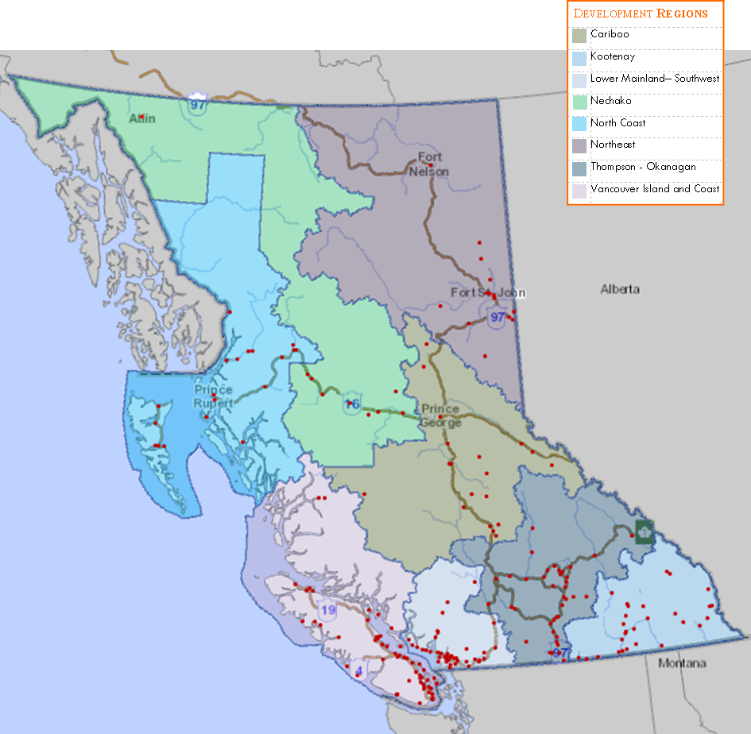
231 COMMUNITIES, represented by red dots on the map, benefitted directly from BC Arts Council funding in 2015/16.
Notes:
Provincial organization, funding projects throughout British Columbia.

Slide 5
BCAC has 39 programs, in the following four streams:
Professional Arts Funding provides both project and operating funding to support the activities of professional artists and arts organizations.
Community Arts Funding provides both project and operating funding to support the activities of volunteer-run and community arts organizations.
Strategic Initiatives Funding responds to specific strategic goals and policy directions.
Partnerships Funding supports programs delivered by partner agencies, such as First Peoples’ Cultural Council, BC Touring Council, ArtStarts in Schools and Creative BC.

Slide 6
BCAC supports a range of applicants:
Students pursuing post-secondary education in the arts in BC, nationally and internationally
Emerging artists and arts administrators (recently graduated or early career)
Professional Artists and collectives
Arts and Culture Organizations
Non-arts and culture societies* engaged in arts and culture activities
*eligibility is extended to First Nations Band Councils and Friendship Centres

Slide 7
Program Examples
Aboriginal Arts Development Awards through First Peoples’ Cultural Council
Arts-Based Community Development
Discipline specific project programs:
Community Arts
Theatre
Music
Dance
Literary and Publishing
Festivals
Media Arts
Museums
Visual Arts

Slide 8
How to apply:
Review program guidelines
Discuss your project with a Program Officer (assigned by discipline)
Prepare application and submit before deadline
Assessment Process:
Applications are reviewed using peer assessment, which refers to the use of independent artists and administrators to assess grant applications, advise on priorities, and make recommendations to the Council on the awarding of grants.
Through peer assessment, the Council relies on the expertise of the arts community to help make informed funding decisions.
Results:
Applicants notified in writing.
Projects – contact Program Officer for feedback.
Operating – advisory comments provided in writing.

Slide 9
For more information on BCAC funding, please see our website at www.bcartscouncil.ca or contact us
at 250-356-1718

