Slide 1


Private, Public, Community & Charitable Foundation Funding
BC Indigenous Funding Conference
September 2016
Michelle Morning Star Doherty
FoundationSearch Canada
Metasoft Systems, Inc.

Slide 2
BC Indigenous Funding Conference
Connecting
BC Indigenous Nations & Organizations
with
Private, Public,
Community & Charitable
Foundations

Slide 3
BC Indigenous Funding Conference
Walking Together
Michelle Morning Star Doherty
Turtle Island Indigenous Education Corp.
&
FoundationSearch Canada
Created to connect the development needs of Indigenous Qualified Donees &
Charitable Organizations

Slide 4
BC Indigenous Funding Conference
Philanthropy
&
Indigenous Peoples
in Canada

Slide 5
BC Indigenous Funding Conference
‘Aboriginal Philanthropy in Canada: A Foundation for Understanding’
prepared by
The Circle on Philanthropy and Aboriginal Peoples in Canada
illustrates the current state of philanthropy for Indigenous Peoples in Canada,
and the potential for mutual understanding and support.

Slide 6
BC Indigenous Funding Conference
“The time is ripe
to develop
Aboriginal Philanthropy
in Canada

Slide 7
BC Indigenous Funding Conference
“To foster the involvement of philanthropic organizations in Aboriginal communities
and to develop
Aboriginal support for,
and involvement in,
philanthropic organizations.

Slide 8
BC Indigenous Funding Conference
Both these goals require learning and change for both parties –
Aboriginal Peoples
and
philanthropic organizations…

Slide 9
BC Indigenous Funding Conference
“Growing numbers of
philanthropic foundations in
Canada want to learn about and
deepen their engagement with
Aboriginal communities.

Slide 10
BC Indigenous Funding Conference
This includes Community foundations, which operate at a local and typically urban scale, as well as Corporate, Private and Family Foundations, which operate at regional, national or even international scales.
Change at every level is within
our reach.

Slide 11
BC Indigenous Funding Conference
“Our Indigenous communities are not charity cases, nor is philanthropy a new concept, though the word itself may not be familiar.
Philanthropy, in the sense of caring for our fellow human beings, is a deeply held principle of Aboriginal peoples.
We have always shared with each other, within our communities and between communities.”

Slide 12
BC Indigenous Funding Conference
The final words in the Report are given to a foundation representative who has been working on forging relationships with First Peoples:

Slide 13
BC Indigenous Funding Conference
“When it is driven by them, the
change comes from inside.

Slide 14
BC Indigenous Funding Conference
A related broader national question is the way in which Aboriginal public policy is fashioned;
We’ve had a century of it being driven by one dysfunctional government department.

Slide 15
BC Indigenous Funding Conference
“Foundations have a
moral obligation to invest
in public policy work and a responsibility to promote
alternative policy and systems.

Slide 16
BC Indigenous Funding Conference
Foundations can help liberate us from the Indian Act. There is fertile, fruitful ground for philanthropy.”

Slide 17
BC Indigenous Funding Conference
Canadian Foundation Facts
Foundations are registered charities. There are three types of charities in Canada:
Private foundation;
Public foundation or;
Charitable organization

Slide 18
BC Indigenous Funding Conference
There are over 11,000 Canadian foundations that contribute over
$1 Billion
annually to Qualified Donees and Charitable Organizations

Slide 19
BC Indigenous Funding Conference
Arts & Culture
Education
Health
Social & Human Services
Environment
Community Development
Sports & Recreation
Religion

Slide 20
BC Indigenous Funding Conference
Miscellaneous Philanthropy is for initiatives that do not fall into the previous categories

Slide 21
BC Indigenous Funding Conference
How can my Nation or Organization access foundation funding?

Slide 22
BC Indigenous Funding Conference
You need to have either:
Qualified Donee Status
(Nations that perform municipal services)
or
Charitable Organization Status
In order to qualify for foundation funding

Slide 23
BC Indigenous Funding Conference
If your Nation or Organization does not
qualify, partnerships can be formed between
Qualified Donees & Not-for-Profits
and
Charitable Organizations & Not-for-Profits
that serve the same communities

Slide 24
BC Indigenous Funding Conference
FoundationSearch
FoundationSearch is the premier, fully searchable, online database for the serious prospect researcher
Contains vital information about the funding history, preferences and contacts of over 11,000 Canadian foundations
Provides the specific information you need to approach the most qualified prospects with compelling reasons why your project fits their vision

Slide 25
BC Indigenous Funding Conference
FoundationSearch
Recognizes
the need to connect
Indigenous Peoples with
Foundation
Funding

Slide 26
BC Indigenous Funding Conference
FoundationSearch
Helps eligible Indigenous Charitable Organizations and Qualified Donees find the resources they need to provide services in their communities
Has helped more than 10,000 not-for-profit organizations in Canada raise in excess of $29 Billion since 1998
Detailed information on over 11,000 Canadian foundations
Metasoft Systems Inc. FoundationSearch and Big Online established by Metasoft Systems Inc. in 1998

Slide 27
BC Indigenous Funding Conference
FoundationSearch
Where do we find these foundations?

Slide 28
BC Indigenous Funding Conference
FoundationSearch
The BC Indigenous Funding Conference’s Daycare Centre is an excellent example to demonstrate My Best Prospects:
We need to raise $250,000 by March 2017 for the Daycare Centre, that will be located in the Community
The Project will benefit the Children, Elders and Parents of BC Indigenous Funding Conference by having a Daycare Centre located in the Community
The Daycare Centre will be inclusive of all children living in the area, regardless of their race or status
Using My Best Prospects (MBP), we simply name the Project, provide a description, the amount needed, the date funding is needed, location, granting category, giving interests and recommends the size of the grant your organization should request

Slide 29
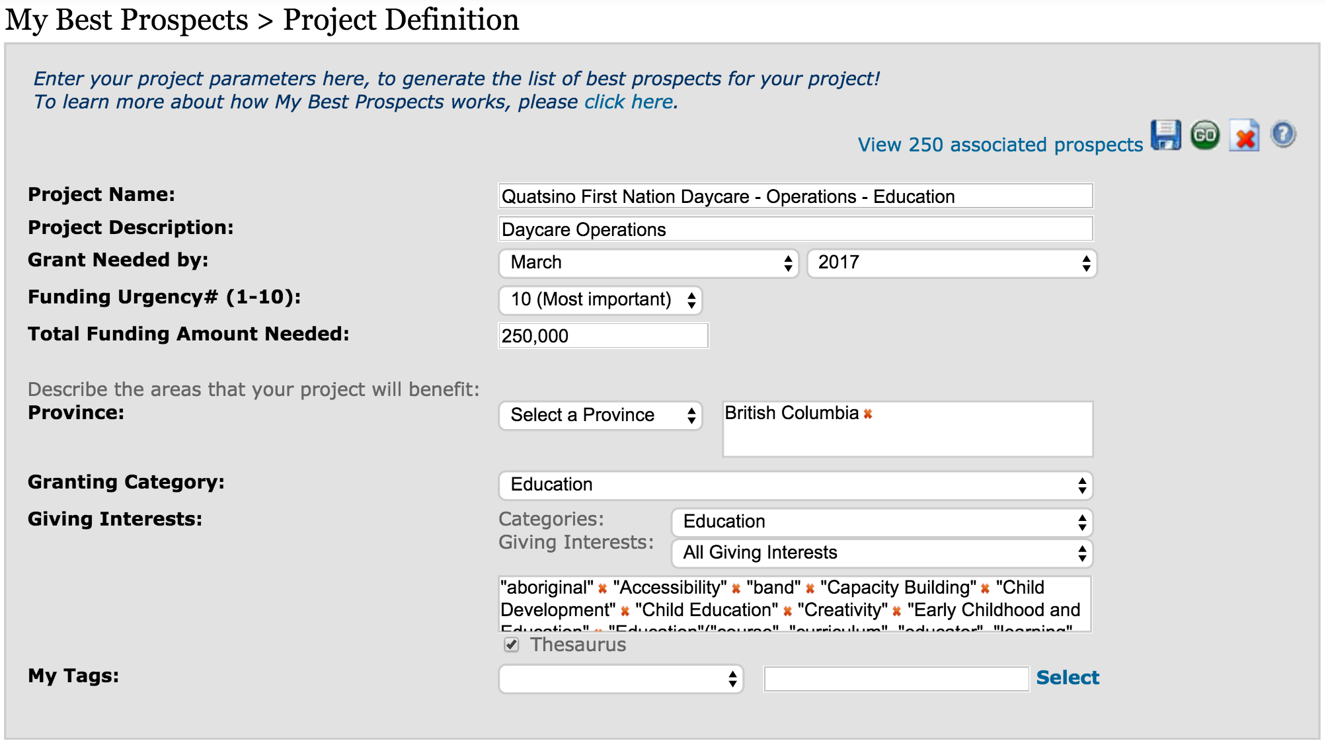
BC Indigenous Funding Conference
FoundationSearch

Slide 30
BC Indigenous Funding Conference
FoundationSearch
After entering information into the fields, saving it and pressing GO, My Best Prospects analyzes:
Each of the 11,000 Canadian foundations
Gives each funder and funding dimension a score related to a given project based on its multi-year granting history
Examining funding category
Funding province
Number of grants awarded
Dollar amount of grants
Giving interests
New giving ratio (percentage of grants given to new recipients versus old recipients)
Giving trending (increasing, decreasing, or flat)
Recommended Ask Amount

Slide 31
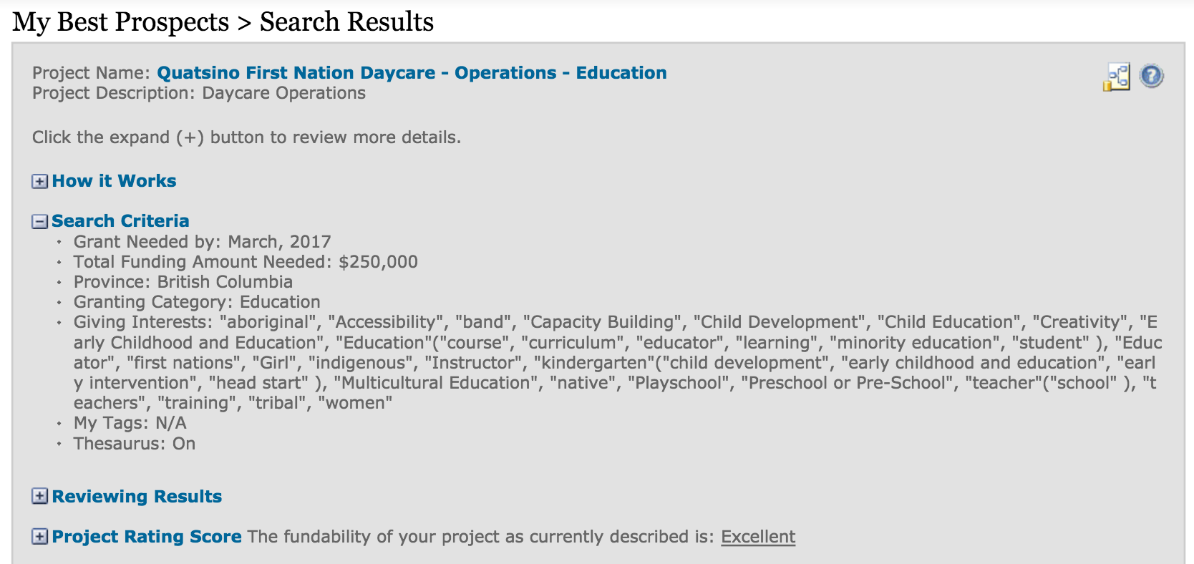
BC Indigenous Funding Conference
FoundationSearch

Slide 32
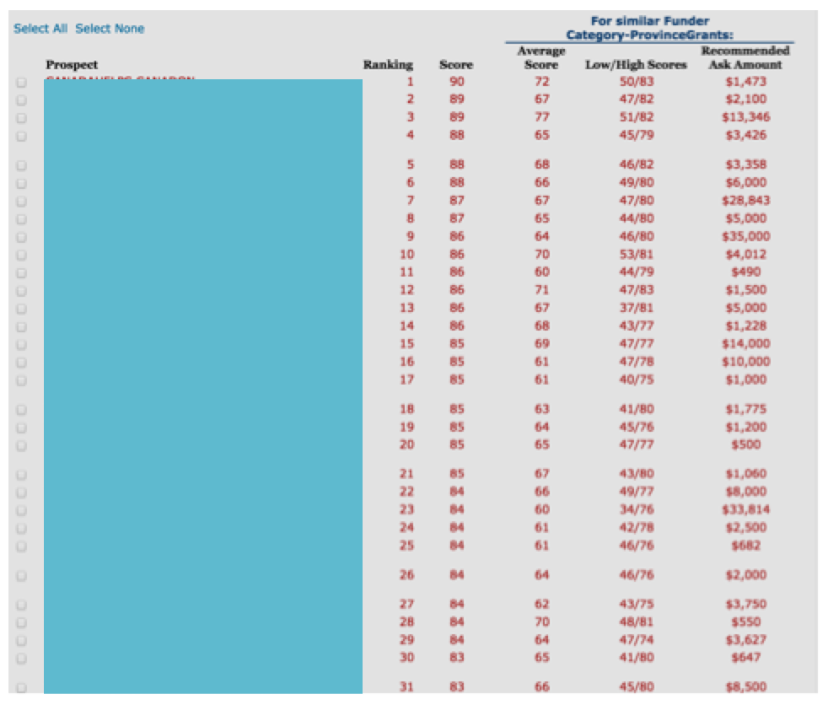
BC Indigenous Funding Conference
FoundationSearch
BC Indigenous Funding Conference Prospects
1-31 out of 250 Foundations identified

Slide 33
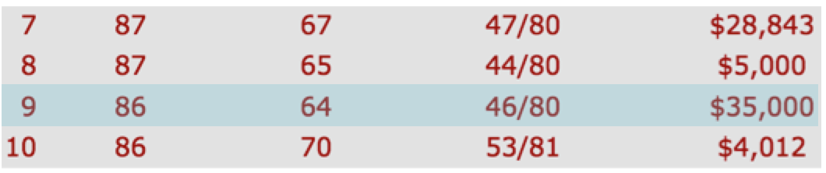
BC Indigenous Funding Conference
FoundationSearch
Prospect Report
By clicking on the score, one can see why a prospect was selected.
Using the 9th ranked foundation as an example, the final score is 86/100, exceeding the average score for funding of 64 (low 46/high 80). The Recommended Ask Amount is $35,000

Slide 34
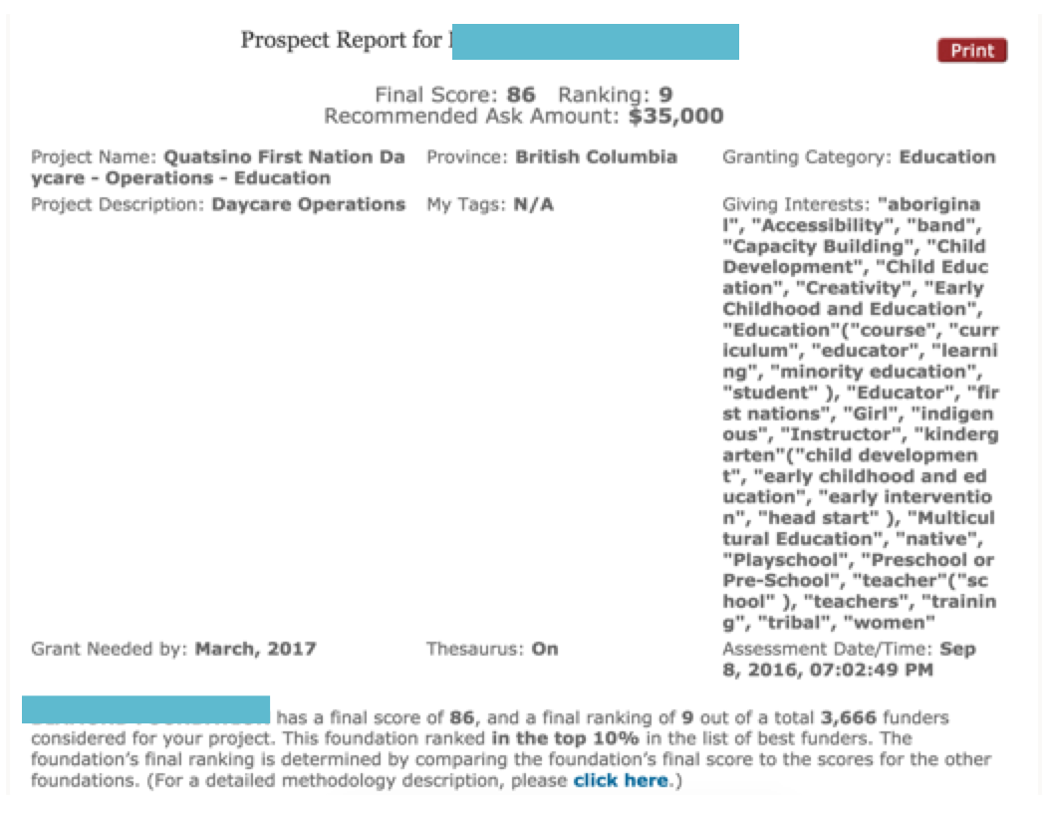
BC Indigenous Funding Conference
FoundationSearch

Slide 35
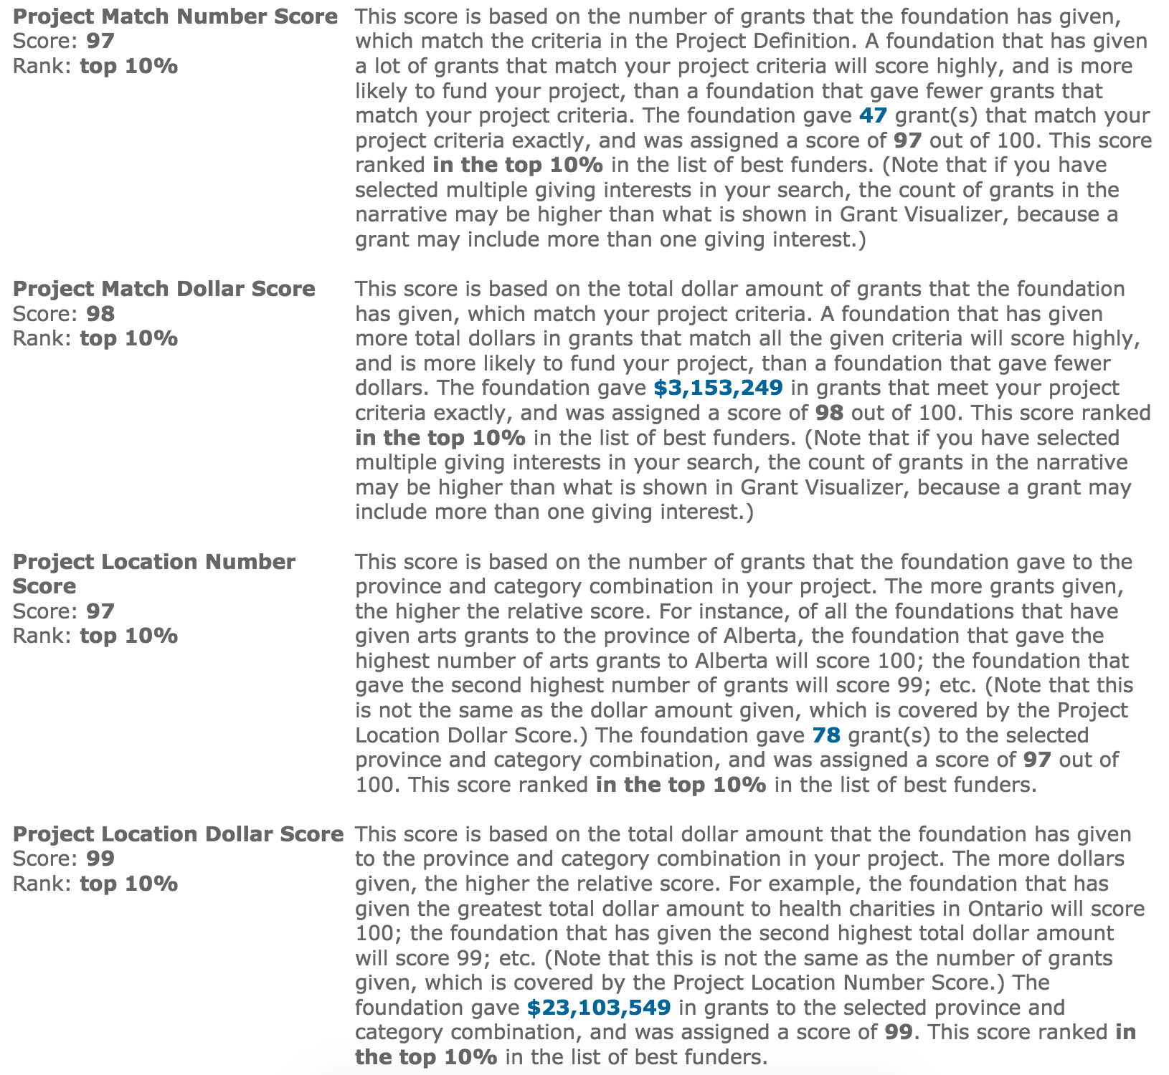
BC Indigenous Funding Conference
FoundationSearch
My Best Prospects Report
Part 1
Criteria for #9 Rating
4 Criteria Results

Slide 36
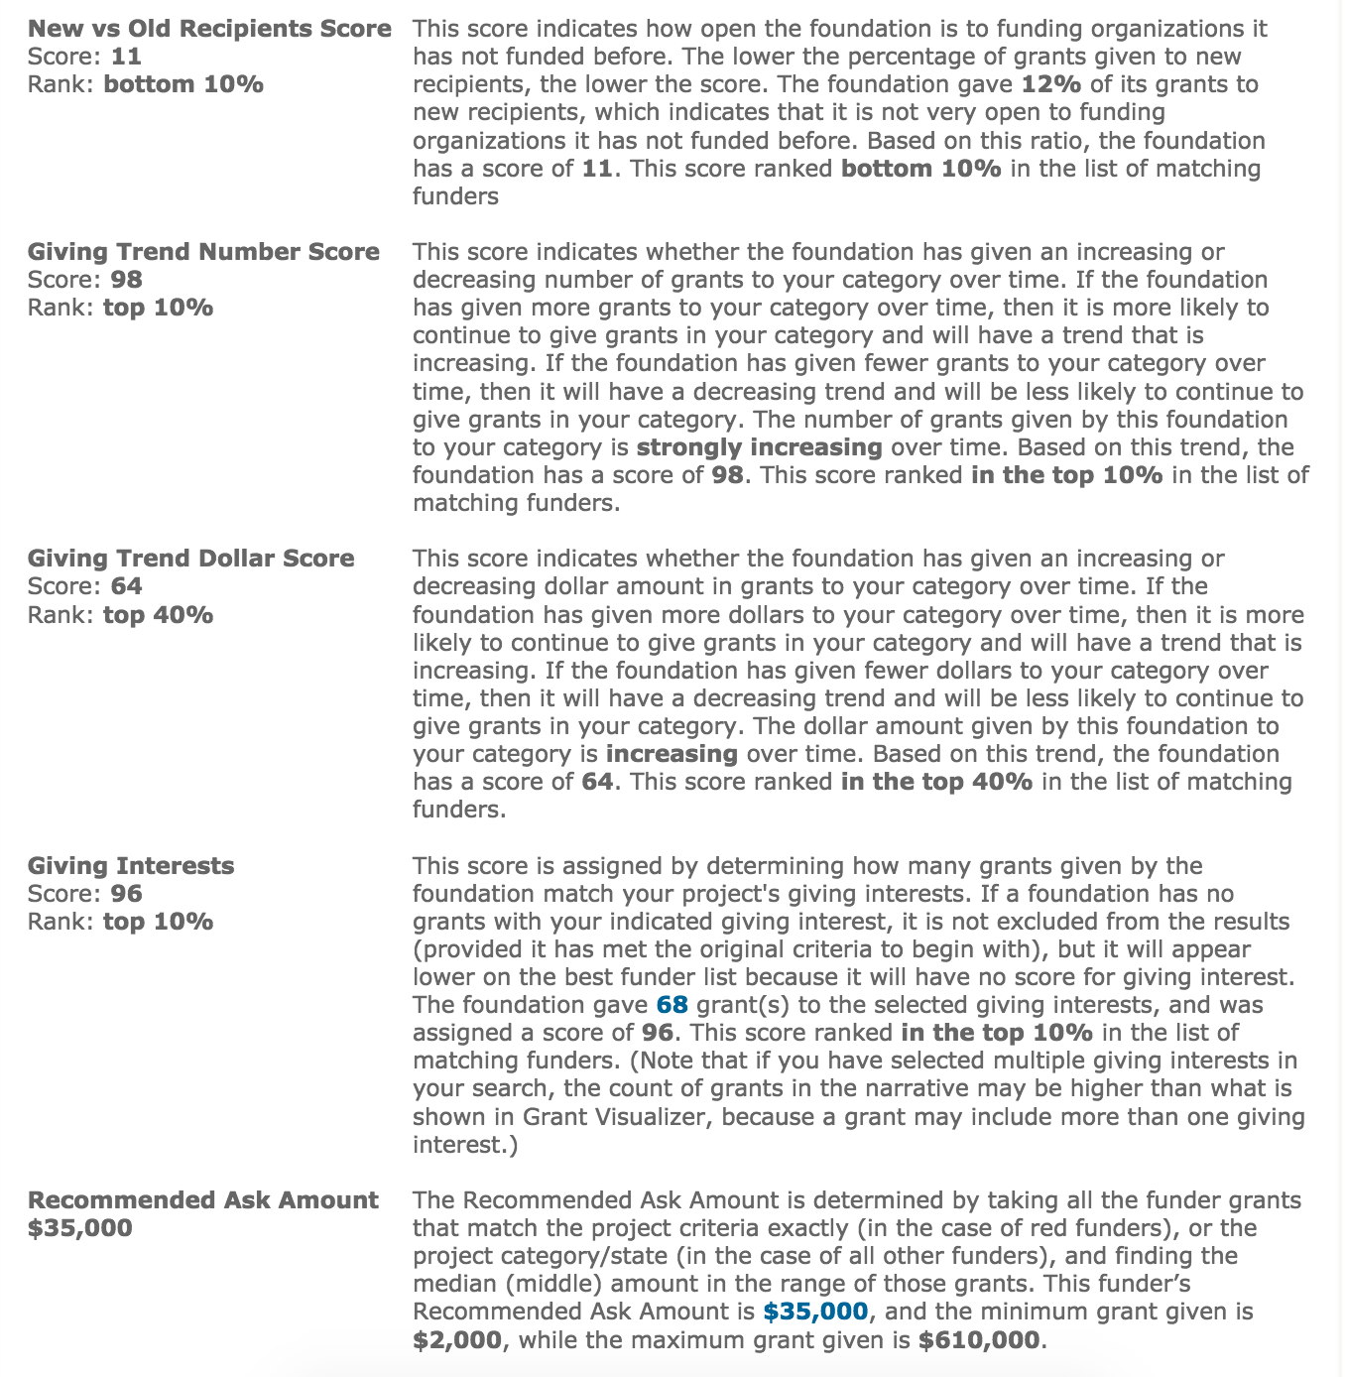
BC Indigenous Funding Conference
FoundationSearch
My Best Prospects Report
Part 2
Criteria for
#9 Rating
4 Criteria Results
Plus
Recommended
Ask Amount
$35,000

Slide 37
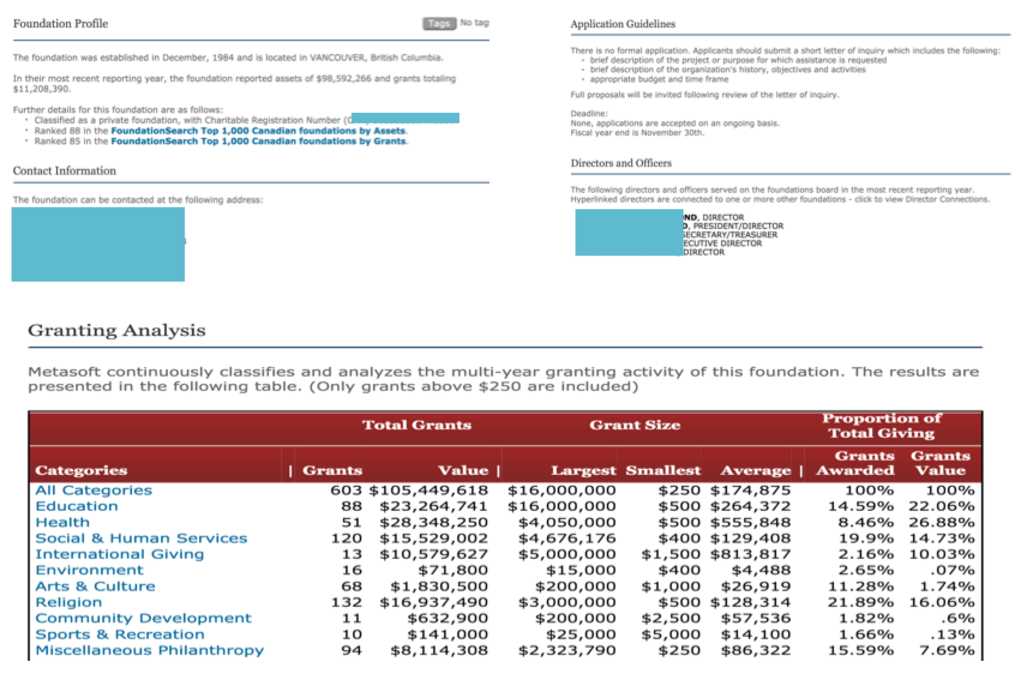
BC Indigenous Funding Conference
FoundationSearch

Slide 38
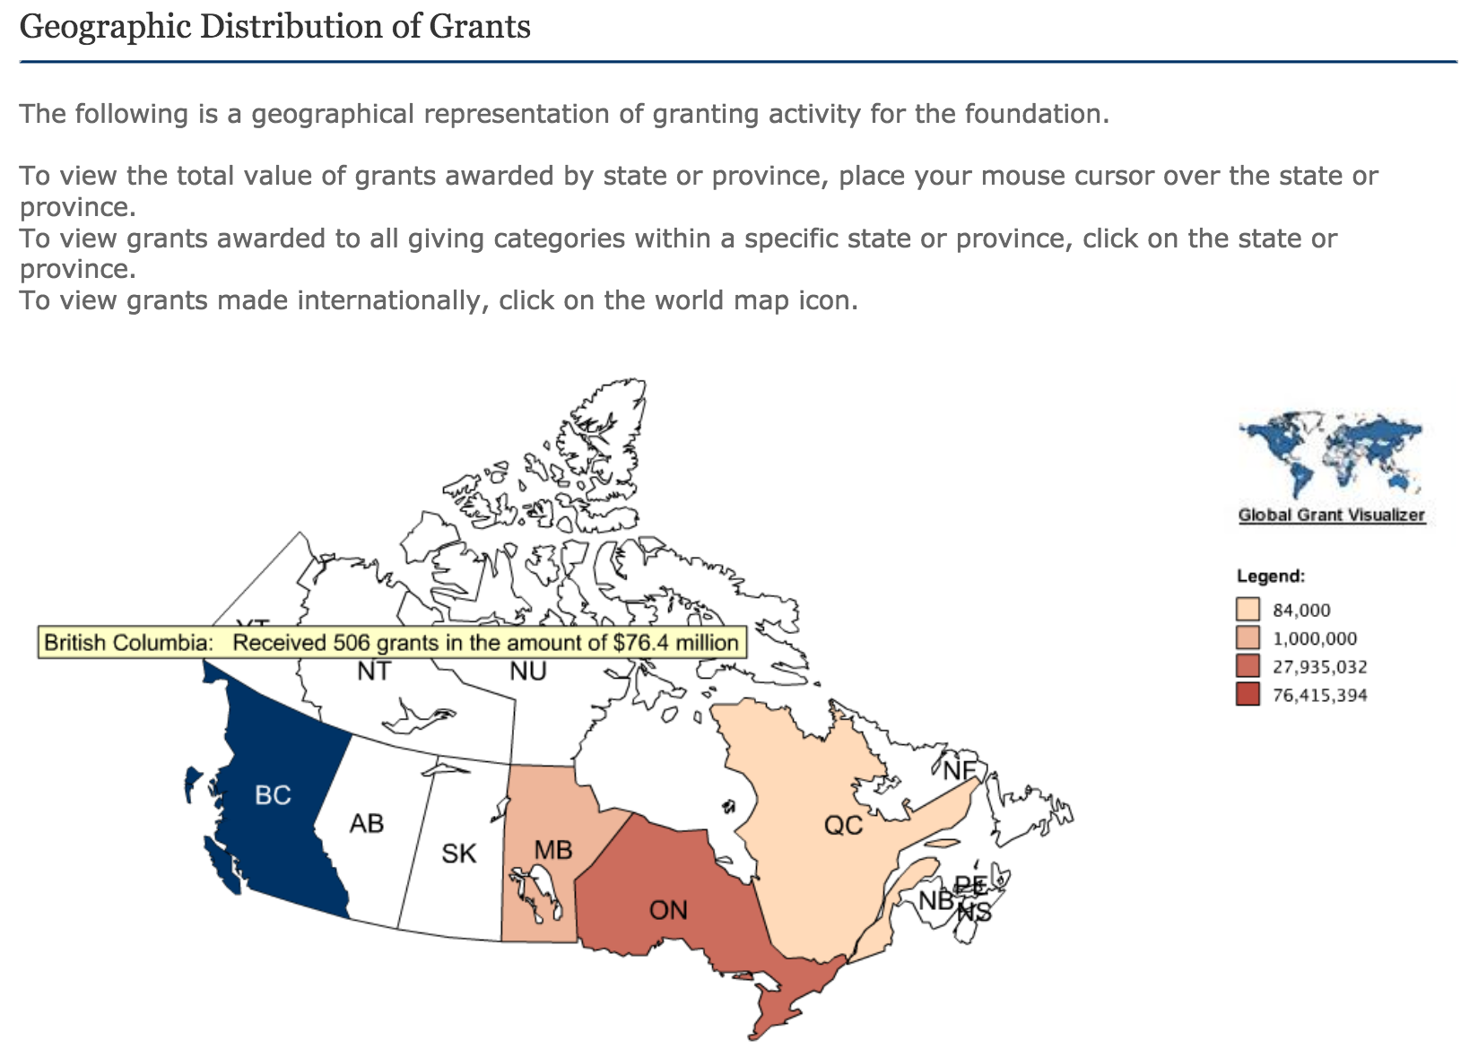
BC Indigenous Funding Conference
FoundationSearch

Slide 39
BC Indigenous Funding Conference
FoundationSearch
Professional Development
The professional development aspect of FoundationSearch membership is an important part of our offering, especially for organizations that are just starting to source philanthropic funding
Metasoft Systems (FoundationSearch) is a CFRE Approved Education Provider
CFRE (Certified Fundraising Executive) International is an independent certifying body whose sole mission is to set the highest standards of professional practice in philanthropy through a rigorous certification process
CFRE certification serves as an impartial, third-party endorsement of knowledge and experience against international standards in the philanthropic sector

Slide 40
BC Indigenous Funding Conference
FoundationSearch
Who Should Take Metasoft Online Education?
New fundraisers seeking to educate themselves in the essentials of foundation, corporate or government fundraising
Seasoned fundraisers seeking to refresh or update their knowledge and skills
Managers involved in the training of fundraising staff and volunteers
Board members and volunteers involved in the fundraising process at any level
Individuals not currently employed in the non-profit sector who are interested in pursuing a career in fundraising

Slide 41
BC Indigenous Funding Conference
FoundationSearch
Sample Action Plan
Week 1 (2-3 hours):
Participate in “Welcome Aboard” Webinar & Learn how to use the Resource
Send Letters of Intent to Newly Registered & Proven Foundations using our Sample Templates
Week 2 (2-3 hours):
Participate in the Live “Grant Development” Seminar with our Team
Create a list of Proven Prospects for your Current Needs
Determine “Fit” using 4 Point Assessment to Create a Shortlist of Foundations to Pursue with Confidence
Week 3 and on you will have the confidence to:
Write Successful Letters of Intent and Proposals
Widen Prospect Pool when New Funding Priorities Emerge We are here for you!
Contact us for Live Support Monday to Friday 7:00am to 4:00pm PST

Slide 42
BC Indigenous Funding Conference
FoundationSearch
We look forward to connecting with your Organization!
Michelle Morning Star Doherty
Senior Funding Consultant
First Nations, Inuit, Metis and urban Aboriginal Development
FoundationSearch / Metasoft Systems Inc.
300-353 Water Street
Vancouver, BC V6B 1B8
Telephone: 604-683-6711
Toll Free: 1-888-638-2763
Email: mdoherty@foundationsearch.com

