Slide 1


Growing your Business through Hiring People with Disabilities

Slide 2
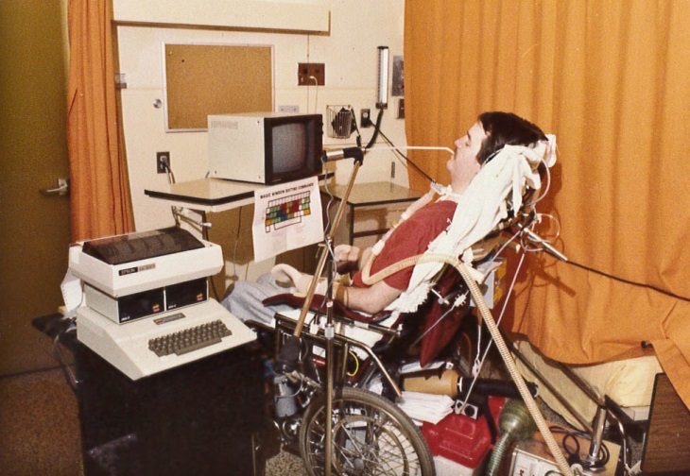
Neil Squire

Slide 3
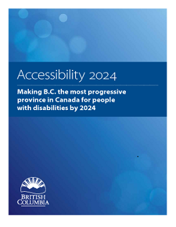
Accessibility 2024
Accessibility 2024 is the B.C. government’s 10 year action plan to make B.C. the most progressive place in Canada for people with disabilities.
546,000 people in BC, equivalent to 15% of the population, over the age of 15 identify as having a disability.

Slide 4
What is Disability?
Disability can be any condition that is permanent, temporary or episodic. It can be best understood as a functional (physical or cognitive) impairment that is resulting in a barrier at work or in getting to/from work. Some examples include:
Cumulative trauma disorders and repetitive strain injuries (i.e. carpal tunnel)
Upper extremity injuries
Neck and back injuries
Chronic fatigue
Sensory issues (low vision, blindness and loss of hearing)
Medical conditions (arthritis, multiple sclerosis, spinal cord injury, stroke)

Slide 5
Mythbusters
The Business Case for Hiring people with disabilities

Slide 6
Myth: Workers with disabilities do not perform well.
Source: Rethinking DisAbility in the Private Sector (2013)

Slide 7
Reality
90% of workers with disabilities rated average or better in job performance (DuPont 2007)
77% of workers with disabilities met or exceeded expectations (BMO 2012).
Source: Rethinking DisAbility in the Private Sector (2013)

Slide 8
Myth: Hiring some with a disability is expensive
Source: Rethinking DisAbility in the Private Sector (2013)

Slide 9
Reality
57% no workplace accommodation is required
37% one-time cost to accommodate
The average amount spent for accommodation is $500.
Insurance rates don’t change
*plus funding assistance
Source: Rethinking DisAbility in the Private Sector (2013)

Slide 10
Myth: People with disabilities don’t have the skills I need
Source: Rethinking DisAbility in the Private Sector (2013)

Slide 11
Reality
1 in 3 people with disabilities looking for employment have a post-secondary education.
People with disabilities are excellent problem-solvers
Source: Rethinking DisAbility in the Private Sector (2013)

Slide 12
Myth: The company’s bottom line will suffer if we hire people with disabilities
Source: Return on Disability
The National

Slide 13
Reality
Less sick days
Less turn over – 72% higher retention rate
*89% of our participants stayed with employer after wage subsidy ended
Source: Return on Disability
The National

Slide 14
Information for Small Business Owners in British Columbia
What this all means….
There is a large untapped market of qualified individuals that can productively contribute to the labour market!

Slide 15


Slide 16
Working Together
Federally funded employment program that connects job-ready individuals with disabilities to businesses with a hiring need
Wage subsidy support may be available to businesses who hire an individual with a disability
Individuals are interviewed, hired, and put on payroll like all other staff
We are able to reimburse a pre-determined portion of wages after receiving a paystub and time sheet showing wages paid to employee

Slide 17
Employer Eligibility
Long term opportunities: Businesses intend to retain the employee once the wage subsidy contract ends
We do not provide wage subsidies for contract or temporary work
Basic company information must be provided in order to create documents, and banking information is needed to electronically transfer funds
The position being offered cannot displace another employee or volunteer

Slide 18

How to Participate in Working Together
Identify a Candidate
Inform us that you have a candidate with a disability you would like to hire
The candidate has an intake meeting with us to determine eligibility
Once deemed eligible, we can start the paperwork
BC Christian Academy

Slide 19

How to Participate in Working Together
Identify a Need
Inform us of your needs and what you are looking for in the ideal candidate
We search through pre-screened and eligible applicants to see if there is a match
If you want to hire recommended candidate, we can start the paperwork

Slide 20


Slide 21
What is Technology@Work
Provincially and Federally funded program
Designed to support employment for people with disabilities in British Columbia
Goal is to assist individuals with overcoming disability related barriers at their workplace or in traveling to/from their workplace
Offers services to individuals and employers
Program is delivered throughout British Columbia

Slide 22
Technology@Work
The Technology@Work program can provide funding in the following areas:
Assistive devices, equipment and technology
Communication and hearing devices
Ergonomic supports and other personal devices
Personal attendant care services (Max 4 weeks)
Interpreting and captioning services (Max 4 weeks)
Workplace access and modification (This includes vehicle conversions, building accessibility, etc.)

Slide 23
Technology@Work
Funding:
The Technology@Work program can include cost-sharing between the Client, the Employer and Technology@Work
The Employer’s contribution stems from the acknowledgement of their “duty to accommodate”
The Client’s contribution is based upon whether there is cross-over into their personal life
Contributions are not mandatory and are determined on a case-by-case basis.
Notes:
Talk about tools of the trade, cross-over applications here

Slide 24
Technology@Work
Individual Criteria
Employer Criteria
Legally eligible to work in British Columbia
At least 16 years of age
Self-identify as a Person with a Disability
Employed, self-employed, or volunteering (members of the public sector excluded)
Have a disability related barrier in the workplace
Anyone interested in creating a more accessible worksite
Self-employed
Employers seeking solutions and accommodations related to the duty to accommodate obligations

Slide 25
Contact Information
Neil Squire Society
#400 – 3999 Henning Dr.
Burnaby, BC V5C 6P9 T 604.473.9363
Nate Toevs natet@neilsquire.ca
Greg Scott gregs@neilsquire.ca
Emily Corenblith emilyc@neilsquire.ca
Chad Leaman chadl@neilsquire.ca

