Slide 1
WP1 – MSM
Voltage-Driven Evolution of Lithium Nanoparticle Morphology
(paper in Progress)
Brad Ayers , Arihant Bhandari, Gilberto Teobaldi, Chris-Kriton Skylaris

Slide 2
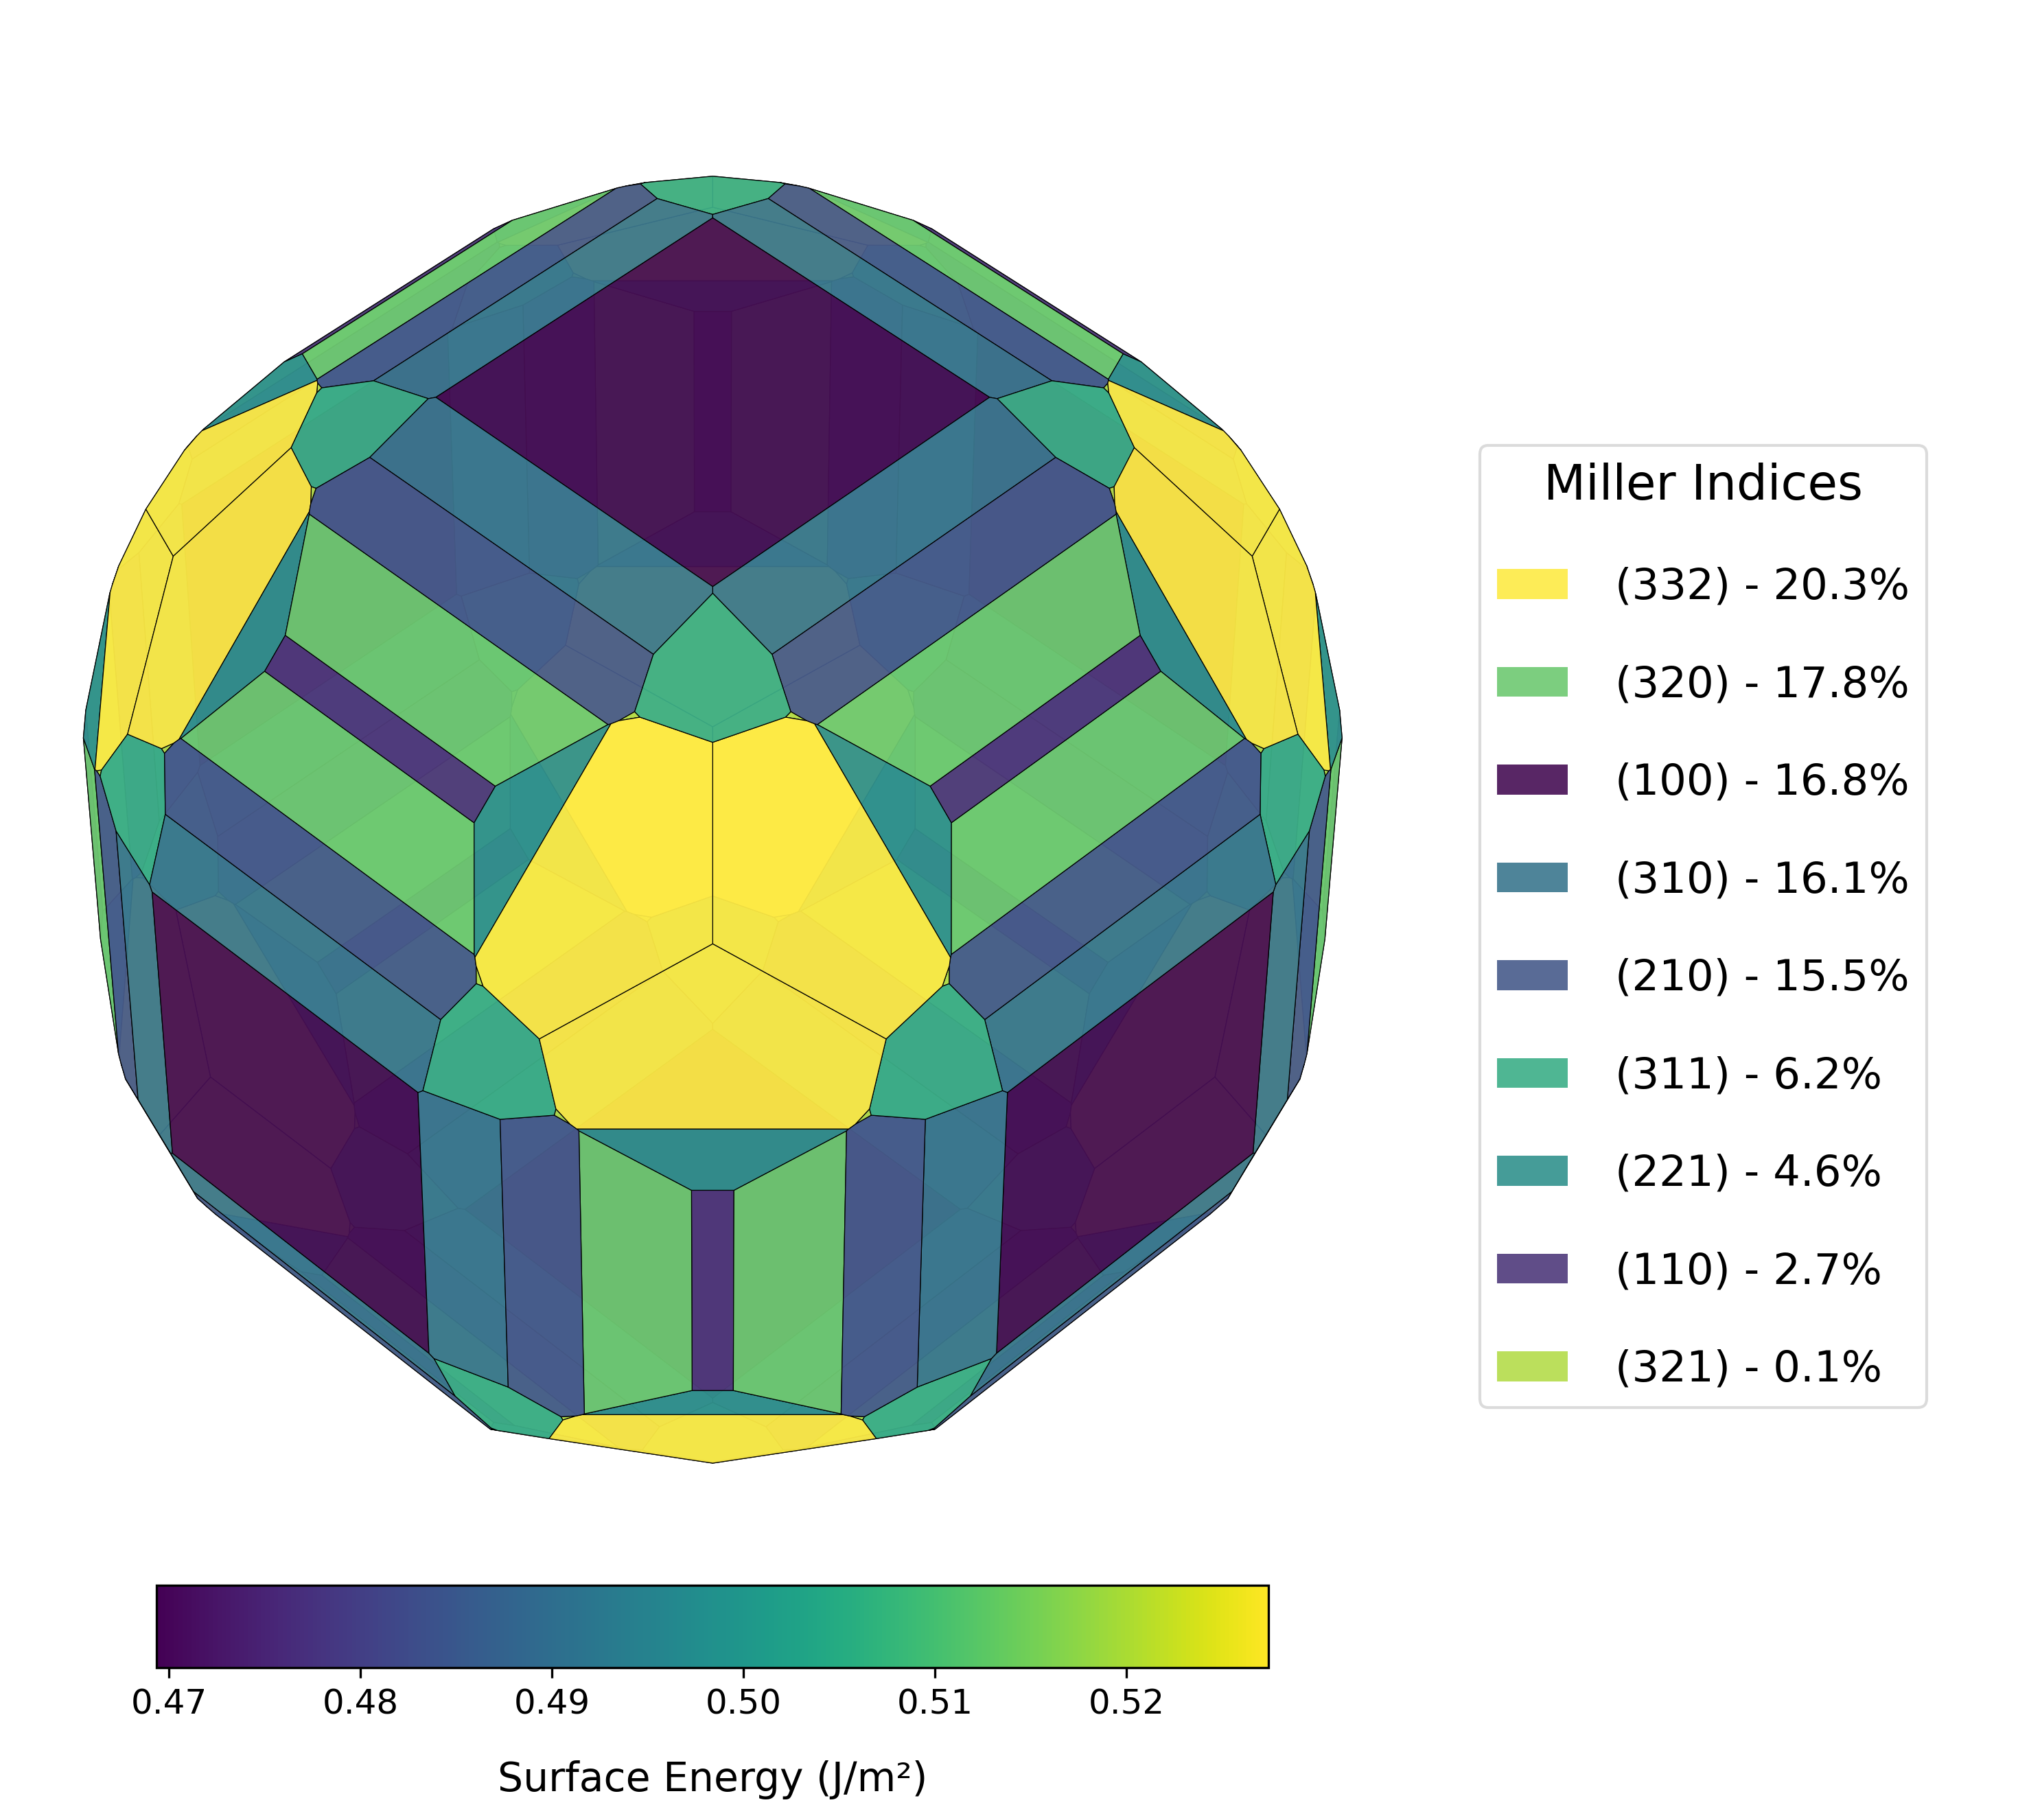
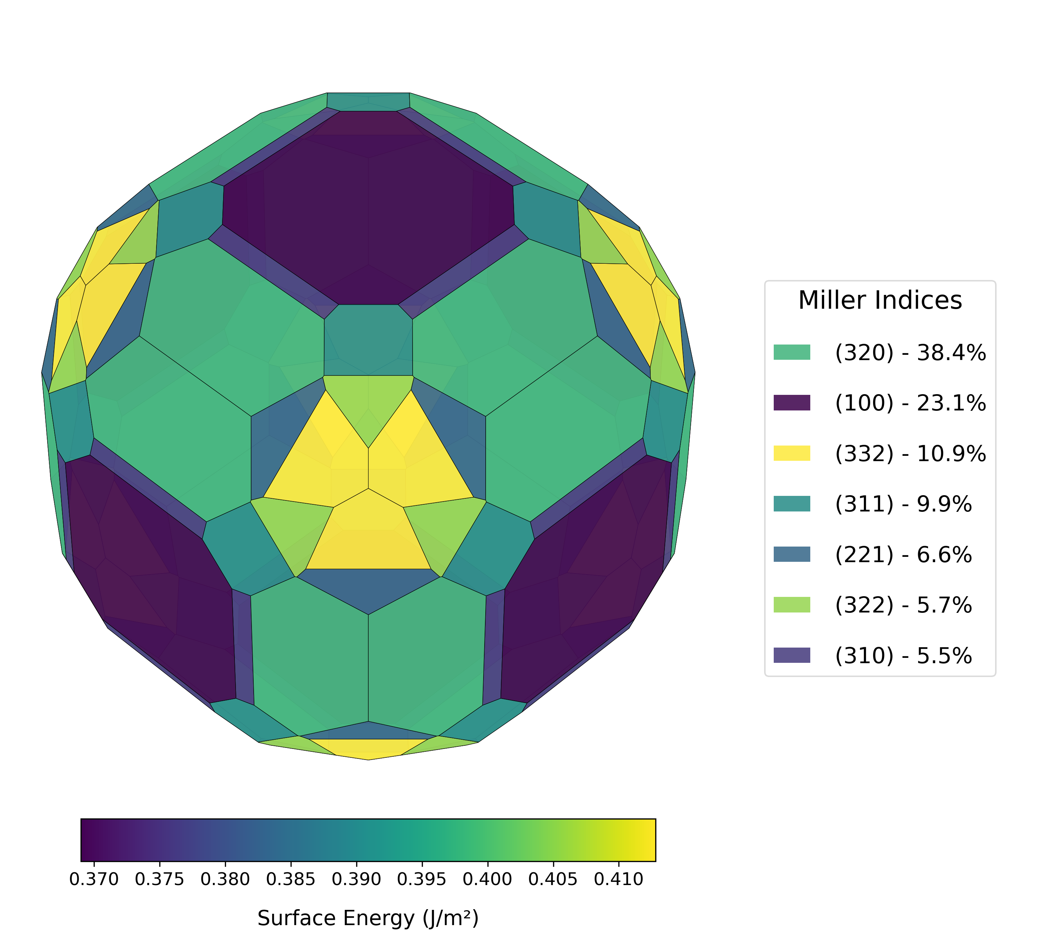
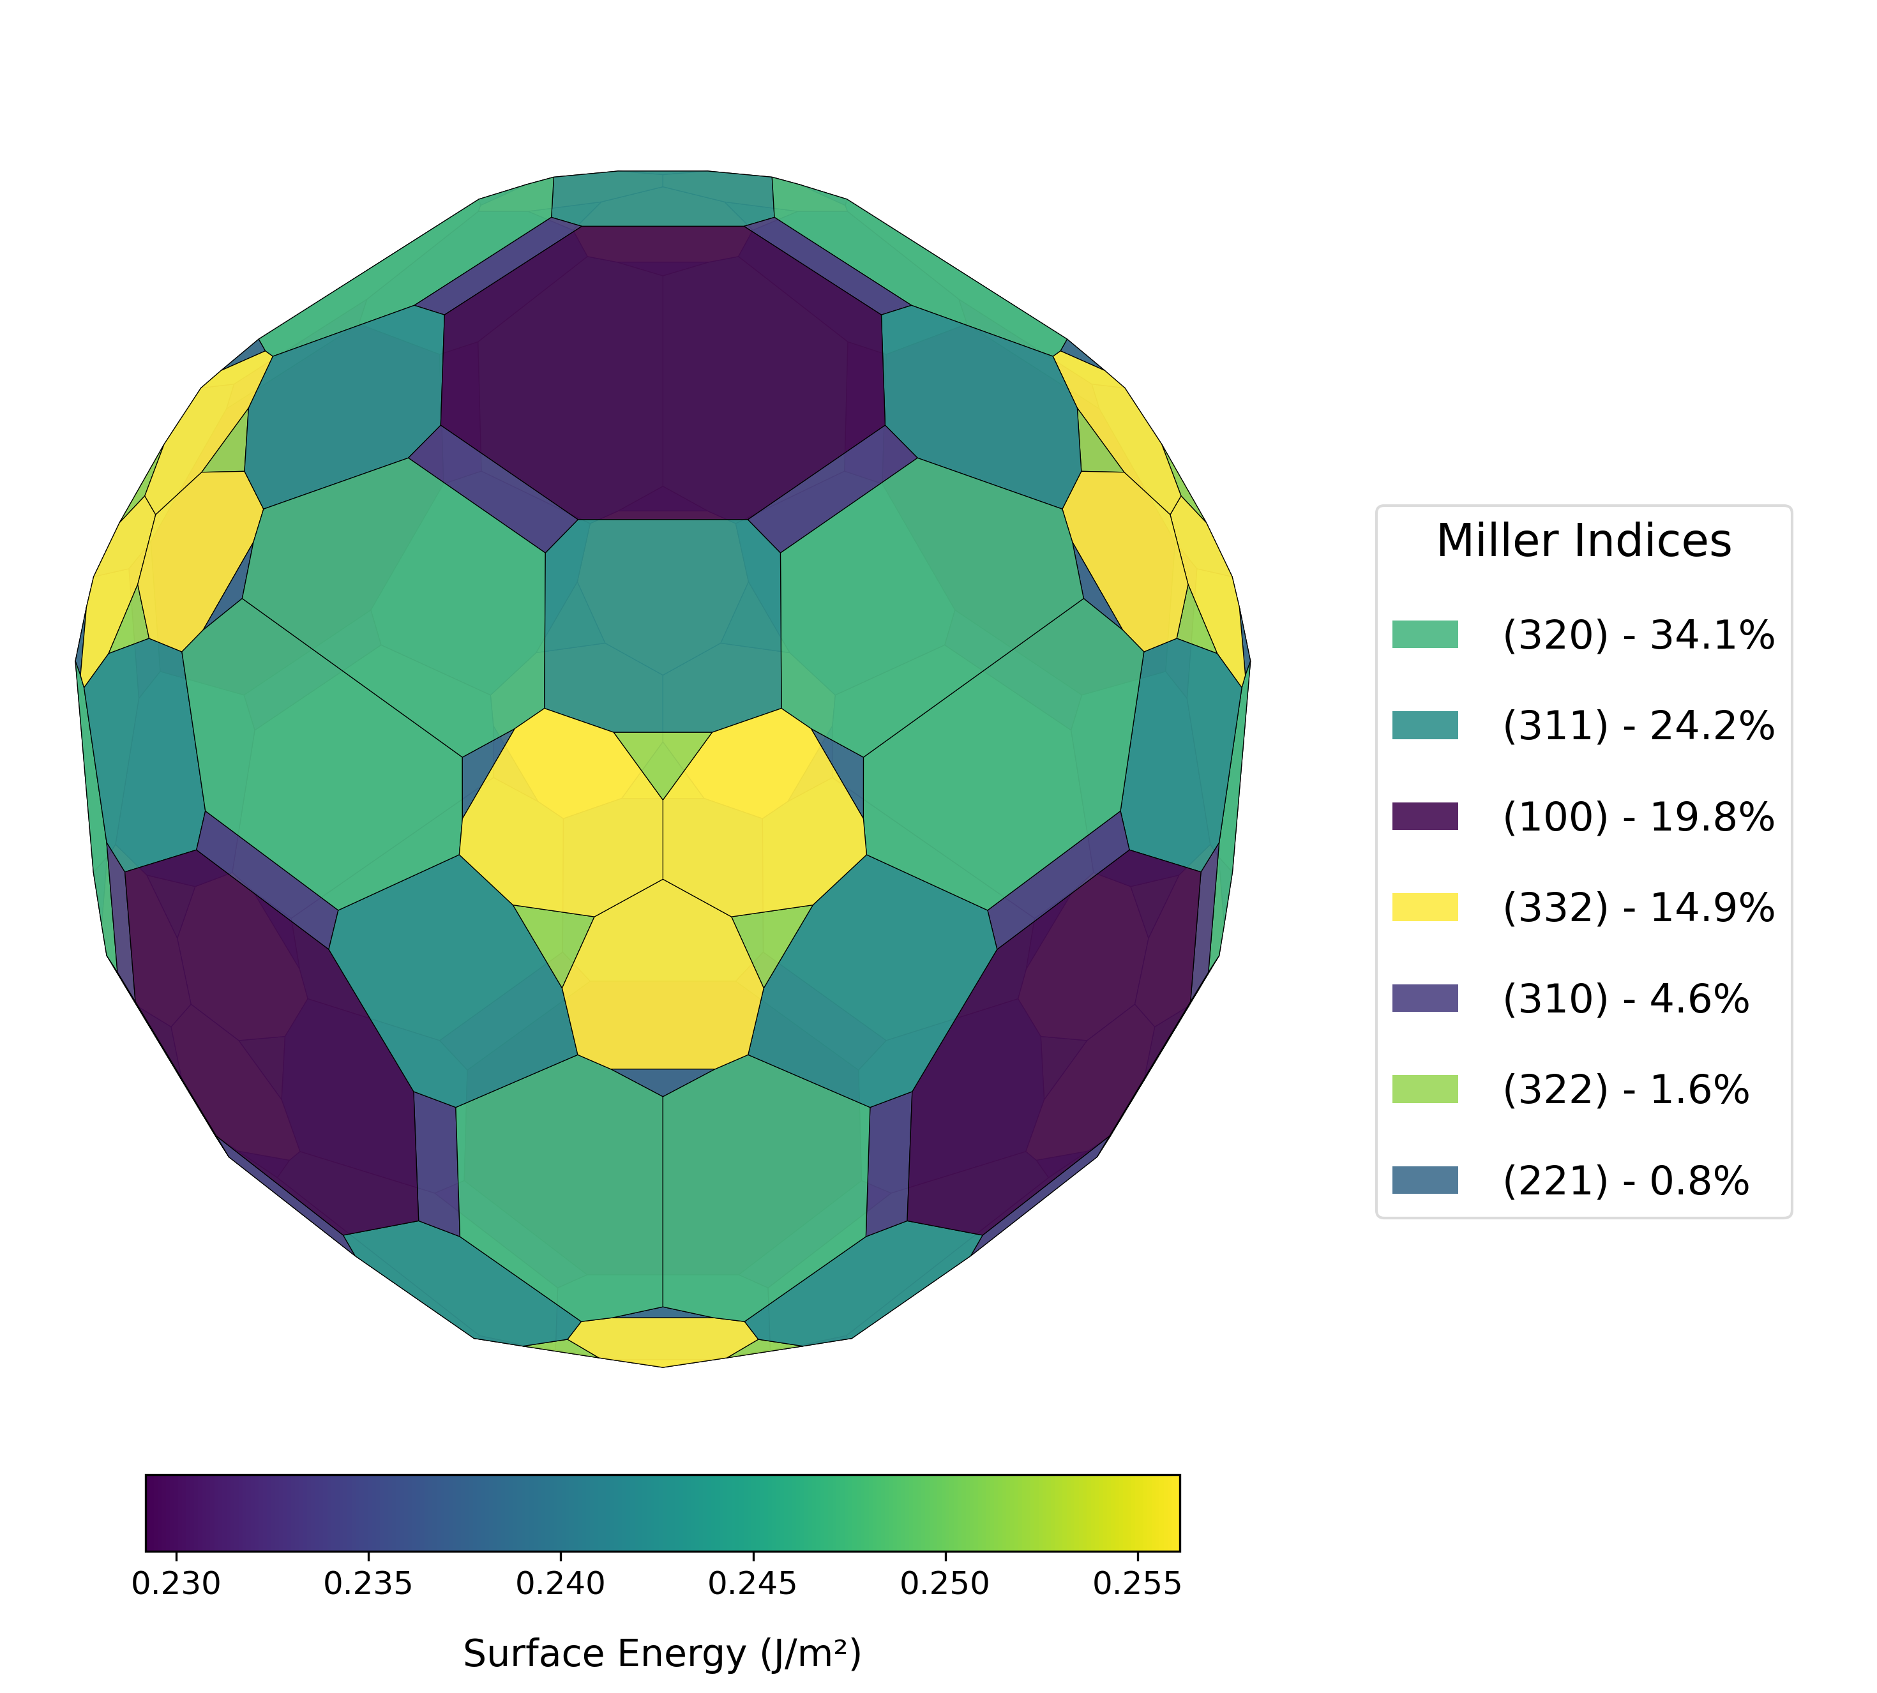
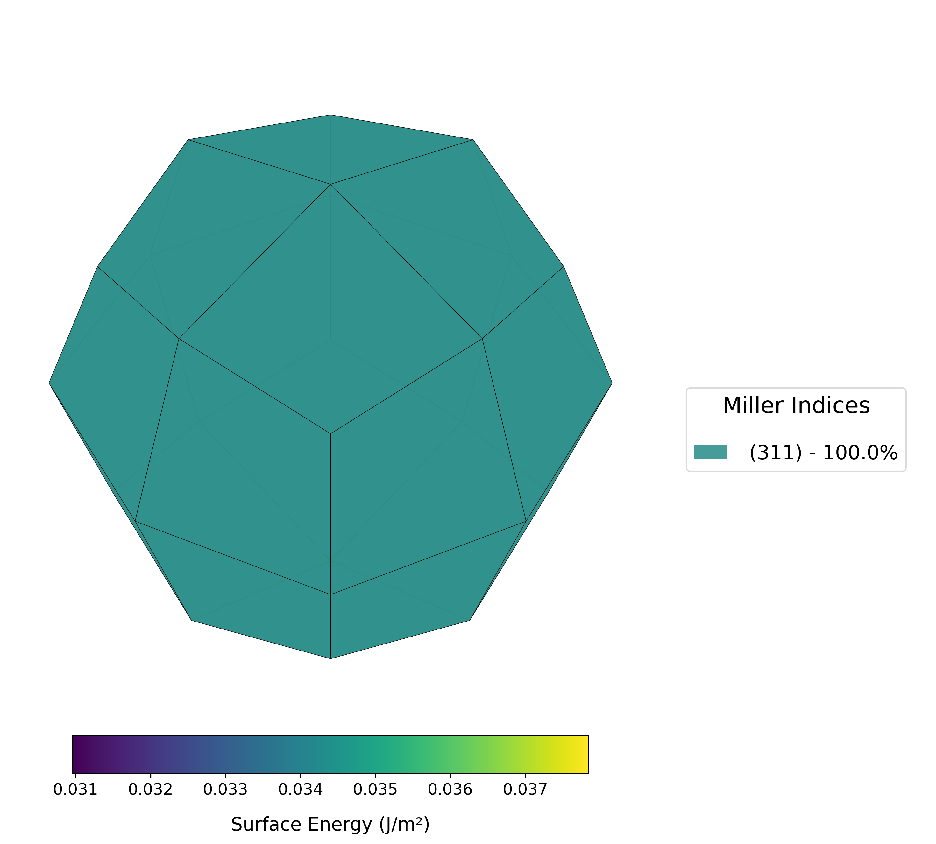
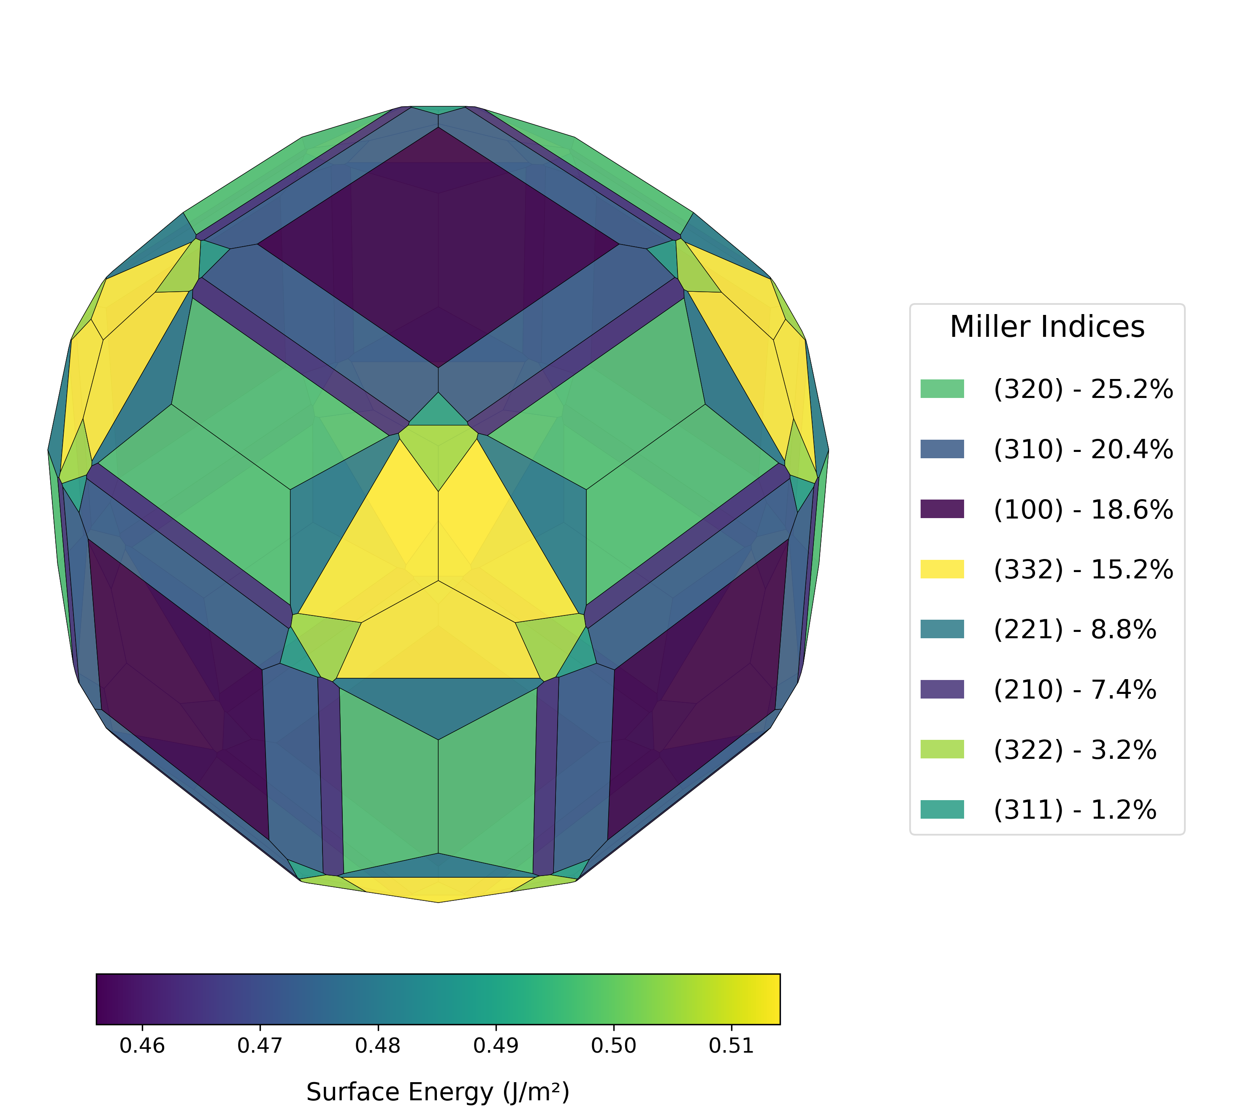
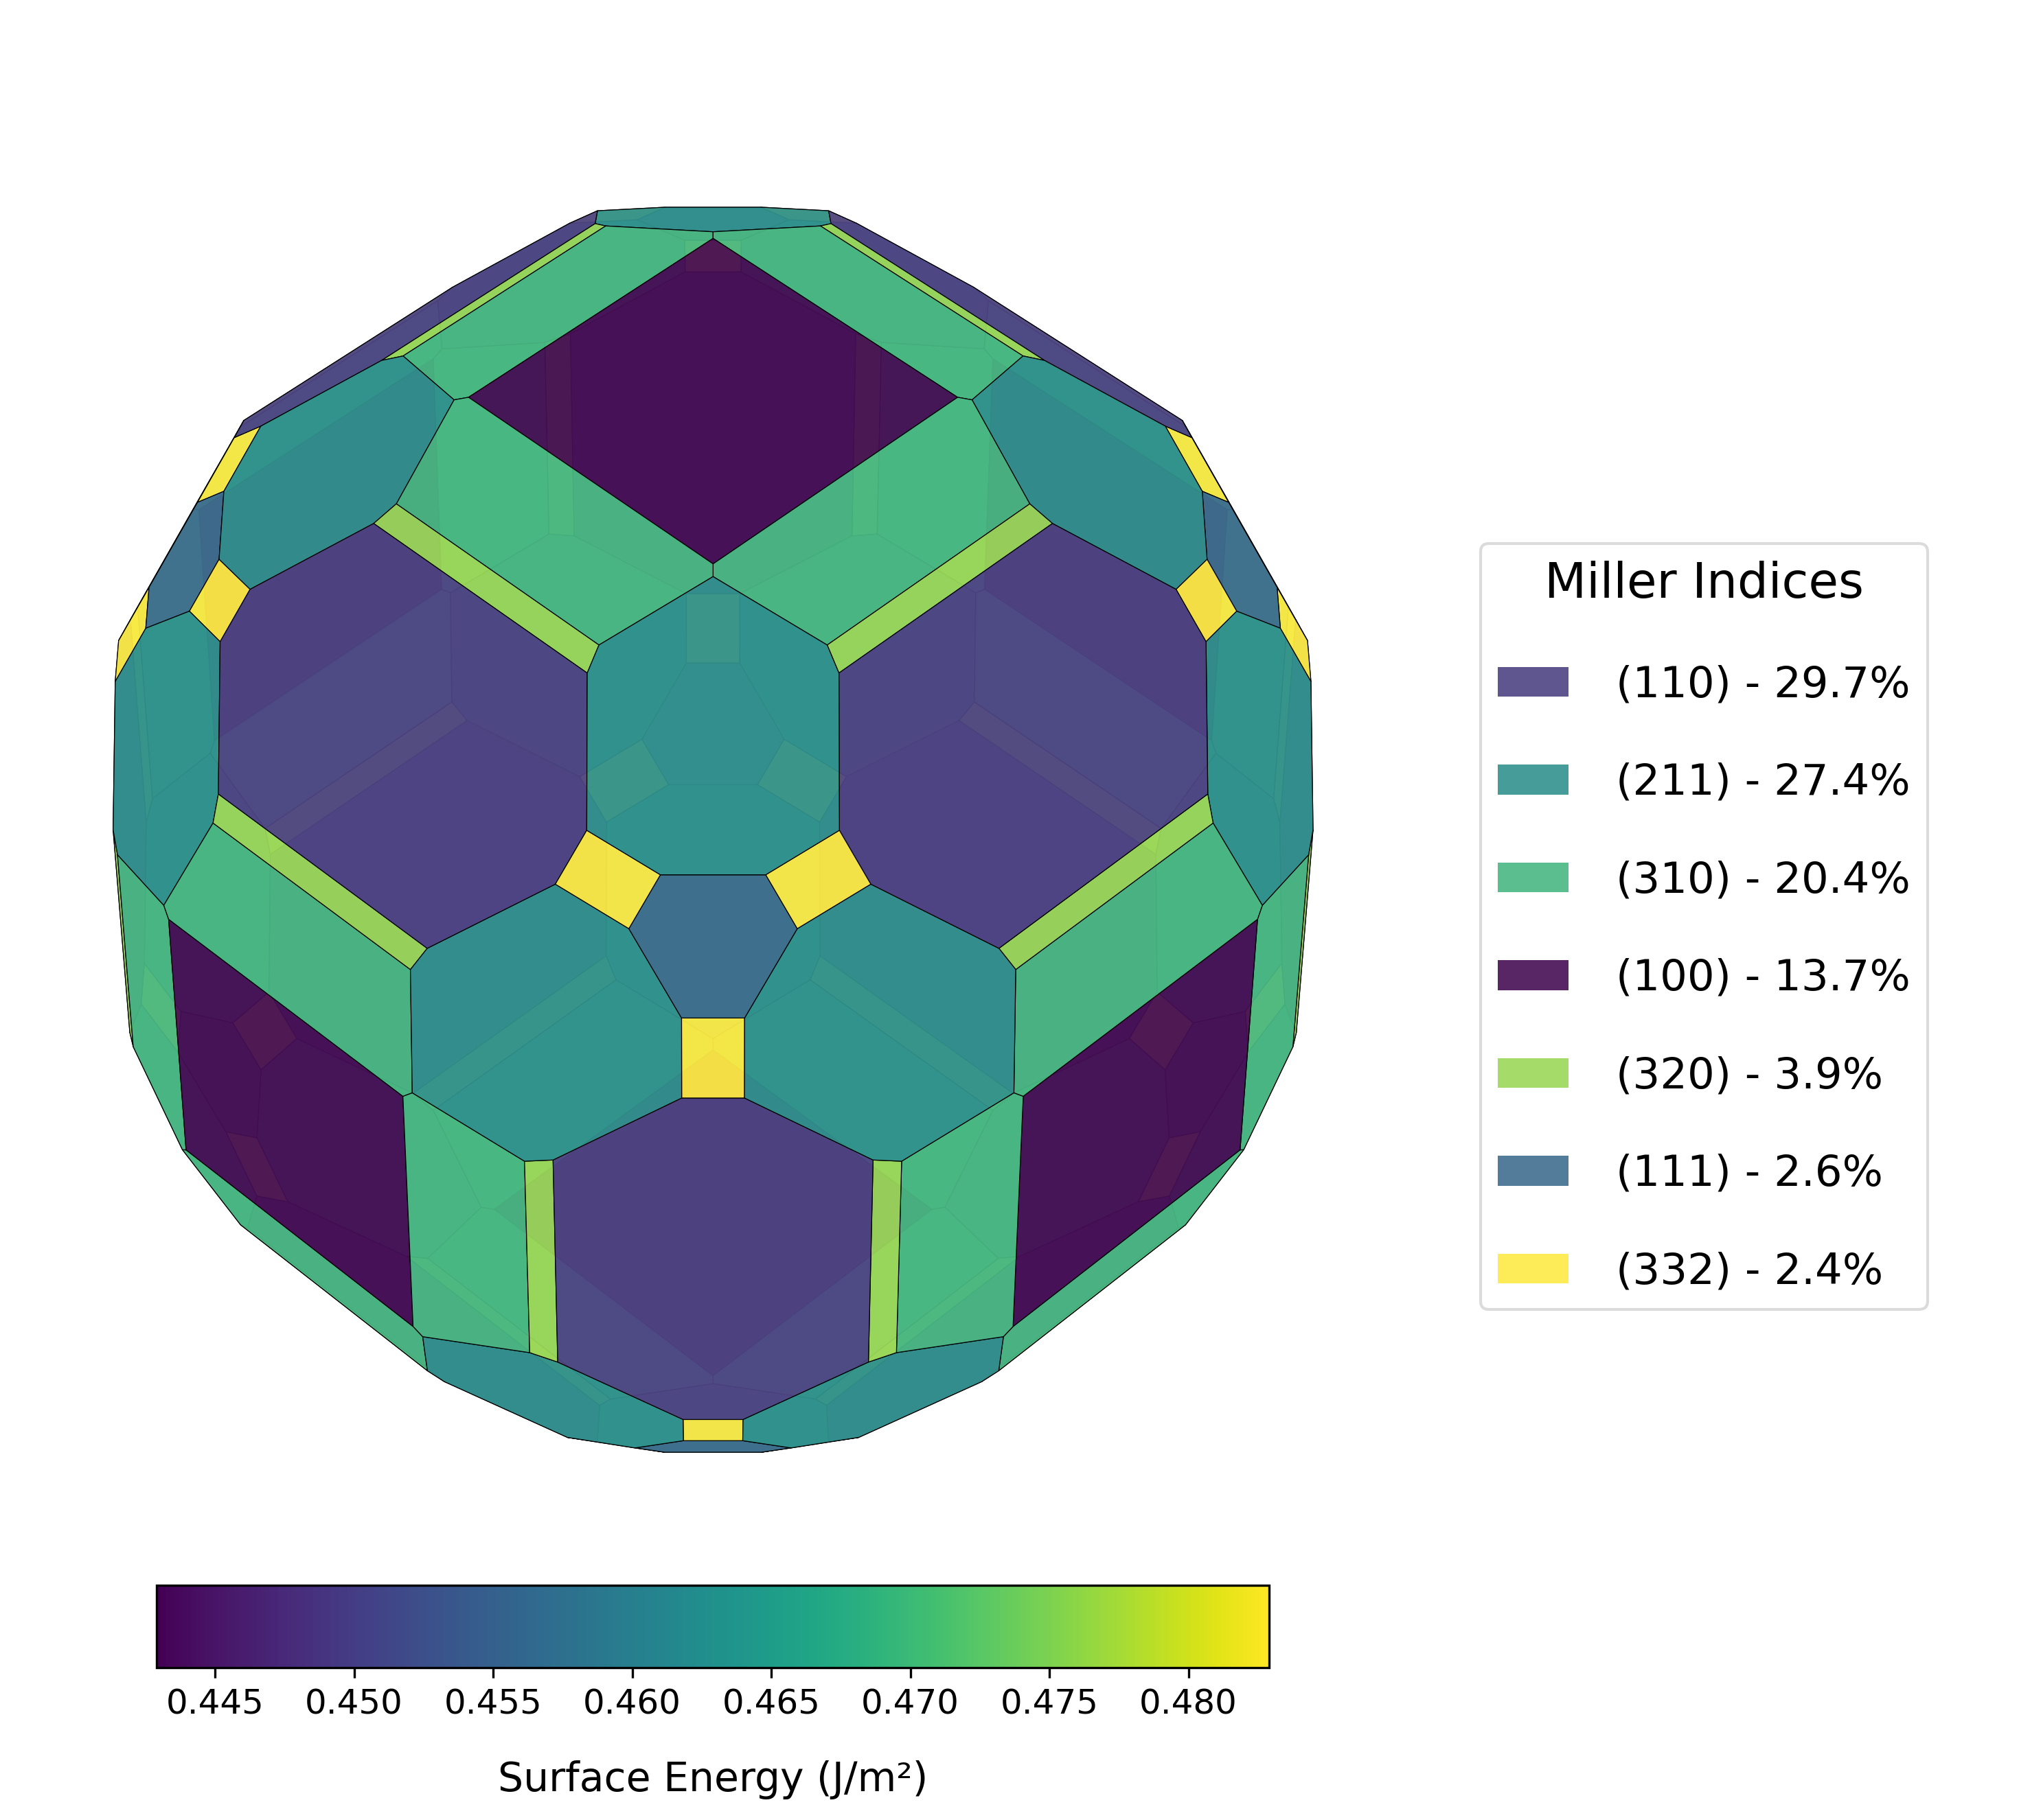
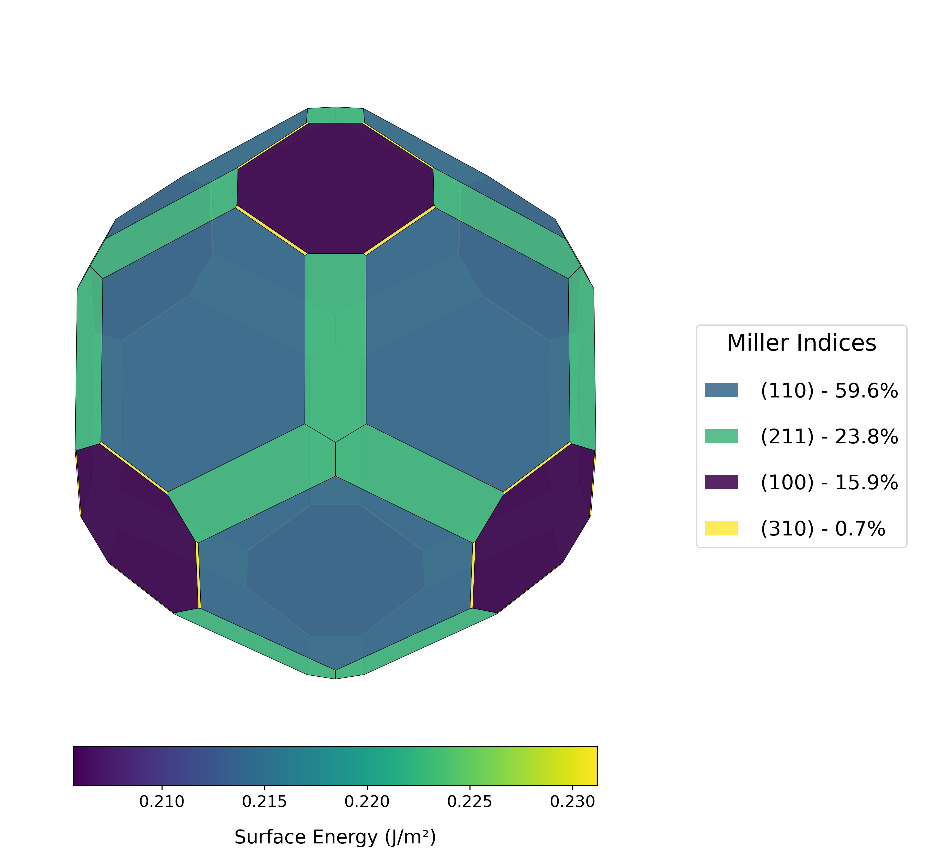
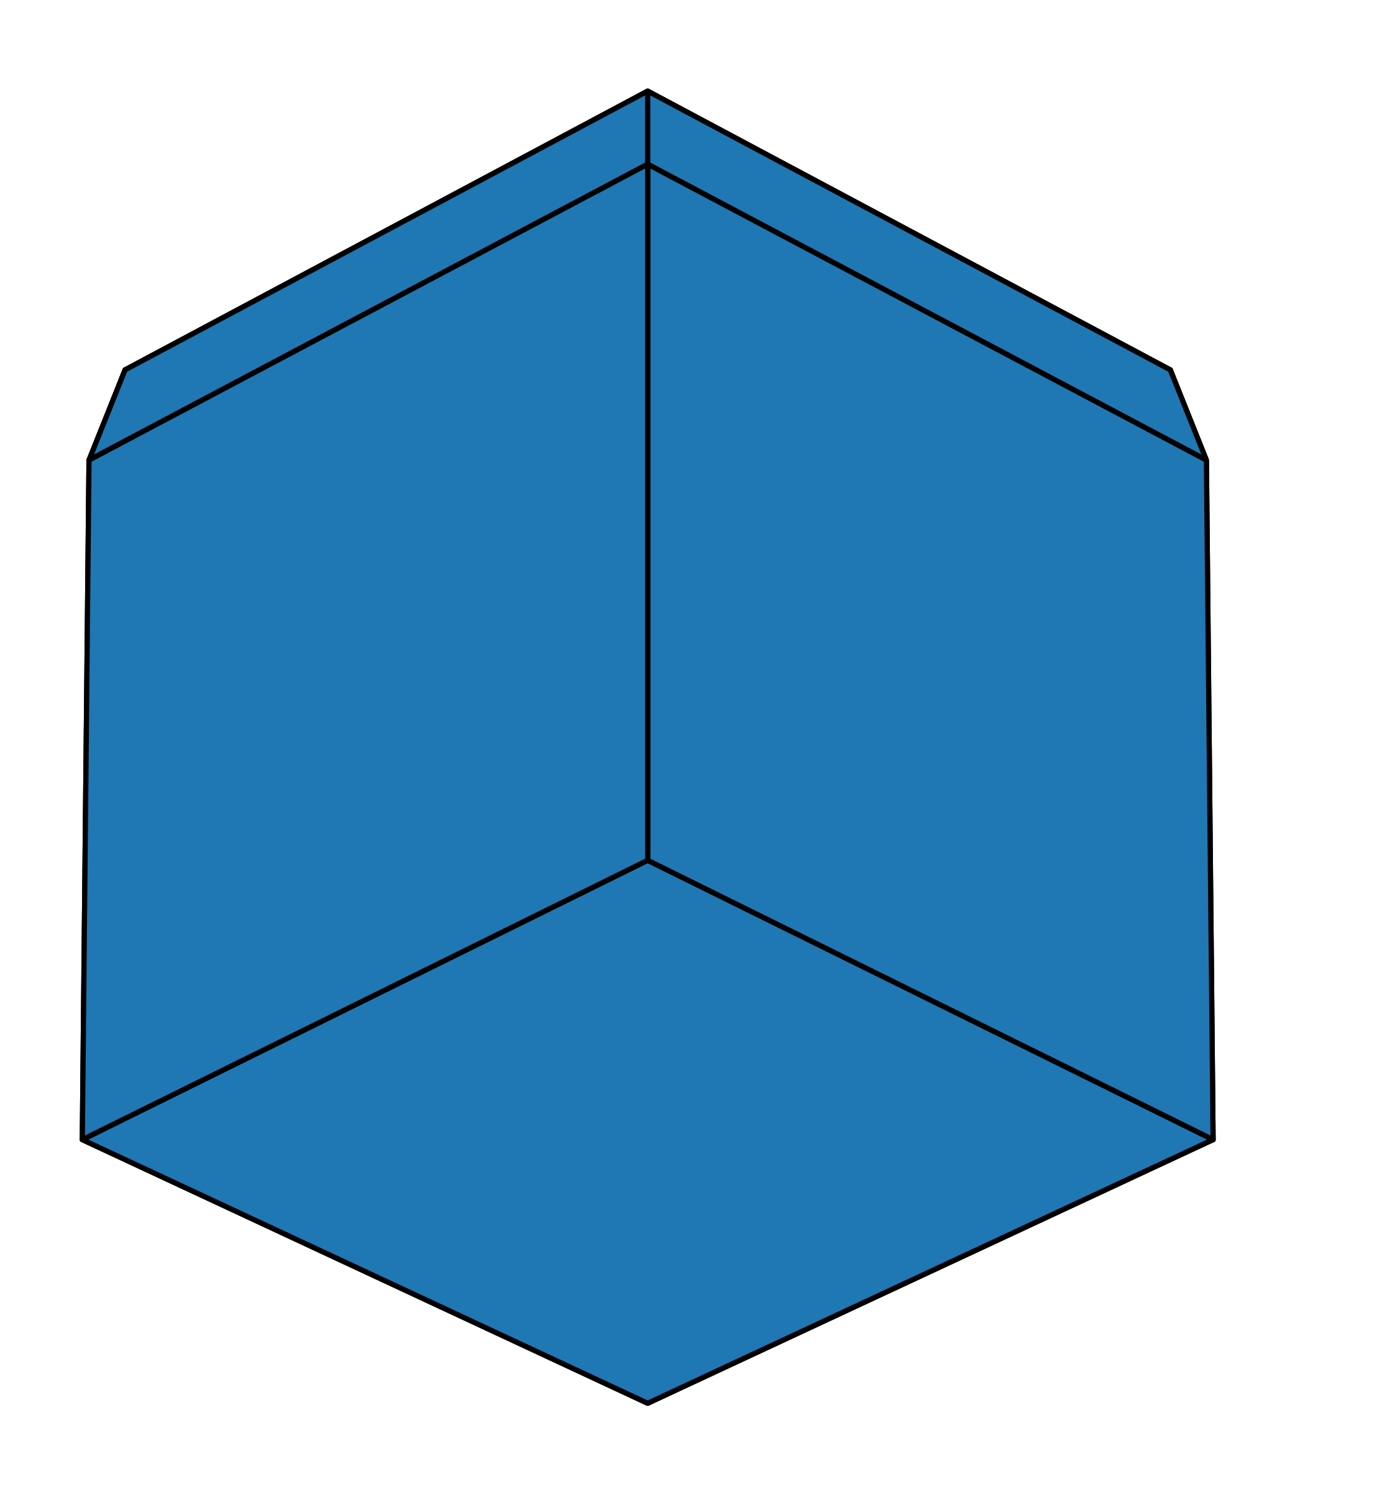

Lithium Wulff shapes
PZC
0.0V
0.5V
1.0V
Vs. Li/Li+
-0.5V
-1.0V
-1.5V
-1.75V
Vs. Li/Li+

Slide 3
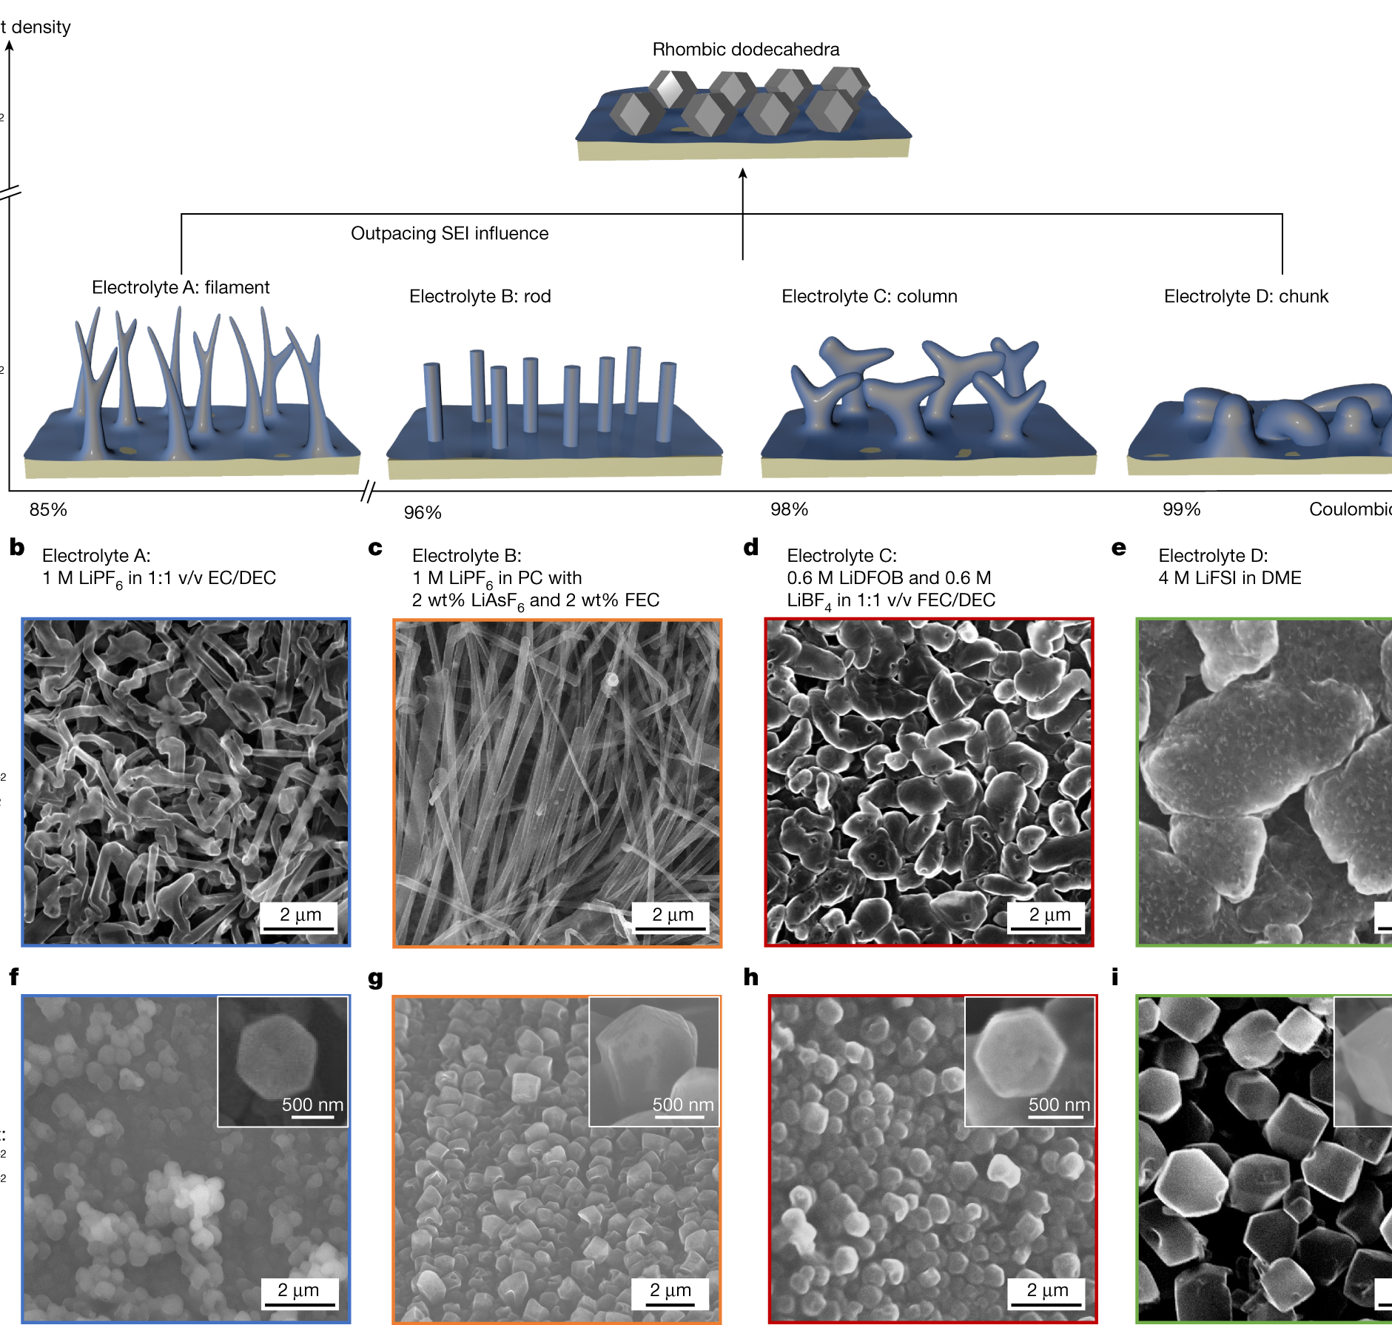
Lithium Wulff shapes – PT 2
Key Findings:
Experimental confirmation: Yuan et al. directly observed rhombic dodecahedral Li crystals bounded by {110} facets when deposition outpaces SEI formation (Nature 2023)
Morphological transformation: At typical rates, Li forms diverse structures depending on electrolyte; at ultrafast rates (50-1000 mA/cm²), it consistently forms {110}-faceted single crystals
Strong validation of DFT predictions: Our calculations showing {110} dominance at negative potentials perfectly align with experimental findings
Structure-property relationship: Thermodynamically predicted morphology (rhombic dodecahedron) emerges when kinetic limitations are removed
REFERENCES:
Yuan, X.; Liu, B.; Mecklenburg, M.; Li, Y. Ultrafast deposition of faceted lithium290. 291.
polyhedra by outpacing SEI formation. Nature 2023 620:7972 2023, 620, 86–91.

Slide 4
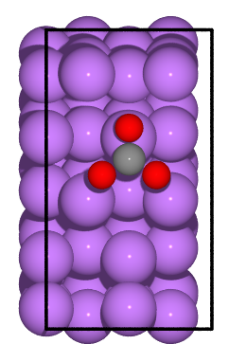
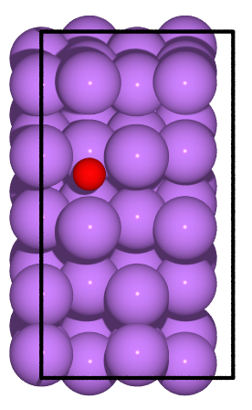
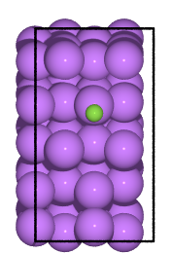
Potential-MEDIATED Competitive Adsorption OF SEI COMPONENTS: F⁻, O²⁻ and CO₃²⁻
Simulations:
Calculating adsorption energies of F⁻, O²⁻, and CO₃²⁻ on all possible sites (top, bridge, 4-fold) across voltage-dependent dominant Li surfaces.
Determining how applied potential affects competitive adsorption preferences between these key SEI components.
Identifying voltage thresholds where preferential binding shifts between ions, explaining why cycling protocols directly influence SEI composition.

