Slide 1
Significance Modules Integrating the Transcriptome and Epigenome (SMITE)
Sept 16, 2021

Slide 2
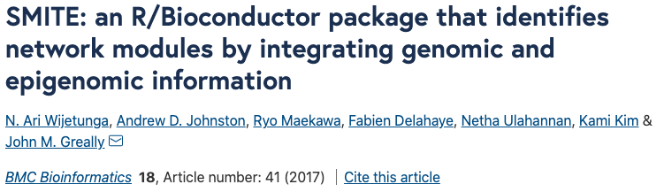
What is SMITE?
R package used for multi-omic integration, typically between DNA methylation and gene expression (but supports additional data types)
Gene scoring approach followed by network analysis
Returns genes with statistically significant changes to one or more of your input ‘omics, as well as regulatory “modules” of genes with changes to one or more of your ‘omics that interact with each other

Slide 3
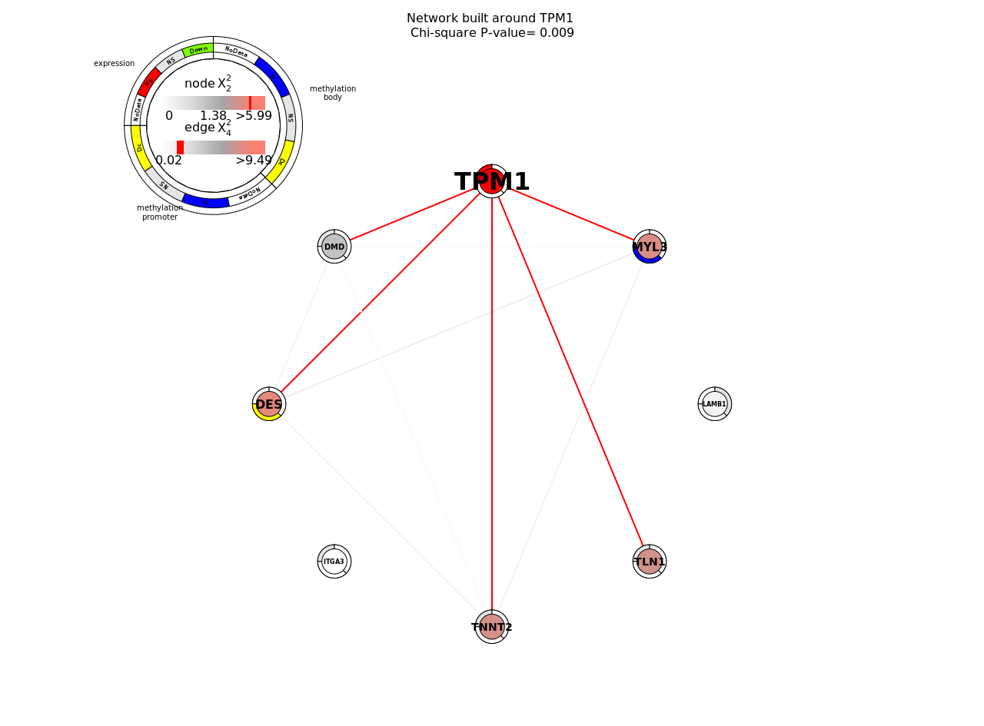

Slide 4
SMITE builds on FEM, a pre-existing scoring and network analysis approach
Functional Epigenetic Modules (FEM) was published in 2014 by the Teschendorff group (Jiao et al.)
Uses promoter DNA methylation only, and assumes a negative relationship between promoter DNA methylation and gene expression
SMITE allows incorporation of DNA methylation across multiple gene features, customizable relationship between DNA methylation and expression, and weighting of feature importance to overall gene score

Slide 5
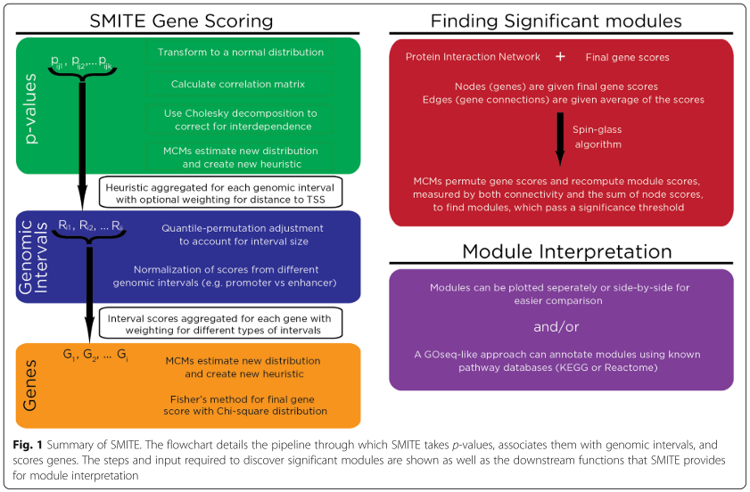
Overview of steps in SMITE
Wijetunga et al., 2017

Slide 6
1. Gather DNA methylation and gene expression data
Create “PvalueAnnotation” object, which stores p-values and effect sizes from each ‘omic, as well as genome annotation information

Slide 7
2. Combine DNA methylation p-values across gene features
Default features are promoter and gene body, but this is customizable
Features defined by distance (to TSS, or custom, e.g. if you provide files with locations of ChIP-seq peaks)

Slide 8
3. Score genes
DNA methylation and expression data can be optionally normalized to obtain similar ranges for p-value distributions
User can specify the weight of each feature, i.e. how much it will contribute to overall gene score
User can also specify whether there is an expected relationship between DNA methylation at each feature and expression

Slide 9
4. Find regulatory modules
Scores are annotated to a reference protein-protein interaction network (e.g. REACTOME, STRING)
Spin-glass algorithm is applied to find “modules,” i.e. sub-networks containing highly scoring genes (with alterations to DNA methylation and/or expression)

Slide 10
5. Module interpretation
Module/network plotting
Gene ontology enrichment
Extract gene scores
Open to possibilities – any downstream analysis you wish!

Slide 11
Limitations/caveats to be aware of
Combining p-values across features and then across genes can result in some loss of information
Good idea to check your most interesting/most highly scoring genes against original input statistics to ensure they are true positives
Assumptions are built in when defining gene features by distance
Weighting and specifying directionality will influence your results
Keep in mind what kind of questions you want to ask with your data!

