Slide 1
Diffusion Tensor Imaging
Neuroimaging Workshop
Cognitive Science Lab
IIIT Hyderabad
14-Sep-2024

Slide 2
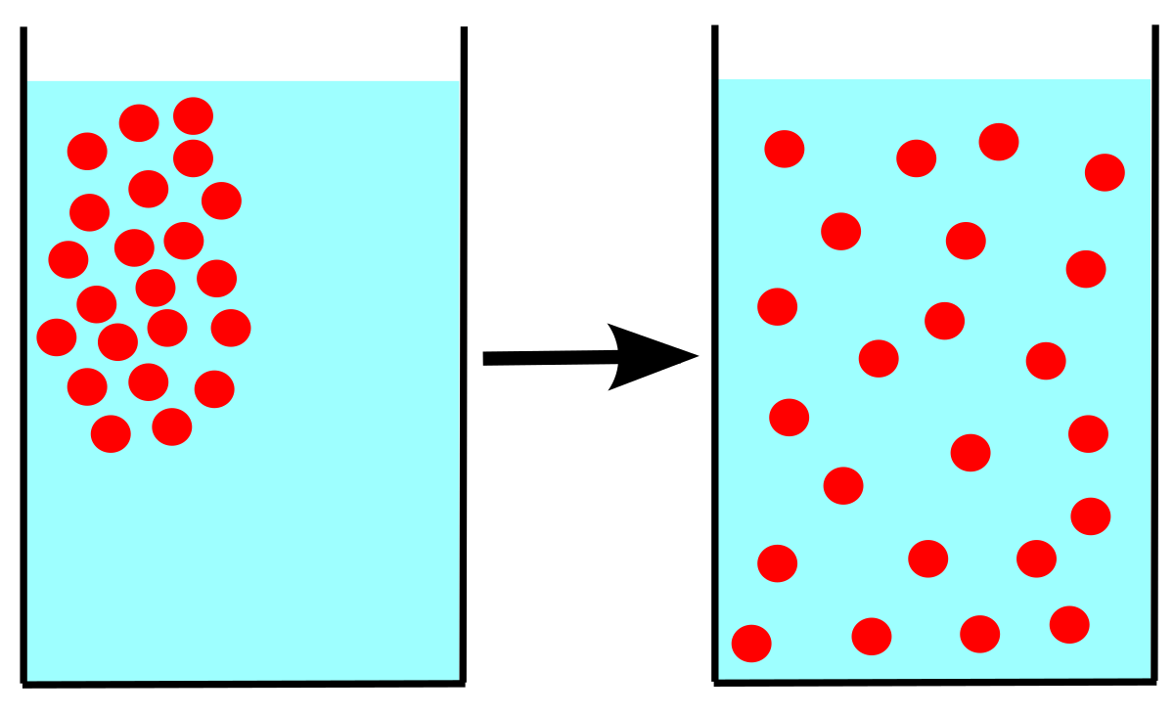
What is Diffusion?

Slide 3
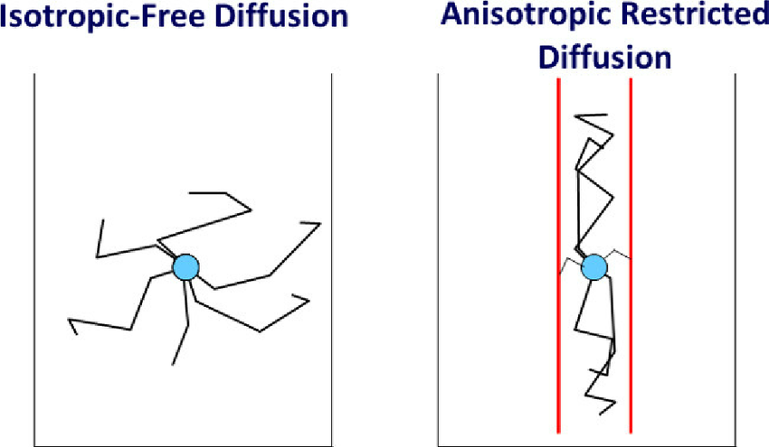
Types of Diffusion

Slide 4

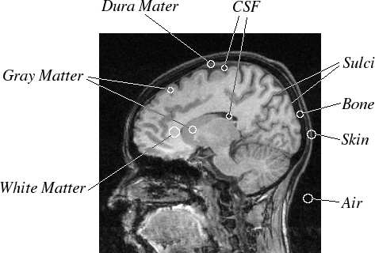

Types of Tissues

Slide 5
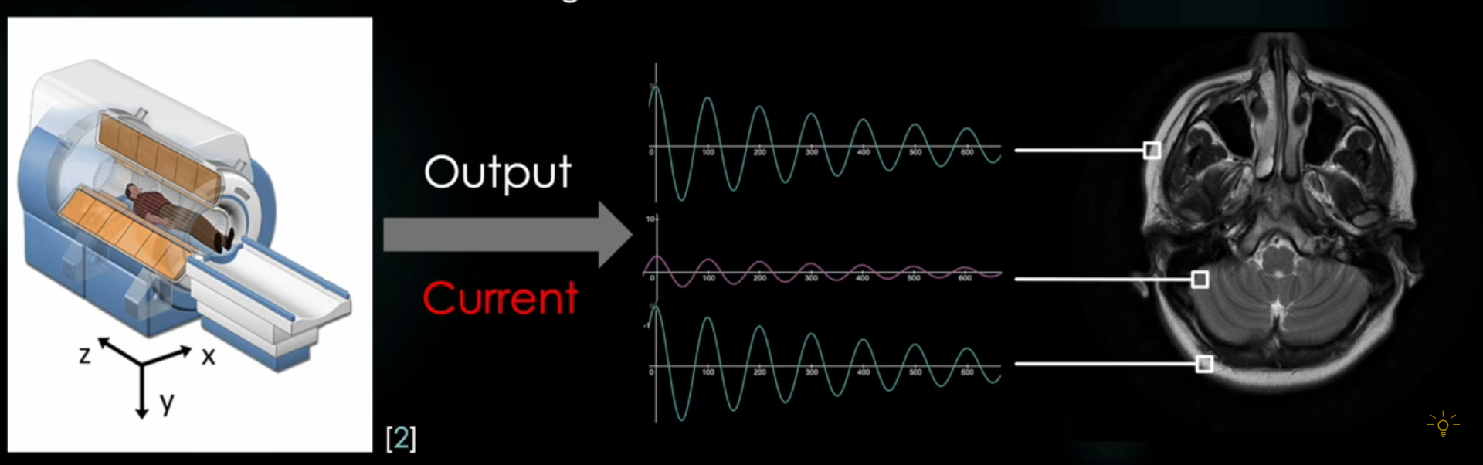

Slide 6
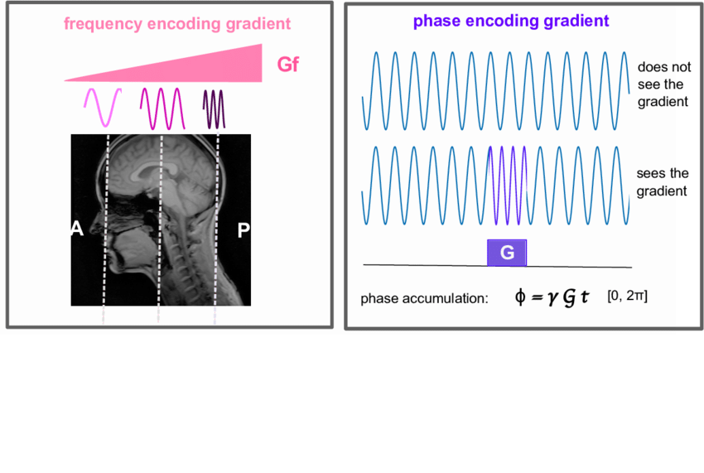

Slide 7
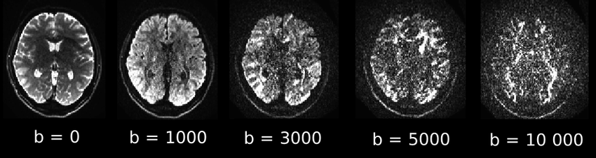
B - values

Slide 8
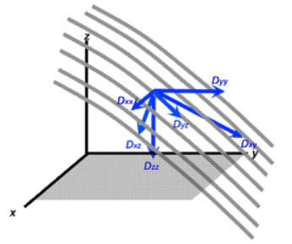
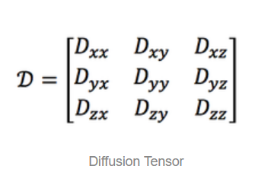
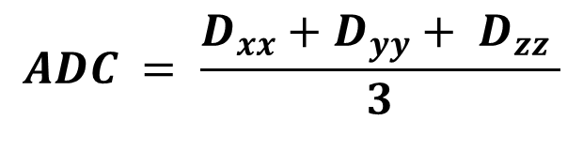
Diffusion Tensor
Apparent Diffusion Coefficient
$$ADC = \frac{D_{xx}+D_{yy}+ D_{zz} }{3}$$
How does an isotropic diffusion tensor look like?

Slide 9
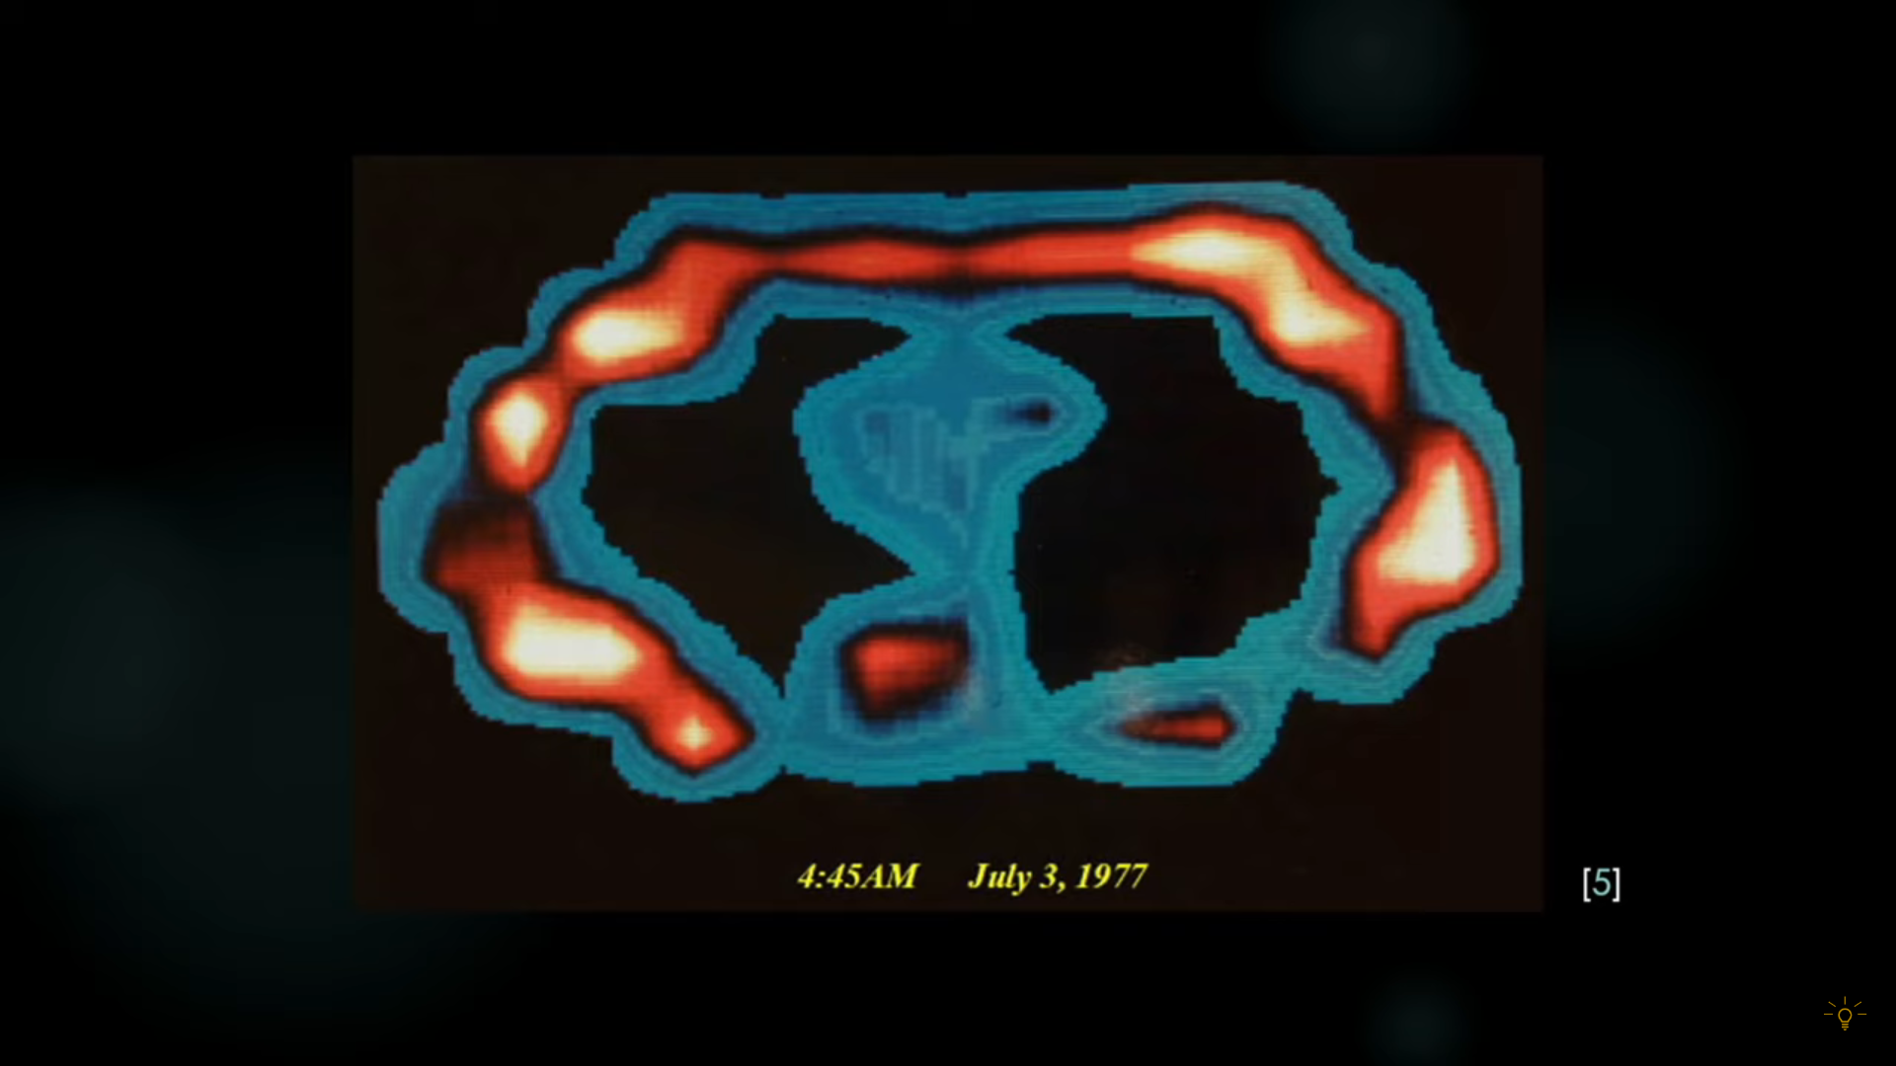
CAN YOU GUESS?

Slide 10
Pre-processing steps
Warping effects
Susceptibility distortion
Eddy currents distortion
Movement Distortion
Gibbs effects
DeNoise
Bias Correction (Intensity Normalization)
Registration

Slide 11
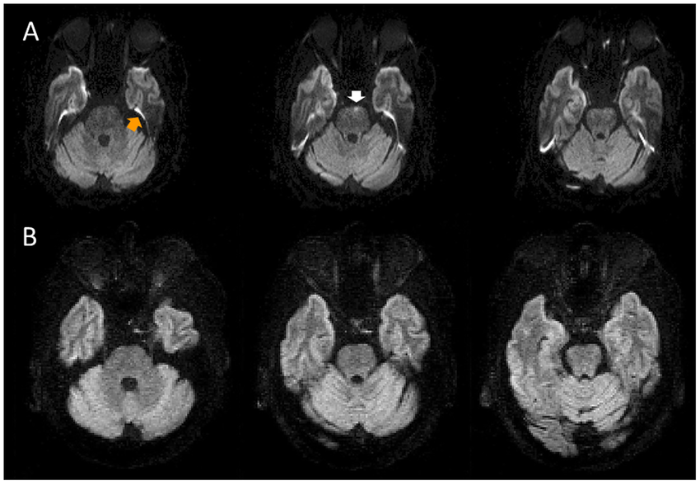
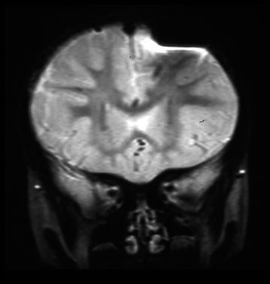
Susceptibility artifacts

Slide 12
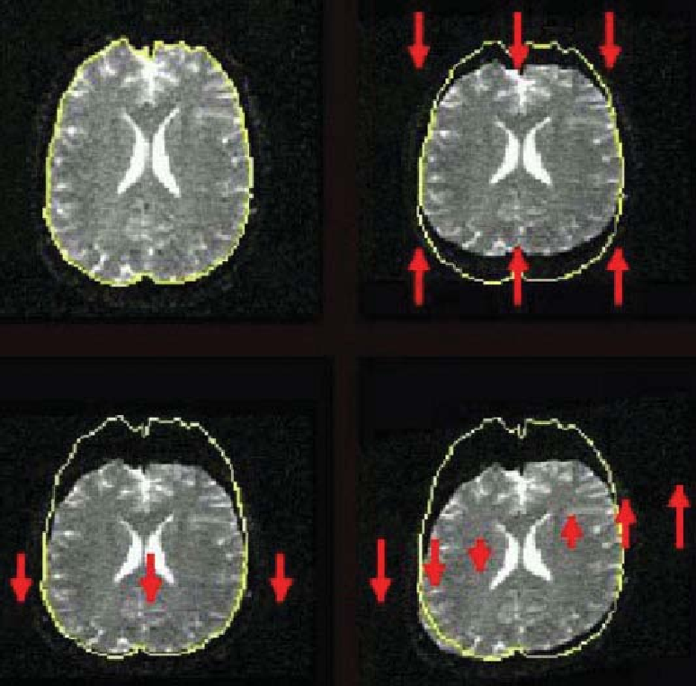
Eddy currents Distortion

Slide 13
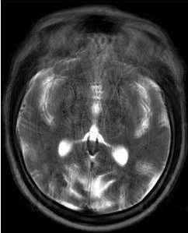
Motion artifacts

Slide 14
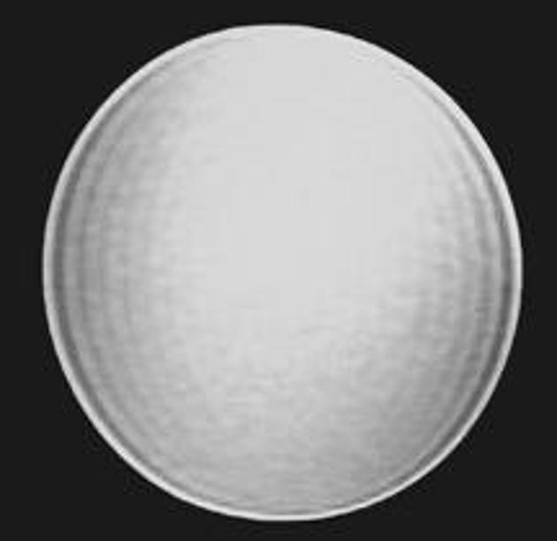
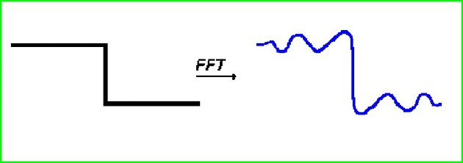
Gibbs ringing effects

Slide 15
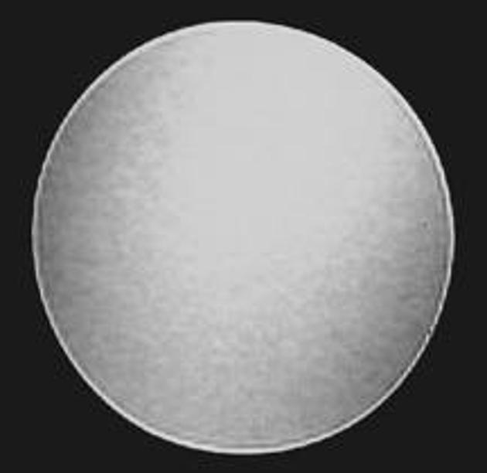

Slide 16
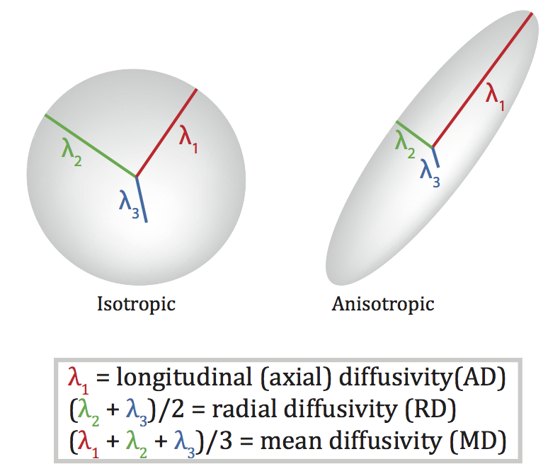
Measures of Diffusion

Slide 17
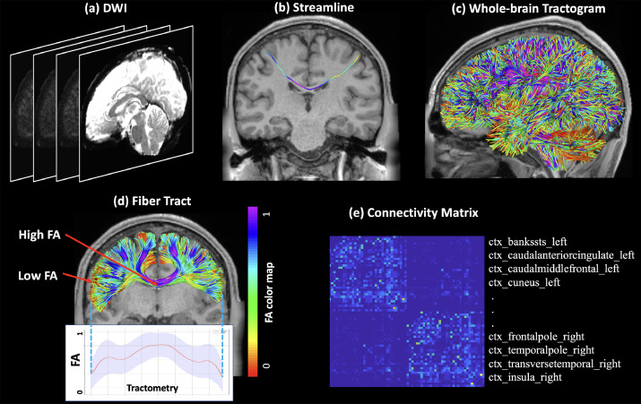

Slide 18
