Slide 1

Angle calculations for a `4S+2D' six-circle diffractometer
H. You
Volume 32 | Part 4 | August 1999 | Pages 614–623 | 10.1107/S0021889899001223
Notes:
Angle calculations are derived for the operation of a `4S+2D' six-circle X-ray or neutron diffractometer. Four sample-orienting and two detector-orienting degrees of freedom are used to control the scattering vector and a reference vector in the laboratory frame of reference.

Slide 2
Angle calculations for a `4S+2D' six-circle diffractometer
Angle calculations are derived for the operation of a `4S+2D' six-circle X-ray or neutron diffractometer. Four sample-orienting and two detector-orienting degrees of freedom are used to control the scattering vector and a reference vector in the laboratory frame of reference.
You
Volume 32 | Part 4 | August 1999 | Pages 614–623 | 10.1107/S0021889899001223
Notes:
Angle calculations are derived for the operation of a `4S+2D' six-circle X-ray or neutron diffractometer. The six degrees of freedom [four sample-orienting (`4S') and two detector-orienting (`2D')] of the diffractometer are used to control the scattering vector and a reference vector in the laboratory frame of reference. Several modes of operation unavailable in other types of diffractometer are presented.

Slide 3
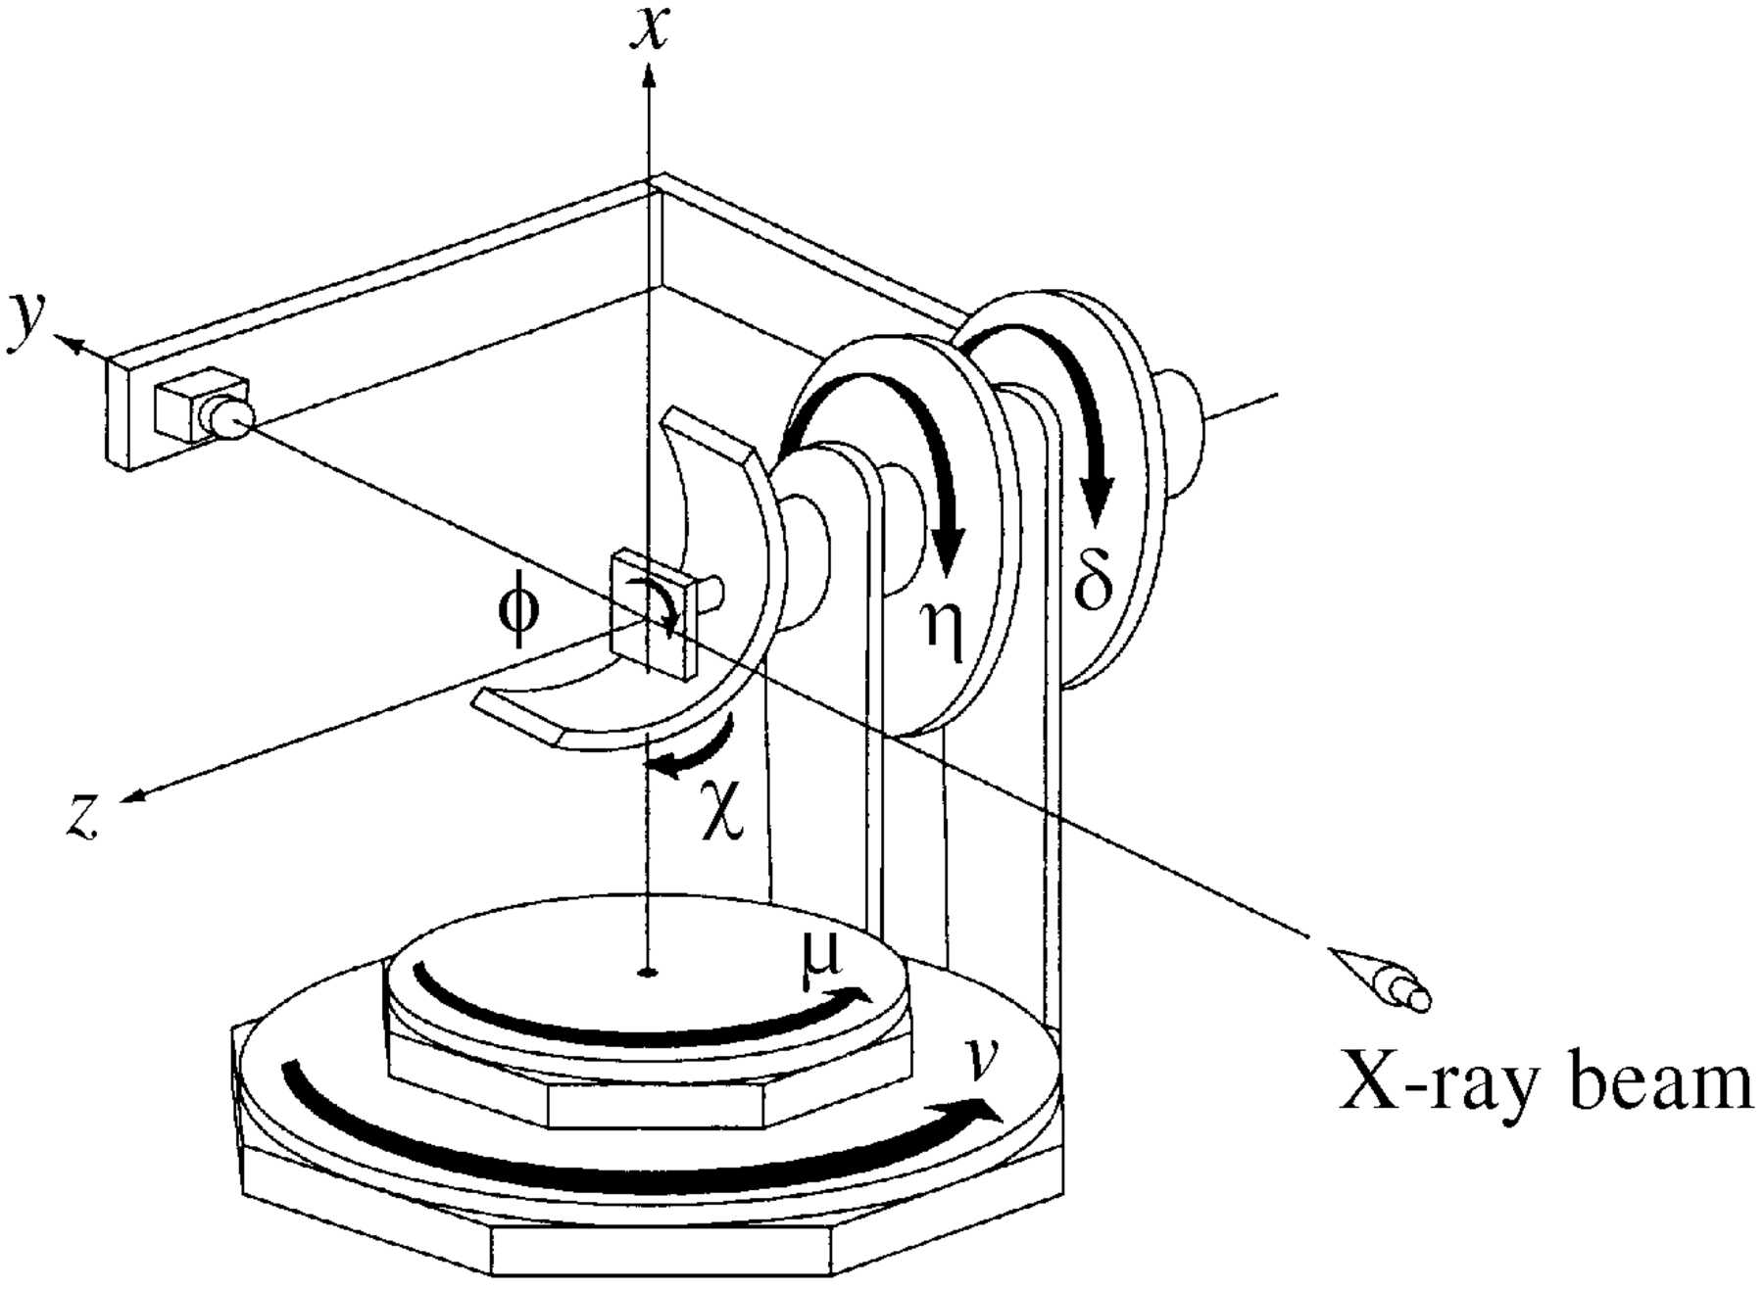
Figure 1. A schematic drawing of the `4S+2D' diffractometer. The sense of rotations, laboratory frame, and the incoming X-ray directions are shown as arrows.
You
Volume 32 | Part 4 | August 1999 | Pages 614–623 | 10.1107/S0021889899001223
Notes:
A schematic drawing of the `4S+2D' diffractometer. The sense of rotations, laboratory frame, and the incoming X-ray directions are shown as arrows. [You, H. (1999). J. Appl. Cryst. 32, 614-623. 10.1107/S0021889899001223]

Slide 4
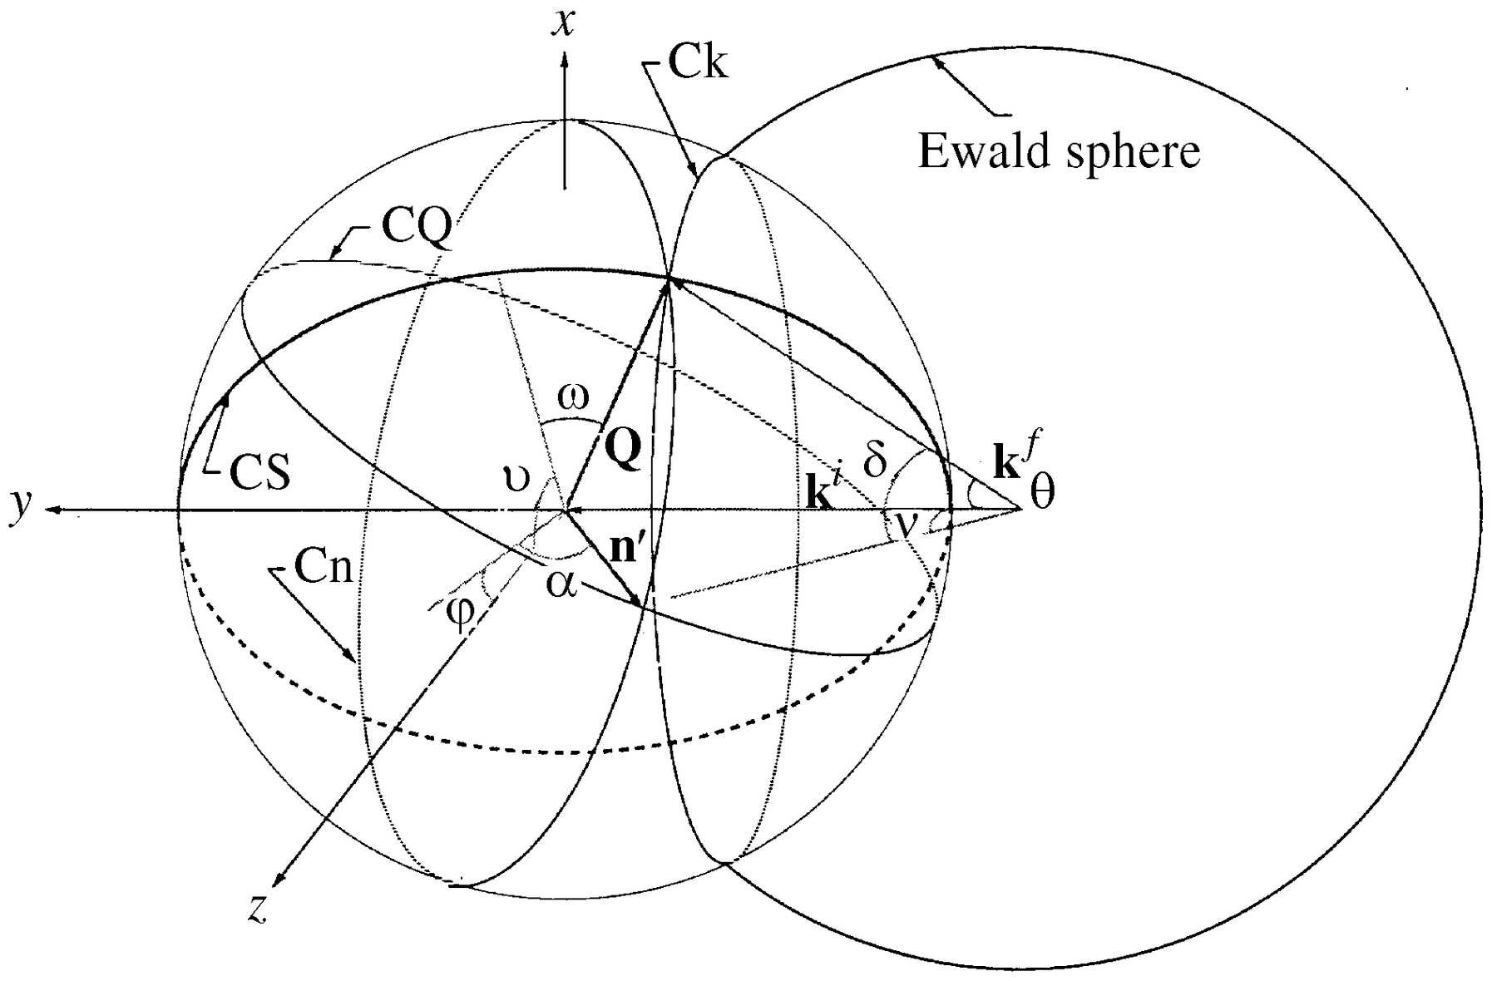
Figure 2. Definitions of pseudo-angles shown with the scattering vector and Ewald sphere.
You
Volume 32 | Part 4 | August 1999 | Pages 614–623 | 10.1107/S0021889899001223
Notes:
Definitions of pseudo-angles shown with the scattering vector and Ewald sphere. [You, H. (1999). J. Appl. Cryst. 32, 614-623. 10.1107/S0021889899001223]

