Slide 1
Coffee & Code:
Creating digital exhibits with Omeka
Chelcie Rowell & Stephen Sturgeon • 28 April 2018
GitHub.com/BCDigSchol/coffee-code

Slide 2
Today’s session
Overview of Omeka
Metadata! Or, describing items for digital collections
Exercise 1. Describe an item
Exercise 2. Create an item record in Omeka

Slide 3
Overview of Omeka

Slide 4
What kinds of resources can you create in Omeka?
Items: individual descriptive metadata records, or building blocks
Collections: groups of items
Exhibits: curated items with deep contextualization, essays, or teaching materials
Pages: additional web pages, e.g. ‘About’ or ‘Credits’
For examples of each, see Stark & Subtle Divisions: A Collaborative History of Segregation in Boston.

Slide 5
Questions to ask yourself while planning
What are the primary goals of the website?
Who is the primary audience of this website?
What sections will this website include?
What will I do with items in this website?
See the Omeka Classic User Manual for these and other questions to ask yourself while conceptualizing your digital exhibit.

Slide 6
Metadata! Or, describing items for digital collections

Slide 7
Metadata and its nature
Analytical Bibliography — A listing of works that indicates in precise details the name of the author, the exact title of the work, and publication details, and that emphasizes the material nature of the work, including the format, the pagination, typographical particulars, illustrations, and other characteristics, such as the kind of paper and binding.
Society of American Archivists glossary
Notes:
Not the content of items, but the material nature, its reliability, its social context, provenance. As humanities research and teaching moves away from the printed book and into the digital world, you need something that performs a similar function for digital objects. What are you looking at? Social or historical significance or non-significance? So you know what you’re using in two or three different levels.

Slide 8
Metadata and its uses
Short and sweet (mostly — what about ‘Description’?)
Uniform (mostly — what about author name ambiguities? ‘Condition’?)
Linkable (mostly — not all metadata is usefully linked)
Useful (mostly — different metadata fields have different audiences)

Slide 9
What are you describing?
Boston landmark?
Photo of the Boston landmark?
Digital file of the photo of the Boston landmark?

Slide 10
To describe an item, ask yourself?
What is is the item of ?
What is the item about ?

Slide 11
2 kinds of descriptive metadata
Fields — the buckets into which you place your description, e.g. ‘Title’ or ‘Subject’
Which are required? Which recommended?
Values — the items you place in the bucket
Will you use title case or sentence case in titles? Supplied information in brackets?
Are you going to draw your subjects from a limited list of terms so that you don’t use two different words to describe the same thing?
The upshot? Be consistent across records!

Slide 12
Today we’ll focus on item description
Which of the Dublin Core Metadata Initiative’s Element Set apply to your item? Remember that you don’t have to use all of them.
Some elements require decisions about the extent of explanation and context your metadata will provide, as in the ‘Description’ and ‘Relation’ fields.
Other elements, such as ‘Date’, call for straightforward, factual information—but there are exceptions here!

Slide 13
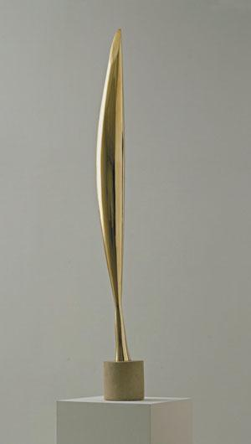
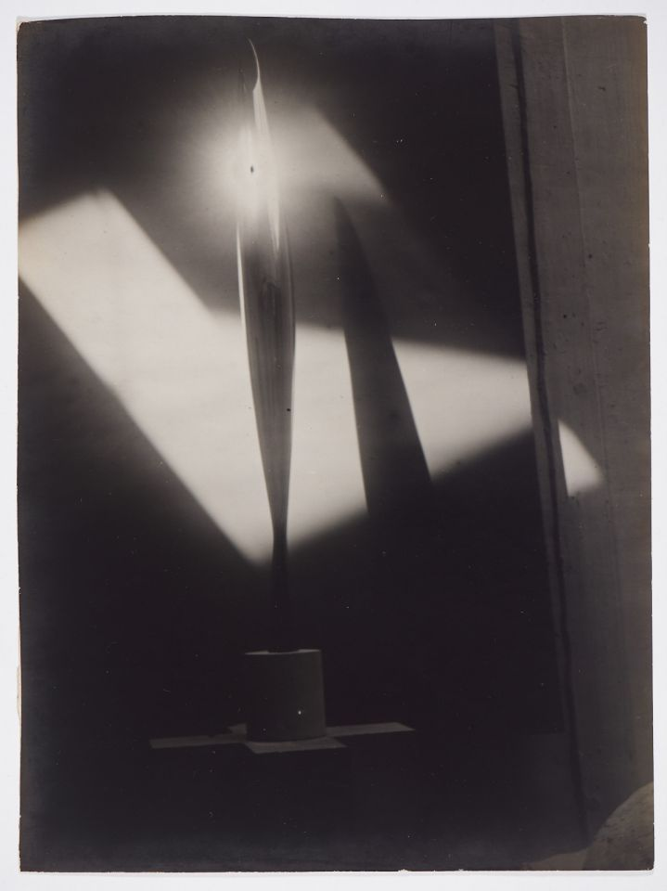
Birds in Space, briefly
What separate demands do Constantin Brâncuși’s sculpture Bird in Space and a photograph of that sculpture make of metadata?
images from the Museum of Modern Art and Kettle’s Yard, University of Cambridge

Slide 14
Exercise 1.
Describe an item

Slide 15
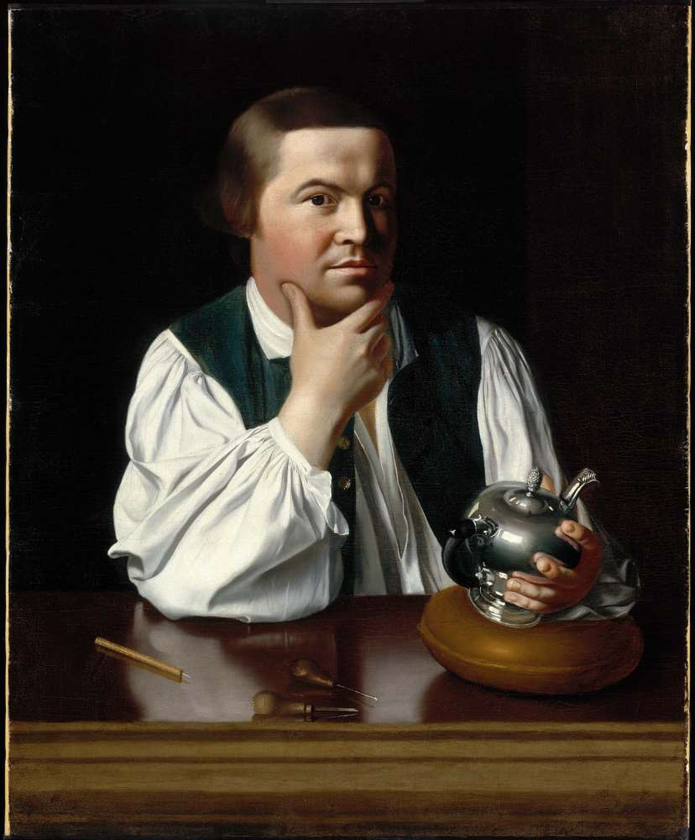
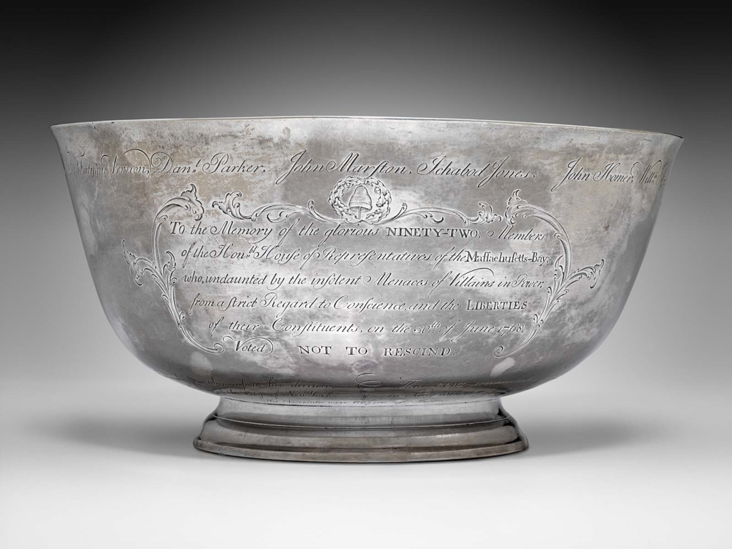
Exercise 1: Describe an item
Drawing upon the descriptive text provided, describe one or both items below adhering to the structure of the Dublin Core metadata elements. Create your description(s) using the provided worksheet.
Portrait of Paul Revere John Singleton Copley
Sons of Liberty punch bowl Paul Revere

Slide 16
Exercise 2.
Create an item record in Omeka

Slide 17
From items to collections: in theory
The most useful organizing properties for information resources are those based on their content and meaning, and these are not directly apparent when you look at a book or document . . .
The most effective organizing systems for information resources often are based on properties that emerge from analyzing the collection as a whole.
The Discipline of Organizing, ed. Robert J. Glushko, p. 15
Notes:
The point of this slide is about creating connections, relationships between items.

Slide 18
From items to collections: in practice
What connections among items do you want to create?
How would you create these connections through metadata?

Slide 19
Demo
Creating an item record in Omeka.net
Notes:
Demonstrate how to create

Slide 20
Exercise 2: Create an item record in Omeka
Create an item record based on the first exercise, but making any revisions after our discussion.
You may also draw upon the metadata records for these items created by the Museum of Fine Arts:
Paul Revere by John Singleton Copley
Sons of Liberty punch bowl by Paul Revere

