Slide 1
Gentle Intro to Text Mining
Anna Kijas
Digital Scholarship Librarian | Boston College
June 24, 2016

Slide 2
Text Mining
Parsing and structuring data or text using computational and natural language processing methods
Tasks may include:
Analysis
Categorization
Clustering
Concept/Entity recognition
Modeling
Pre-processing
Sentiment Analysis
Speech tagging
Visualization

Slide 3
Finding data or texts
Hathi Trust Research Portal: https://analytics.hathitrust.org/
Internet Archive: https://www.archive.org
JSTOR Data for Research: http://about.jstor.org/service/data-for-research
Project Gutenberg: https://www.gutenberg.org/
Text Creation Partnership (TCP): http://www.textcreationpartnership.org/tcp-texts/
Sources or materials from special collections (OCR’d, transcribed/encoded), databases, data repositories, websites, or TEI projects may be used.
Notes:
https://www.gutenberg.org/ebooks/search/?query=jane+austen

Slide 4
Pre-Processing
Once you’ve selected a text or corpus, you will need to pre-process your text(s)
What is pre-processing? (see Selected Tools & Resources slide)
Remove stop words using a default stop word list or create modified list. Scrub the text (i.e. remove punctuation, numerals, etc.)
Tag parts of speech (i.e. identify words that are not nouns)
Text chunking or segmentation (i.e. by section or milestone)
After pre-processing, do some file and text checking
Check file names, make sure you use leading zeroes (i.e. 01, 02, 03) so that files can be run in sequence
Check texts to make sure you don’t have un-necessary text, such as license or copyright information (for example, this is appended to texts in Project Gutenberg)
If any texts look problematic you may need to do some cleanup or find a better OCR’d copy
Notes:
When you’ve pre-processed and checked your text(s), upload the file(s) into the sample-data directory in MALLET and start training your topic models!

Slide 5
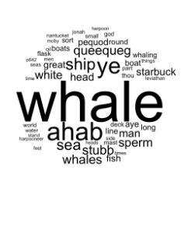
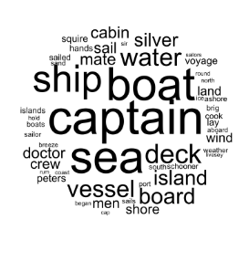
Un-processed vs. Processed Example from Moby Dick
Un-processed
Processed
Jockers, Matthew L. ““Secret” Recipe for Topic Modeling Themes.” April 12, 2013. http://www.matthewjockers.net/2013/04/12/secret-recipe-for-topic-modeling-themes/.
Notes:
For example – Matthew Jockers (DH and literature professor at Unebraska) ran a topic model on Moby Dick. Here are word clouds with topics, but the difference is that he used un-processed text for the word cloud on the left and a processed text on the right.
What is the difference? Why would you want to use processed text and what does that mean?
Bags of words – topic models don’t care what the word order is, topic models look for themes.

Slide 6
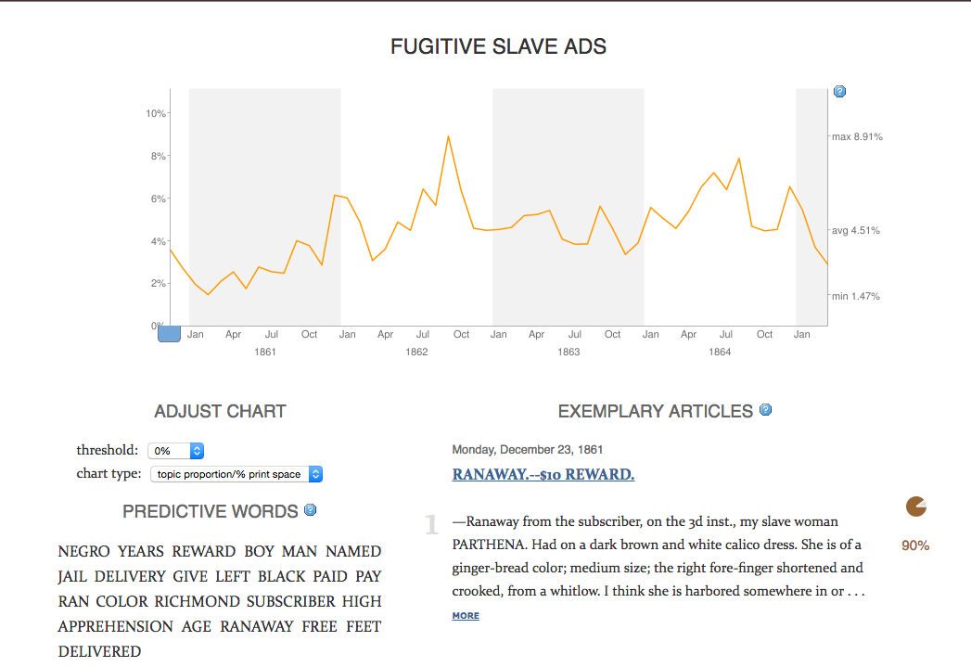
Text Mining Projects
Mining the Dispatch http://dsl.richmond.edu/dispatch/pages/home
Explores Social and political life in Richmond, VA during the Civil War
by running topic models on the Richmond Daily Dispatch from
November 1860 – April 1865
Notes:
Diachronic model – temporal approach (change over time)
Synchronic – topics during one instance (snapshot)

Slide 7
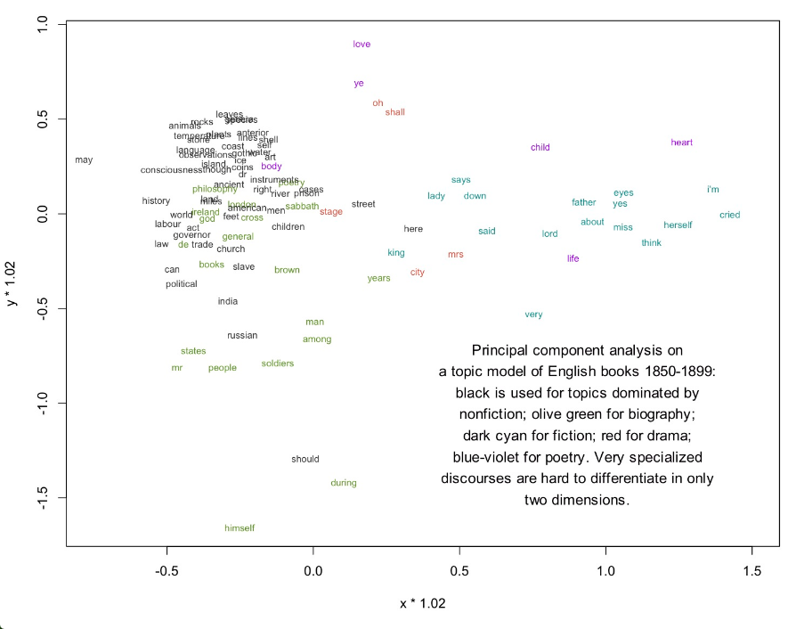
Text Mining Projects
Visualization of topic model of English books 1850-1899
10k words in 872 volume-length documents
Underwood, Ted. Visualizing Topic Models. November 11, 2012. https://tedunderwood.com/2012/11/11/visualizing-topic-models/.
Notes:
Principal Component Analysis
Compresses topic model into two dimensions (statistical procedure)
Convert observations into a set of values
https://en.wikipedia.org/wiki/Principal_component_analysis

Slide 8
Hands-on Work
Anne Brönte’s novel, Agnes Grey (1847)
25 chapters, approximately 219 pages, 68,340 words
Public domain text from Project Gutenberg: http://www.gutenberg.org/files/767/767-0.txt

Slide 9
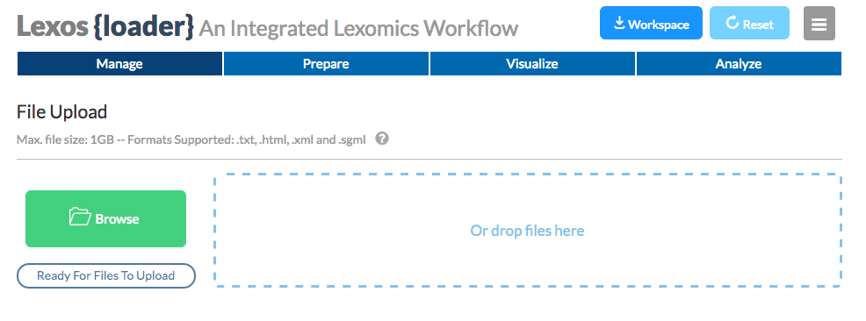
Lexos
http://lexos.wheatoncollege.edu/upload
Pre-processing: 68,340 words in 1 text file
Post-processing: 23,500 words in 25 text files

Slide 10
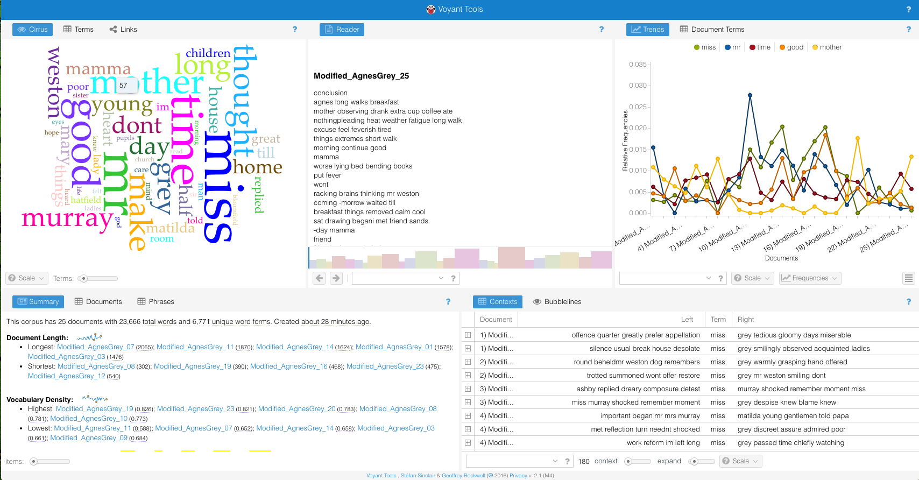
Voyant
http://voyant-tools.org/

Slide 11
Selected Tools & Resources
Extracting & Scraping (E&S):
Beautiful Soup: https://www.crummy.com/software/BeautifulSoup/
Import.io: https://import.io/
RegEx: https://www.datascraping.co/doc/22/regular-expression
R: https://www.r-project.org/ (also C&P, A&V)
Tabula: http://tabula.technology/
Web Scraper: http://webscraper.io/documentation
Cleaning & Processing (C&P):
Lexos: http://lexos.wheatoncollege.edu (also A&V)
OpenRefine: http://openrefine.org/
Stanford Parser: http://nlp.stanford.edu/software/lex-parser.shtml
Stanford Part-of-Speech Tagger: http://nlp.stanford.edu/software/tagger.shtml
Analysis & Visualization (A&V):
AntConc: http://www.laurenceanthony.net/software/antconc/
Mallet: http://mallet.cs.umass.edu/
TAPoR: http://www.tapor.ca/ (directory of)
Voyant: http://voyant-tools.org/ (corpus analysis and visualization suite)
Word Cloud Generator: https://www.jasondavies.com/wordcloud/

Slide 12
Selected Tools & Resources
Additional tools:
DH Toychest: http://dhresourcesforprojectbuilding.pbworks.com/
DiRT Directory: http://dirtdirectory.org/
TAPoR: http://www.tapor.ca/
Tutorials:
Codecademy: https://www.codecademy.com/
DataCamp: https://www.datacamp.com/
Programming Historian: http://programminghistorian.org/lessons/

Slide 13
Further Reading
Brett, Megan R. “Topic Modeling: A Basic Introduction,” Journal of Digital Humanities 2, No. 1, Winter 2012. http://journalofdigitalhumanities.org/2-1/topic-modeling-a-basic-introduction-by-megan-r-brett/.
Graham, Shawn, Ian Milligan, Scott Weingart. Exploring Big Historical Data. The Historian’s Macroscope. Imperial College Press, 2016.
Jockers, Matthew. Text Analysis with R for students of literature. New York: Springer-Verlag, 2014.
Shaw, Ryan. “Text-mining as a Research Tool in the Humanities and Social Sciences.” https://aeshin.org/textmining/.
Underwood, Ted. “Where to Start with Text Mining,” The Stone and the Shell. June 8, 2015. https://tedunderwood.com/2012/08/14/where-to-start-with-text-mining/.
Weingart, Scott B. “Topic Modeling for Humanists: A Guided Tour.” July 25, 2012. http://scottbot.net/topic-modeling-for-humanists-a-guided-tour/.

