Slide 1
RC+S Artifact Detection Pipeline
A walkthrough for the lab
Provenza Lab — Rice Neuroengineering Initiative

Slide 2
MOTIVATION
Why this exists
The problem
RC+S recordings contain movement artifact and other broadband contamination mixed in with genuine neural signal. Distinguishing the two by eye, session by session, doesn't scale.
The clinical case
A grad student in the lab is trying to determine whether unusual LFP activity in a BPD patient reflects real reward sensitivity around mealtimes -- or is simply movement artifact from chewing.
The constraint
No ground-truth labels exist yet (no concurrent video, no provocation protocol). The pipeline has to work as a triage and review aid, not a validated classifier.
2

Slide 3
SIX STAGES
Pipeline overview
1
2
3
4
5
6
Load LFP + accel by real timestamp
1.0s window (0.5s hop): broadband power per channel
Score each channel: LOCAL 5.0s window + GLOBAL whole-session MAD
Merge flagged sub-windows; overlay channels in time
Tier by confidence: single-channel / high / priority-agreement
Find every distinct crossing event; render a diagnostic figure
→
→
→
→
→
3

Slide 4
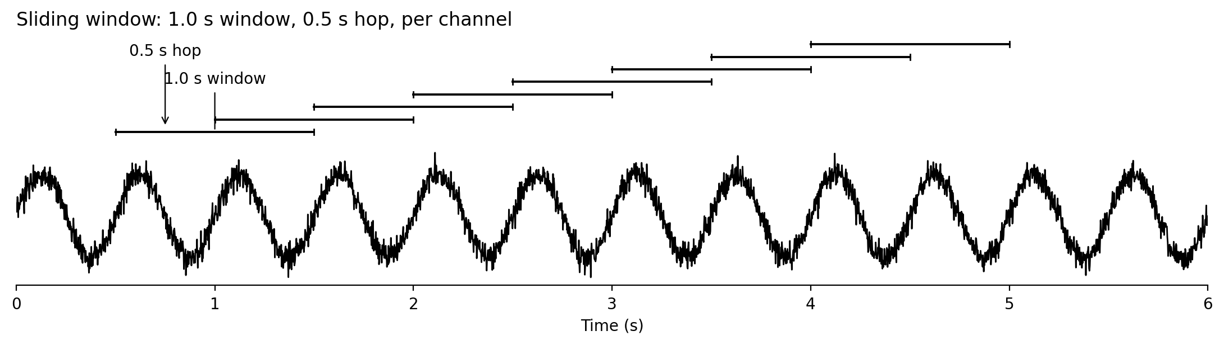
HOW THE SIGNAL IS SCANNED
Step 2: sliding window
Every channel is scanned independently. A window is 1.0 second wide, and the window slides forward by 0.5 seconds each step -- so consecutive windows overlap by half their width.
4

Slide 5
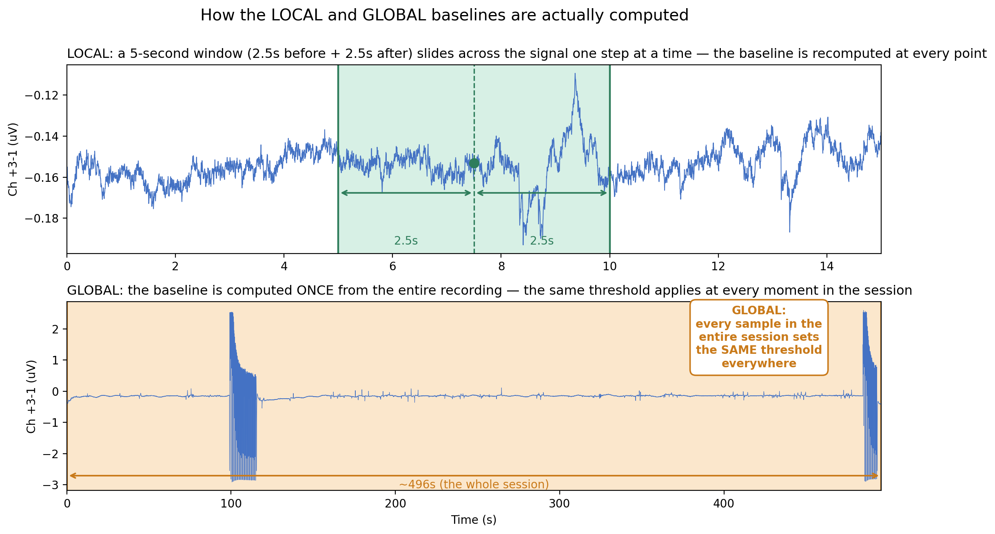
REAL DATA, ADBS012, CHANNEL +3-1
Step 3: local vs. global scoring
LOCAL recomputes the baseline from a small window at every step, so the threshold adapts to whatever's happening nearby -- but a window that lands entirely inside a long event goes blind to it. GLOBAL computes one baseline from the whole session, so it stays sensitive to sustained events -- but only as long as they're a minority of the recording. A channel is flagged if EITHER crosses threshold (z > 6.5).
5

Slide 6
THREE CONFIDENCE TIERS
Steps 4-5: cross-channel agreement
priority-agreement
2 windows in aDBS012
Channels 3 & 4 both flagged, each cleared BOTH local and global thresholds independently.
high
6 windows in aDBS012
Two or more channels agree, but not both priority channels this strongly.
single-channel
39 windows in aDBS012
Only one channel caught it -- the weakest tier of evidence.
6

Slide 7
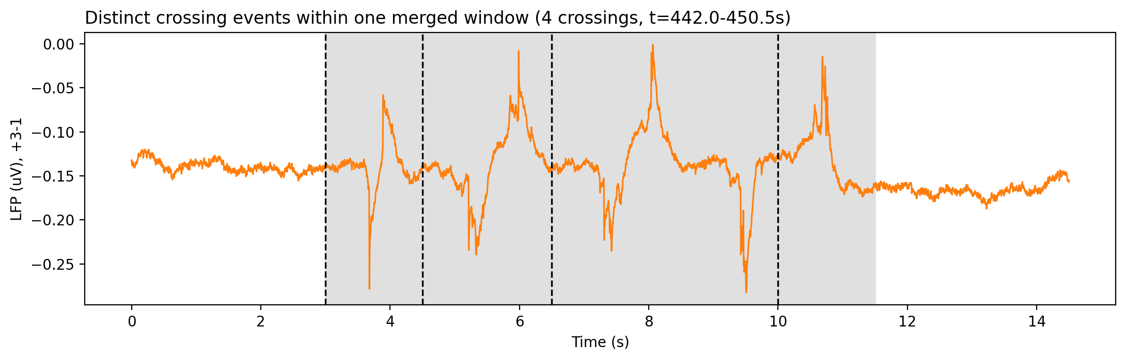
REAL DATA, ADBS012
Step 6: distinct crossing events
A merged window can contain several distinct crossings, not one continuous event. A crossing only counts as NEW if the signal drops back under threshold first and rises again -- so this 8.5s window is reported as 4 separate crossings, not one.
7

Slide 8
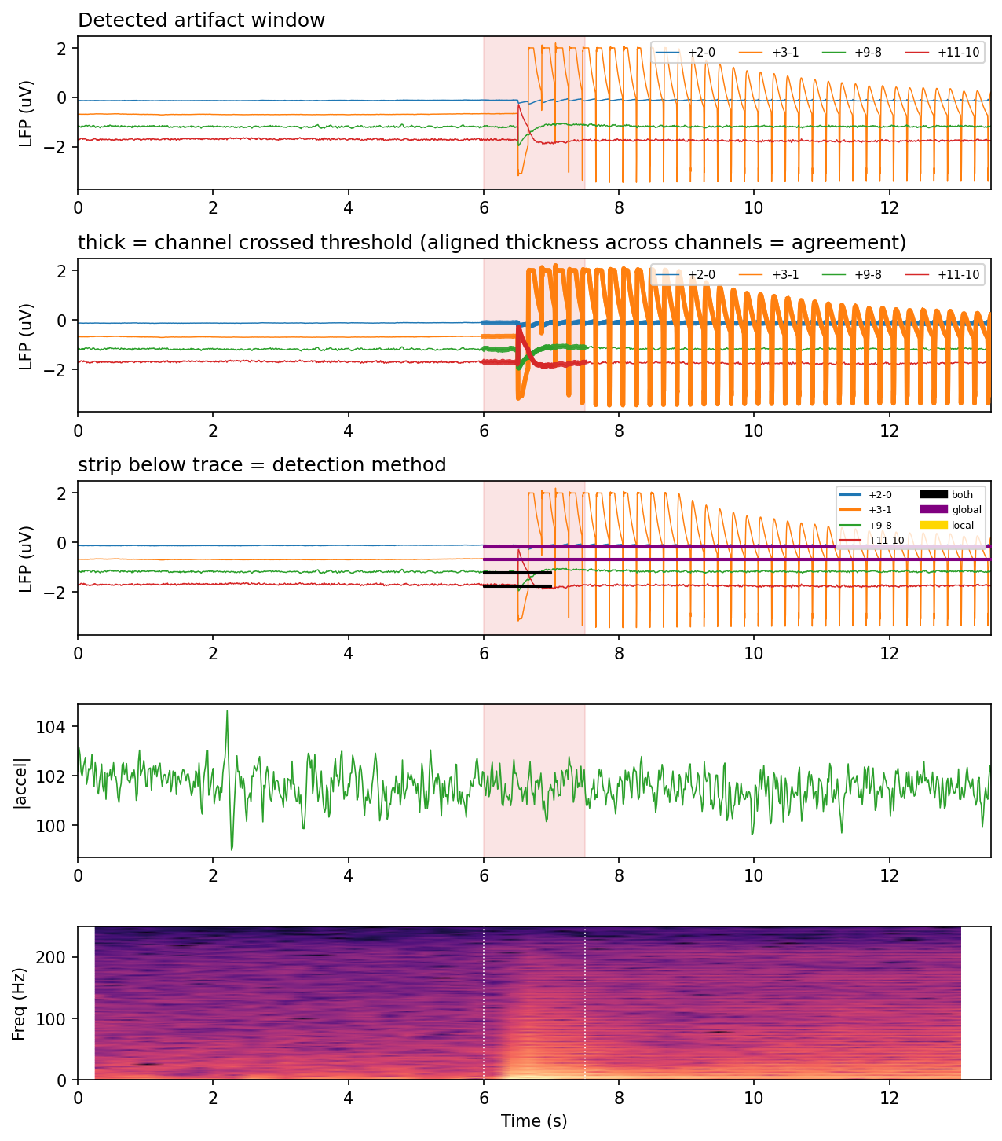
REAL FIGURE, ADBS012, PRIORITY-AGREEMENT WINDOW
Full diagnostic output
This is the actual figure the pipeline writes for every flagged window -- nothing here is illustrative.
Panel 1: raw signal, all 4 channels.
Panel 2: same trace, thick = that channel crossed threshold here.
Panel 3: accelerometer, for visual context only -- not used in the detection decision.
Panel 4: spectrogram of the primary channel.
8

Slide 9
BE UPFRONT ABOUT THIS BEFORE ANYONE RELIES ON IT
What this pipeline does not do
—
Not validated against ground truth. Thresholds (z > 6.5, 5s rolling window) were chosen to produce a reasonable number of flags on this one session -- not calibrated against labeled events.
—
Not source-attributed. A flag means "statistically unusual," not "this is movement" or "this is chewing." The interpretation is left to the reviewer.
—
Not stim-aware. If stimulation is active, stim power is indistinguishable from any other broadband contamination in the current output.
—
Demonstrated on one session so far (aDBS012). Behavior across other patients and recording conditions has not yet been characterized.
9

Slide 10
FOR ANYONE IN THE LAB PICKING THIS UP
How to run it
python artifact_finder.py <lfp.csv> --settings <Settings.json> --accel <accel.csv> --out <out_dir>
Required
LFP CSV: a timestamp column (unix ms) + any number of channel columns. No fixed naming needed.
Optional
Settings JSON for true sample rate + channel labels. Falls back to auto-detection if omitted.
Optional
Accel CSV: exactly timestamp, accel_x, accel_y, accel_z. Column names are NOT flexible here.
Output: one CSV (artifact_times.csv) + one diagnostic PNG per flagged window, plus two filtered subfolders (highest_confidence_artifacts/, high_confidence_artifacts/) for fast triage on long sessions.
10

Slide 11
Questions for discussion
1.
Is z > 6.5 the right threshold, or should it be tuned per-patient?
2.
Should channels 3 & 4 stay the priority pair for every patient, or is that session-specific?
3.
What's the plan for ground truth -- video review, a provocation protocol, or something else?
4.
Is broadband-only detection sufficient, or does stim need its own dedicated check before this is handed to other grad students?
11

