Slide 1
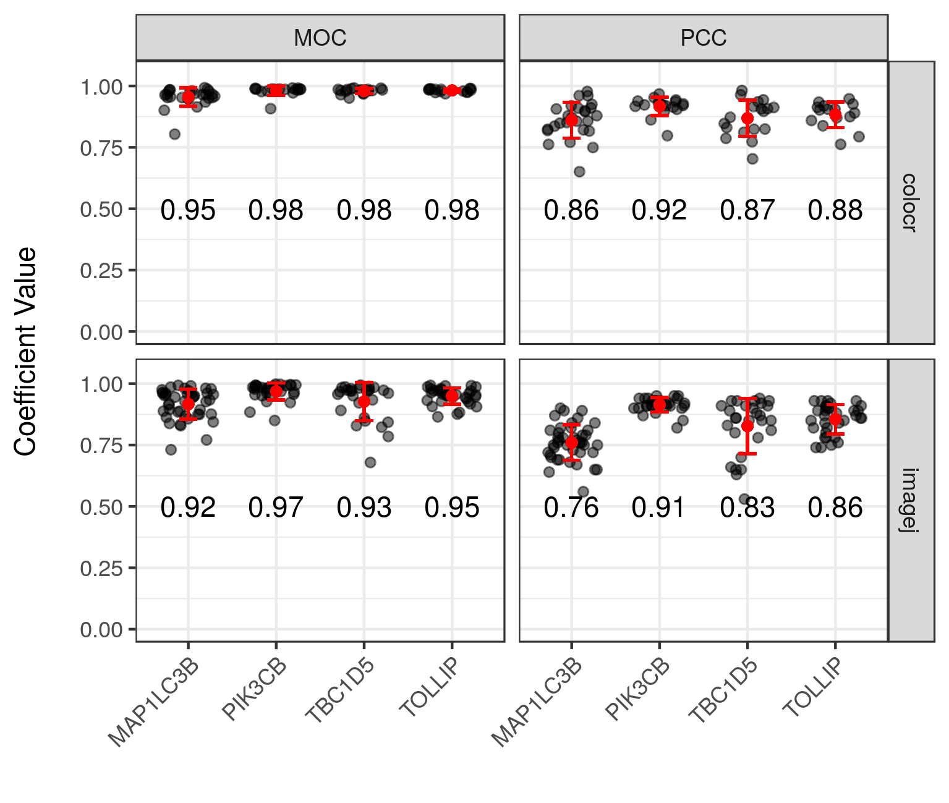
A
RKIP
Hoechst
Merge
MAPLC3B
PIK3CB
TBC1D5
TOLLIP
B

