Slide 1


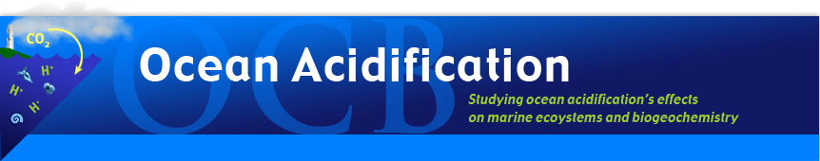
Introduction to Data Management for Ocean Science Research
Cyndy Chandler
Biological and Chemical Oceanography Data Management Office
12 November 2009
Ocean Acidification Short Course
Woods Hole, MA USA

Slide 2
Discussion Topics
Part 1 of 2: Introduction
Why data management matters
New funding agency requirements
New research paradigms
New expectations for data access
Part 2: data management specifics

Slide 3

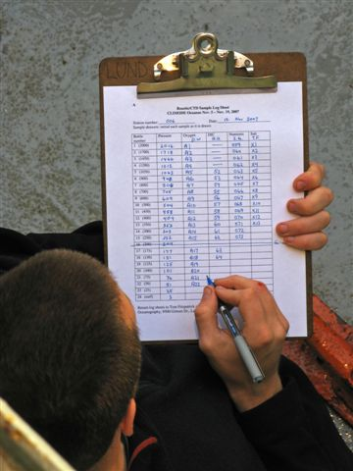
Why data management matters
good data management practices have always been integral to the scientific method
1949 – recording BT
2007 - CTD
Notes:
it has always been important to accurately record data and information as part of the research process

Slide 4
Why data management matters
It’s important to science
careful and deliberate record keeping
results reported and made publicly available
enabling reproducibility of results
from the pre-course survey
57% of students reported having ‘minimal experience’ with “Metadata production and data archiving”

Slide 5
Some definitions … what do I mean by …
Data Management
end-to-end data management
proposal to preservation
having a plan from the beginning
to ensure that data and metadata
are recorded accurately,
are preserved securely (backups)
and will be made accessible to others
and ‘dataset’ ?
a logical grouping of related measurements
(often from the same sampling device or sensor)

Slide 6
Metadata
metadata ~ “about the data”
information required to interpret the data
Metadata records capture the information required to answer the who, what, where, why, how and when questions that are asked about a data set. It is important to know who collected, analyzed and contributed the data and where, when and how those data were acquired and subsequently analyzed and processed.

Slide 7
Changes and Challenges
data sets used to be smaller
and were often published on paper
(in a journal article or a data report, and they fit in Table 1)
data were published as a tangible thing
as data acquisition becomes automated, rate of acquisition and volume increases
but metadata acquisition (data documentation) is not being automated at the same rate
Notes:
Data were published on paper because they could be, and there were not many other choices, but even microfilm was a tangible thing
Infrastructure existed to document tangible things
Metadata recording/reporting still largely done manually
But this doesn’t mean it shouldn’t still be done

Slide 8
What else has changed?
shift from ‘local’ to ‘global’
  research themes
  collaborative teams of researchers are trending toward being more distributed ~~ thematically and geographically
technological advances are enabling these changes
cultural changes lag behind technological changes
  no direct relationship between career advancement
  and publication of data

Slide 9
Why data management matters
Cultural Changes – a work in progress:
goal: scientific data should be freely accessible to all
achievement of that goal relies on agreement that:
anyone using the data
must properly acknowledge the data originators
(proper citation of all source data used)
Notes:
the goal is to make scientific data freely available to everyone. but achievement of that goal relies on the understanding that anyone using the data is expected to properly acknowledge the data originators

Slide 10
Publication of Data
Cultural issues …
  little incentive for researchers to publish their data
  exacerbated by the perception that the data are the ‘property’ of the originating investigator, and might be ‘stolen’
Conventional wisdom is still that ‘publish or perish’ applies predominantly to journal publications, not data publication.
In the US, funding agency program managers are beginning to effect change in this area. NSF, NASA and NOAA all require publication of data generated by federally funded research.

Slide 11
New funding agency requirements
Division of Ocean Sciences Data and Sample Policy.
National Science Foundation. NSF 04-004
http://www.nsf.gov/pubs/2004/nsf04004/nsf04004.pdf
General Data Policy
Principal Investigators are required to submit all environmental data collected to the designated National Data Centers as soon as possible, but no later than two (2) years after the data are collected. Inventories (metadata) of all marine environmental data collected should be submitted to the designated National Data Centers within sixty (60) days after the observational period/cruise.

Slide 12
New funding agency requirements
Proposal Requirements
The NSF Grant Proposal Guide requires that proposal Project Descriptions outline plans for preservation, documentation, and sharing of data, samples, physical collections, curriculum materials and other related research and education products. Plans for the handling of data and other products will be considered in the review process.
Reporting Requirements
Annual reports, required for all projects, should address progress on data and research product sharing. The Division of Ocean Sciences requires that final reports document compliance or explain why it did not occur.

Slide 13



Publication of Data
my
data
community
data
call me and I might share freely available
Each approach has associated pros and cons, but as more data are
published and are made freely available, it will become more of an
accepted practice, and community expectations will change as well.

Slide 14


Paradigm Shift
Updating the ‘red phone paradigm’ . . .
developing new and better ways to locate and retrieve data.
familiar easy to learn
it works convenient
effective
yields better results
The grand challenge facing data managers today
is to design a data access system that can replace the telephone.

Slide 15
New research paradigms . . .
science themes are trending toward
  interdisciplinary
  basin-wide
studies involving coupling of complex models
  atmospheric and hydrologic
  end-to-end food web
. . . require access to data from many disciplines

Slide 16
New expectations for data access
complex research themes (ocean biogeochemistry, ocean acidification research) require access to data collected by other researchers
access to research designed to enable science-based decision support for legislative policies
  social science
  economics
  history
  broad range of disciplines

Slide 17
What does ‘access to data’ mean?
ability to locate data of interest
determine ‘fitness for purpose’
accurately use the data
“Scientists are confronted with significant data management problems due to the large volume and high complexity of scientific data. In particular, the latter makes data integration a significant technical challenge.” (A.K. Sinha, Geoinformatics, 2006)

Slide 18
New expectations for data access
New tools based on emerging technologies are being developed to address the challenge of
integration of distributed heterogeneous data
informatics
semantic mediation
registered ontologies
Notes:
once you find the data, determine fitness for purpose, download them … now what?
do you have sufficient metadata to accurately interpret the data

Slide 19
New expectations for data access
all of the new technologies assume that data resources will be accompanied by machine-readable metadata
while we wait for the new informatics tools, and semantic e-science resources to come online …
… ocean science data accompanied by human readable metadata are of great value

Slide 20
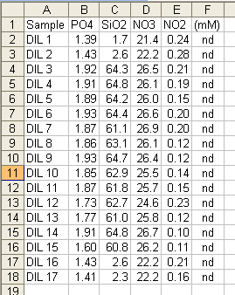
these data . . .
. . . are incomplete and of little use to colleagues
The dataset lacks sufficient metadata to enable efficient and accurate reuse.
Presumably the data originator would decode Sample ‘DIL 10’ because they know it to be a proxy for where, when and how the data were collected.
Notes:
if you were relying on this colleague to report the nutrient data from your collaborative project, you now need to contact them for the rest of the information (data, metadata)

Slide 21
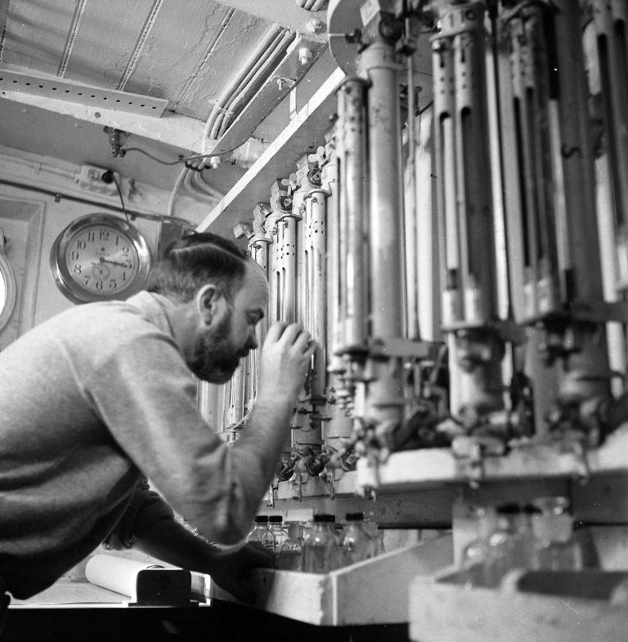
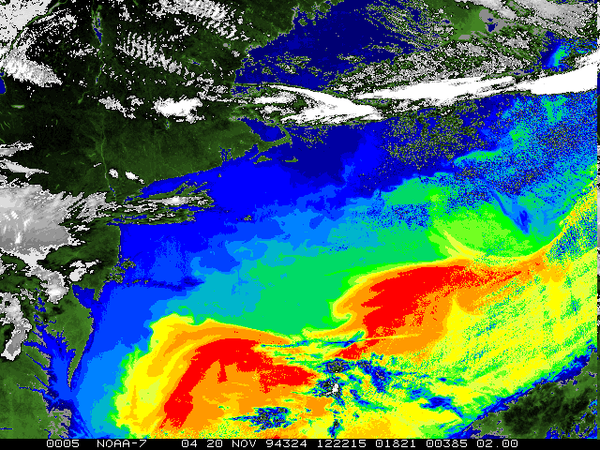
local
Challenges and Opportunities
. . . to global
old
new
Atlantis, 1958
Notes:
There are challenges and opportunities associated with the shift from ‘local’ to ‘global’; a shift in the understanding that local work has global relevance. Likewise, there are challenges and opportunities associated with the transition from the ‘old’ and familiar to the ‘new’ and improved.

Slide 22
end of part 1
“ You can’t play with the data without the metadata.
Well, you can, but it’s much less fun. “
(Peter Wiebe, WHOI, 2009)

