Slide 1
Data and Data Management:
Introduction to the BCO-DMO
Presented to
Professor Keiichi Uchida
November 16, 2009
Robert C. Groman

Slide 2
Conversation Overview
NSF now says: Your data or your funding
Data: – facts, statistics, or items of information; and metadata
Accessing data: Data discovery, display and retrieval
Data Interoperability

Slide 3
Points to make
Permanent archive of data
Benefits of early open access to data (with minimum/no restrictions)
Metadata are data and critical for data reuse

Slide 4
Venn Diagram:
Data and Metadata
All data and information (D)
necessary to use the data.
Data (d)
facts, statistics,
or
items of information
Metadata (m)
D ≠ m + d

Slide 5
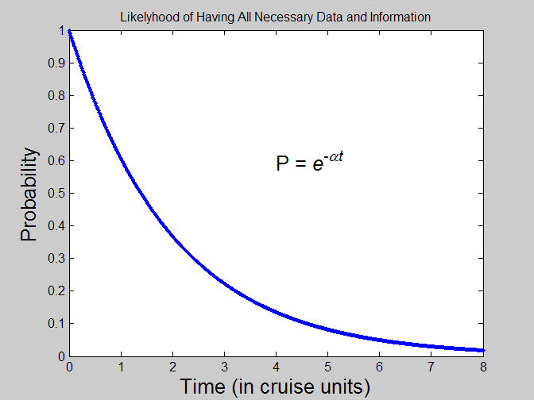
Probability Inversely Proportional to Time
Second order effects:
Length of cruise
Success of cruise
Participants
Immediate activity following the cruise

Slide 6
Theorems†
Theorem 1: The probability that all the necessary data and information are collected and preserved to allow another researcher to properly use your data is inversely proportional to time since the data were collected.
Corollary: Unless data and information are collected and preserved during the experiment (e.g. cruise), subsequent researchers will have a difficult time using your data.
Theorem 2: The longer the time since the data were collected the less likely the data will be considered “final”.
†Left to the reader as an exercise.

Slide 7
Seeing Versus Using Someone’s Data
Maybe you don’t want others to use your data.
  Not done publishing papers based on the data
  Graduate student is still analyzing the data
  It’s not final yet
Old policies and practices about data archiving
New policies about data publishing and data archiving
  Web accessible
  NSF mandate

Slide 8
Better, higher quality data
The more people look at
the data the higher their quality.

Slide 9
Ocean Observing → Sharing Data
Northeast Coastal and Ocean Data Partnership (née Gulf of Maine Ocean Data Partnership)
  “… to promote and coordinate the sharing, linking, electronic dissemination, and use of data in the Gulf of Maine region. “
  “… linking databases that are created and individually maintained by Participants ….”
  “… develops the web-based, visualization, and other information technologies needed for the seamless exchange ….”
  24 member organizations consisting of research, educational, non-profit, commercial, and local, state, and federal agencies.
Ocean observing systems
  Oceans.us: National Office for Integrated and Sustained Ocean Observations
  NFRA: National Federation of Regional Associations
  NERACOOS (Northeast Coastal Regional Observing System), MACOORA, ….
  ORION: Ocean Research Interactive Observatory Networks
  GOOS: Global Ocean Observing System

Slide 10
Biological and Chemical Oceanography
Data Management Office
BCO-DMO
NSF funded 3 year project to provide short and medium term data management, including web based access, to all NSF funded projects from the biological and chemical oceanographic programs
Large NSF projects are expected to have their own data management offices – a person
Web site: http://www.bco-dmo.org/

Slide 11
MapServer interface and interoperability enhancements
Provides access to geo-referenced scientific data and metadata
Presents distributed data sets in a unified way
Uses MapServer as the visualization application
Visualize data with graphics generated on-the-fly
Request custom subsets of data in a variety of file formats – flat file, Matlab, netCDF, WFS, WMS.
Compare data from different sources

Slide 12
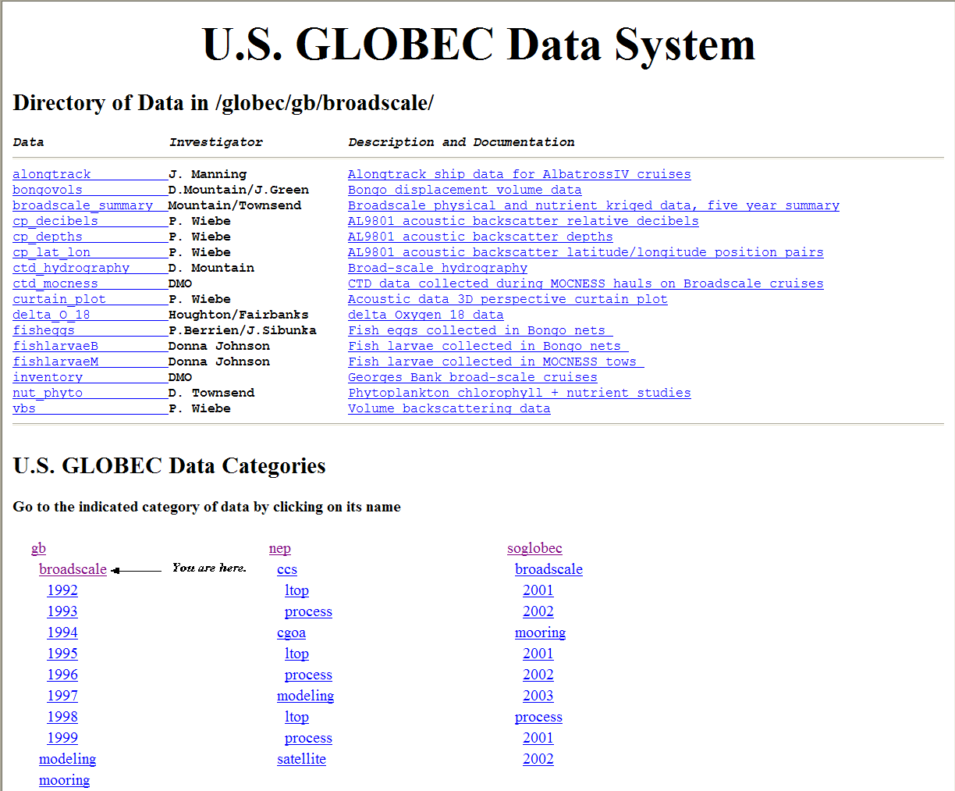
JGOFS/GLOBEC Data Management System

Slide 13
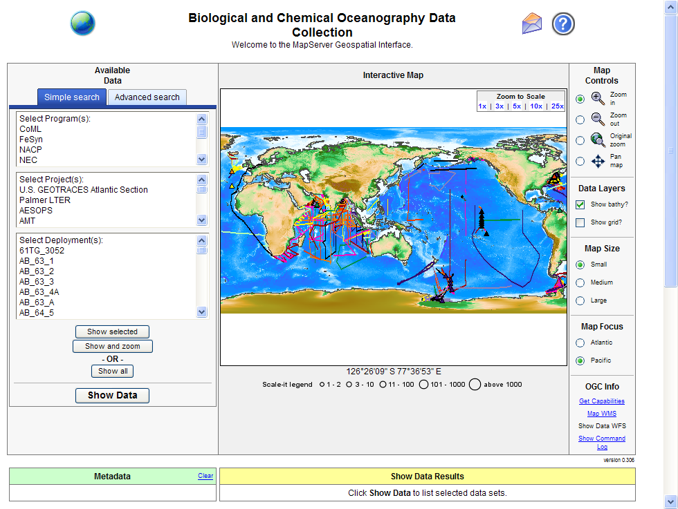
http://www.bco-dmo.org/

Slide 14
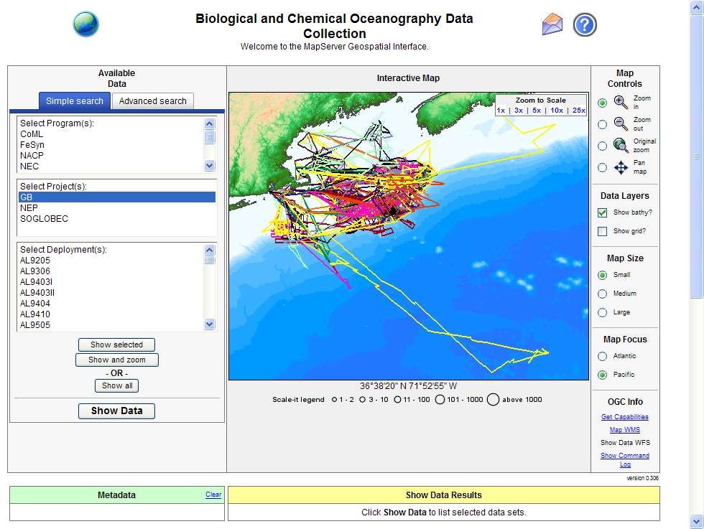
Cruise Tracks

Slide 15
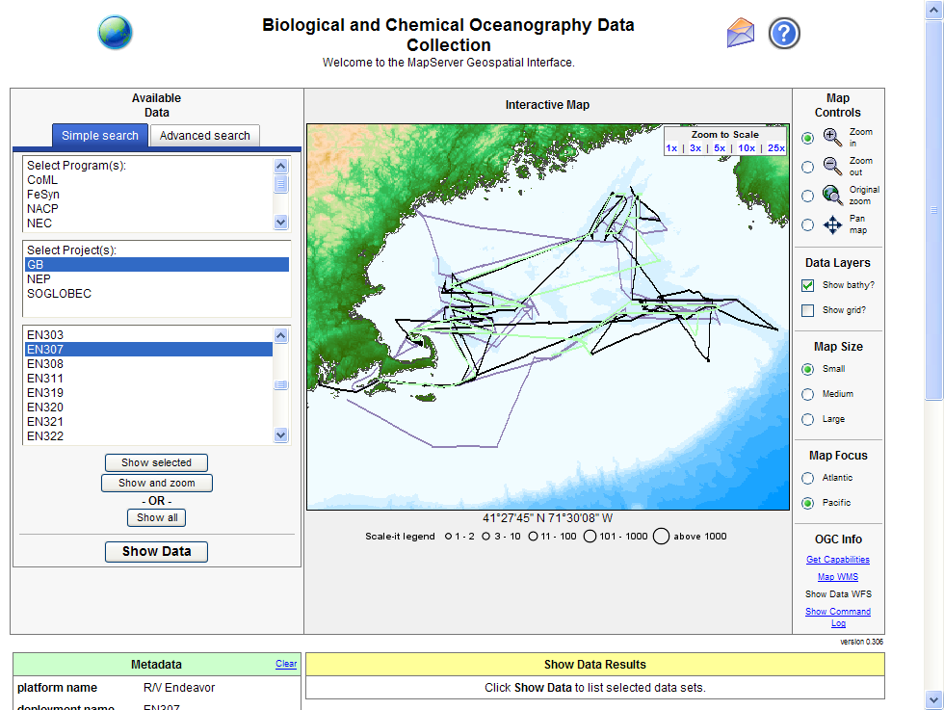
Select 5 Cruises

Slide 16
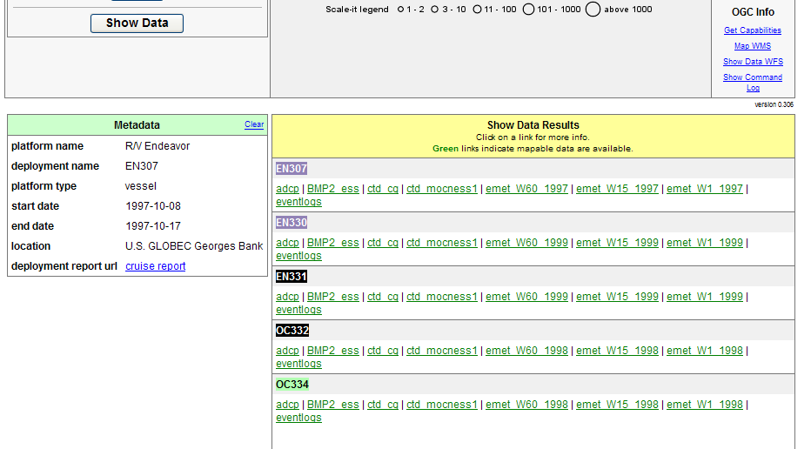
Click on “Show Data” Button

Slide 17
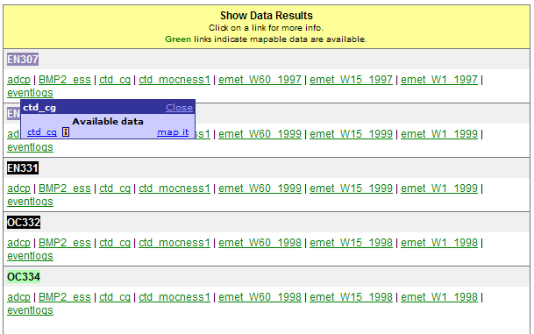
Select CD data in EN307

Slide 18
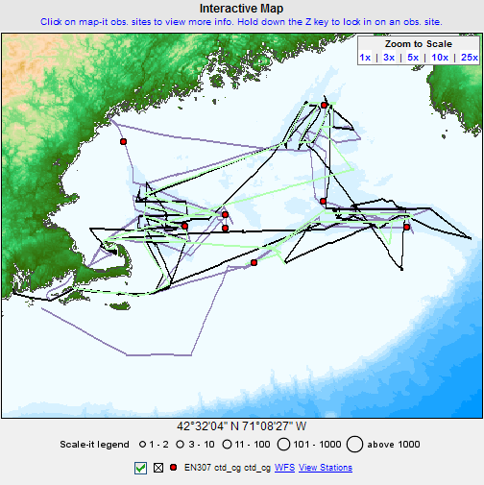
Shows stations

Slide 19
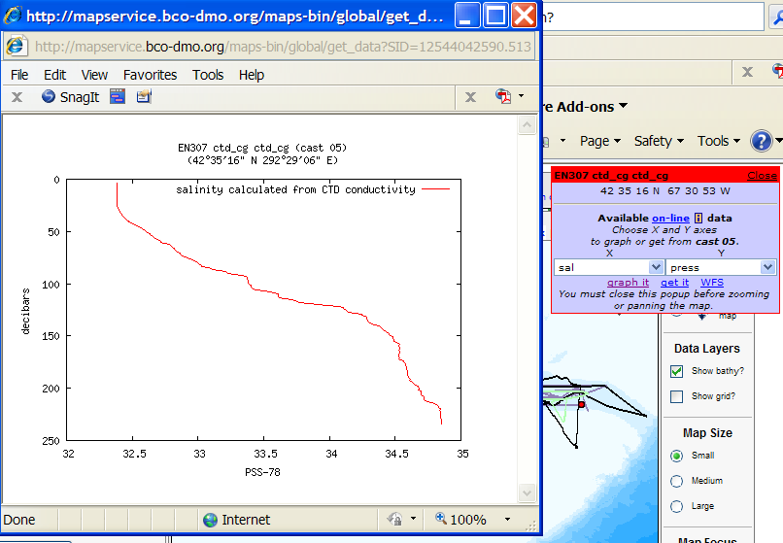
EN307 graph it options

Slide 20
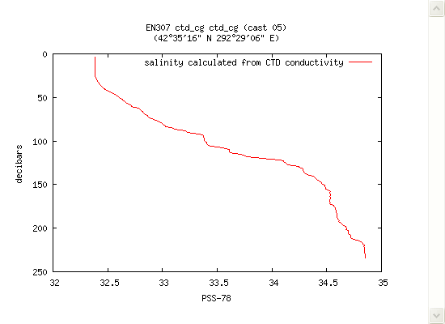
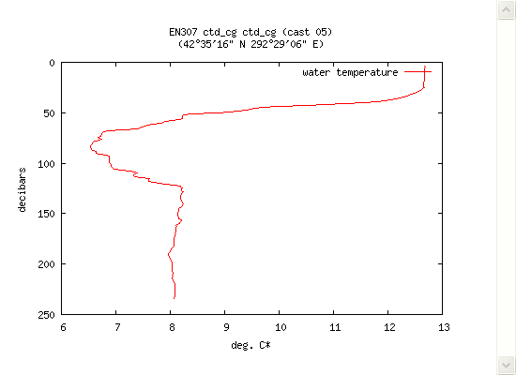
Depth versus salinity and versus temperature

Slide 21
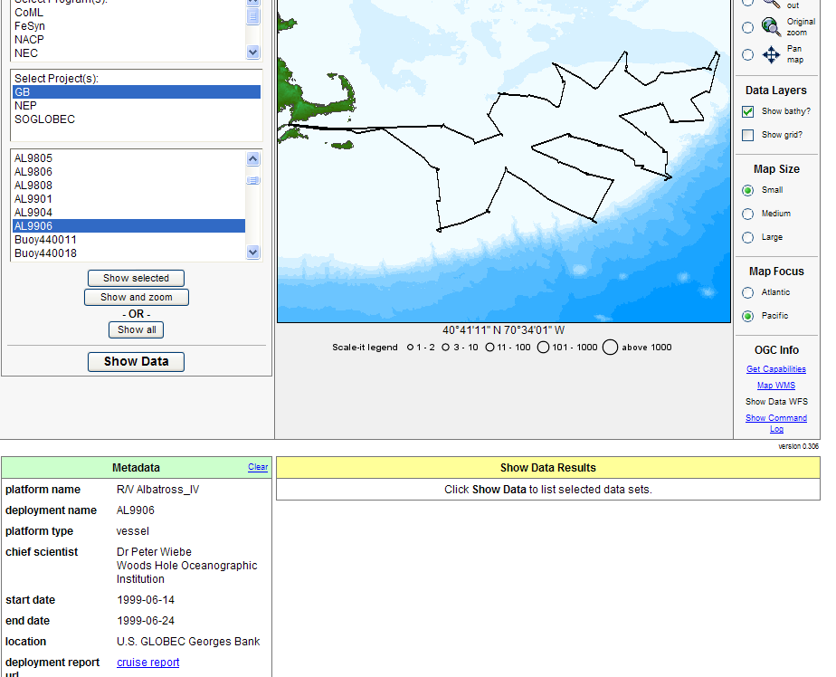
Select another cruise: AL9906

Slide 22
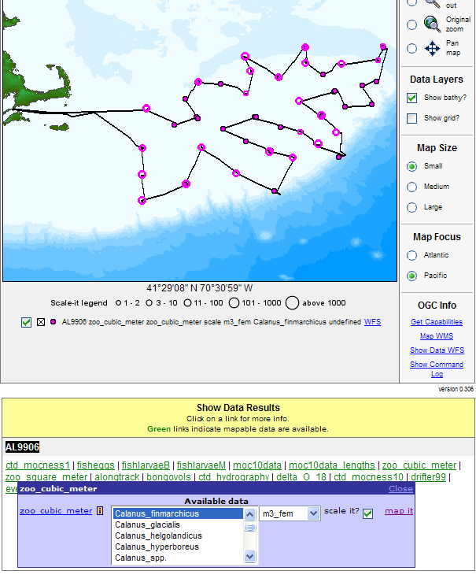
Map it options for abundances

Slide 23
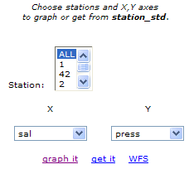
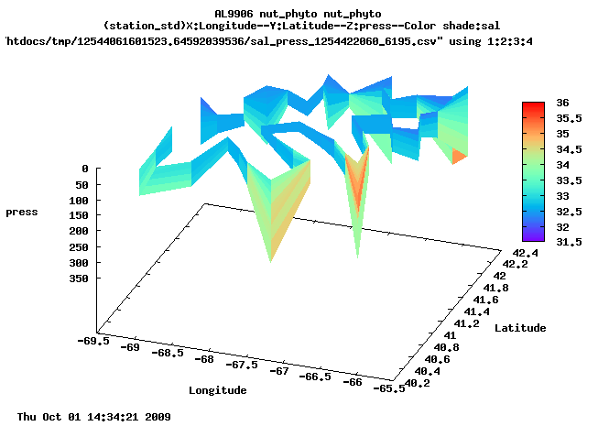
Graph it option for AL9906

Slide 24
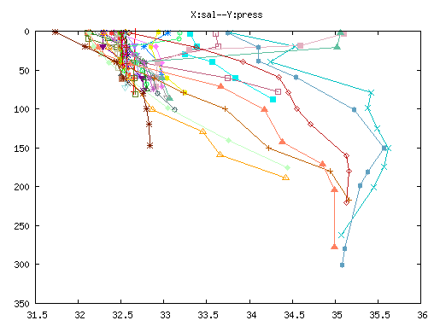
AL9906 Nutrient/Phytoplankton Plot

Slide 25
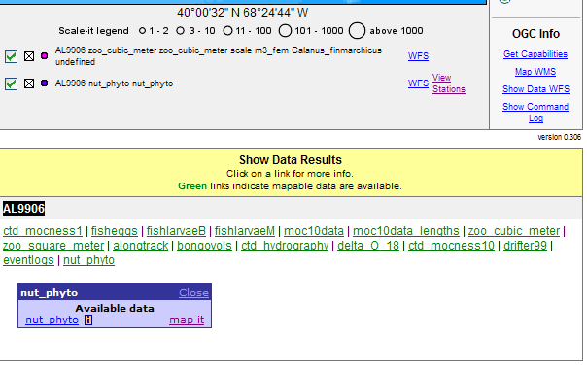
Interoperability features (for free)

Slide 26
MapServer Supports Interoperability Features
Open Geospatial Consortium standards
  Web Mapping Service (WMS), and
      Show me the data
  Web Feature Service (WFS)
      Get me the data
Retains the functionality of the JGOFS/GLOBEC Data Management System
  Download data as ASCII, CSV, Matlab, netCDF
Will be adding Google Earth output file option

Slide 27
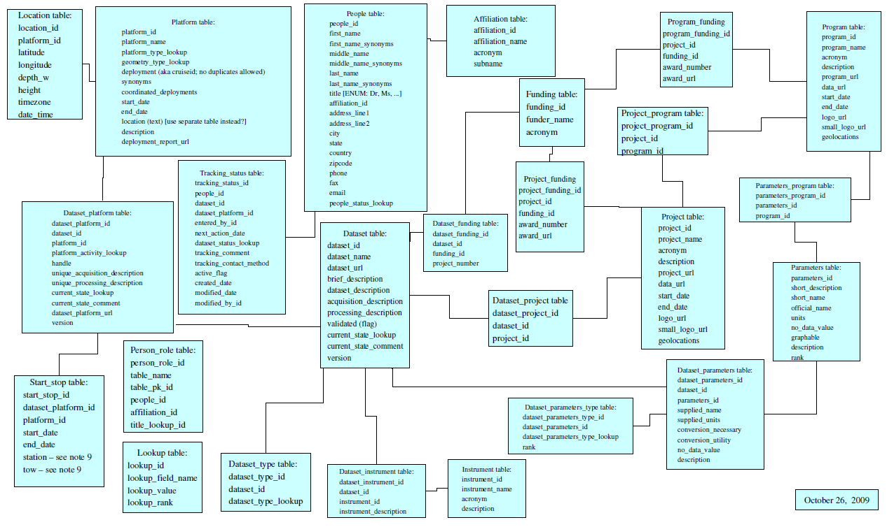
Metadata Schema

Slide 28


