Slide 1
Data and Data Management:
Publish (your data) or Perish
Presented at the
UMass Seminar Series
October 7, 2009
Robert C. Groman

Slide 2
Topics to Cover
Has data management gone mainstream?
NSF now says: Your data or your funding
“Data” is a plural noun – facts, statistics, or items of information; and metadata
Accessing data: Is a picture worth a thousand bytes?
Data Interoperability

Slide 3
Points to make (somewhere)
Permanent archive of data
Benefits of early open access to data (with minimum/no restrictions)

Slide 4
Purpose
Metadata are data and critical for data reuse
Raise level of awareness (appreciation?) for data management
Want to use some formulas
Difference between an engineer and a mathematician

Slide 5
Venn Diagram:
Data and Metadata
All data and information (D)
necessary to use the data.
Data (d)
facts, statistics,
or
items of information
Metadata (m)
D ≠ m + d
Set Theory

Slide 6
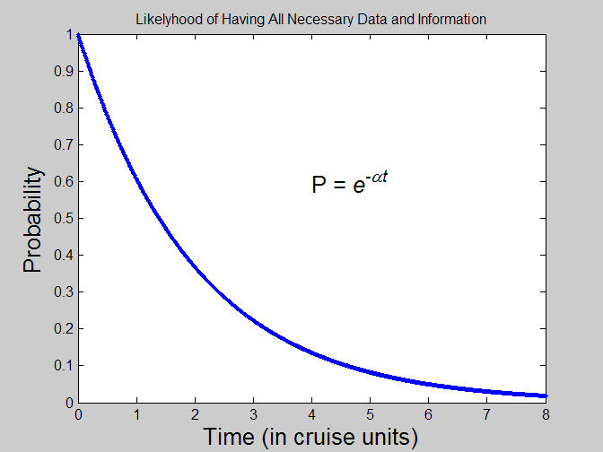
Probability Inversely Proportional to Time
Second order effects:
Length of cruise
Success of cruise
Participants
Immediate activity following the cruise

Slide 7
Theorems†
Theorem 1: The probability that all the necessary data and information are collected and preserved to allow another researcher to properly use your data is inversely proportional to time since the data were collected.
Corollary: Unless data and information are collected and preserved during the experiment (e.g. cruise), subsequent researchers will have a difficult time using your data.
Theorem 2: The longer the time since the data were collected the less likely the data will be considered “final”.
†Left to the reader as an exercise.

Slide 8
Seeing Versus Using Someone’s Data
Maybe you don’t want others to use your data. Hard to believe, but this does happen. For example:
  I’m not done publishing my papers based on the data
  My graduate student is almost done analyzing the data
  It’s not final yet
  My dog ate it (No, I haven’t heard this one yet, but there was a case where the data were erased.)
Old/current policies and practices about data archiving
New policies about data publishing and data archiving
  Web accessible
  NSF mandate (for real this time)

Slide 9
Quantum Mechanics Revisited
Heisenberg Uncertainty Principal (HUP) does NOT seem to apply
If Δx and Δp are the uncertainties in the measurements of the position and momentum, then the product ΔxΔp is at least on the order of Planck's constant, h.
When measuring conjugate quantities, the product of their standard deviations must be at least h / 4π
Not to be confused with the term observer effect (OE) which refers to changes that the act of observing will make on the phenomenon being observed.
HUP does not seem to apply,
but observer effect (OE) does.
The more people look at the data the higher their quality.

Slide 10
Ocean Observing → Sharing Data
Northeast Coastal and Ocean Data Partnership (née Gulf of Maine Ocean Data Partnership)
  “… to promote and coordinate the sharing, linking, electronic dissemination, and use of data in the Gulf of Maine region. “
  “… linking databases that are created and individually maintained by Participants ….”
  “… develops the web-based, visualization, and other information technologies needed for the seamless exchange ….”
  24 member organizations consisting of research, educational, non-profit, commercial, and local, state, and federal agencies.
Ocean observing systems
  Oceans.us: National Office for Integrated and Sustained Ocean Observations
  NFRA: National Federation of Regional Associations
  NERACOOS, MACOORA, ….
  ORION: Ocean Research Interactive Observatory Networks
  GOOS: Global Ocean Observing System

Slide 11
NERACOOS
Northeast Regional Coastal Ocean Observing System (NERACOOS) efforts
Rivaling the difficulties of the First and Second
Continental Congresses, but NERACOOS did prevail.

Slide 12
Northeast Coastal and Ocean Data Partnership Technical Committee Activities
(2008 Report from Chair)
Partner table of expertise - S. Most has been gathering completed surveys from the partners. Bob G. developed a web site to add, query and review the partner records.
2) Dataset accessibility survey - An accessibility survey format has been created by the subcommittee. Many of the partner’s data links identified through a previous survey and through the GoMODP portal have been reviewed. This is still a work in progress.
3) Update technical guidance - Thanks to Anne and Lou, a section on registering metadata records with the GeoSpatial One-Stop was added to the technical guidance. In the first version, we only had a placeholder for this info. The revised version of the technical guidance is on the GoMODP web site: http://www.gomodp.org/technical-committee.
4) Participate in pilot projects - We may be taking another look at the monitoring location project in light of the IOOS Regional Observation Registry (http://oceanobs.org/wc/). Stay tuned for details. Modification of the EPA’S Data Exchange Template. [But is this the way to go?]
5) Other - Are we interested in NOAA’s Data Transport Library (DTL) - http://www.csc.noaa.gov/DTL? Anne Ball will discuss this when we next have a conference call.

Slide 13
Biological and Chemical Oceanography
Data Management Office
BCO-DMO
NSF funded 3 year project to provide short and medium term data management, including web based access, to all NSF funded projects from the biological and chemical oceanographic programs
Large NSF projects are expected to have their own data management offices – a person
Web site: http://www.bco-dmo.org/

Slide 14
MapServer interface and interoperability enhancements
Provides access to geo-referenced scientific data and metadata
Presents distributed data sets in a unified way
Uses MapServer as the visualization application
Visualize data with graphics generated on-the-fly
Request custom subsets of data in a variety of file formats – flat file, Matlab, netCDF, WFS.
Compare data from different sources

Slide 15
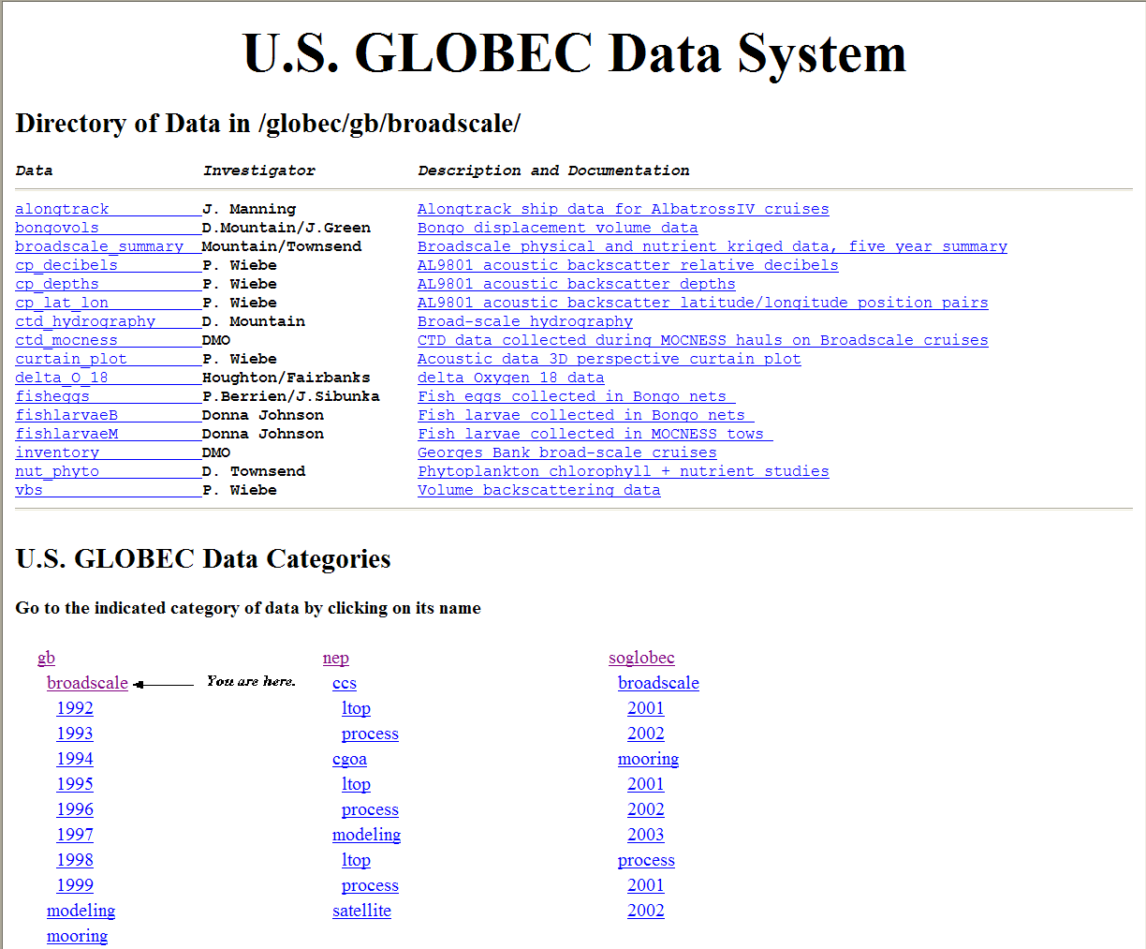
JGOFS/GLOBEC Data Management System

Slide 16
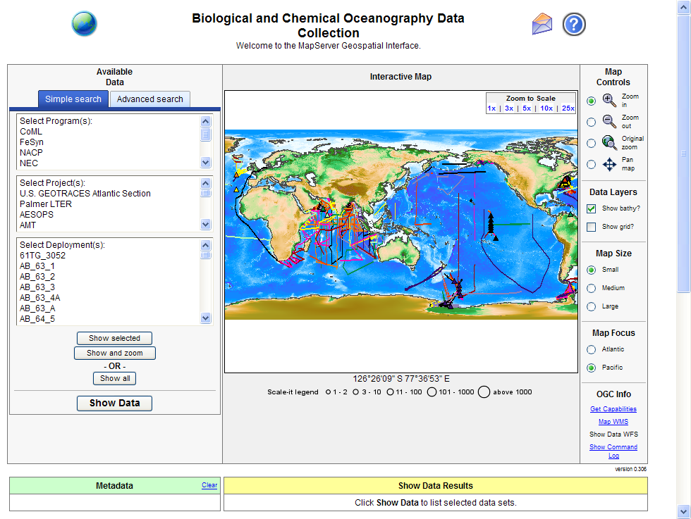
http://www.bco-dmo.org/

Slide 17
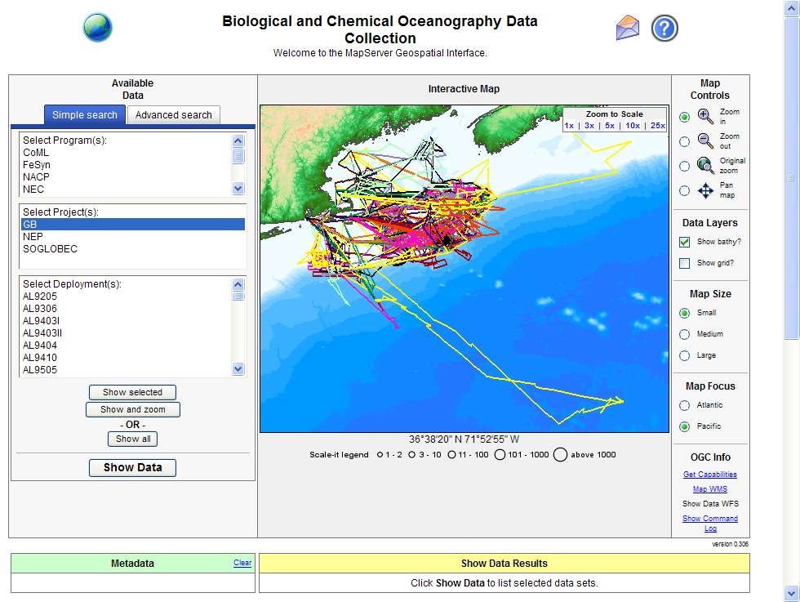
Cruise Tracks

Slide 18
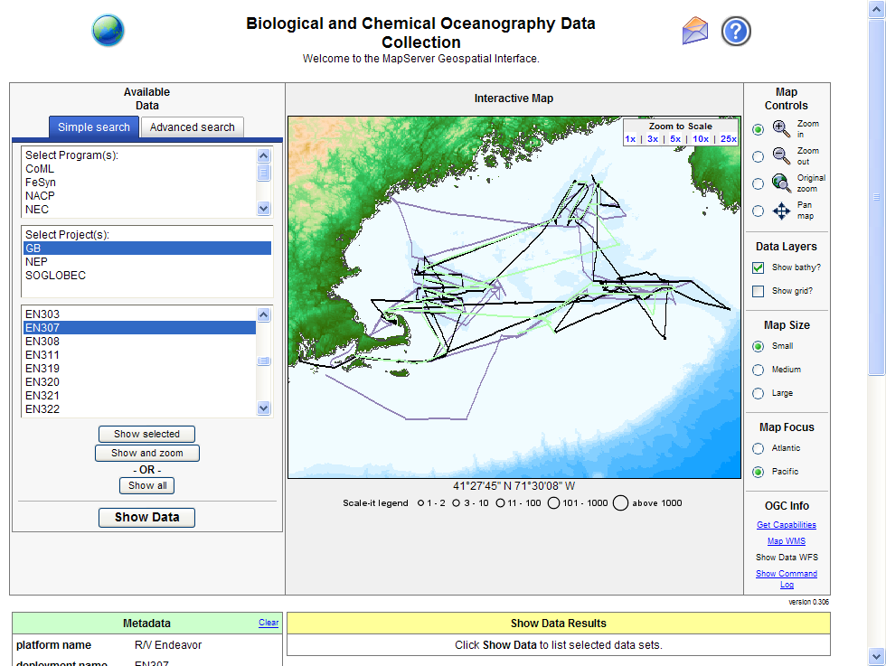
Select 5 Cruises

Slide 19
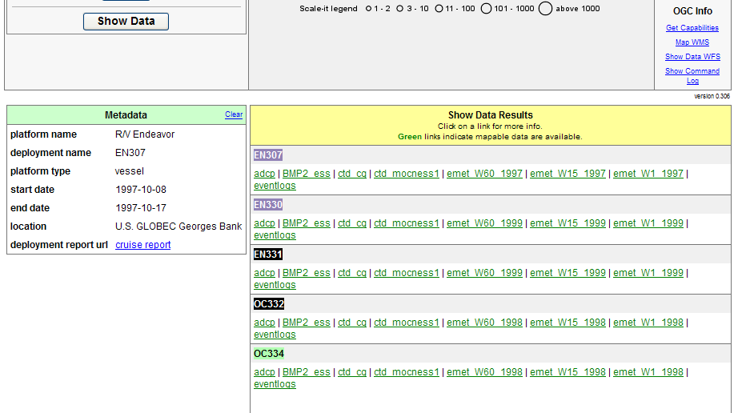
Click on “Show Data” Button

Slide 20
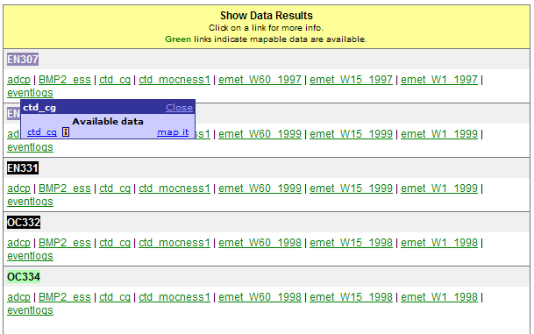
Select CD data in EN307

Slide 21
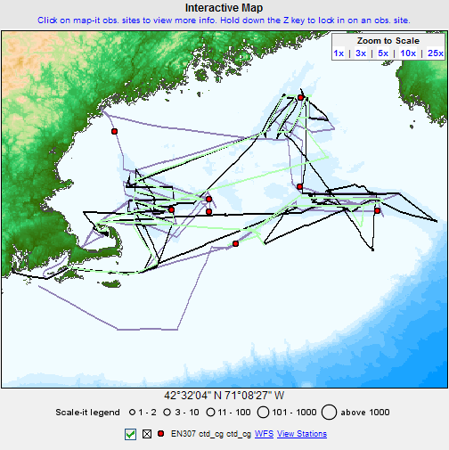
Shows stations

Slide 22
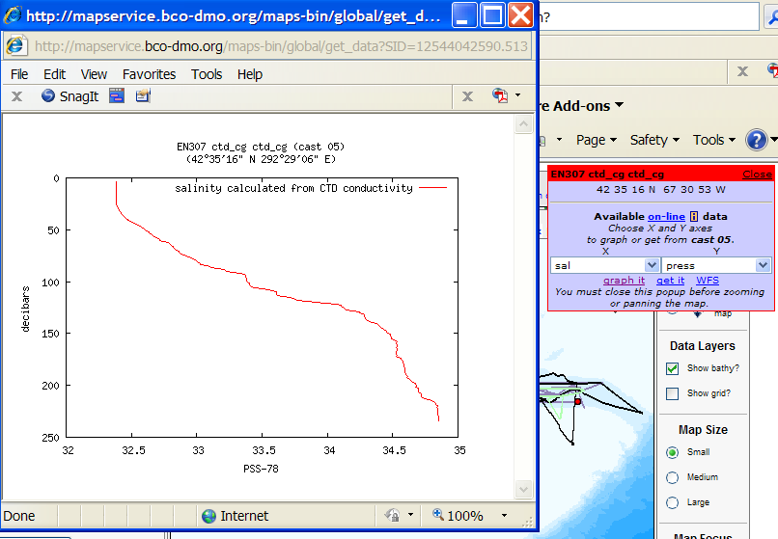
EN307 graph it options

Slide 23
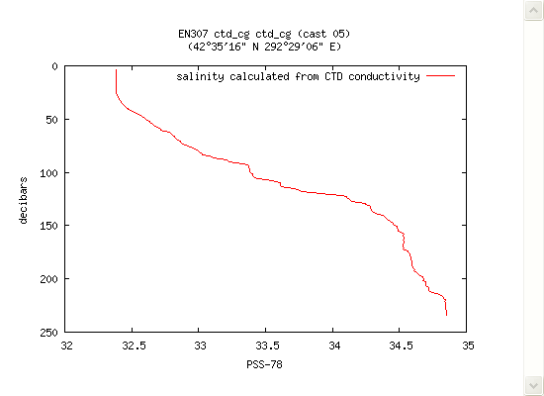
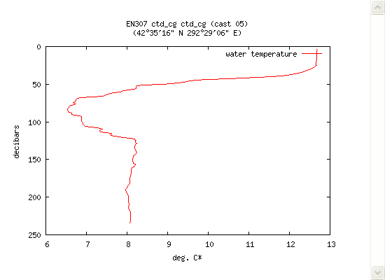
Depth versus salinity and versus temperature

Slide 24
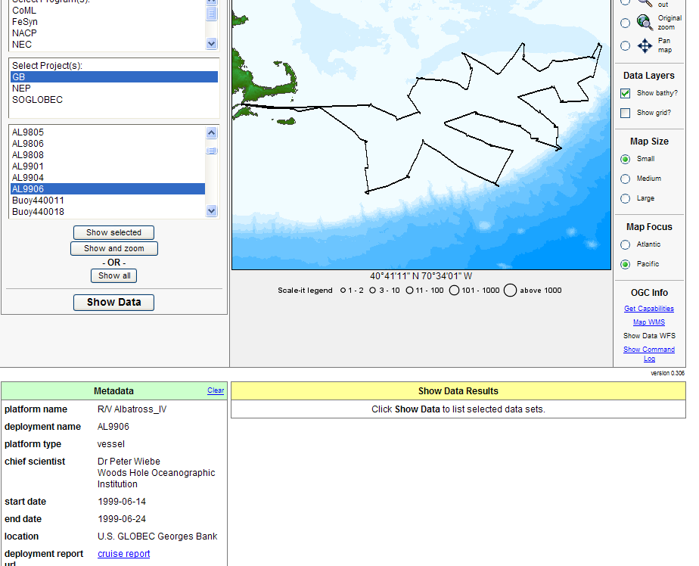
Select another cruise: AL9906

Slide 25
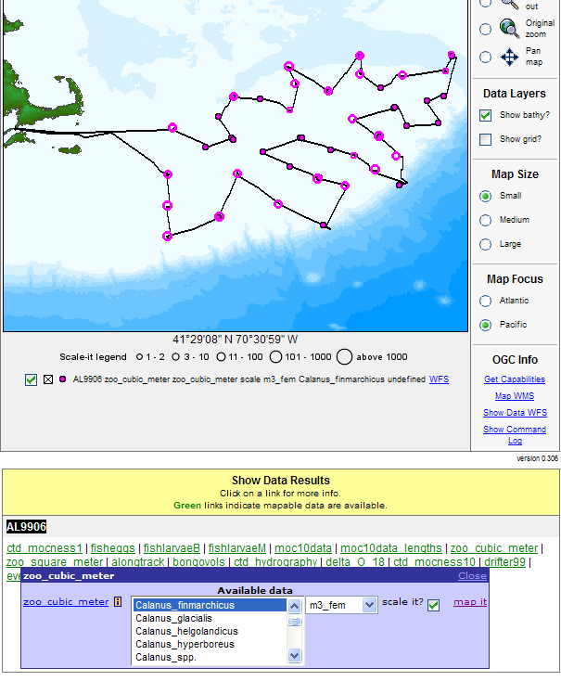
Map it options for abundances

Slide 26
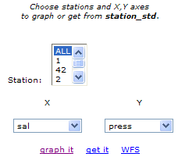
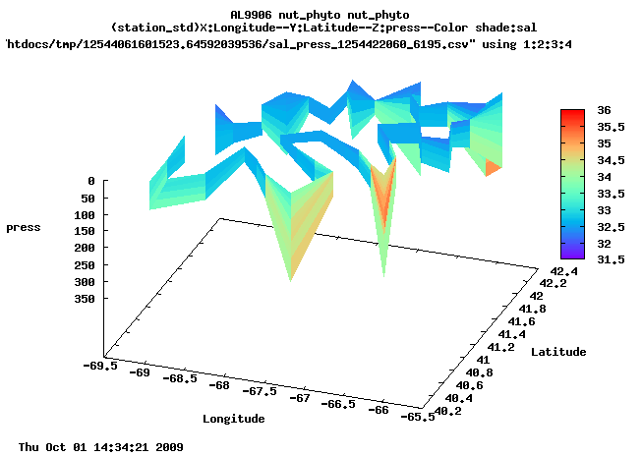
Graph it option for AL9906

Slide 27
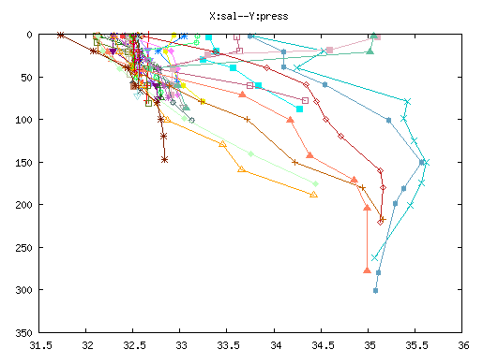
AL9906 Nutrient/Phytoplankton Plot

Slide 28
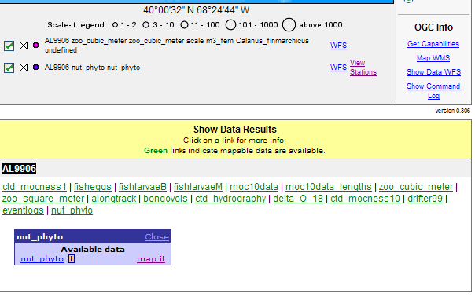
Interoperability features (for free)

Slide 29
MapServer Supports Interoperability Features
Open Geospatial Consortium standards
  Web Mapping Service (WMS), and
      Show me the data
  Web Feature Service (WFS)
      Get me the data
Retains the functionality of the JGOFS/GLOBEC Data Management System
  Download data as ASCII, CSV, Matlab, netCDF
Will be adding Google Earth output file option

Slide 30
Related Activities
MMI – Marine Metadata Interoperability
  “Promoting the exchange, integration and use of marine data through enhanced data publishing, discovery, documentation and accessibility."
UNOLS Subcommittee to Report on Best Practices for the Collection of Data and Metadata at Sea to Promote Public Dissemination
  Too new to even have its own web site
The Working Group on Zooplankton Ecology (WGZE), with guidance from the Working Group on Marine Data Management (WGMDM), is providing these general metadata guidelines for plankton data collected and submitted to ICES. (2003)
Sensor Interoperability Metadata Workshop (2006)
ICES ASC 2006 Theme session M "Environmental and fisheries data management, access, and integration"
NOAA Coastal Services Center Data Transport Laboratory (DTL)
  Integrated Ocean Observing System (IOOS)
  Ocean.US data management and communications (DMAC) strategy
Etc. NEEDS UPDATING

Slide 31
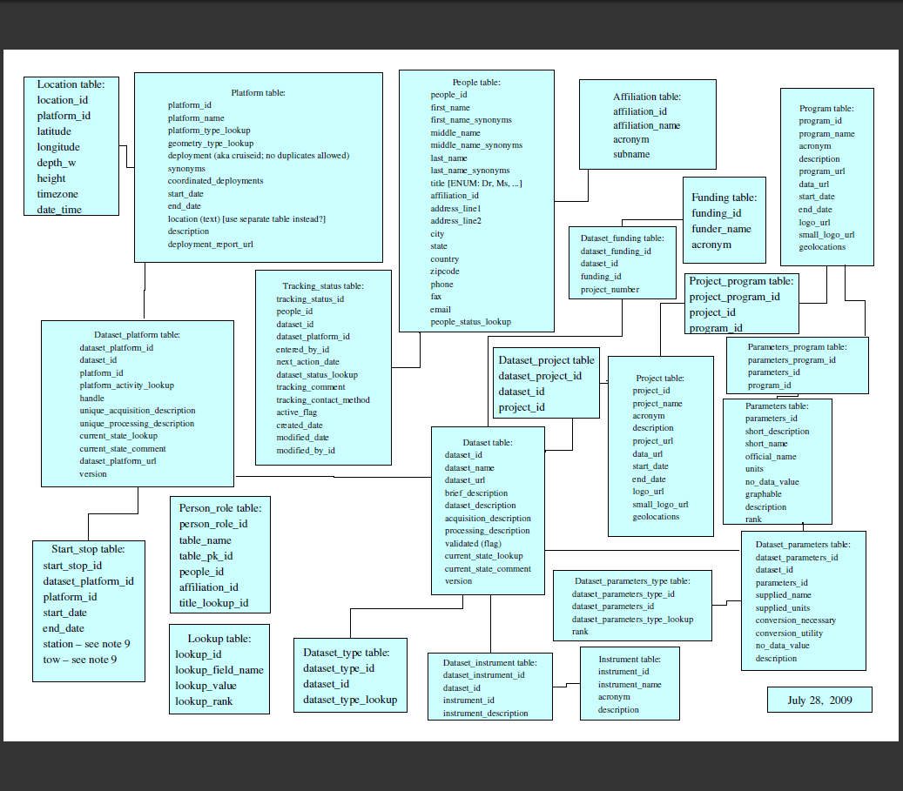
Metadata Schema
The print size is
small to protect
the innocent and
guilty.

Slide 32


What is the difference between an engineer and a mathematician?

Slide 33


Slide 34
NERACOOS
Evan Richert (chair), Philip Bogden (GoMOOS), Janet Cambell (UNH), David Mountain, Neal Pettigrew (UMaine), John Trowbridge (WHOI), Robert Weller (WHOI)
Purpose: “… formation of a Regional Association (RA) for the Northeast region “
Advisory Committee created (20 members) and others to address governance issues, etc.

