Slide 1
MICRONS · GROUP PROJECT
Structure and Function in a
MICrONS Visual-Cortex Network
Does synaptic wiring predict neural activity?
Pair-level evidence, control tests, and a topology check
MICrONS · Structure & Function in a Visual-Cortex Network

Slide 2
INTRODUCTION
The Question
How strongly does synaptic wiring predict neural activity?
— Structural graphs describe possible communication pathways.
— Functional graphs describe co-variation in measured responses.
— Connectomics asks whether the first predicts the second — and in what sense.
— We test this at two levels: individual neuron pairs, and whole-network topology.
MICrONS · Structure & Function in a Visual-Cortex Network
2 / 31

Slide 3
PRIOR WORK
Background: Like-to-Like Wiring
— Ko et al. (2011) — neurons with similar stimulus responses are more likely to be connected in mouse V1.
— Cossell et al. (2015) — connection strength scales with response correlation in V1 L2/3.
— Ding et al. (2025) — general wiring rule across mouse visual cortex from the MICrONS data.
— MICrONS (2025) — first co-registered EM connectivity + calcium imaging at multi-area scale.
These results frame the assignment: enrichment, not deterministic prediction.
MICrONS · Structure & Function in a Visual-Cortex Network
3 / 31

Slide 4
DATA
The MICrONS Dataset
— Mouse visual cortex, multi-area (V1, RL, AL) and multi-layer (L2/3 — L6).
— Electron-microscopy reconstruction of synaptic connectivity.
— Two-photon calcium imaging of single-neuron responses to visual stimuli.
— Co-registered: every analysed neuron has both an anatomy and an activity record.
— Subset of proofread and functionally matched excitatory neurons used here.
Two cohorts: 906 cross-scan neurons (primary) and 93 same-scan V1/L4 neurons (validation).
MICrONS · Structure & Function in a Visual-Cortex Network
4 / 31

Slide 5
FRAMEWORK
Two Networks, Different Mathematical Objects
Structural network
Functional network
— Sparse — most pairs have no synapse.
— Directed — C[i,j] is i → j.
— Weighted by synapse size / count.
— Derived from EM reconstructions.
— Dense — every pair has a correlation.
— Symmetric — F_corr(i,j) = F_corr(j,i).
— Signed — correlations can be negative.
— Derived from oracle response vectors.
Comparison is not trivial: the two objects do not have the same shape, density, or sign convention.
MICrONS · Structure & Function in a Visual-Cortex Network
5 / 31

Slide 6
HYPOTHESES
Research Questions
Primary
Are directly connected neuron pairs more functionally correlated than unconnected pairs?
Secondary
— Is the effect graded by synapse strength?
— Does bidirectional connectivity add a reciprocity premium?
— Is it robust to distance, area, layer, cell type, and orientation tuning?
— Does it replicate in a same-scan validation cohort?
— Is structural-functional alignment visible at the level of network topology?
MICrONS · Structure & Function in a Visual-Cortex Network
6 / 31

Slide 7
METHOD
Methodology — Overview
— Cohort: 906 functionally matched excitatory neurons (primary). 93 V1/L4 neurons, scan 9.3 (validation).
— Functional similarity: pairwise signal correlation F_corr over shared oracle-response vectors.
— Structural connectivity: directed edge table; C[i,j] = synapse i → j.
— Pair table: 409,965 unordered pairs labelled unconnected / unidirectional / bidirectional.
— Attributes per pair: summed synapse size, soma-soma distance, area, layer, cell type, orientation similarity.
— Inference: bootstrap CIs, Mann-Whitney tests, neuron-identity permutation nulls, distance matching, logistic models.
MICrONS · Structure & Function in a Visual-Cortex Network
7 / 31

Slide 8
METHOD
Analysis Pipeline
1.
Pair baseline
Connected vs. unconnected: means, bootstrap CIs, MW tests, neuron-identity permutations.
2.
Edge weight
Spearman correlation between summed synapse size and F_corr within connected pairs.
3.
Reciprocity
Compare bidirectional, unidirectional, and unconnected groups.
4.
Controls
Distance matching, within-bin contrasts, logistic regression with distance² terms, composition stratification, orientation subset.
5.
Topology
Node-level structural degree/strength vs. mean functional coupling; matched-density thresholded graphs.
6.
Validation
93-neuron same-scan cohort with trace, signal, and noise correlation; V1/RL/AL area checks.
MICrONS · Structure & Function in a Visual-Cortex Network
8 / 31

Slide 9
STRUCTURE OF THE ANALYSIS
Hypothesis Map
H1
Connected vs. unconnected
Direct pair-level test
H2
Synapse strength gradient
Edge-weight refinement
H3
Reciprocity
Bidirectional premium?
H4
Distance control
Geometry confound
H5
Composition controls
Area, layer, cell type
H6
Orientation similarity
Tuning confound
H7
Hub-coupling & topology
Node-level alignment
V
93-neuron validation
Same-scan replication
H1 sets the baseline. H2–H3 refine it. H4–H6 stress-test it. H7 moves to topology.
MICrONS · Structure & Function in a Visual-Cortex Network
9 / 31

Slide 10
HYPOTHESIS 1
H1 — Connected Pairs Should Be More Correlated
— Pair classes: unconnected, unidirectional, bidirectional.
— Metric: pairwise signal correlation F_corr.
— Test: mean-difference with bootstrap 95% CI and one-sided Mann–Whitney.
— Null: neuron-identity permutation that shuffles labels but keeps the structural graph fixed.
— Why this null: pair rows are not independent — each neuron appears in many pairs.
MICrONS · Structure & Function in a Visual-Cortex Network
10 / 31

Slide 11
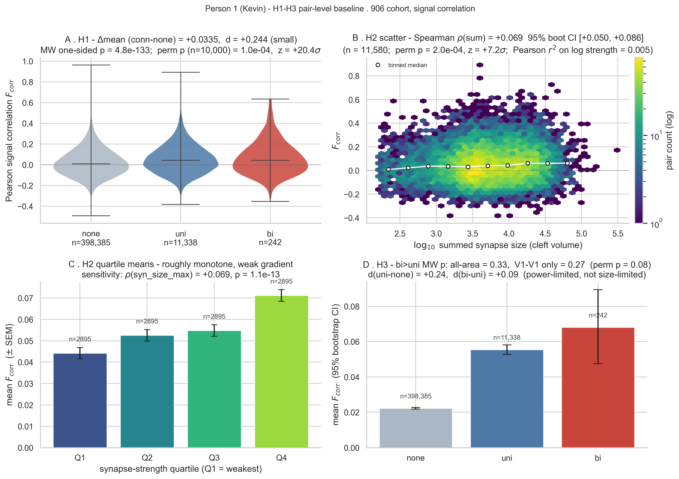
HYPOTHESIS 1
H1 — Result
Headline
— ΔF̄_corr = 0.0334
— 95 % CI [0.0307, 0.0360]
— ≈ 20.6 σ above the permutation null mean
— Effect is modest but consistent across the distribution
MICrONS · Structure & Function in a Visual-Cortex Network
11 / 31

Slide 12
HYPOTHESIS 1
H1 — Conclusion
Connected pairs are more correlated. The effect is real but small.
— Far outside the neuron-identity permutation null, so not a pair-dependence artefact.
— Population-level enrichment, not pair-deterministic prediction.
— Most connected pairs are still only modestly correlated.
— Sets the baseline that all downstream tests revisit.
MICrONS · Structure & Function in a Visual-Cortex Network
12 / 31

Slide 13
HYPOTHESIS 2
H2 — Synapse Strength Gradient
Is the effect graded by anatomical edge weight, or only binary?
— Among connected pairs, Spearman ρ between summed synapse size and F_corr = 0.0686.
— 95 % CI [0.0501, 0.0864] — positive and detectable.
— But small: edge weight explains a tiny fraction of pairwise correlation.
Verdict
Weight refines the binary H1 result rather than replacing it.
MICrONS · Structure & Function in a Visual-Cortex Network
13 / 31

Slide 14
HYPOTHESIS 3
H3 — Reciprocity
Do bidirectional pairs gain something beyond a single one-way connection?
— Mean ordering goes as expected: bidirectional > unidirectional > unconnected.
— Bidirectional − unidirectional ≈ 0.0126, permutation p ≈ 0.090.
— The reciprocity premium is not detected at conventional significance.
— Restricting to V1 — V1 pairs gives the same null result.
Verdict
Connectedness matters; directionality of that connection does not, in this cohort.
MICrONS · Structure & Function in a Visual-Cortex Network
14 / 31

Slide 15
CONTROL
H4 — Distance as a Confound
— Cortical connection probability decays steeply with soma-soma distance.
— Signal correlation also decays with distance — nearby neurons see similar visual inputs.
— Could H1 be a side-effect of shared geometry rather than a structure-function relation?
— Test: distance matching, within-bin contrasts, logistic models with distance and distance².
MICrONS · Structure & Function in a Visual-Cortex Network
15 / 31

Slide 16
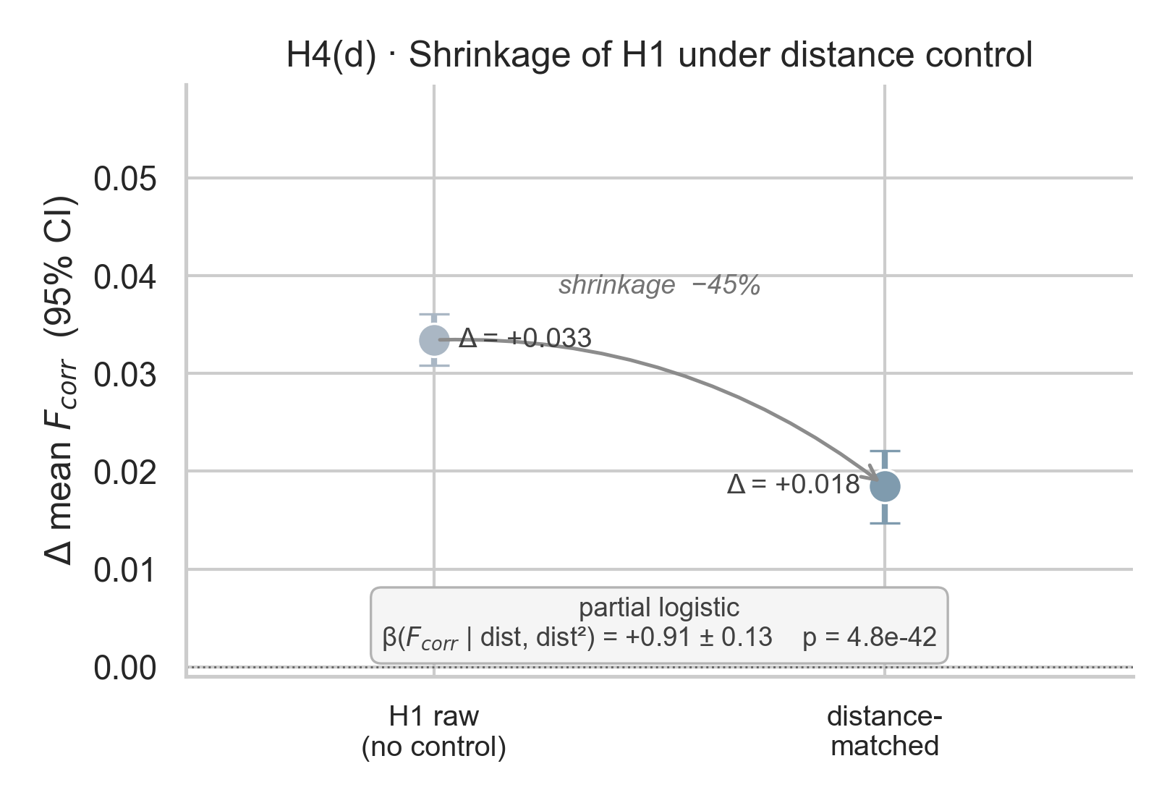
CONTROL
H4 — Distance Matching Shrinks but Does Not Erase H1
After matching
— Raw ΔF̄_corr ≈ 0.033
— After distance matching: 0.0186
— Still positive within distance bins
— Positive in logistic model with distance² controls
MICrONS · Structure & Function in a Visual-Cortex Network
16 / 31

Slide 17
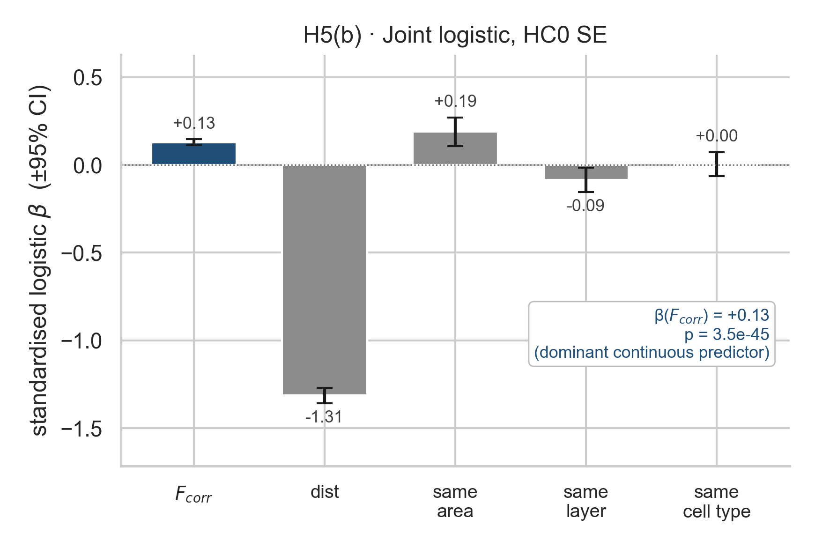
CONTROL
H5 — Composition Controls
Joint logistic model
— Predictors: F_corr, distance, same-area, same-layer, same-cell-type.
— Standardised β_F_corr = 0.130, 95 % CI [0.112, 0.148].
— F_corr remains a positive predictor of connection probability.
— H1 is not just "pairs sharing a compartment".
MICrONS · Structure & Function in a Visual-Cortex Network
17 / 31

Slide 18
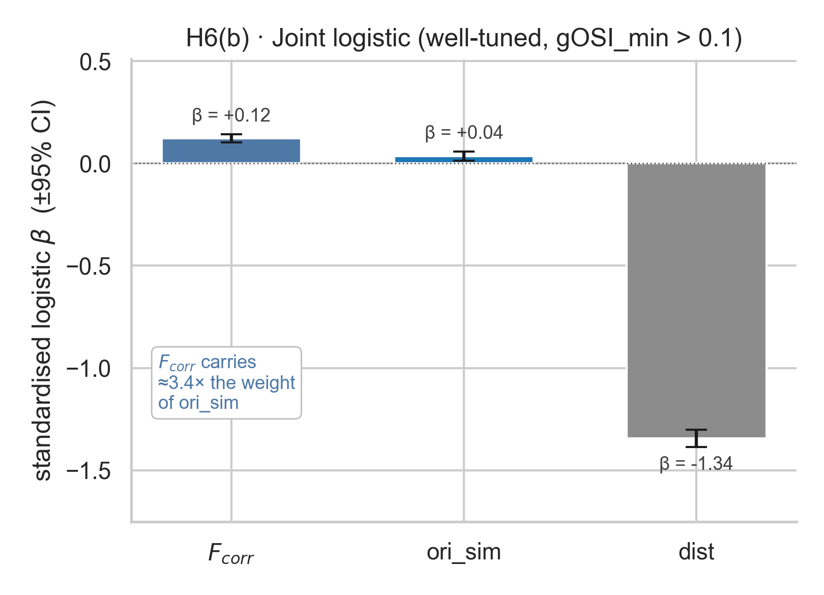
CONTROL
H6 — Orientation Similarity
Like-to-like check
— Well-tuned subset only.
— Connected pairs are slightly more orientation-similar.
— F_corr remains the stronger predictor when modelled jointly with ori_sim and distance.
— Signal correlation is broader than a single tuning axis.
MICrONS · Structure & Function in a Visual-Cortex Network
18 / 31

Slide 19
NETWORK ANALYSIS
From Pairs to Topology
The assignment also asks whether the two networks share broader structure.
— Node-level: degree, strength, hubness, mean functional coupling.
— Graph-level: clustering, thresholded density, degree distribution.
— Conceptual mismatch: sparse directed synapses vs. dense symmetric correlations.
— Two strategies — (a) compare continuous node-level signals, (b) threshold the functional graph to match structural density.
MICrONS · Structure & Function in a Visual-Cortex Network
19 / 31

Slide 20
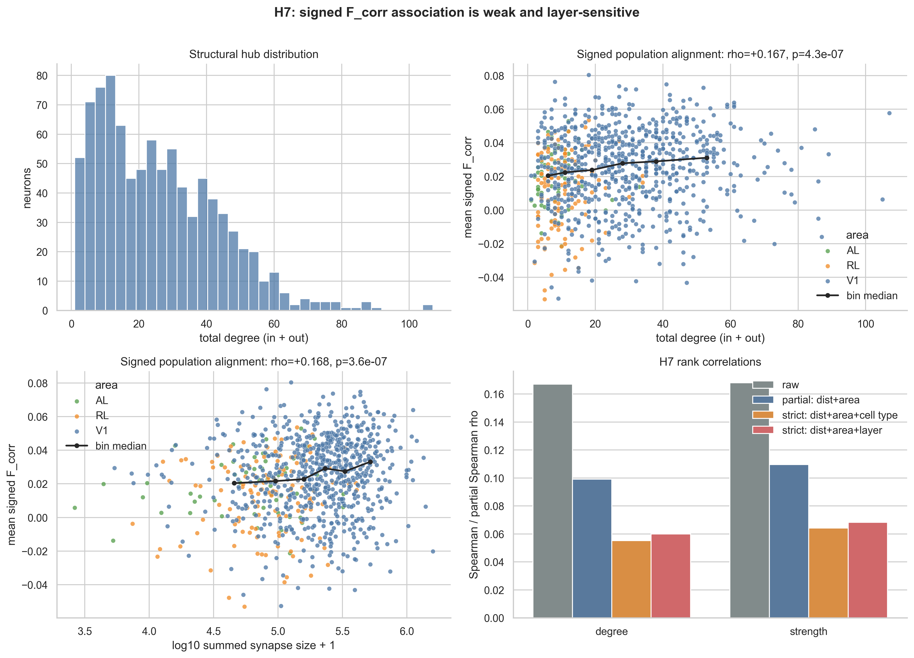
TOPOLOGY
H7 — Hub Coupling (node-level)
Headline
— Partial Spearman ρ ≈ 0.110 between total structural strength and mean signed F_corr, after distance and area controls.
— ≈ 1 % rank variance.
— Weakens under stricter controls.
— Absent for absolute (sign-agnostic) F_corr.
MICrONS · Structure & Function in a Visual-Cortex Network
20 / 31

Slide 21
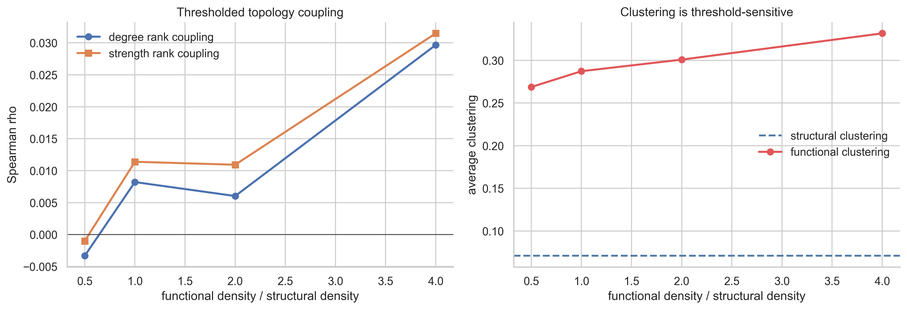
TOPOLOGY
Thresholded Topology Sensitivity
Matched-density graphs
— At matched density, structural-vs-functional degree ρ = 0.008 (p = 0.805).
— Functional clustering exceeds structural clustering.
— Topology metrics depend on density, sign convention, and threshold choice.
— No detectable degree-level alignment.
MICrONS · Structure & Function in a Visual-Cortex Network
21 / 31

Slide 22
VALIDATION
93-Neuron Same-Scan Validation
— Same animal, same recording session — V1 layer 4, scan 9.3.
— Smaller cohort but tighter measurement regime: trial-level repeated stimuli available.
— Three correlation measures: trace, signal, residual noise.
— Each measure isolates a different aspect of co-firing — signal subtracts stimulus mean; noise is the residual.
MICrONS · Structure & Function in a Visual-Cortex Network
22 / 31

Slide 23
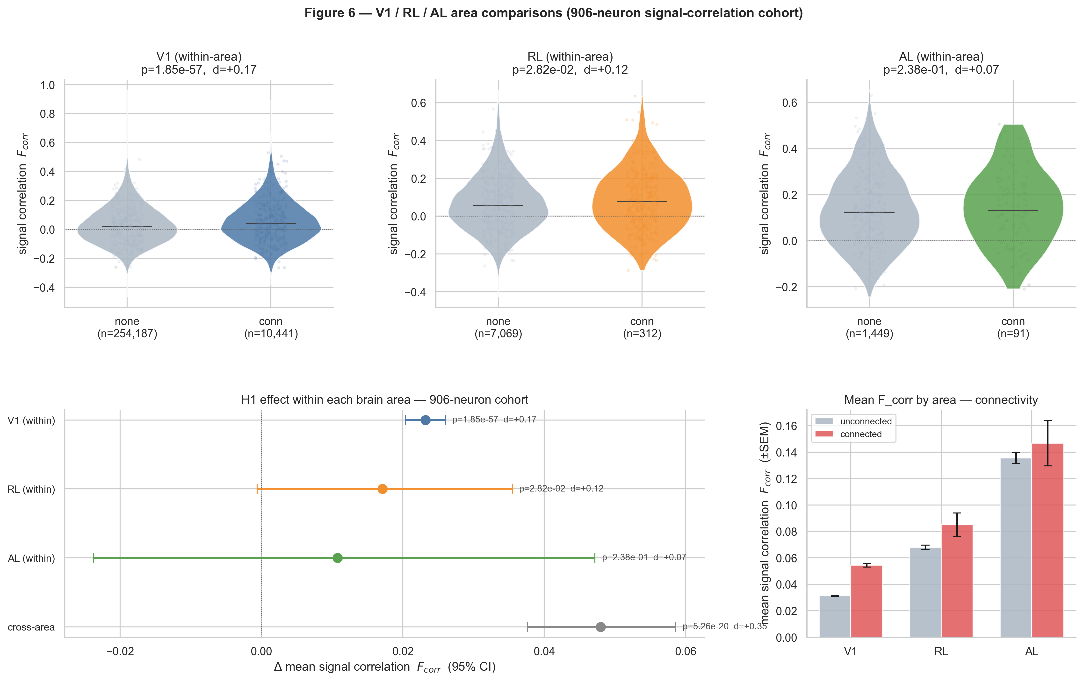
VALIDATION
Validation — H1 Replicates Across Measures
93-neuron cohort
— Trace Δ = 0.0258, CI [0.018, 0.034]
— Signal Δ = 0.0529
— Noise Δ = 0.0466
— Same direction as 906-neuron H1 — independent measurement regime.
MICrONS · Structure & Function in a Visual-Cortex Network
23 / 31

Slide 24
VALIDATION
Signal vs. Noise Decomposition
Why this matters
— Trace correlation mixes stimulus tuning with shared trial-to-trial noise.
— Signal correlation = correlation of per-stimulus means → tuning component.
— Noise correlation = correlation of residuals after subtracting stimulus mean → shared variability.
— The connected-pair effect appears in all three.
— Noise correlation is the strongest discriminator here: connected pairs share variability even after tuning is removed.
MICrONS · Structure & Function in a Visual-Cortex Network
24 / 31

Slide 25
VALIDATION
V1 / RL / AL — Scope Across Areas
— Cohort split: V1 = 728 neurons, RL = 122, AL = 56 — strongly imbalanced.
— V1: clear positive H1 effect.
— RL: positive but weaker, underpowered.
— AL: unresolved — confidence interval crosses zero.
— Cross-area pairs: positive overall.
— Read as exploratory: the non-V1 areas have too few neurons to draw strong claims.
MICrONS · Structure & Function in a Visual-Cortex Network
25 / 31

Slide 26
SUMMARY
Summary of Quantitative Results
Test
Question
Effect
Verdict
H1
Connected vs. unconnected
ΔF̄ = 0.0334
Supported
H2
Synapse strength gradient
ρ = 0.0686
Supported, weak
H3
Bidirectional vs. unidirectional
Δ = 0.0126, p = 0.09
Not detected
H4
Distance control
Δ = 0.0186 after matching
Shrinks but holds
H5
Composition controls
std. β = 0.130
Holds
H6
Orientation control
std. β = 0.122
Not orientation alone
H7
Hub / topology alignment
ρ ≈ 0.11; matched-deg ρ ≈ 0.008
Narrow signal only
V93
Same-scan V1/L4 validation
trace Δ = 0.0258
Replicates H1
MICrONS · Structure & Function in a Visual-Cortex Network
26 / 31

Slide 27
INTERPRETATION
Discussion — A Two-Level Finding
Pair level — positive
Topology level — inconclusive
— Direct synaptic connection → higher expected F_corr.
— Survives distance, area, layer, cell-type, and orientation controls.
— Reads as enrichment, not deterministic prediction.
— Consistent with prior like-to-like wiring literature.
— No robust hub-coupling effect under stricter controls.
— Matched-density degree correlations near zero.
— Functional clustering ≠ structural clustering.
— A genuine mismatch in network mathematical form, not only sampling.
MICrONS · Structure & Function in a Visual-Cortex Network
27 / 31

Slide 28
CAVEATS
Limitations
— Pair non-independence: every neuron appears in many pairs; permutation tests help but don't eliminate hierarchical dependence.
— Structural graph is a proofread, functionally matched subset — not a complete connectome.
— Functional graph depends on the chosen response metric (signal vs. trace vs. noise).
— Topology comparison is sensitive to thresholding choices.
— Area imbalance: claims outside V1 are exploratory.
— Coarse composition labels — finer cell-type or transcriptional controls were not available.
— Single dataset — no across-animal replication in this notebook.
MICrONS · Structure & Function in a Visual-Cortex Network
28 / 31

Slide 29
NEXT STEPS
Future Work
— Hierarchical / mixed-effects models that absorb the per-neuron dependence directly.
— Axon-dendrite opportunity controls — distinguish "could not connect" from "chose not to".
— Richer tuning decompositions beyond orientation: spatial / temporal frequency, motion direction.
— Repeated animals or scans to test generalisation outside MICrONS.
— Spectral / community-level comparisons rather than threshold-dependent topology metrics.
MICrONS · Structure & Function in a Visual-Cortex Network
29 / 31

Slide 30
BOTTOM LINE
Conclusion
Anatomical connectivity carries a clear pair-level
functional signal. Broader topology matching is not detected.
— Connected neurons are, on average, more correlated.
— The effect is statistically robust, quantitatively modest, and survives the controls available here.
— The structural and functional networks do not show topology-level equivalence.
— Best read as enrichment, not one-to-one prediction.
MICrONS · Structure & Function in a Visual-Cortex Network
30 / 31

Slide 31
BIBLIOGRAPHY
References
Ko, H. et al. (2011). Functional specificity of local synaptic connections in neocortical networks. Nature 473, 87–91.
Cossell, L. et al. (2015). Functional organization of excitatory synaptic strength in primary visual cortex. Nature 518, 399–403.
The MICrONS Consortium (2025). Functional connectomics spanning multiple areas of mouse visual cortex. Nature 640, 435–447.
Ding, Z. et al. (2025). Functional connectomics reveals general wiring rule in mouse visual cortex. Nature 640, 459–469.
MICrONS · Structure & Function in a Visual-Cortex Network
31 / 31

