Slide 1
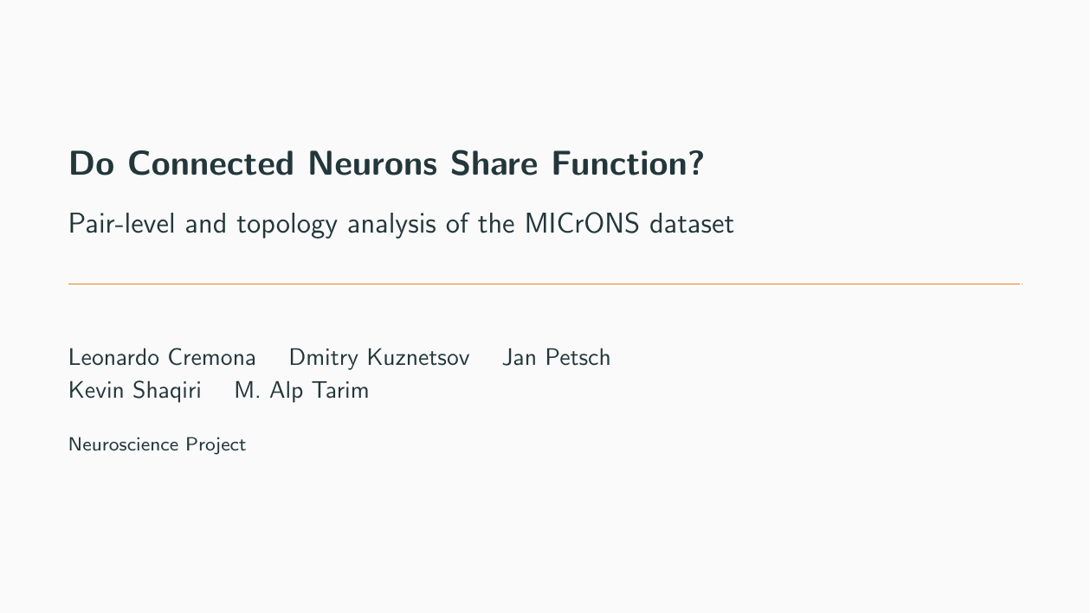

Slide 2


Slide 3
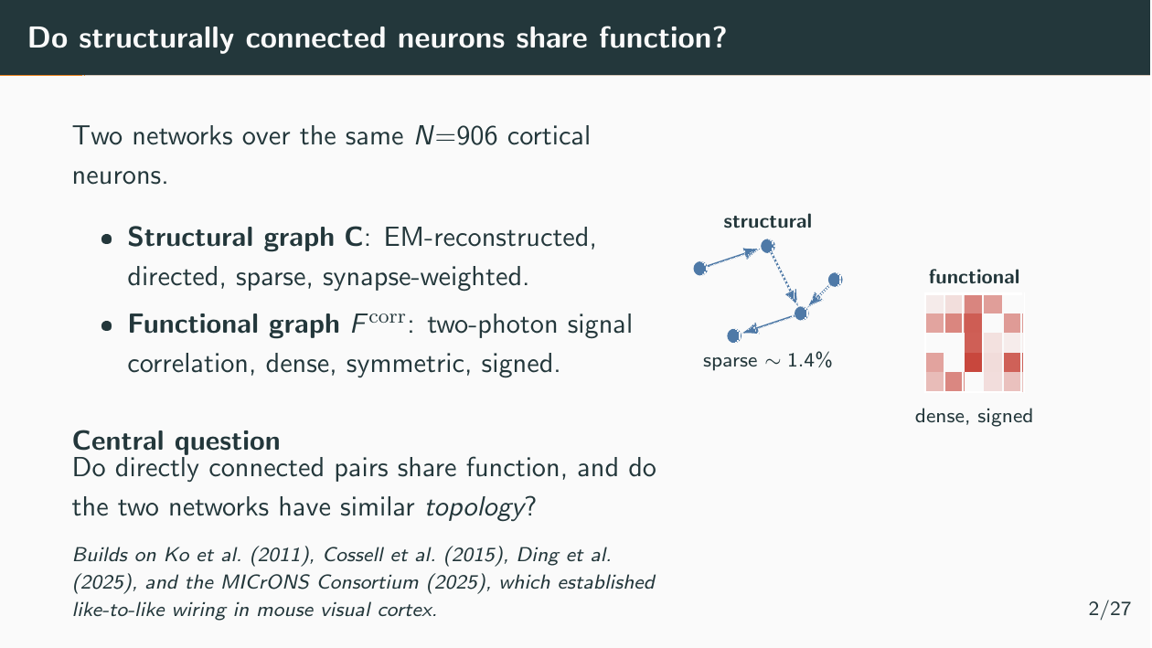

Slide 4


Slide 5
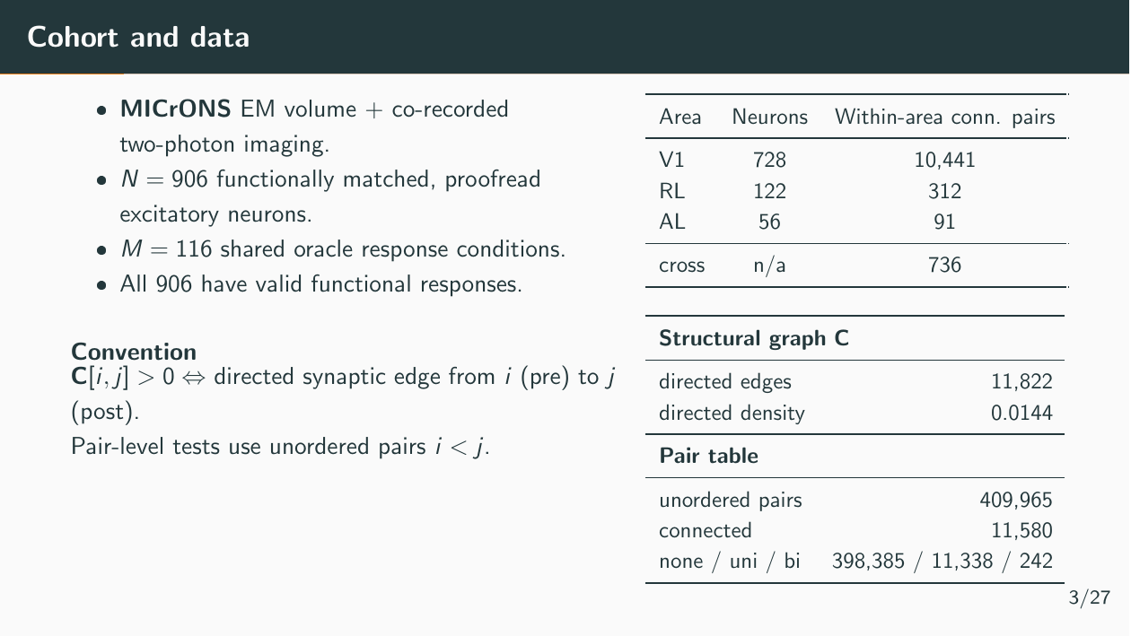

Slide 6
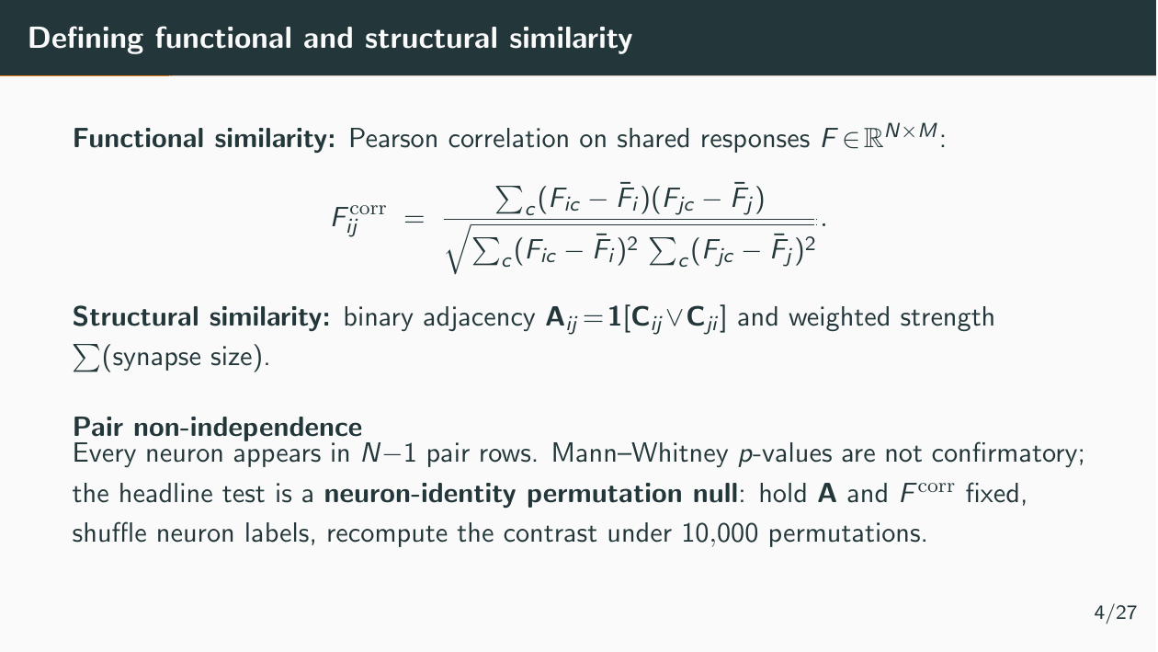

Slide 7
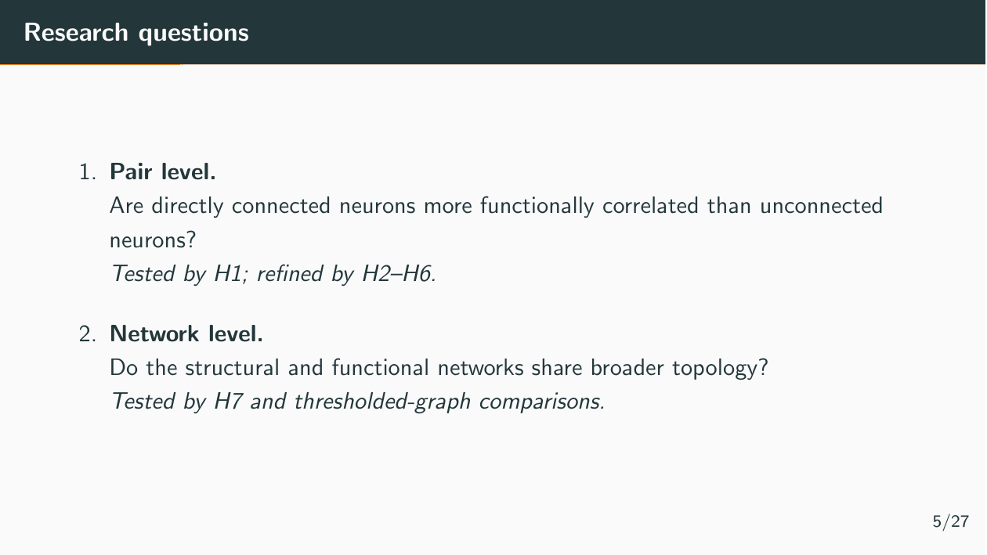

Slide 8
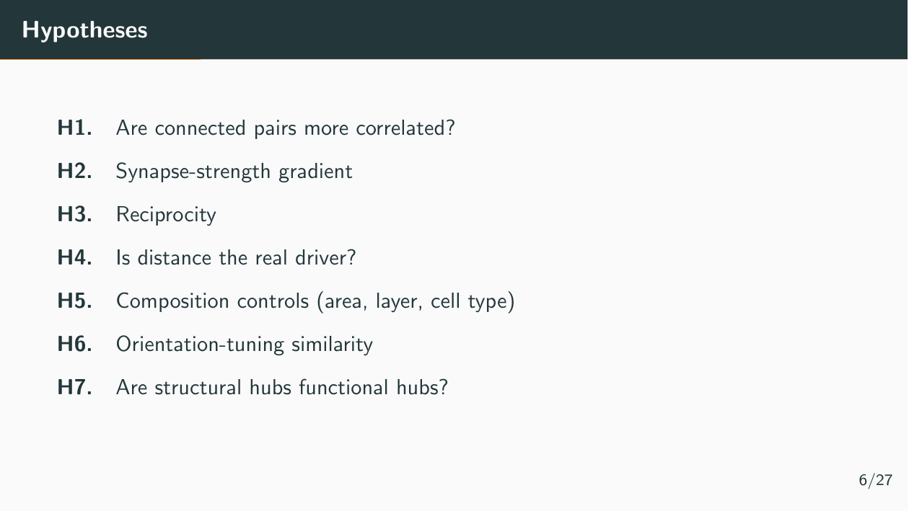

Slide 9
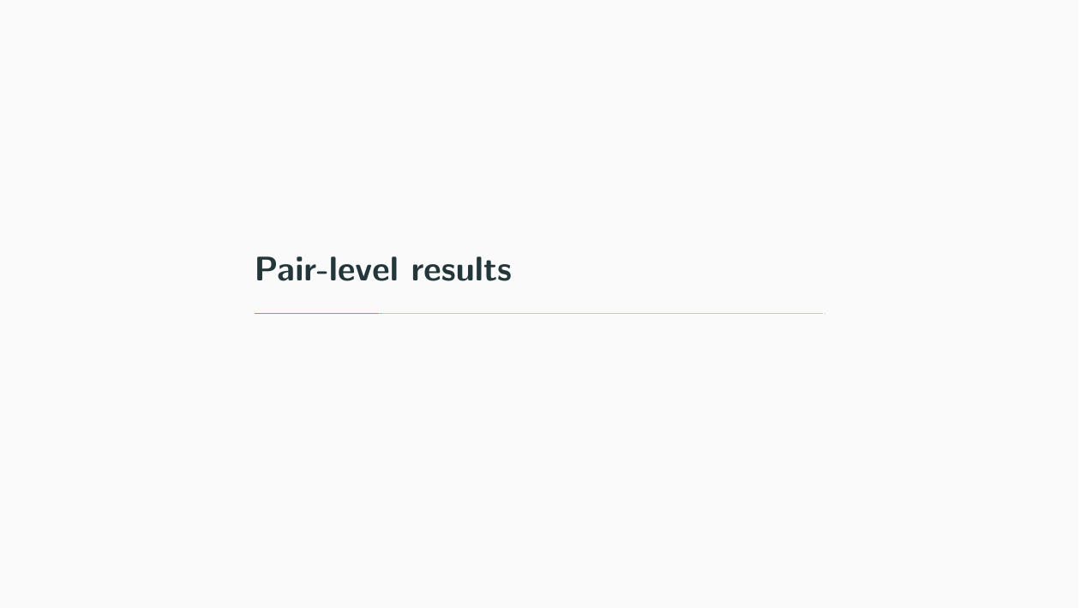

Slide 10
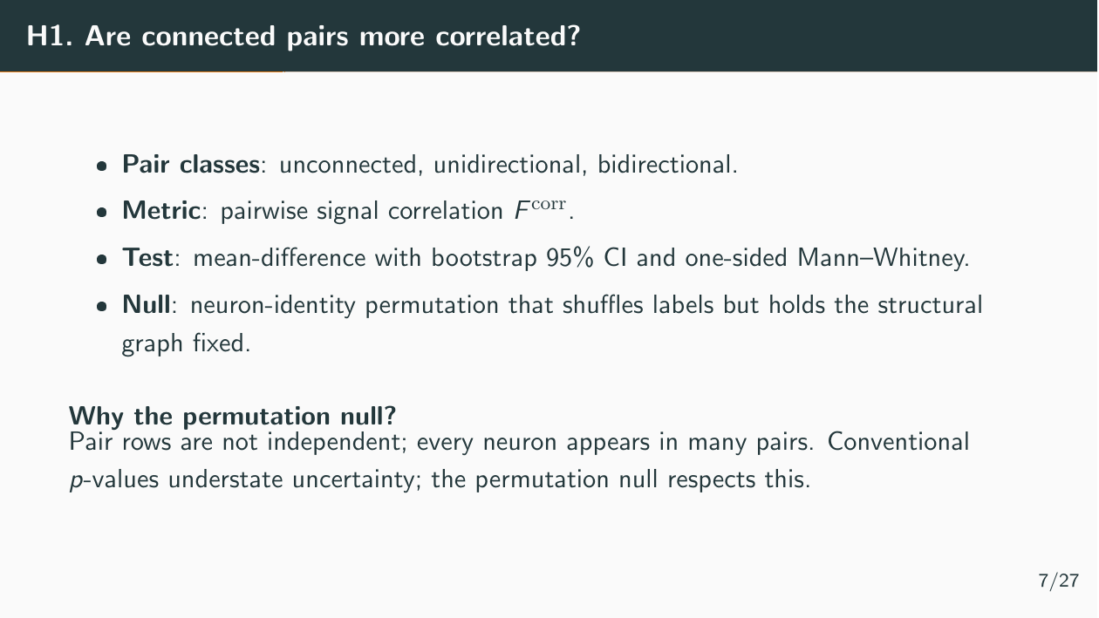

Slide 11
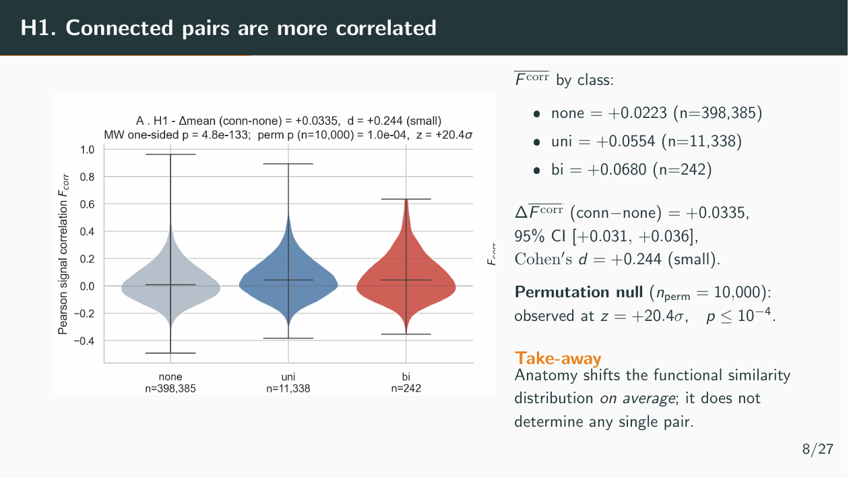

Slide 12
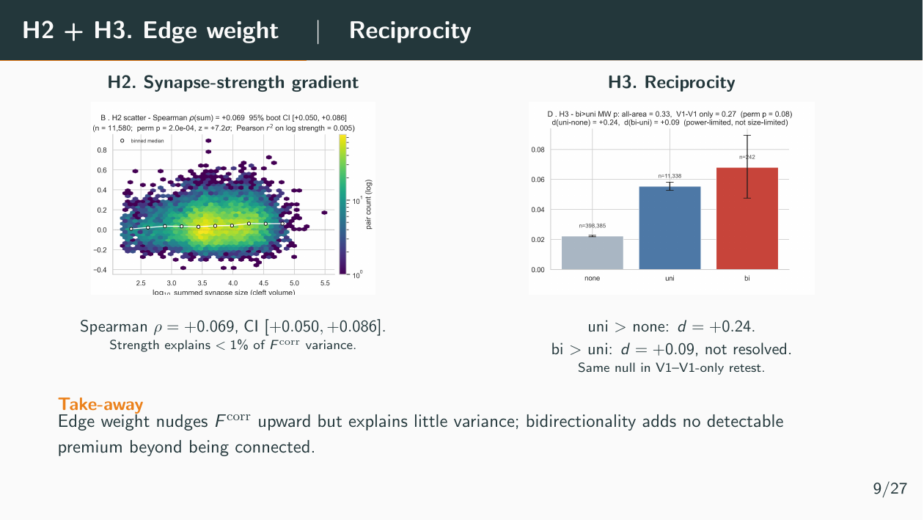

Slide 13
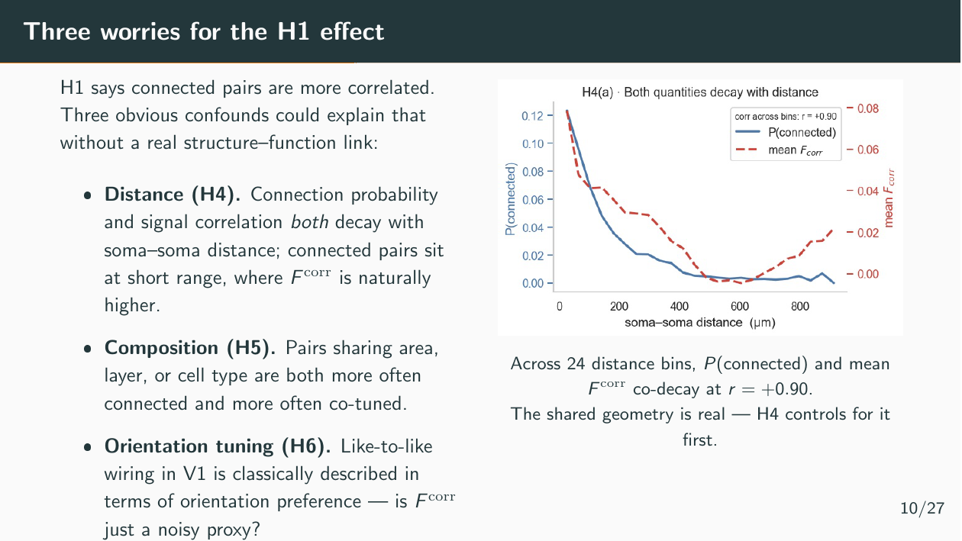

Slide 14
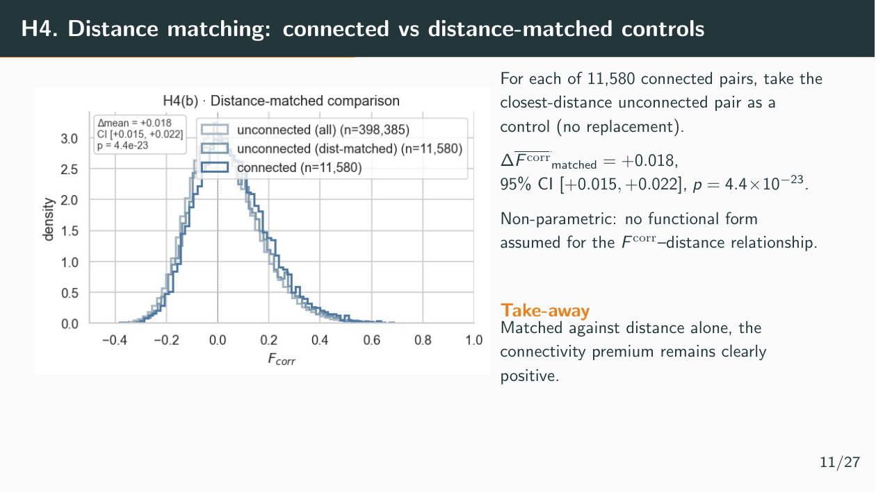

Slide 15
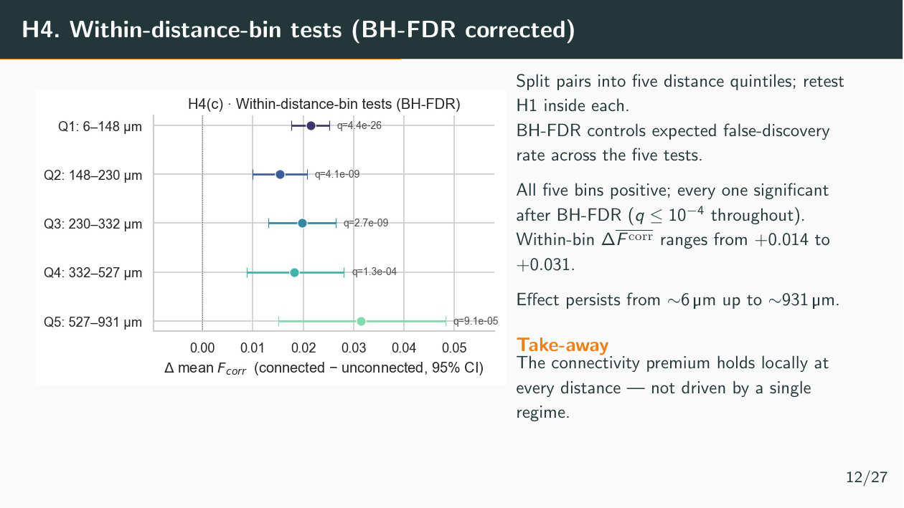

Slide 16
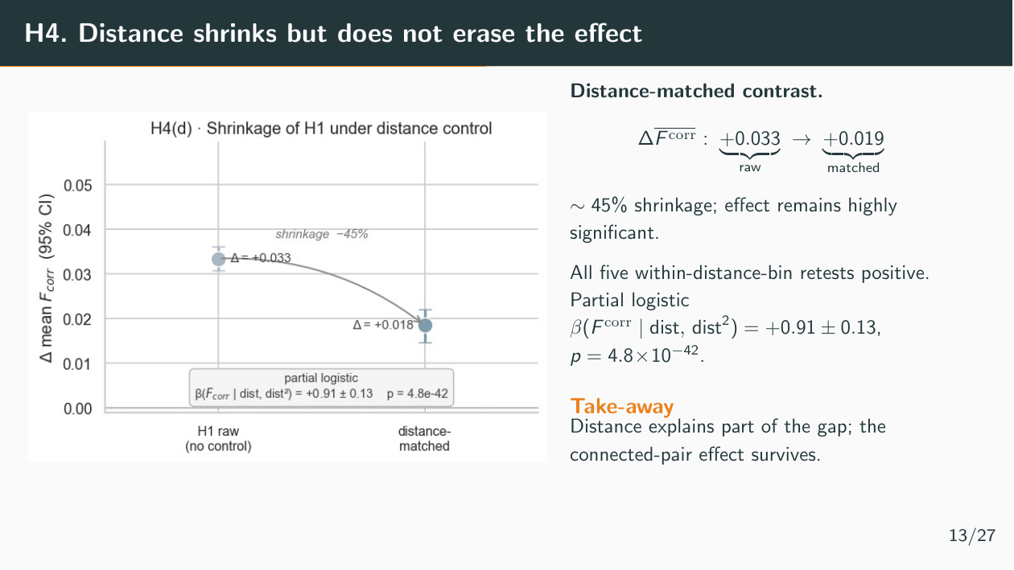

Slide 17
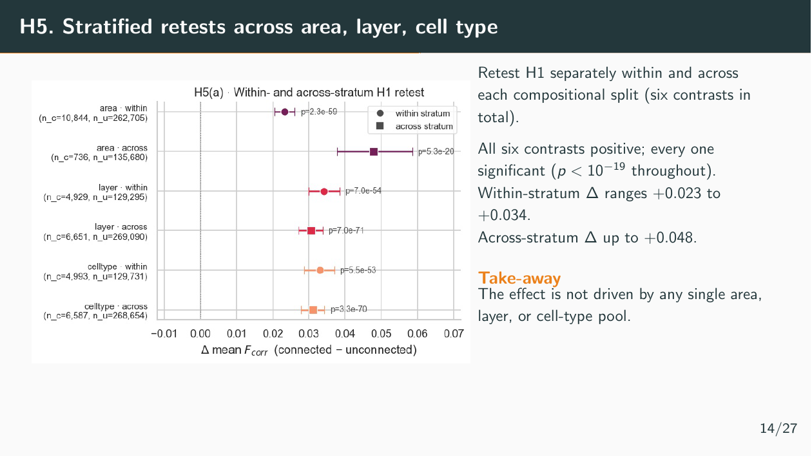

Slide 18
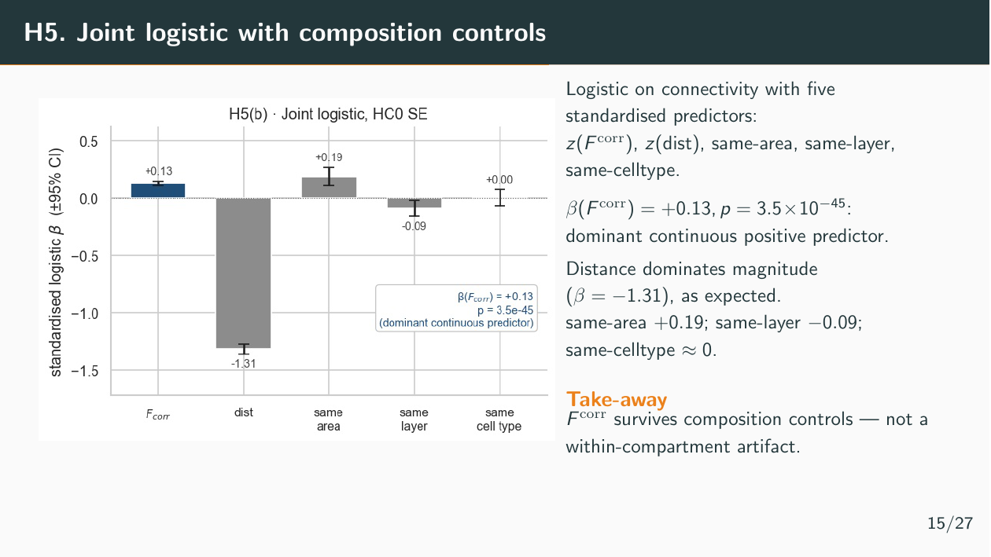

Slide 19
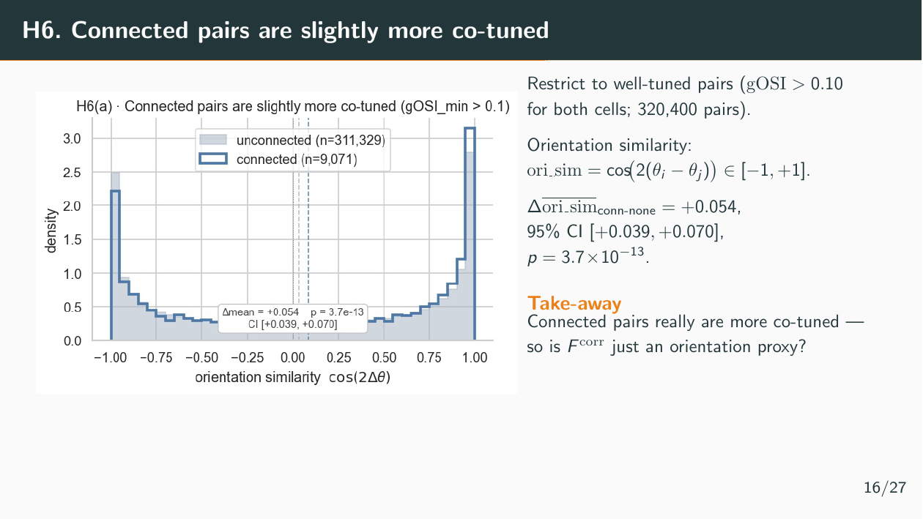

Slide 20
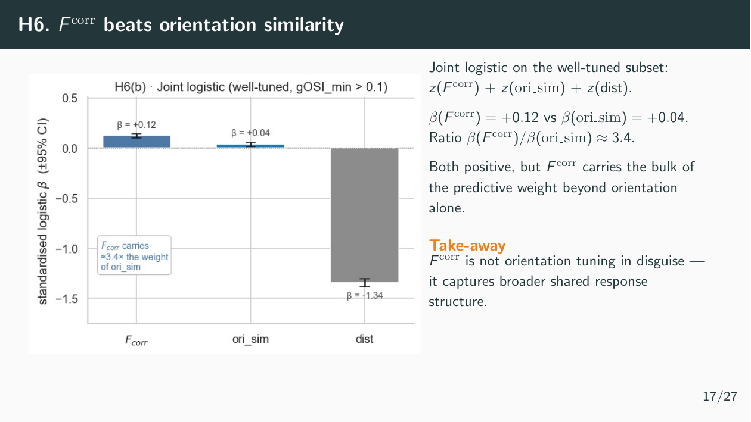

Slide 21

Notes:
Now we move from pair-level effects to network-level structure. Up to this point, the main result was that directly connected pairs are more functionally similar. The question here is stricter: do the two whole networks have similar topology?

Slide 22
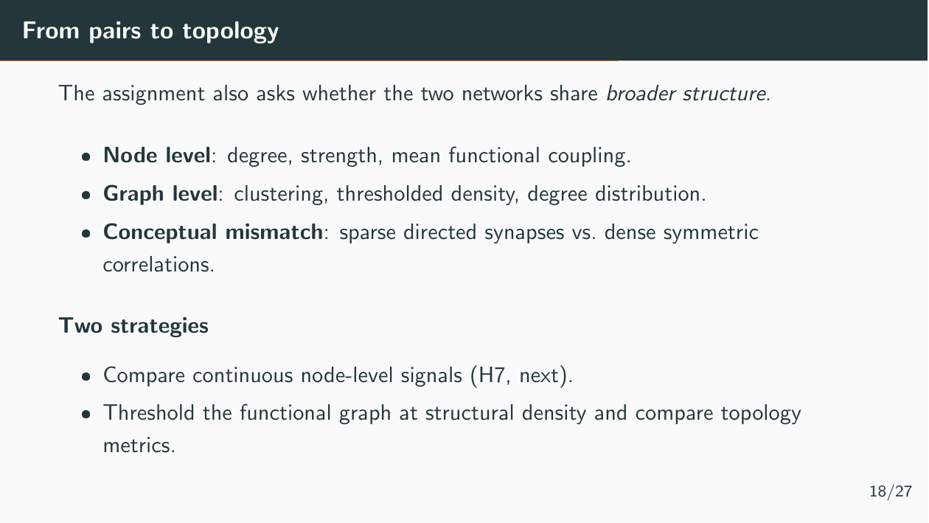
Notes:
At the topology level, we are no longer asking whether one connected pair has higher correlation than one unconnected pair. We are asking whether structurally important neurons are also functionally important. So we compare node-level quantities like degree, synaptic strength, and mean functional coupling, as well as graph-level quantities like clustering. The main caveat is that the two networks are very different objects: the structural graph is sparse, directed, and synapse-weighted, while the functional graph is dense, symmetric, and signed. To bridge this gap, we implemented two main strategies

Slide 23
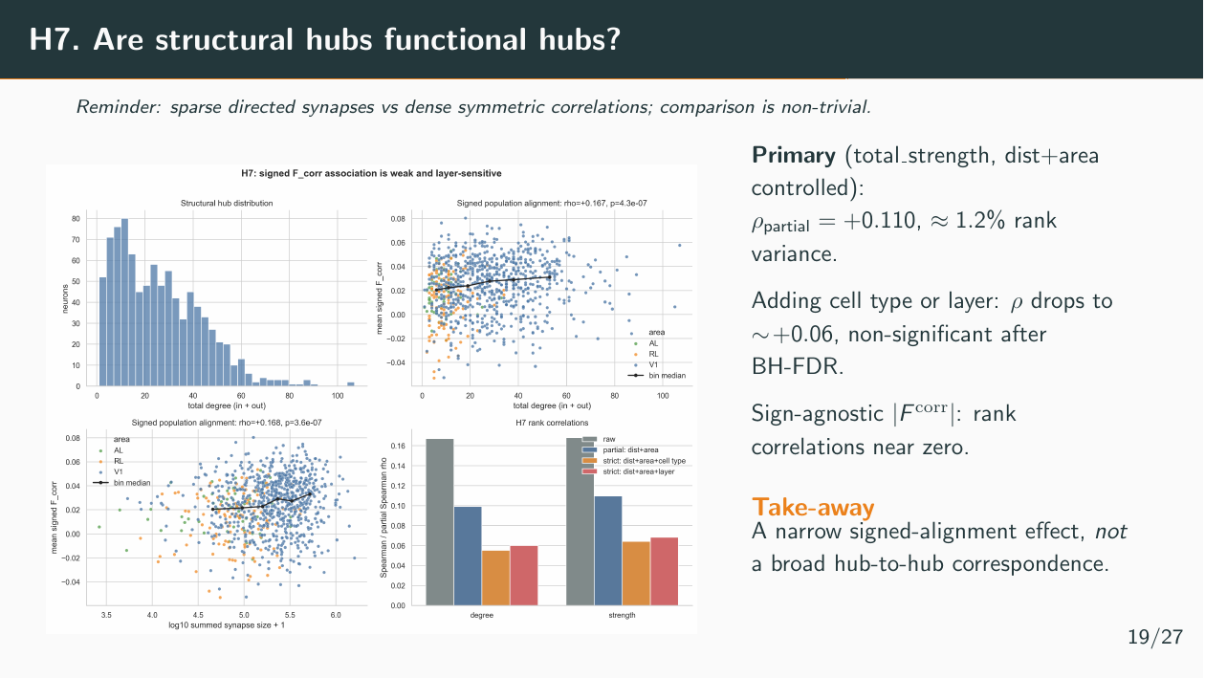
Notes:
The primary result is a partial Spearman correlation of about +0.110 after controlling for distance and area. That is statistically detectable, however it only explains about 1.2% of rank variance, so the effect is very small. When we add stricter controls like cell type or layer, the correlation drops to around +0.06 and is no longer robust after correction. In addition, if we ignore sign and use absolute functional correlation, the relationship is essentially gone. So the conclusion is not broad hub-to-hub matching, but a narrow weak signed alignment.

Slide 24
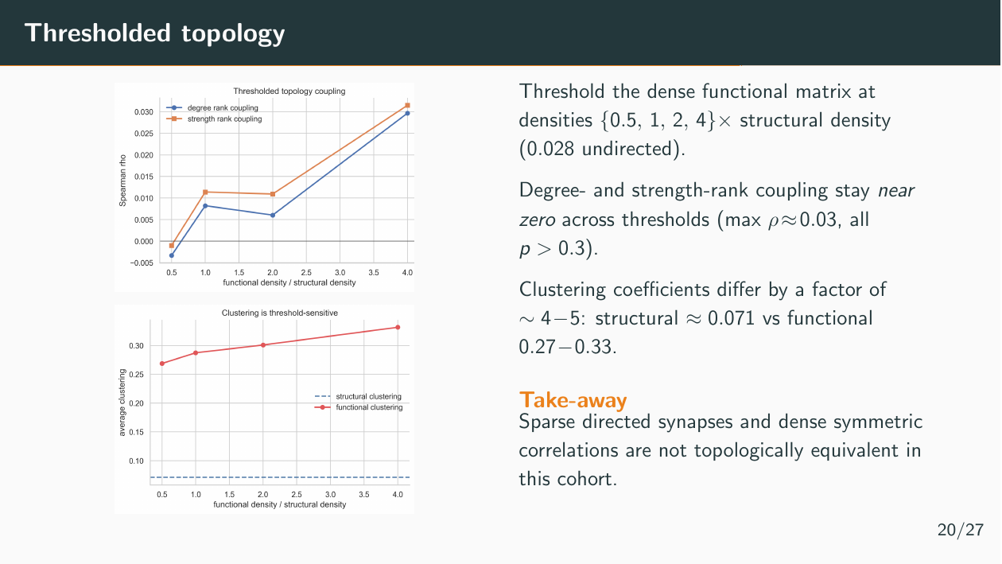
Notes:
Because the functional matrix is dense, we also tried turning it into a sparse graph by thresholding it at densities matched to the structural graph. Across thresholds from 0.5x to 4x structural density, degree and strength coupling stay near zero, with maximum rho only around 0.03 and all p-values above 0.3. Clustering also looks very different: structural clustering is about 0.071, while functional clustering is around 0.27 to 0.33. So even after forcing the graphs to comparable densities, their topology does not match.
The overall conclusion is: connectivity predicts function at the pair level, but the structural and functional networks are not topologically equivalent. Anatomy shifts functional similarity locally, but it does not reproduce the global organization of the functional correlation network.

Slide 25


Slide 26
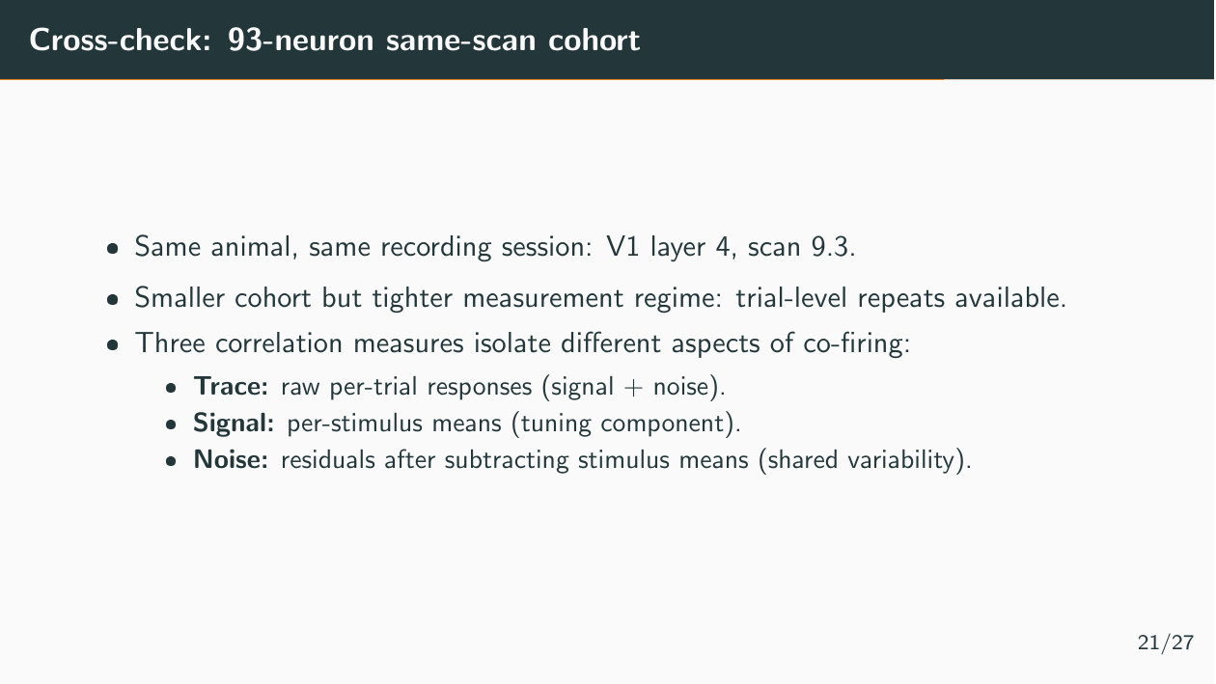

Slide 27
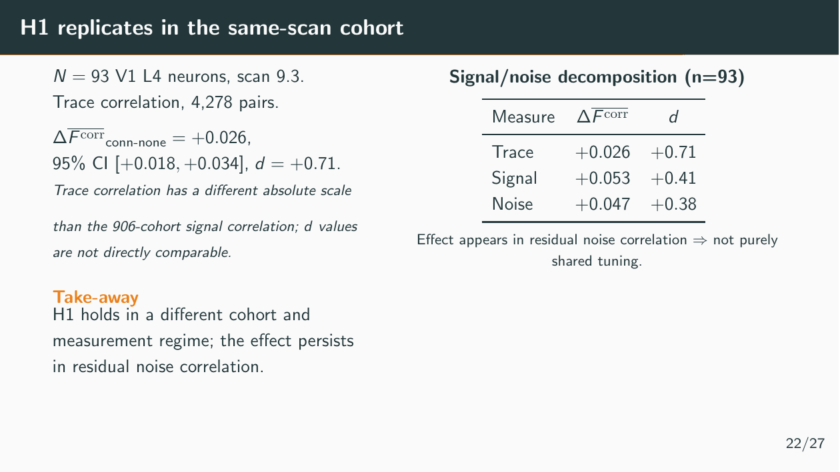

Slide 28
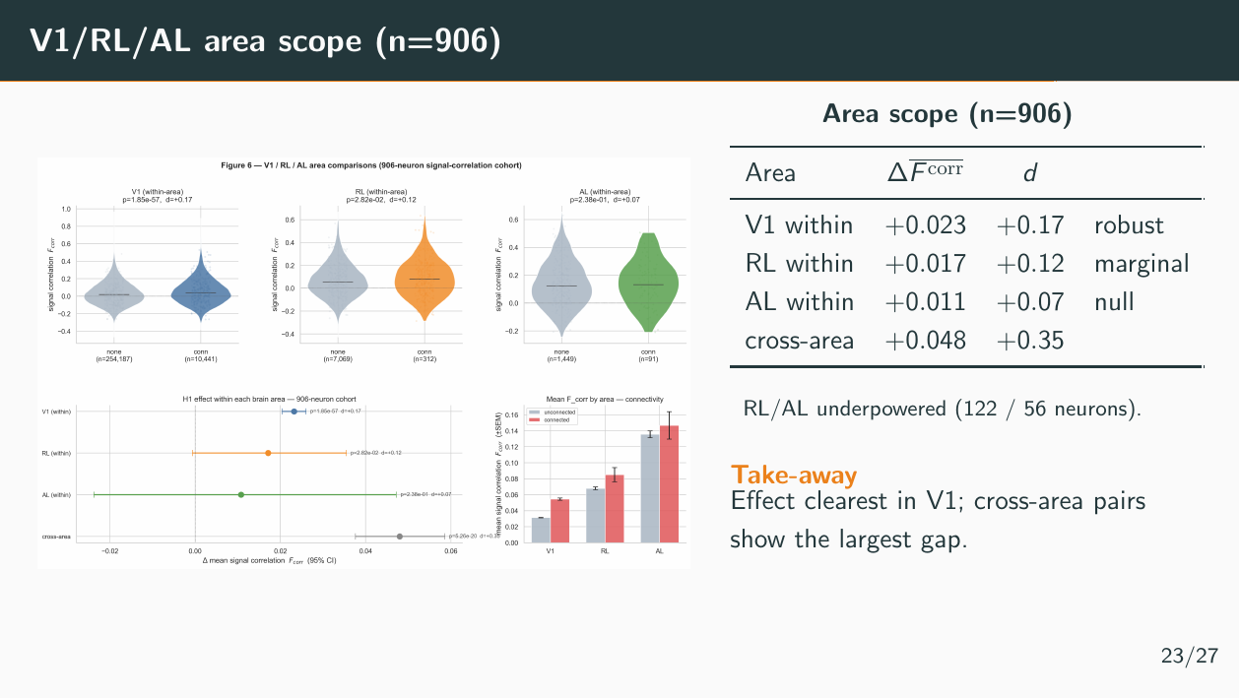

Slide 29


Slide 30
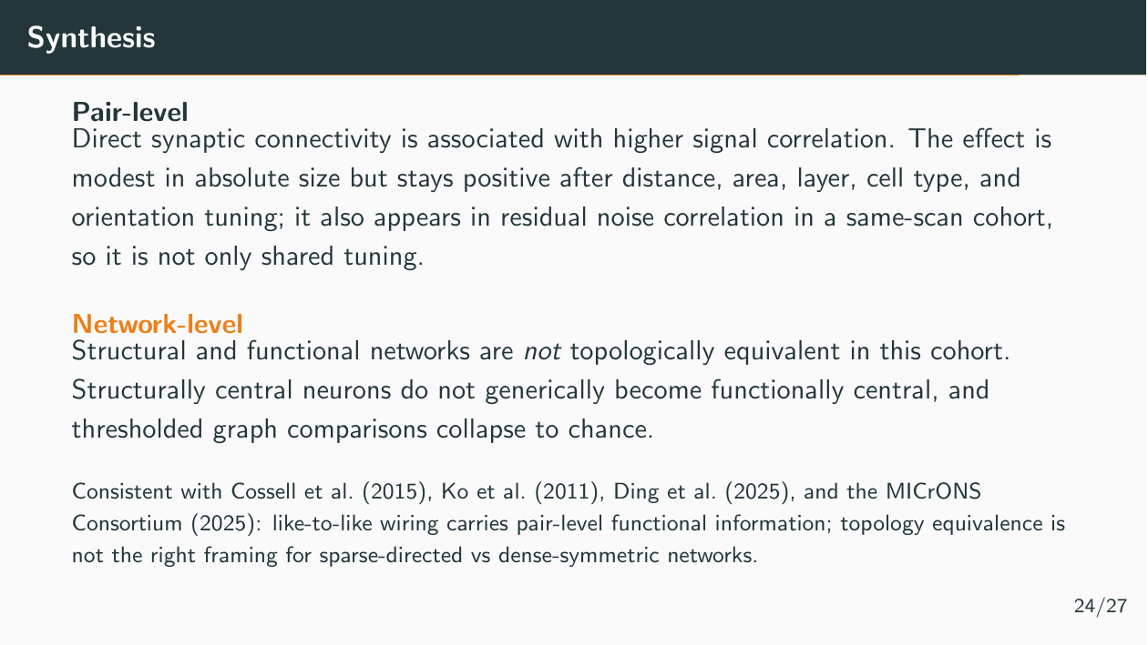

Slide 31
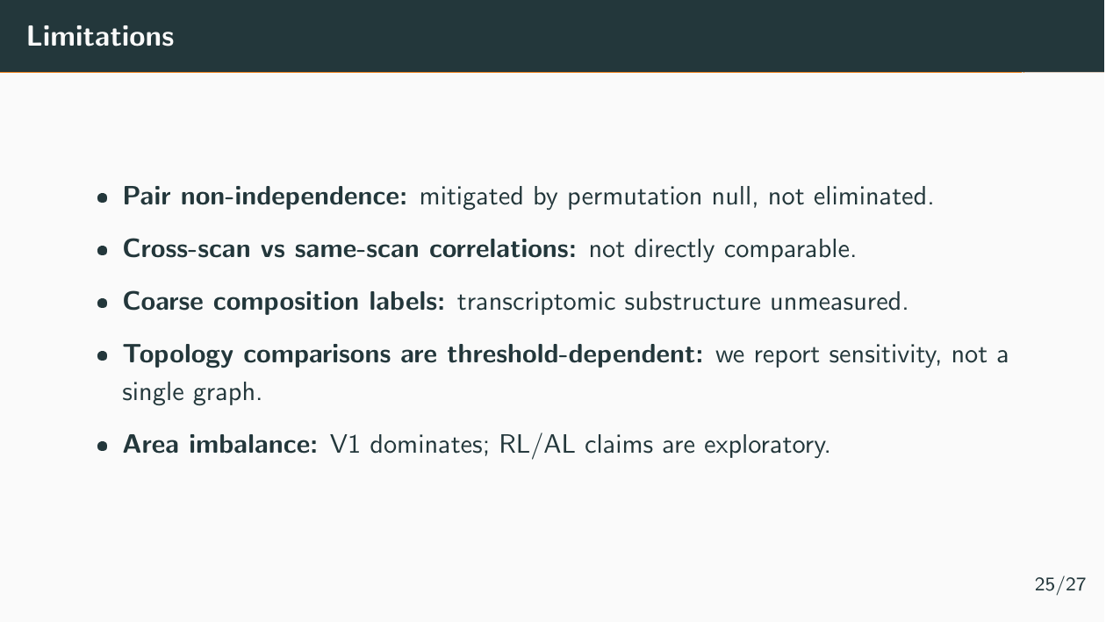

Slide 32
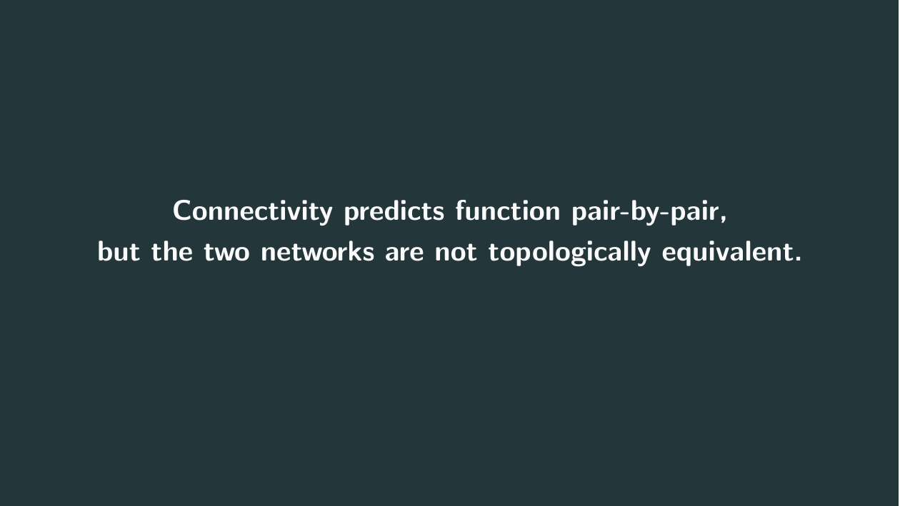

Slide 33
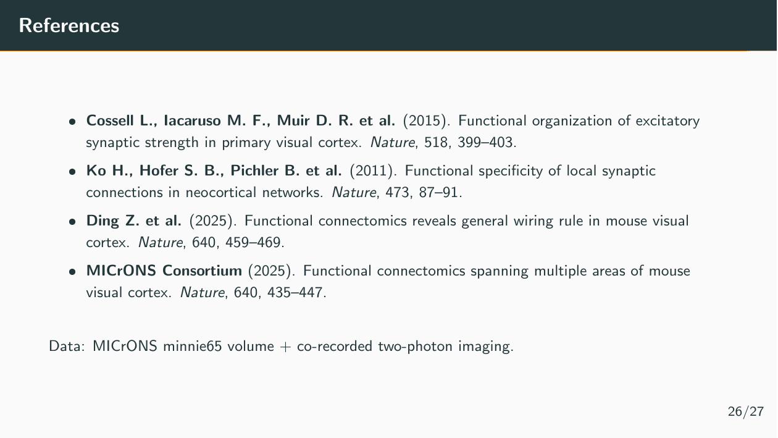

Slide 34
