Slide 1

ACM Git Tutorial

Slide 2
What is source control?
Version control for code
Catalogues snap shots of code over time
Can browse code history at points in time
Lets multiple people work on the same code

Slide 3

Git
Created by Linus Torvalds, creator of Linux
Very fast
Incredible branching system

Slide 4
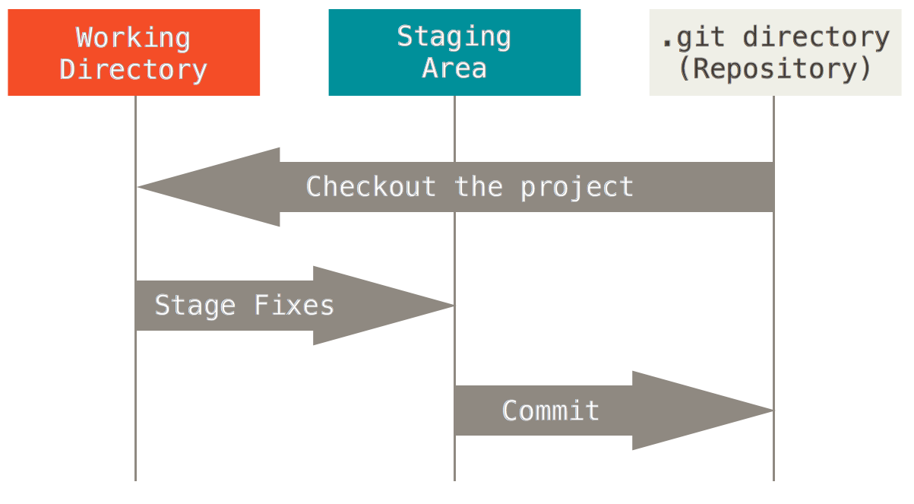
Directory Structure
Working directory is a single version checked out from the local repo
Staging is where files ready to commit to the repo are listed
.git is where commits are stored until checked out

Slide 5
Installation
Linux
(Ubuntu) sudo apt-get install git-all
OSX
Install Homebrew first
Brew.sh: Homebrew’s site
/usr/bin/ruby -e "$(curl -fsSL https://raw.githubusercontent.com/Homebrew/install/master/install)"
brew install git

Slide 6
Installation cont’d
Windows
http://git-scm.com/download/win
“Use Git from the Windows Command Prompt”
“Checkout as-is, commit Unix-style line endings”
“Use MinTTY”
Leave both boxes checked

Slide 7
Some minor config
git config --global user.name "John Doe"
git config --global user.email johndoe@example.com
Editor
git config --global core.editor "C:/Program\ Files/Sublime\ Text\ 3/subl"
git config –global core.editor "C:/Program\ Files/Notepad++/notepad++.exe"

Slide 8
How to terminal
Basic navigation
cd <path> | Change Directory to path specified
ls | List files in directory
mkdir <new name> | Makes a directory with <new name>
touch <filename> | creates a blank file in the directory
mv <filename> | Move a file; also lets you rename it
rm <filename> | Delete File

Slide 9
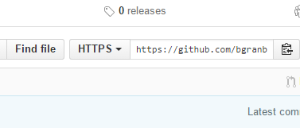
Starting out
Log in to Github.com
https://github.com/USM-ACM/Git-tut
Copy clone URL

Slide 10
Cloning
git clone <url> will pull the repo down locally
cd Git-tut and you’re in the repo

Slide 11
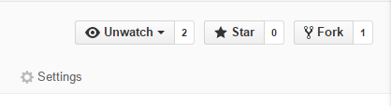
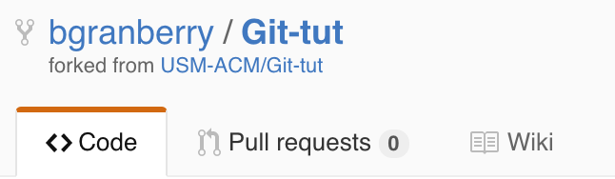
Getting your own copy
Fork the repo to your account
Navigate to your fork from your profile

Slide 12
Adding your fork as a remote
git remote –v to see a list of remotes
git remote add <name> <url> creates a new remote with <name>

Slide 13


Adding your fork as a remote

Slide 14
Committing new code
touch test.txt
git add test.txt OR git add .
git commit’ OR `git commit –m

Slide 15
Write good commits!
Please please please do not write ‘Fixed shit’
Or ‘this is broken’ or ‘debug stuff’

Slide 16
Write good commits!
Good examples include:
Add text box to <specific page>
Created new module <module>
Add unit tests for <thing>
Check out http://chris.beams.io/posts/git-commit/ for more good examples

Slide 17
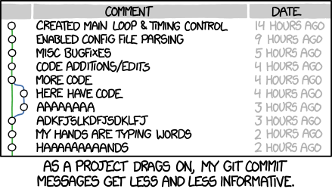

Slide 18
Pushing your code
git push <remote> <branch>
Its as simple as that!

Slide 19
Pulling code
Very similar, git pull <remote> <branch>
Internally performs a ‘fetch’ and ‘merge’, but don’t worry about this yet.

Slide 20
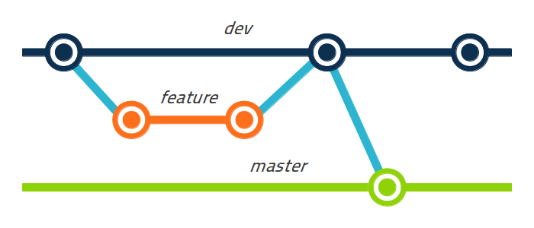
Branching
Branches ’branch’ off of the primary version of the code
Changes in the branch do not affect any other branch until merged

Slide 21
Branching
Default branch is ‘master’
New branches can be made using either:
git branch <name>
git checkout –b <name>
Checkout is also used to switch branches

Slide 22
Branching
Create a new branch, say test-branch
test-branch is identical to master in everything except its future changes
It is a “branch” off of master, where changes will not affect master
Note: This also means changes to master do not affect test-branch

Slide 23
Merging
Commit some change to test-branch
Move back to master ‘git checkout master’
Merge test-branch into master ‘git merge test-branch’
Make sure you have checked out the target branch first!

Slide 24
Scary merging(AKA Conflicts)
Set up a controlled fire merge conflict
Commit a new change to master
Switch to test-branch
Commit new change to test-branch
Attempt to merge test-branch into master

Slide 25
Conflict resolution
Things will fail. This is normal
Two different versions of the file are present
Source(master)
Target(test-branch)
You must manually decide which parts of each file belong in the merge

Slide 26
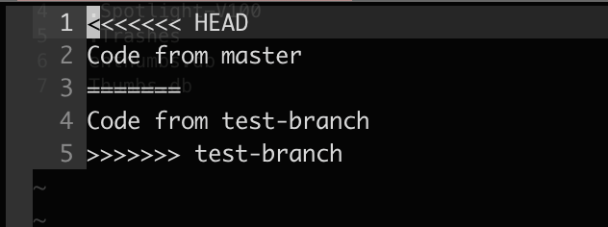
Removing conflicts
Conflicting code will be wrapped in conflict markers
Code between HEAD and the ===== is code that is committed to master
From ===== to test-branch shows conflicting code from test-branch

Slide 27
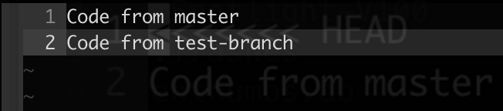
Removing conflicts
Carefully select which code to merge manually and delete the markers
Multiple sets of markers for separate conflicts, even on the same file
Save file

Slide 28
Finishing the merge conflict
Add the file that was conflicting
Create a new commit to confirm the merge
You’re done!

Slide 29
Pull Requests
On to Github!
When you don’t have push access to a repo, use a pull request
PR’s tell the owner to pull and personally merge commits in the PR

Slide 30
Pull Requests
Go to your fork
Click ”New pull request”
The base fork should be the original repo
Head fork is the repo to merge code from
Select the appropriate branch to merge into
Make a descriptive and helpful PR message and you’re done!
The admin can automatically merge conflict-free branches using Github

Slide 31
Helpful resources
git <command> --help
https://help.github.com/
https://git-scm.com/doc
http://chris.beams.io/posts/git-commit/

