Slide 1

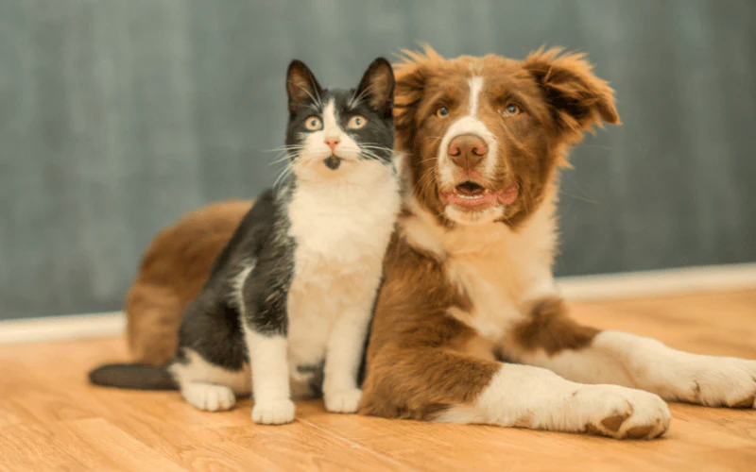
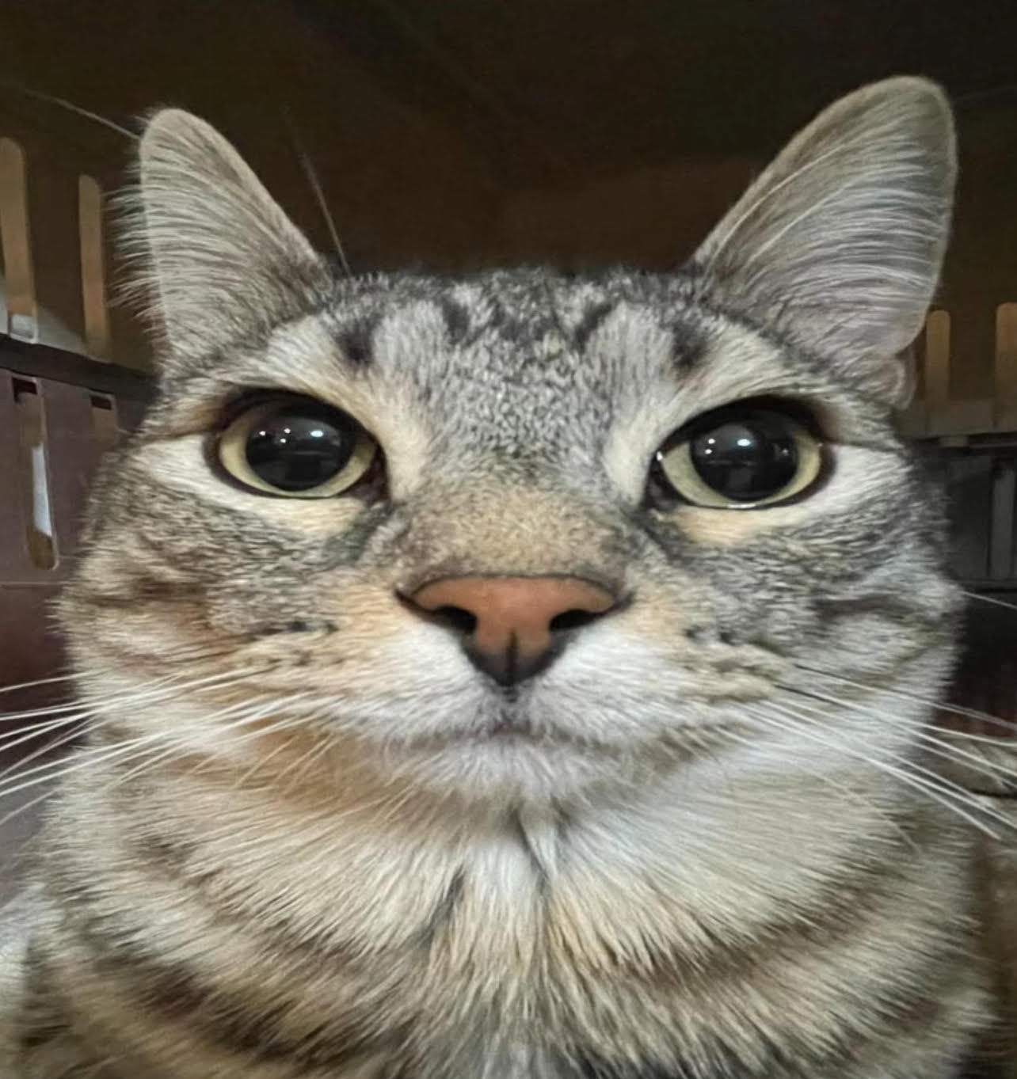
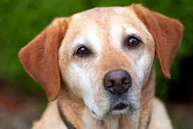
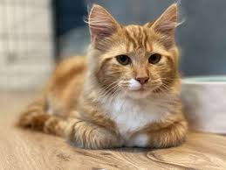
Paws Animal Rescue
Home Adopt Get Involved How It Works About Contact
Find your new best friend!
Paws Animal Resuce connects loving families with pets in need of a forever home.
Featured Friends
Why Adopt with Us?
We are a non-profit rescue dedicated to matching pets with caring homes. Every adoption includes vaccinations, microchipping, and support after adoption.
How Adoption Works
View Adoptable Pets

