Slide 1
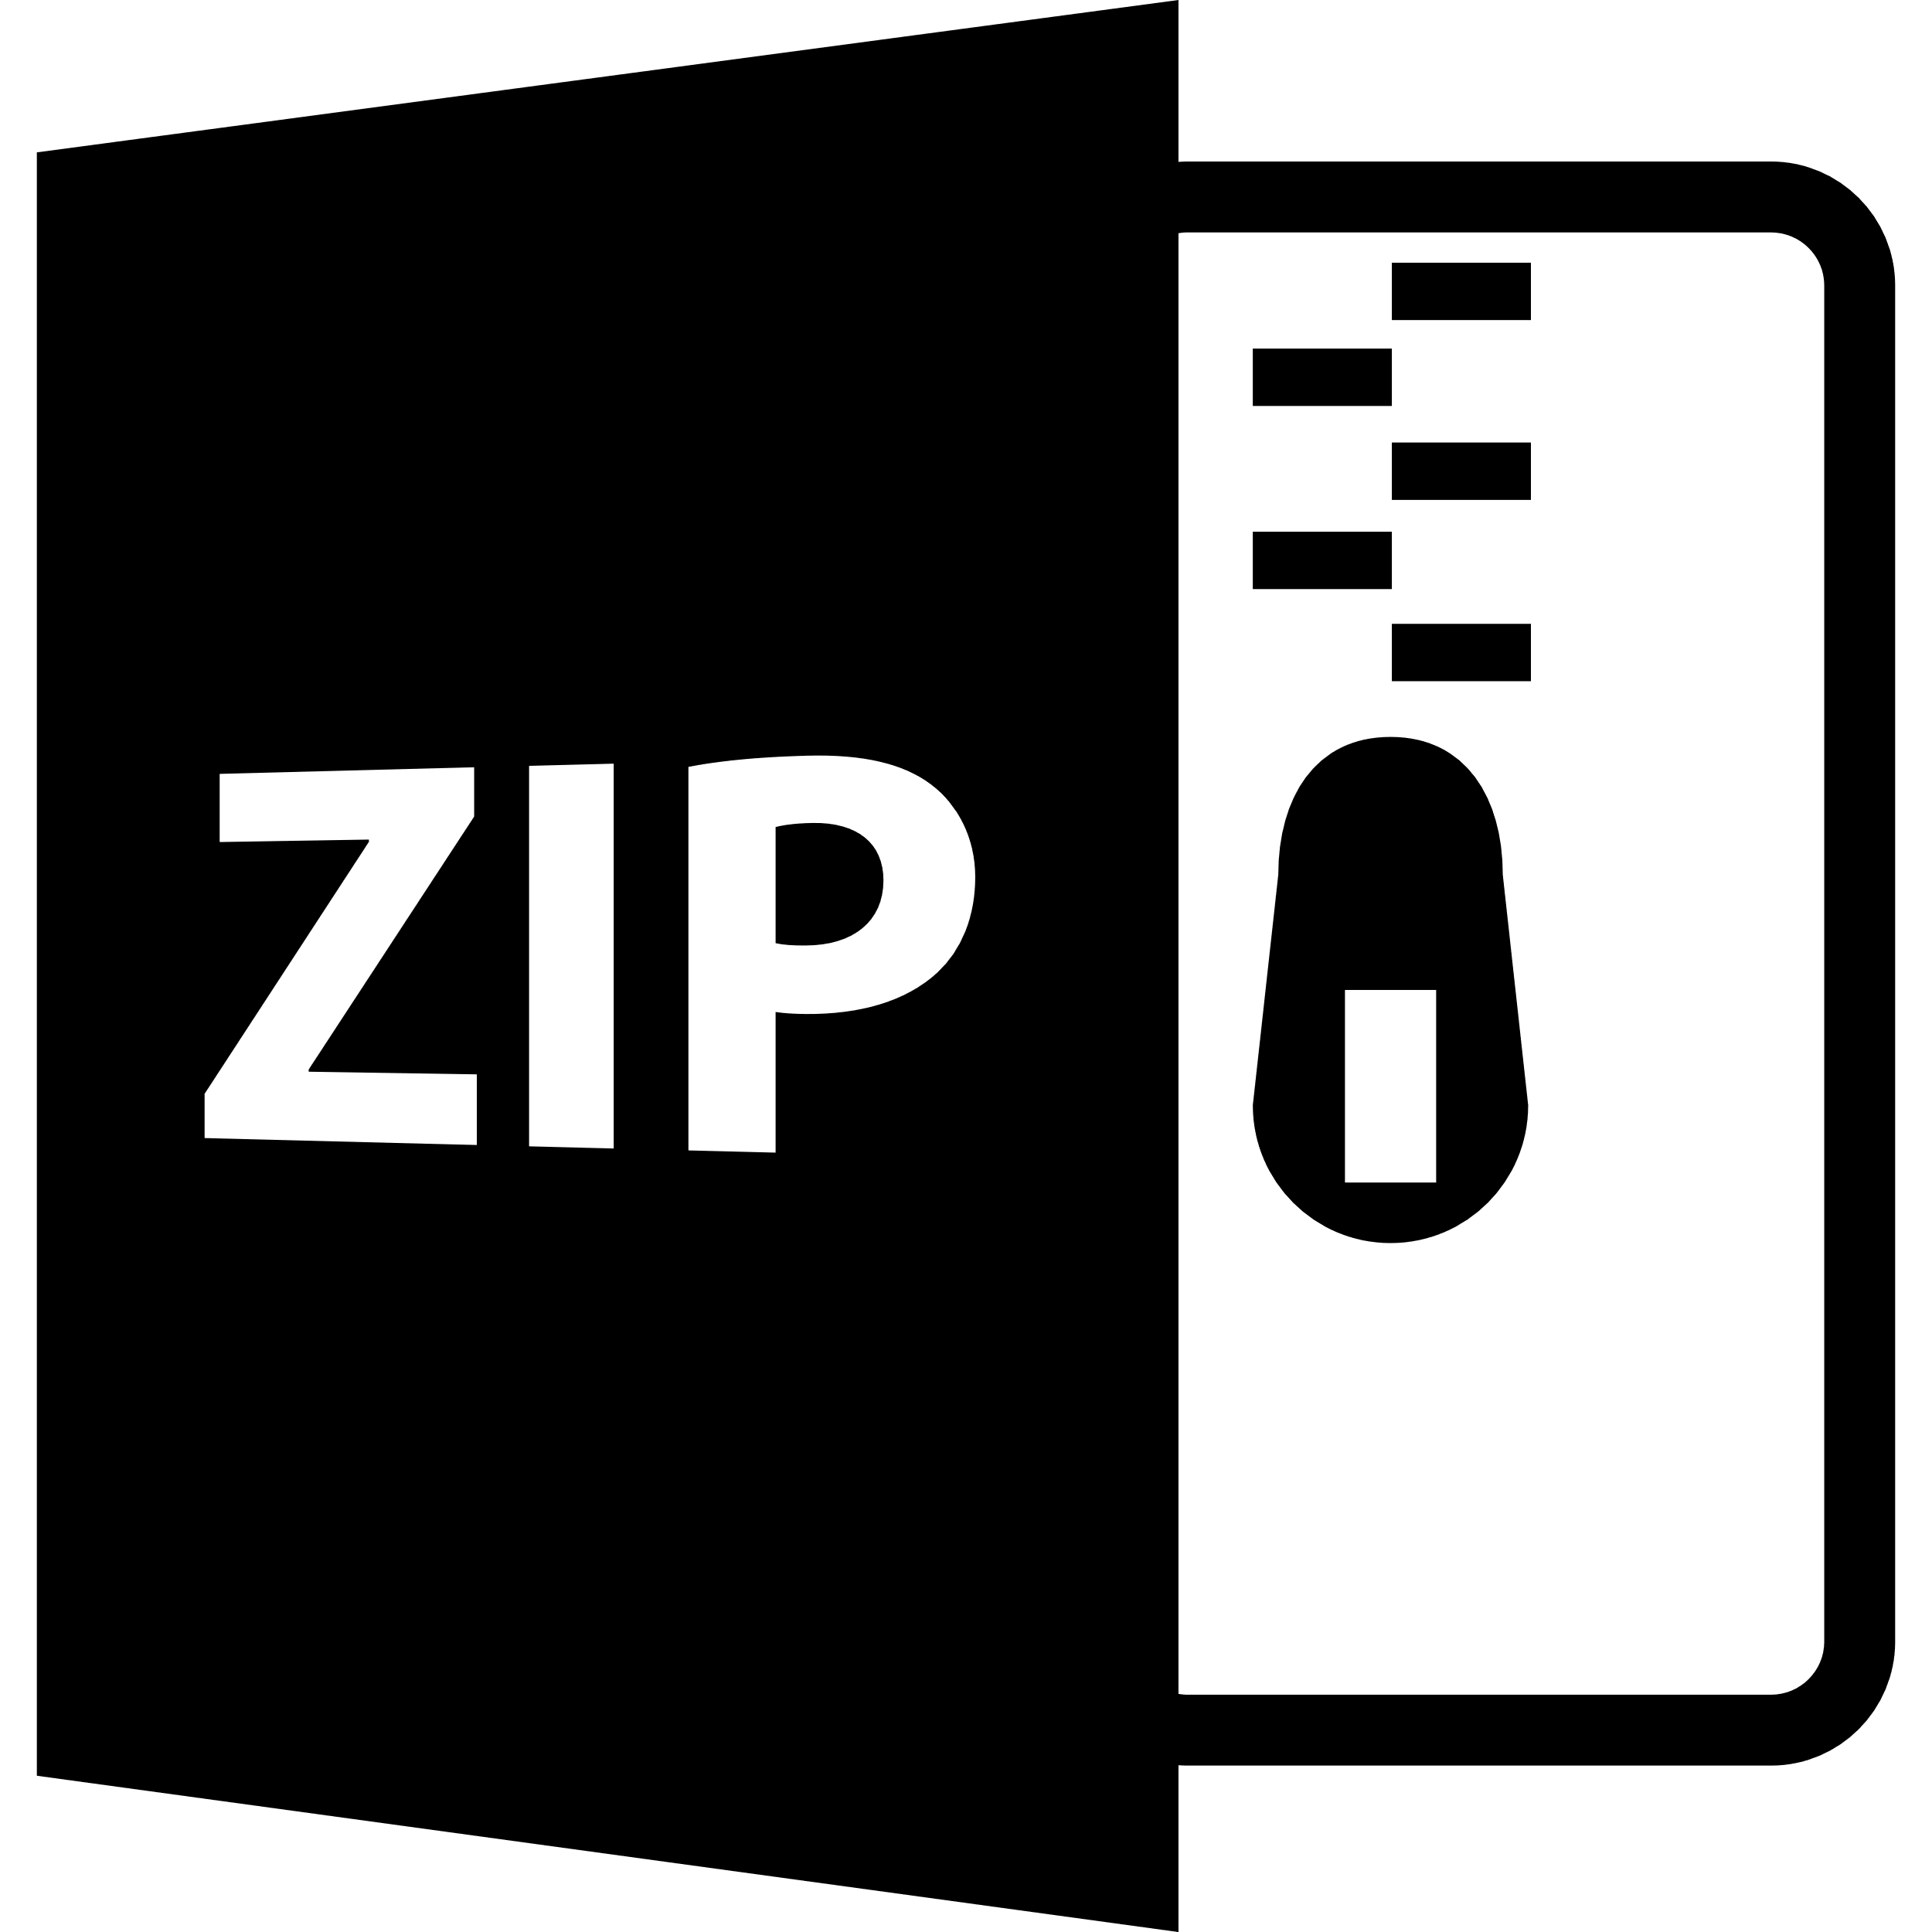

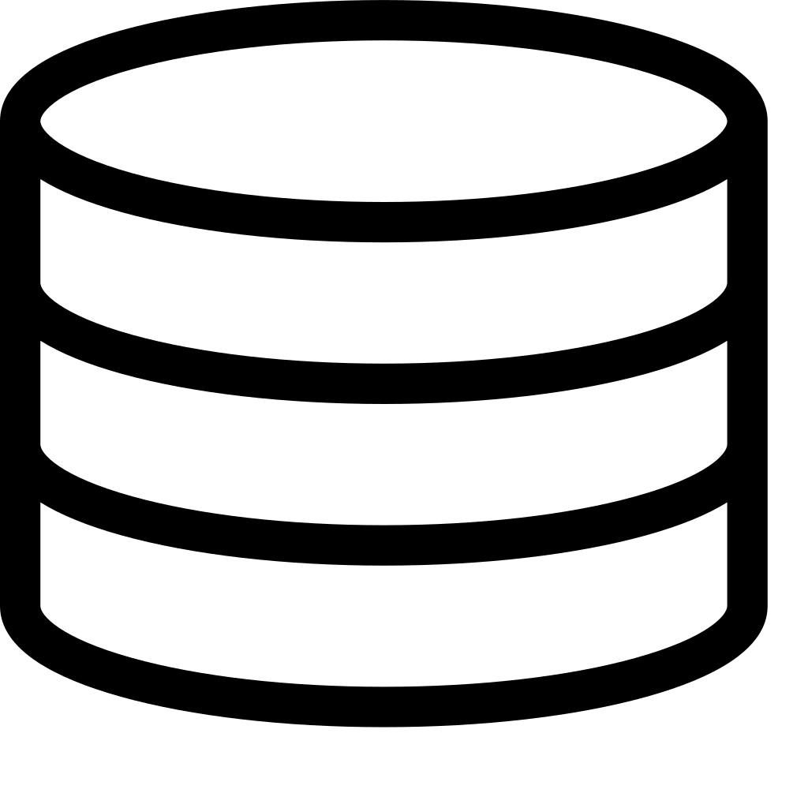
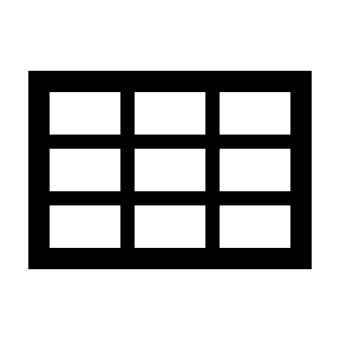
Data
Collection
Erigon Archive Node
Etherface
1
Ingest Observation Window
2
Add Signatures
Blocks
Postgres Database
Transactions
Logs
Model Smart Contracts
3
Tabular Dataset
Code
Traces
4
Feature
Engineering
Dataset
Creation
/
Longit.
Analysis

