Slide 1
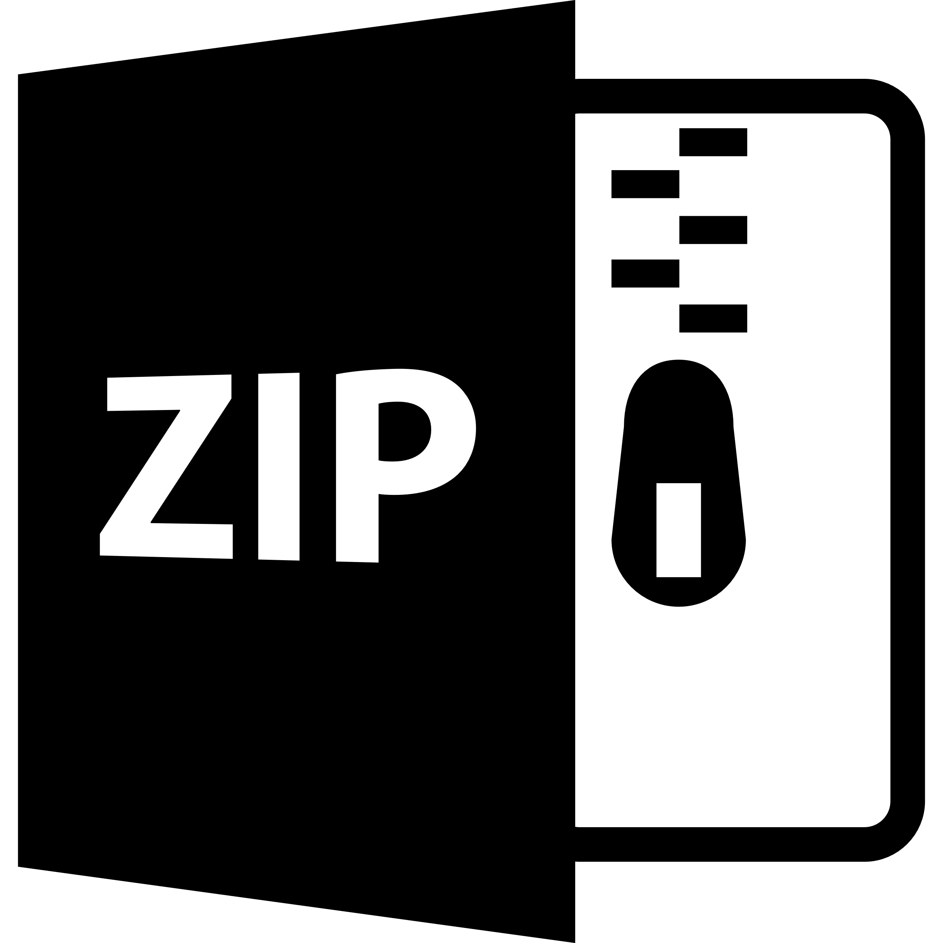

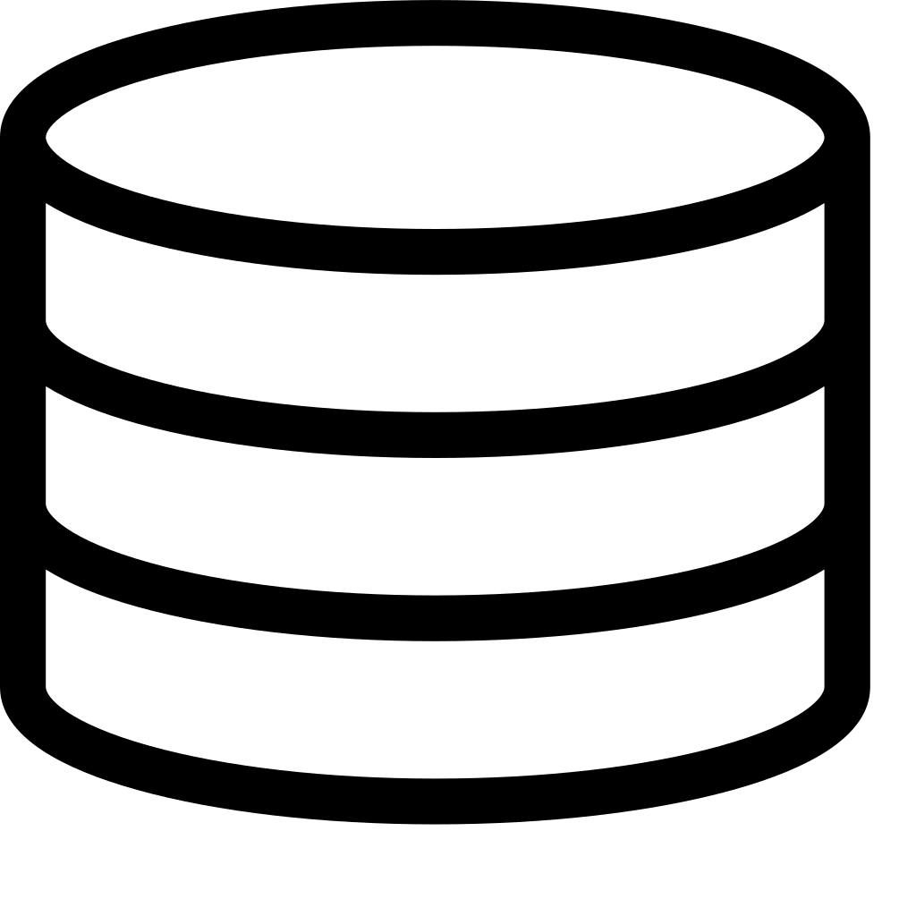

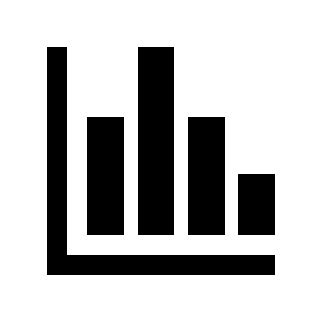

Erigon Archive Node
Postgres Database
Binance
Price Data
Blocks
Transactions
Transactions
Signatures
Logs
Etherface
Logs
Code
Code
model smart contracts
Traces
Tabular Dataset
Feature
Engineering
Preprocessing
Analytics
Experiments

