Slide 1
Space Invaders
4-Geavanceerd programmeren
Bas Calders

Slide 2
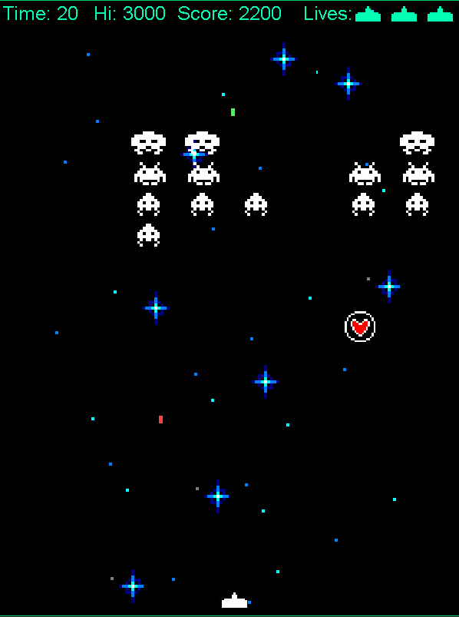
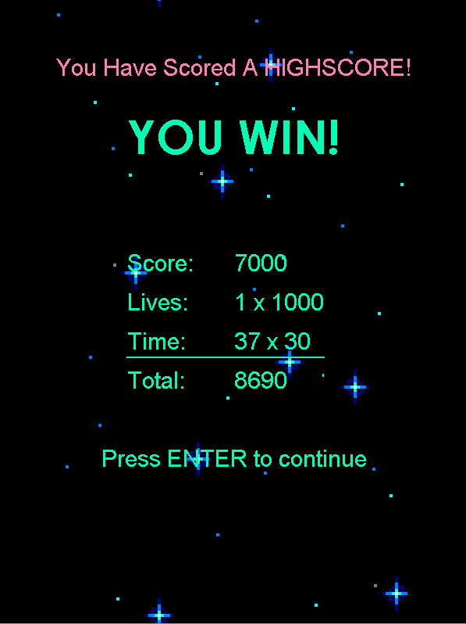
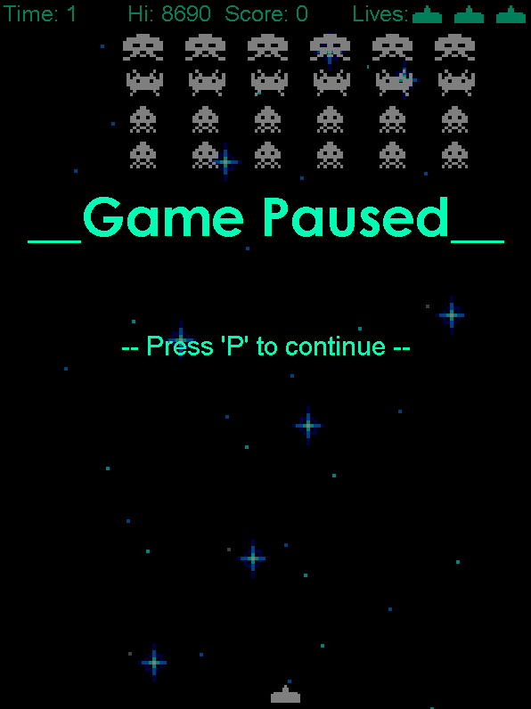
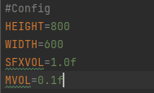
Space Invaders
Working High Score system
Persistent soundtrack and animated background through all game stages
Working pause screen
Random bonus drops
2xPoints, Shield, Health and BoostBack
Config used to setup game variables
Texture Loading happens in beginning once, to keep loading times minimal

Slide 3
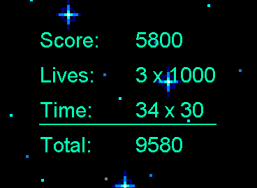
Scoring System
In-game Score
Lives Remaining
Time taken
Enemy killed: +200
Bonus grabbed: +1000
Double Points bonus: all scores received during bonus x2
Player gets 1000 points for each life remaining at the end of the game
Player gets 30 points per second he finished less than one minute
(60 – timeTaken) x 2 = timeScore
Every second over one minute = negative points
High Score
Updates in real time if player exceeds previous high score while in-game
Persistent over game restarts and re-runs

Slide 4
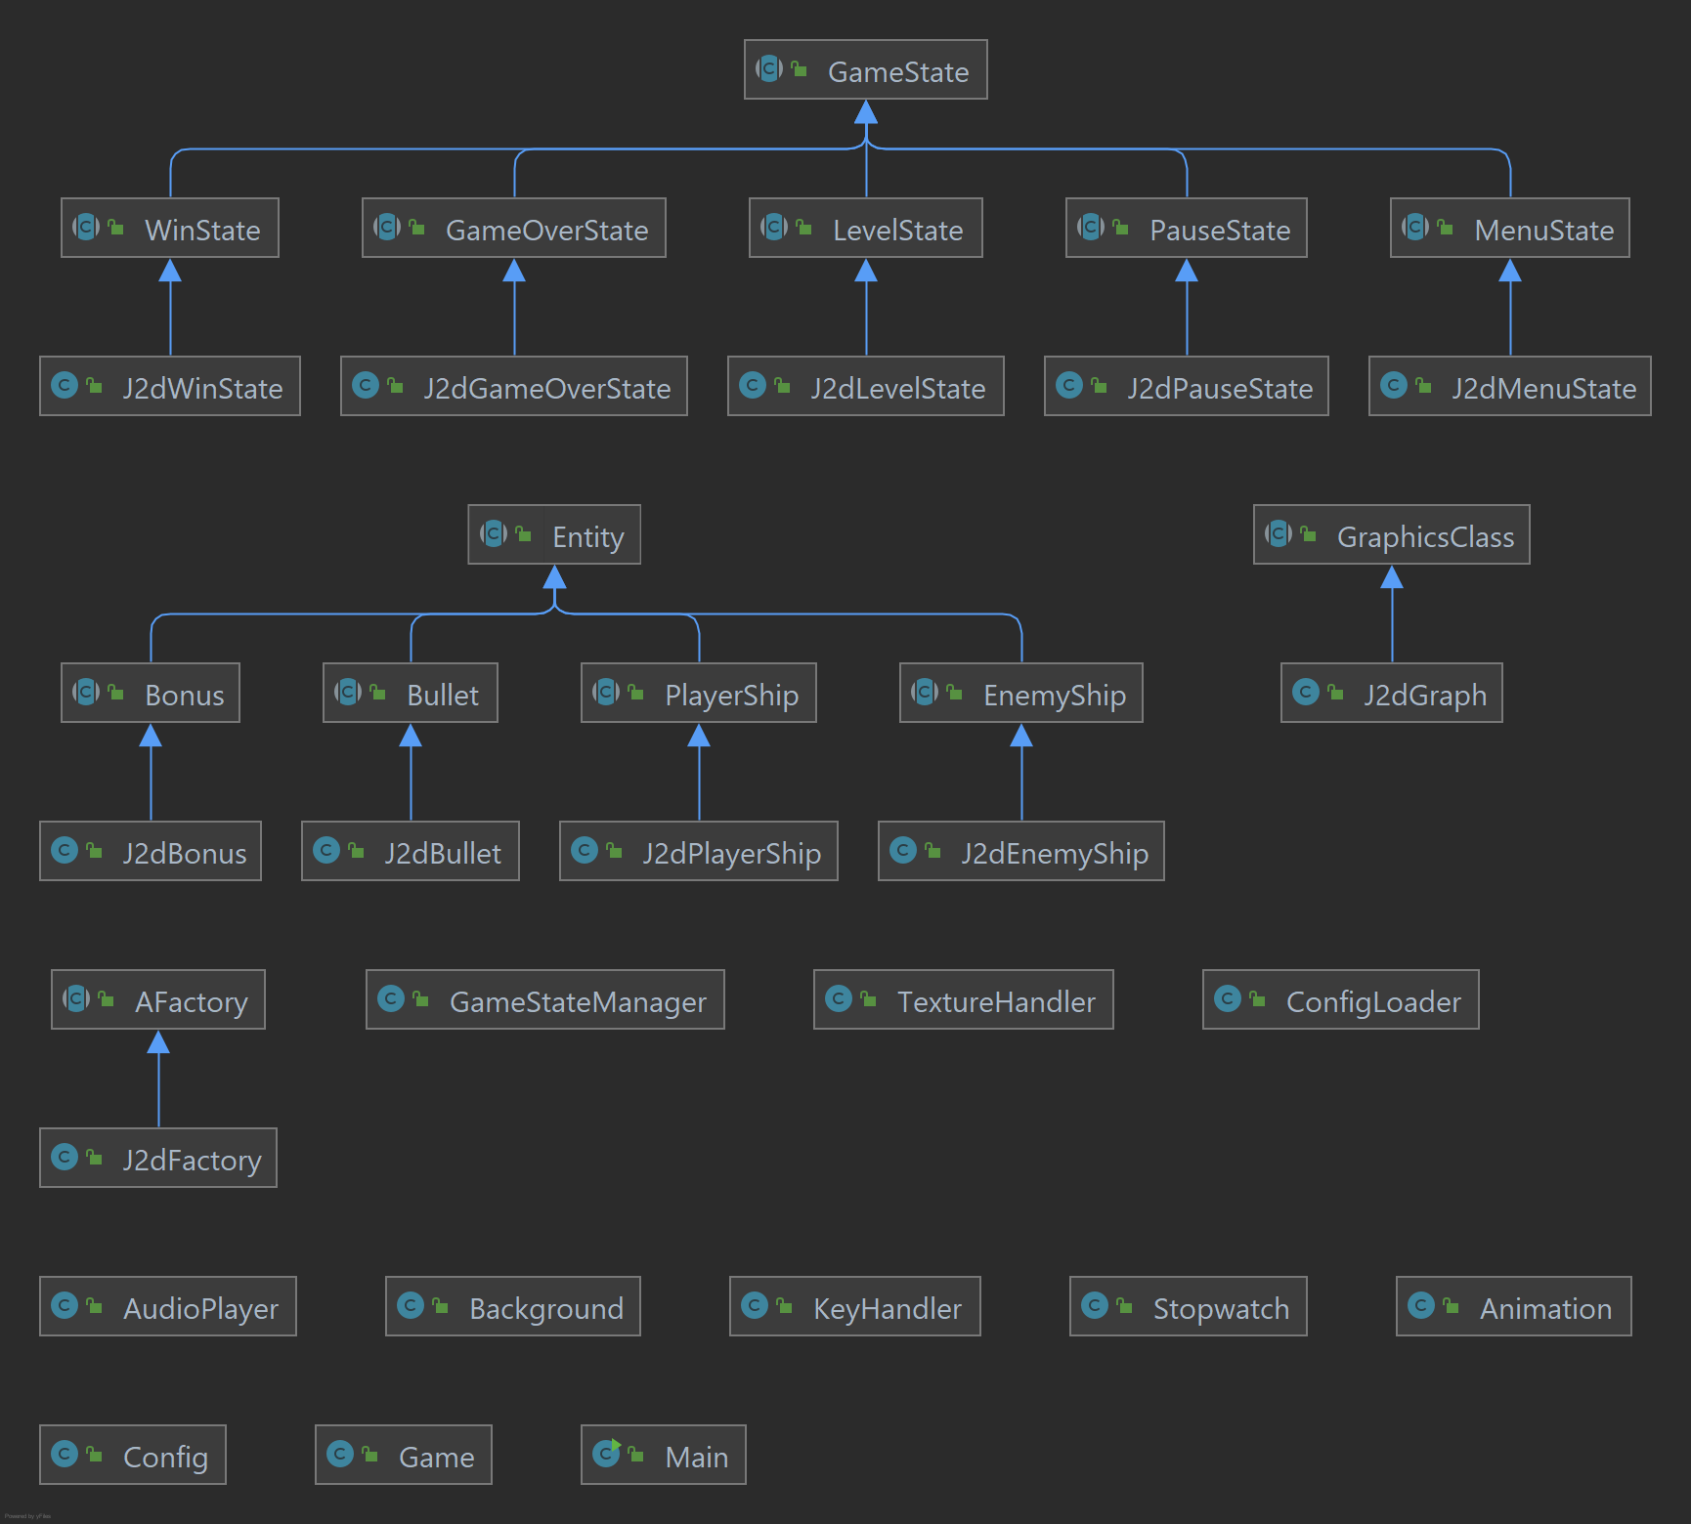
Class structure
Clear distinction between classes for visualization and engine classes
All necessary objects and setup to run and update the game are contained in the LevelState Class

Slide 5
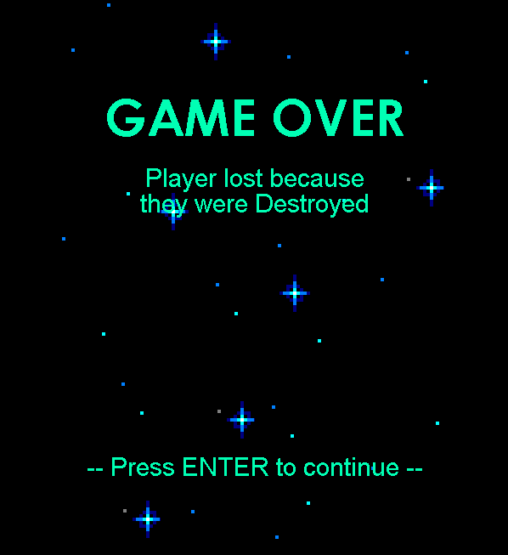
Not implemented
Data oriented programming
Not really an advantage in my case
Made it more obfuscated

