Slide 1


Nutri-Connect: A Comprehensive Nutrition and Health Tracking Solution
Prototype Présentation

Slide 2
TEAM DETAILS
Section: ECE-S1
Team Members & Ideas
Student Name | Student ID | Role
B. Charan Teja | 2310040035 | Leader
Anush Thak | 2310040029 | Member
Sai Sanju | 2310040028 | Member
Sravya | 2310040032 | Member
Kavyanjali | 2310040033 | Member
2

Slide 3
Introduction to Nutri-Connect
Nutri-Connect is a mobile app designed to help users maintain a balanced diet, track physical activity, and solve disease-related queries.
Key Features include: - Check Item - Disease Solve - Delivery - Physical Health - Add Menu

Slide 4
Problem Statement
Many users struggle with maintaining a balanced diet and tracking their physical health. Nutri-Connect aims to offer a personalized solution for healthier lifestyles.

Slide 5
Check Item:
Data Storage: You can use a cloud database (like Firebase or AWS) to store information
about various food items and their nutritional values. When a user inputs a food item (e.g., tomato curry),
the app queries the database to retrieve and display the associated nutrients.
API Integration: You can integrate nutrition APIs (like Edamam or USDA FoodData) to pull real-time nutrient data for different food items.
Disease Solve:
Data Storage: You can maintain a database with disease names, symptoms, recommended medicines, and preventions.
AI/ML Integration: The app can leverage a symptom-checking API or an AI model to provide relevant medical suggestions based on the user’s
input.
Delivery:
Logistics System: You’d likely need an interface with a delivery system or API integration (like Uber Eats or custom delivery partners) to process
orders and track deliveries.
Physical Health:
Sensors: You can use smartphone motion sensors (accelerometer, pedometer) to track steps, and fitness APIs (like Google Fit or Apple Health)
to track physical activity.
Contests: The app can store user steps and participation in a centralized database. A leaderboard can be updated in real-time, with rewards
provided based on contest rules.
Add Menu:
Data Collection: Users can input daily meals into the app. The app stores this data in a database and uses it to analyze nutritional gaps.
Report Generation: At the end of the week, the app runs an analysis to compare what the user ate against recommended daily intakes.
It provides a report detailing missing vitamins, minerals, and the consequences of these deficiencies, while recommending foods to fill these gaps

Slide 6
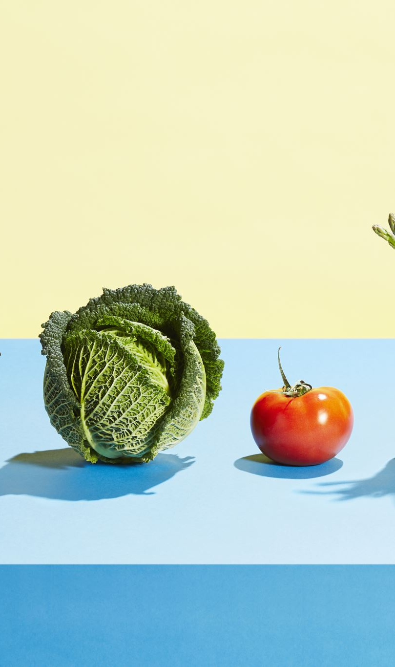
Feature 1: Check Item
Allows users to input any food item to get details on its nutritional content such as vitamins, minerals, proteins, etc.
Data is sourced from a large nutritional database, and users get instant feedback.

Slide 7
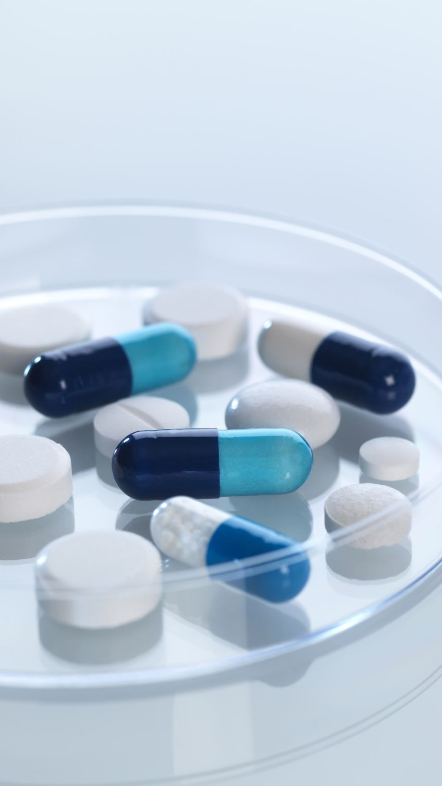
Feature 2: Disease Solve
Allows users to input symptoms or diseases to receive medical advice, suggestions for medicines, and prevention tips.
Powered by AI-based recommendations using data from trusted medical sources.

Slide 8
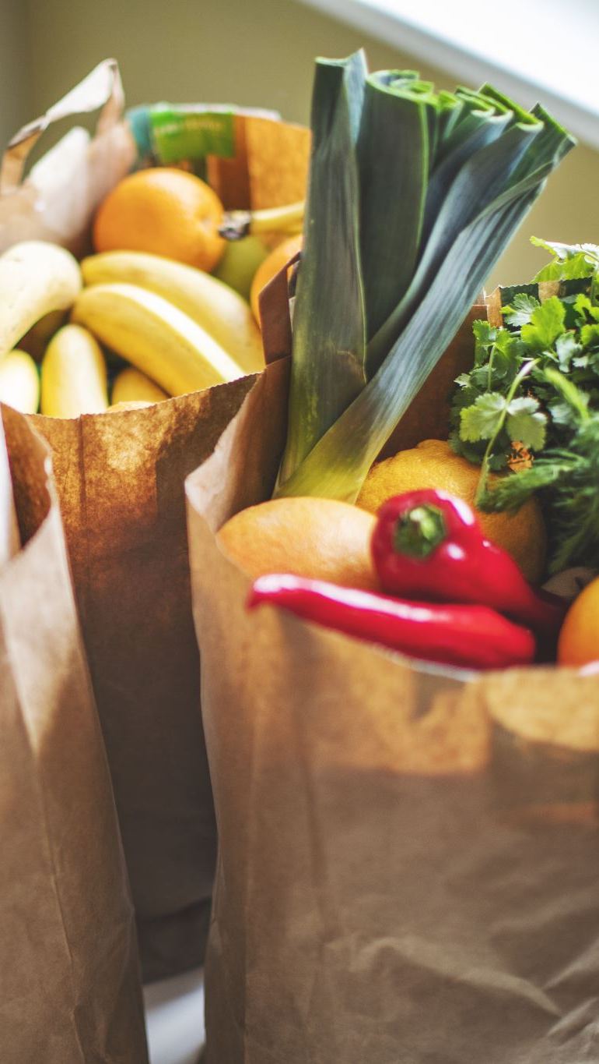
Feature 3: Delivery
Users can order food items through the app, with nutritional data to help fill weekly dietary gaps.
Integrates third-party APIs for delivery services.

Slide 9
Feature 4: Physical Health
Tracks steps, provides exercise routines, and offers monthly step contests for users to win rewards.
Utilizes mobile sensors to track physical activity.

Slide 10

Feature 5: Add Menu
Users input daily meals, and at the end of the week, the app provides feedback on missing nutrients and suggests foods to fill the gaps.

Slide 11
How Nutri-Connect Works
• Stores data in cloud databases.
• Machine learning analyzes food intake and health metrics.
• Mobile sensors track physical activity.

Slide 12
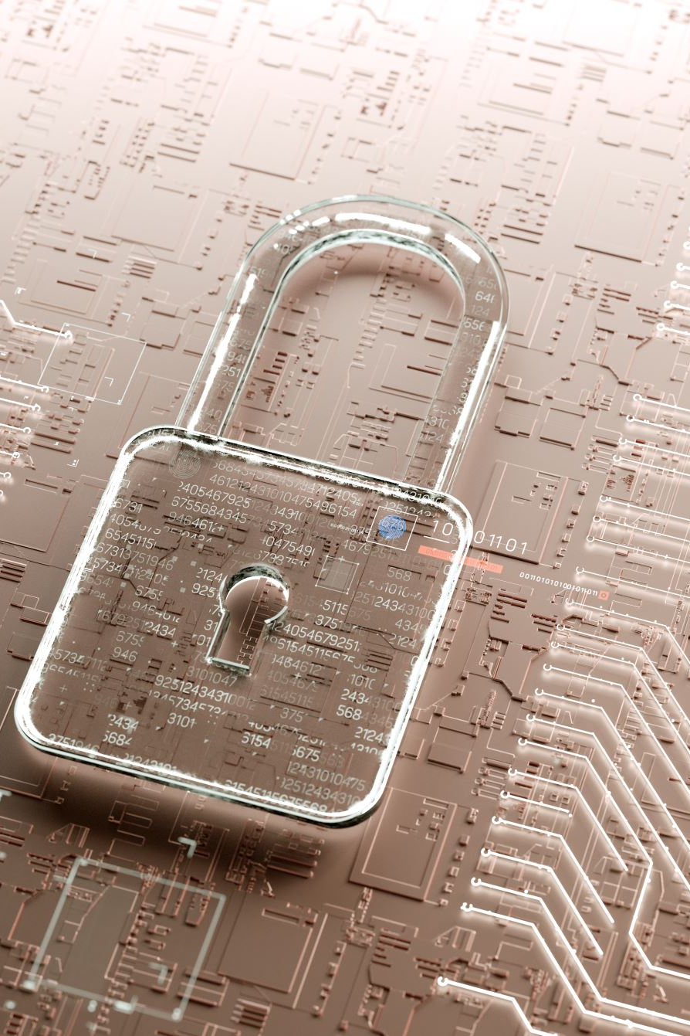
Security and Privacy
User data is stored securely and encrypted to ensure privacy. Personal health information is never shared without consent.

Slide 13

Future Enhancements
• AI integration for advanced nutritional and health suggestions.
• Support for wearable devices like Fitbit for enhanced health tracking.

Slide 14
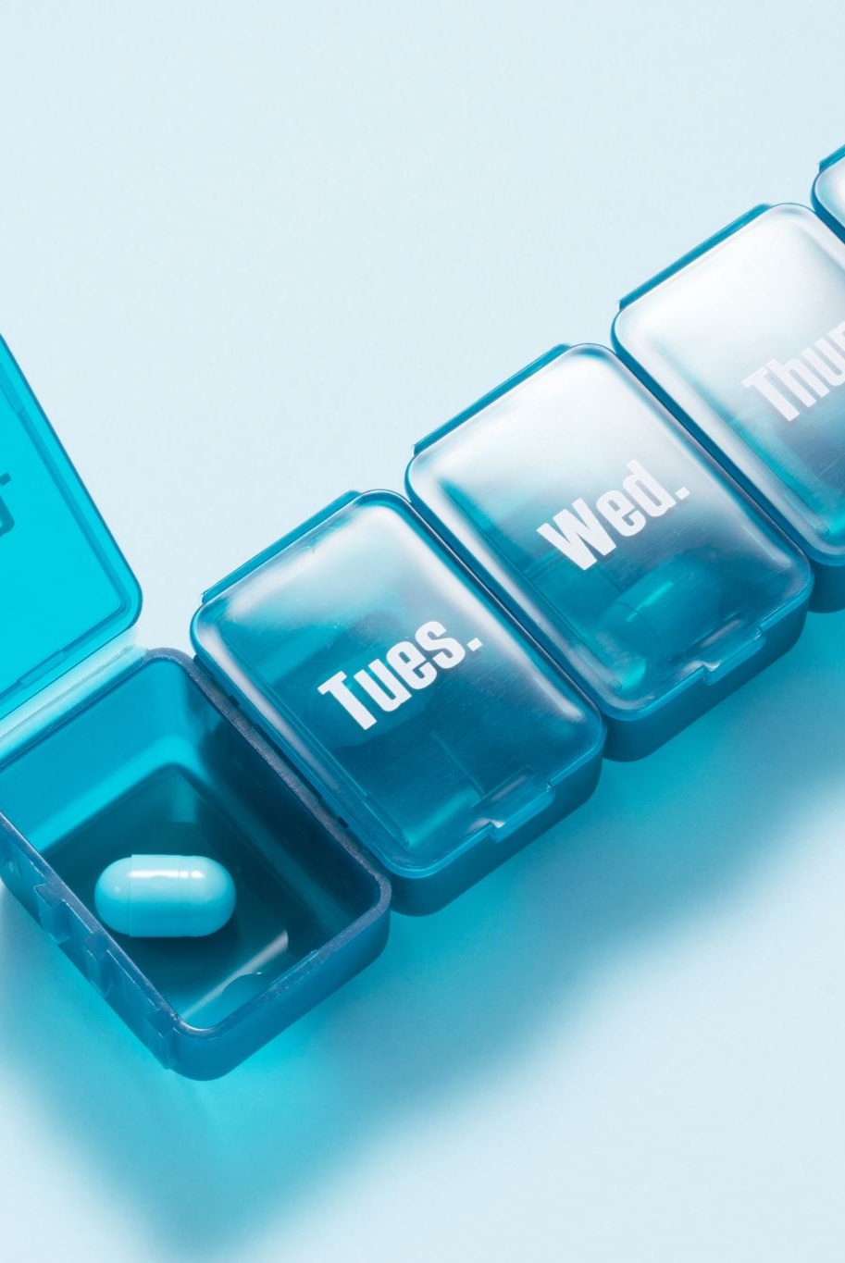
Conclusion
Nutri-Connect is a comprehensive app for tracking nutrition, health, and physical activity. Its unique features provide personalized feedback to help users maintain a balanced lifestyle.

Slide 15


Thank You

