Slide 1











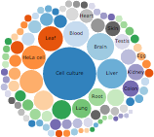




Databases
DDI XML
EBI Search Indexer
CACHE SERVERS
EBI CLUSTER
Indexed Data
INDEXING ENGINE
Lucene
Indexes
REST WS
Lucene
Indexes
SEARCH
ENGINE
520GB
1.1B entries
RESTFUL WS
DATABASE
End points:
Statistics
Datasets
DDI App
WEB APP
SEARCH
STATISTICS
TAGGING

