Slide 1
Ice Cream Flavor Finder
What flavor should you try next?
By: William Grennan

Slide 2
No Accounting for Taste?
So many flavors - 241
How can we find the one for us?
Ice Cream flavor reviews can lead us to the right answer

Slide 3
What Data is Useful and Available?
Four major brands
Ben and Jerry’s (bj)
Häagen-Dazs (hd)
Breyers (breyers)
Talenti (talenti)
Flavors and Reviews compiled from corporate websites
241 Different Flavors
21,674 Reviews

Slide 4
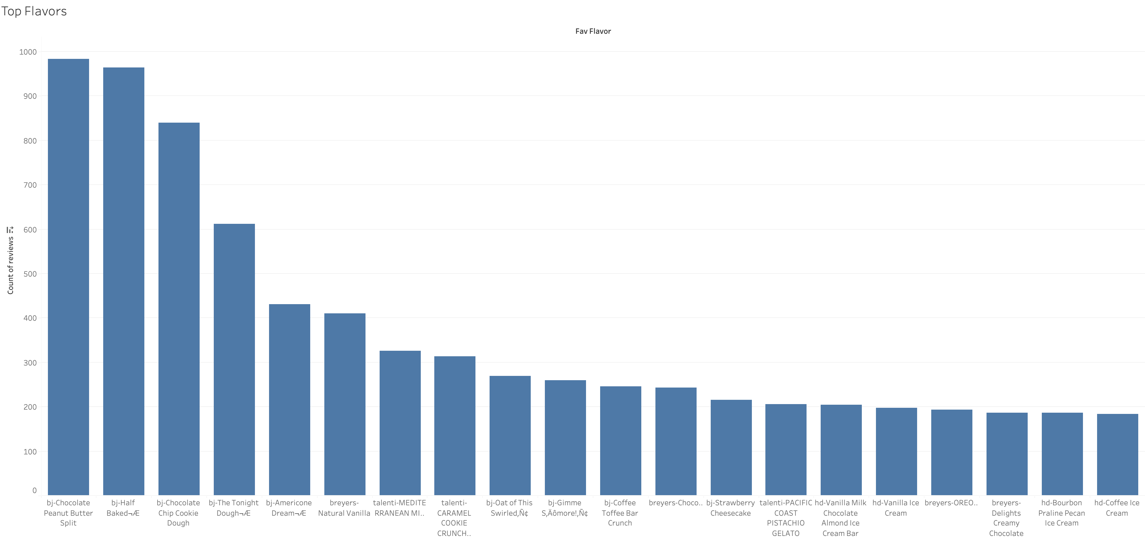
Initial Findings
The quick answer is to track the active reviewers and their favorites

Slide 5
What else can we learn?
Tableau Dashboard
Use the Favorite Flavor finder
Ex.
Breyers – Reese’s
Recommend: Ben and Jerry’s - Chocolate Peanut Butter Split
Recommend: Breyer’s – Oreo

Slide 6
Initial Conclusions
Customer Reviews can get us a base
Result Limitations
Many reviewers only review a single product
Some

Slide 7
Future Work
Use Edit Distance to quantify reviewer taste similarity
Standard Fuzzy Matching uses Levenshtein distance
‘abc’ and ‘abd’ have Levenshtein distance of 0.667
[Breyer’s – Reese’s, Ben and Jerry’s – Half Baked]
[Breyer’s – Reese’s, Breyer’s - Oreo]
Levenshtein distance of 0.5

Slide 8
Appendix
Tableau Public Dashboard
https://public.tableau.com/app/profile/william.grennan/viz/EveryonesFavoriteIceCream/FlavorFinderGraphic?publish=yes

Slide 9
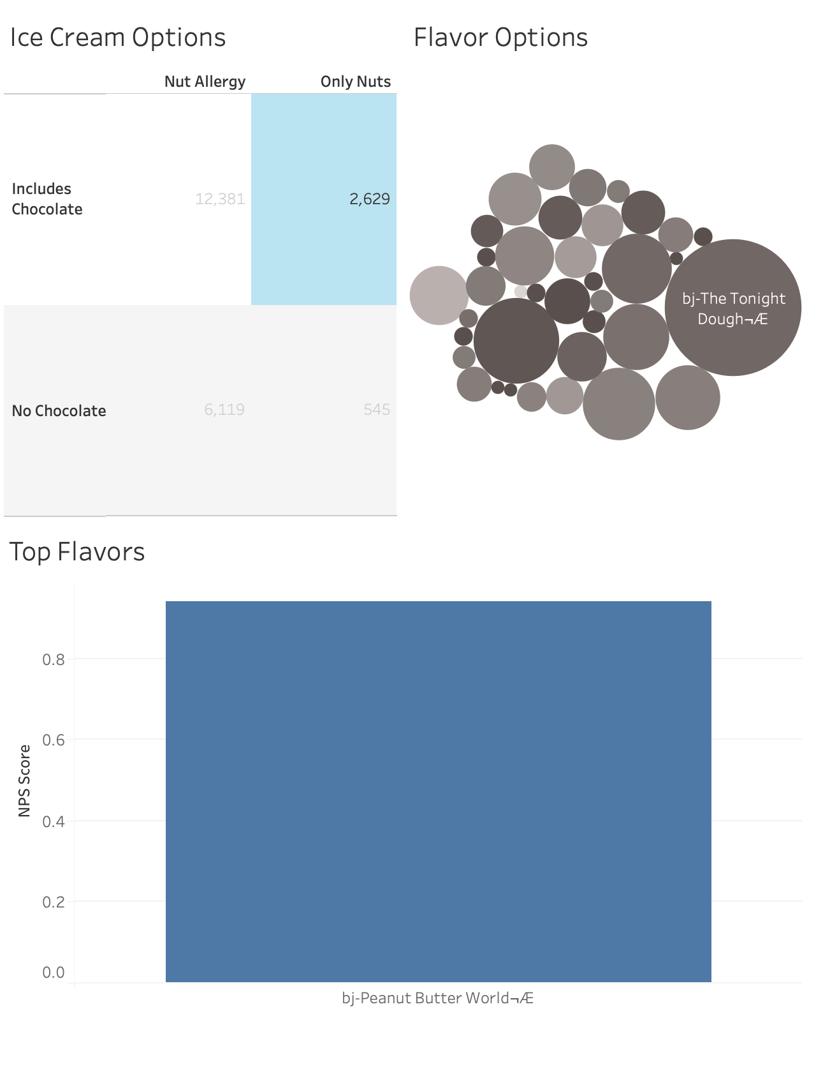
Appendix

