Slide 1
Relevance Feedback (and Pseudo Relevance Feedback)
COMP3009J: Information Retrieval
Dr. David Lillis (david.lillis@ucd.ie)
UCD School of Computer Science Beijing Dublin International College
Reference: Section 9.1, An Introduction to Information Retrieval, Manning, Raghavan & Schütze

Slide 2
Relevance Feedback
Relevance Feedback is when the user is involved in the retrieval process to improve the final result set.
Specifically the user gives feedback on the relevance of documents in the initial set of results, and this is used to re-process their query and provide an updated set of results.
Although this is not typically used in most modern IR systems, the process is important because pseudo relevance feedback is common, which is a simulation of relevance feedback without the user being directly involved.

Slide 3
Relevance Feedback Process
Typical process:
User provides a query (usually short and simple)
The system returns an initial set of results.
The user marks some relevant and nonrelevant documents (in some situations the user only marks relevant results).
The system computes a better representation of the information need based on this feedback.
The system returns a revised set of results.
Possibly the above process is repeated.

Slide 4
Rocchio Algorithm: Background
Probably the best-known algorithm for relevance feedback is the Rocchio Algorithm.
Basic Idea:
Based on the idea that documents and queries are represented as vectors (e.g. using TF-IDF, although any vector representation will work).
Wants to find a query vector that maximises similarity with relevant documents and minimises similarity with nonrelevant documents.

Slide 5
Rocchio Algorithm: Background
Probably the best-known algorithm for relevance feedback is the Rocchio Algorithm.
Basic Idea:
Based on the idea that documents and queries are represented as vectors (e.g. using TF-IDF, although any vector representation will work).
Wants to find a query vector that maximises similarity with relevant documents and minimises similarity with nonrelevant documents.
Part of the SMART Information Retrieval System
Developed @ Cornell University, 1965-
Rocchio, J. J., & Salton, G. (1965, November). Information search optimization and interactive retrieval techniques. In Proceedings of the November 30--December 1, 1965, fall joint computer conference, part I (pp. 293-305).

Slide 6
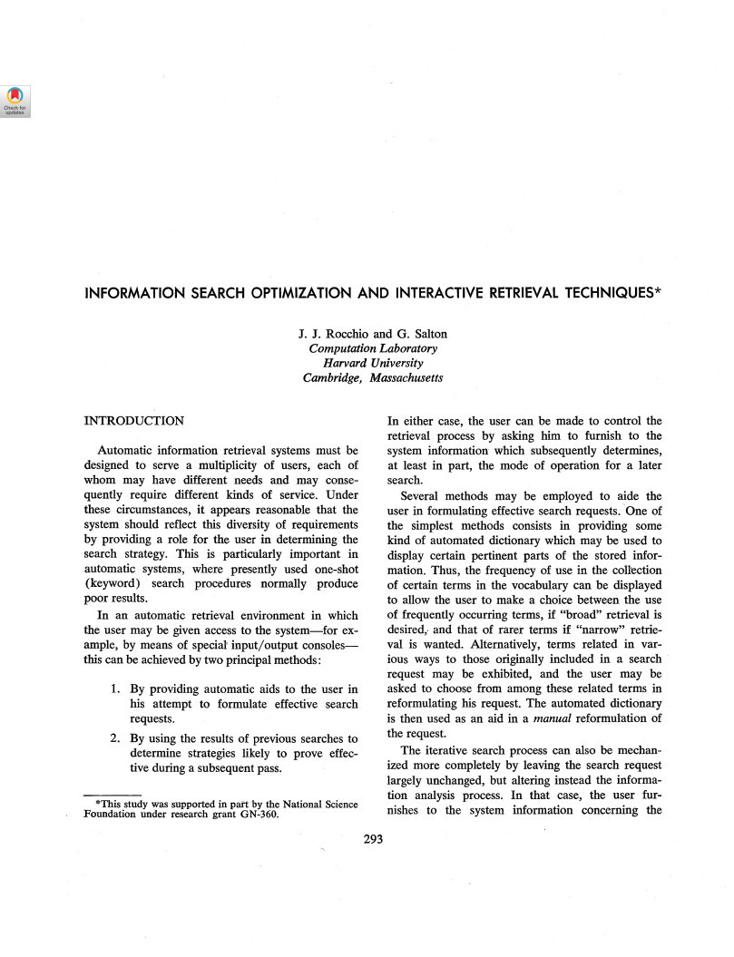

Rocchio Algorithm: Background
Probably the best-known algorithm for relevance feedback is the Rocchio Algorithm.
Basic Idea:
Based on the idea that documents and queries are represented as vectors (e.g. using TF-IDF, although any vector representation will work).
Wants to find a query vector that maximises similarity with relevant documents and minimises similarity with nonrelevant documents.
Part of the SMART Information Retrieval System
Developed @ Cornell University, 1960s
Rocchio, J. J., & Salton, G. (1965, November). Information search optimization and interactive retrieval techniques. In Proceedings of the November 30--December 1, 1965, fall joint computer conference, part I (pp. 293-305).
Gerard Salton
Key Inventions: Vector Space Model, TF-IDF
https://dl.acm.org/doi/pdf/10.1145/1463891.1463926

Slide 7

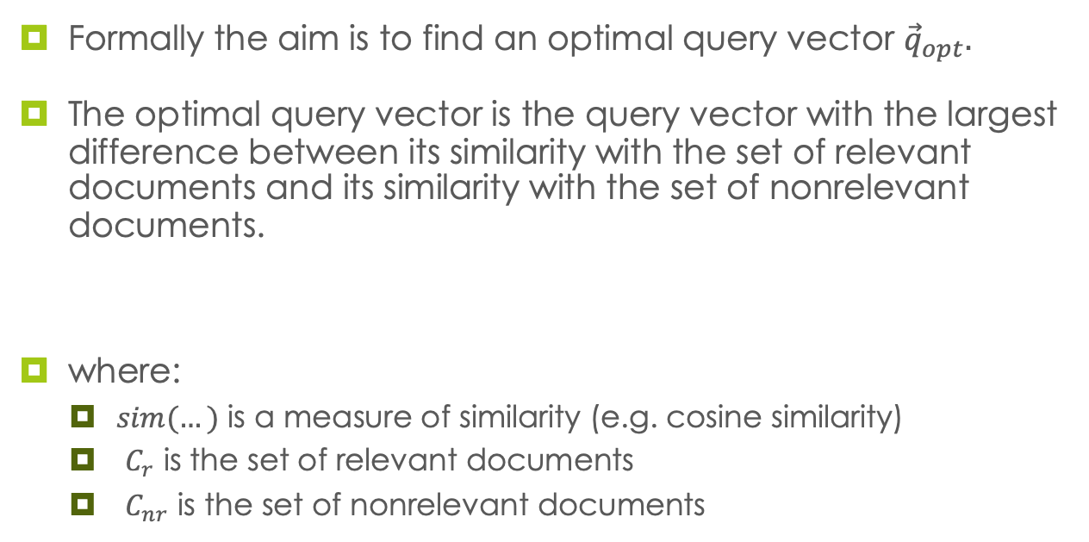
Rocchio Algorithm: Background
Formally the aim is to find an optimal query vector ${\vec{q}}_{opt}.$
The optimal query vector is the query vector with the largest difference between its similarity with the set of relevant documents and its similarity with the set of nonrelevant documents.
where:
$sim(…)$ is a measure of similarity (e.g. cosine similarity)
$C_{r}$ is the set of relevant documents
$C_{nr}$ is the set of nonrelevant documents

Slide 8
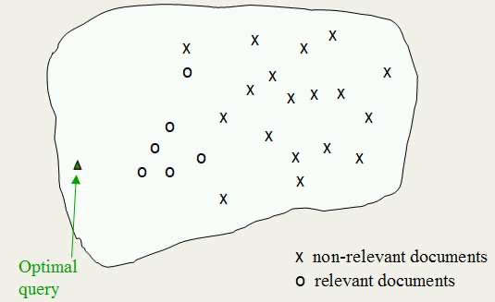
Rocchio Algorithm: Background
This illustrates the ideal situation.
Of course, the real vector space has far more than 2 dimensions: this is only an illustration.

Slide 9
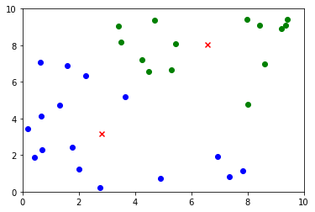
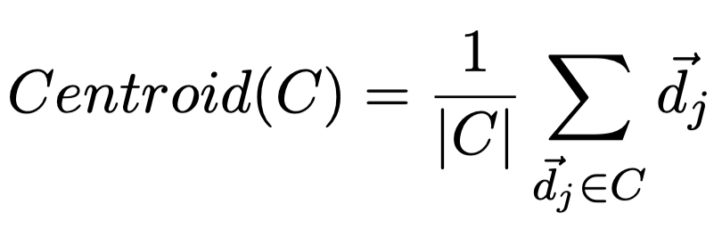
Centroids
To further examine how the similarity between a query vector and a set of documents can be calculated, we need to consider the idea of a centroid of a set of vectors.
The centroid is the centre point of a set of vectors. It is itself a vector.
Green cluster centroid
Blue cluster centroid

Slide 10
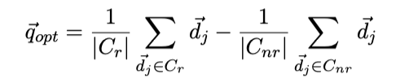
Rocchio Algorithm: Theory With complete knowledge
Using cosine similarity, the formula for calculating the optimal query vector is:
Informally, this is the vector that is obtained by subtracting the centroid of the nonrelevant set from the centroid of the relevant set.
But: In practice we don’t yet know the relevant and nonrelevant sets!
Notes:
Surely this is a direction of travel not the location of the query.

Slide 11
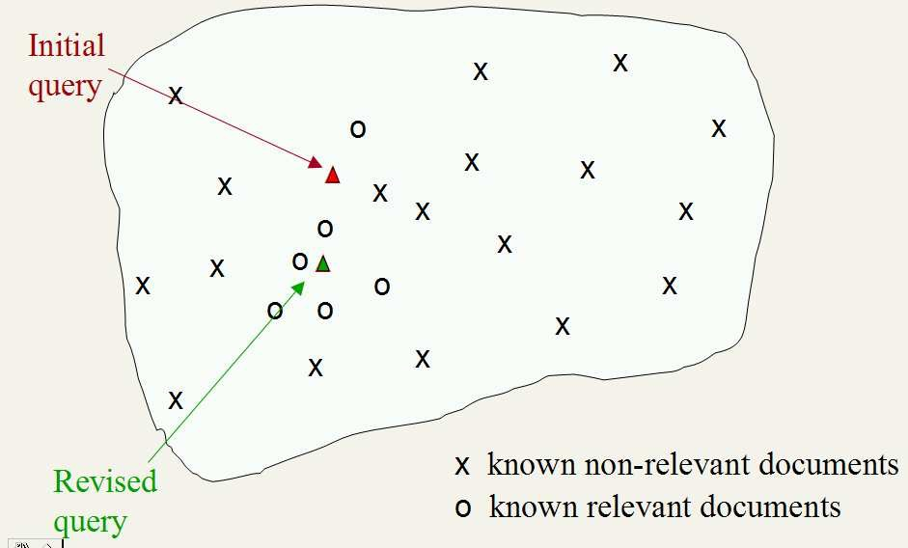
Rocchio Algorithm in practice
In practice, in relevance feedback situations, we have access to a subset of the relevant and nonrelevant sets, which have been identified by the user.
The Rocchio algorithm takes this information and computes a modified query vector (or “revised query vector”), which is probably not the optimal query vector, and re-runs retrieval.

Slide 12
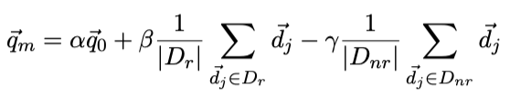
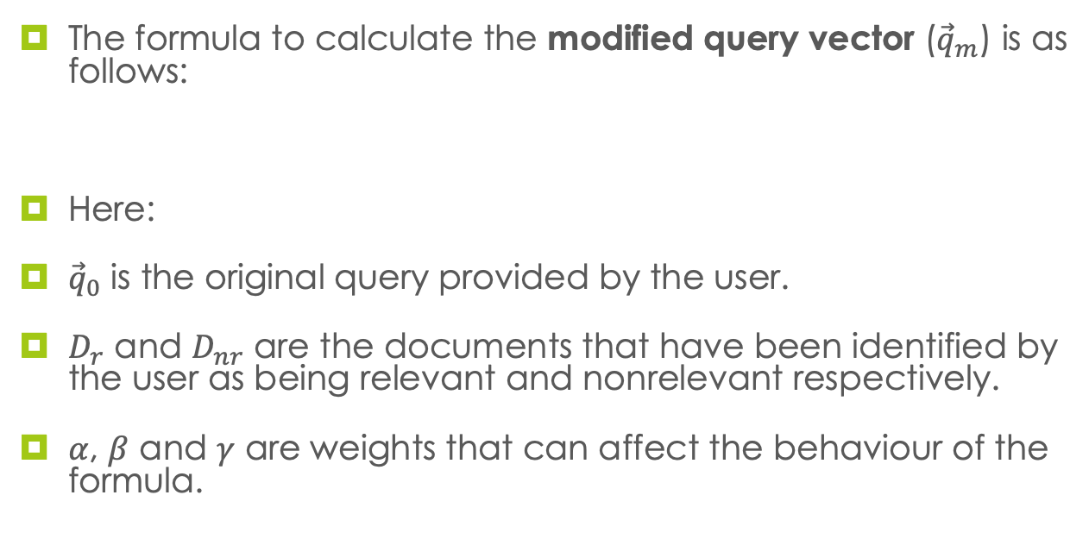
Rocchio Algorithm: Formula
The formula to calculate the modified query vector (${\vec{q}}_{m}$) is as follows:
Here:
${\vec{q}}_{0}$ is the original query provided by the user.
$D_{r}$ and $D_{nr}$ are the documents that have been identified by the user as being relevant and nonrelevant respectively.
$α$, $β$ and $γ$ are weights that can affect the behaviour of the formula.

Slide 13
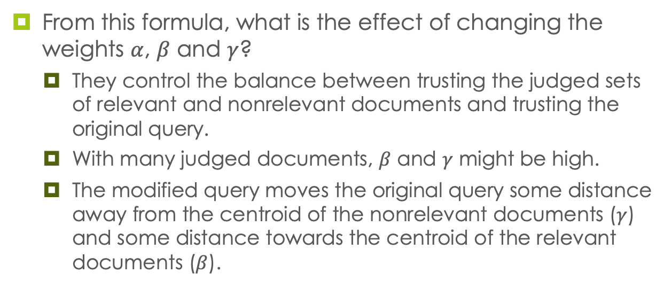
Rocchio Algorithm: Weights
From this formula, what is the effect of changing the weights $α$, $β$ and $γ$?
They control the balance between trusting the judged sets of relevant and nonrelevant documents and trusting the original query.
With many judged documents, $β$ and $γ$ might be high.
The modified query moves the original query some distance away from the centroid of the nonrelevant documents ($γ$) and some distance towards the centroid of the relevant documents ($β$).

Slide 14
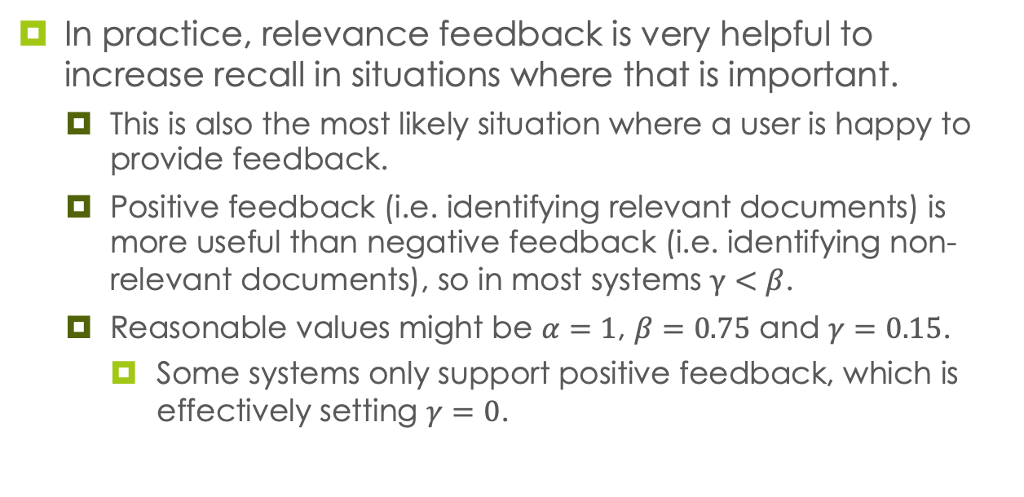
Rocchio Algorithm in Practice
In practice, relevance feedback is very helpful to increase recall in situations where that is important.
This is also the most likely situation where a user is happy to provide feedback.
Positive feedback (i.e. identifying relevant documents) is more useful than negative feedback (i.e. identifying non-relevant documents), so in most systems $γ<β$.
Reasonable values might be $α=1$, $β=0.75$ and $γ=0.15$.
Some systems only support positive feedback, which is effectively setting $γ=0$.

Slide 15
Relevance Feedback Assumptions
The user must have enough knowledge to make an initial query that is close to the relevant documents.
Without this, they will not be shown any relevant documents that they can give feedback on.
Some problems that relevance feedback cannot solve by itself:
Misspellings: if the user’s query does not spell terms correctly.
Cross-language IR: where documents in different languages will not be close in the vector space (although this depends on the vector representation).
Vocabulary Mismatch: where the user uses a different word/phrase to describe something (e.g. “laptop” versus “notebook computer”).

Slide 16
Relevance Feedback Assumptions
Relevant documents are assumed to be close to each other in a cluster.
But sometimes relevant documents can be in several clusters:
Documents might use different vocabulary (e.g. astronaut vs. cosmonaut).
A query that combines two very different things (e.g. Football players who studied at UCD).
General concepts that combine many more specific subjects (e.g. ”felines” includes both wild animals and domestic pets).

Slide 17
Pseudo Relevance Feedback
In practice, users generally do not wish to provide feedback (known as explicit feedback).
Instead, pseudo relevance feedback (also called blind relevance feedback) can be used: assume the top k ranked documents are relevant and then apply a relevance feedback algorithm.
Quite successful in practice, although it can have problems in some situations.

Slide 18
Indirect Relevance Feedback
If users do not provide explicit feedback by actively marking documents as relevant or nonrelevant, other sources of evidence can be gathered to get implicit feedback. For example:
Which documents does the user choose to click on?
How long did the user spend viewing a document?
How long did the user spend browsing the results?

Slide 19
Summary
Relevance feedback allows the user to participate in retrieval by informing the system of results that are relevant and/or ones that are non-relevant.
Example: Rocchio algorithm based on vector representation.
However, this is not popular in practice, so other ways are used to simulate feedback or get some feedback from other sources:
Pseudo Relevance Feedback (or “blind relevance feedback”: assume top k documents are relevant).
Implicit Relevance Feedback (evidence from other sources: clicks and user behaviour).

