Slide 1
IR Pipelines and Modern IR
COMP3009J: Information Retrieval
Dr. David Lillis (david.lillis@ucd.ie)
UCD School of Computer Science Beijing Dublin International College

Slide 2
Recap: where are we now?
So far we have looked at classic Information Retrieval, much of which is still relevant today. We know…
What IR is.
How an index can be built.
How several models can perform retrieval.
How evaluation can be done.
Thus all the basic components are in place.
Next we will look at how this process can be improved.

Slide 3
Classical IR Pipeline
Documents
Query
Preprocessing
(e.g. Tokenisation,
Linguistic Processing)
Indexing
Ranking
(e.g. BM25)
Documents are preprocessed to prepare them for use in the IR system.
The indexer creates a suitable data structure so that retrieval can happen.
A ranking method matches queries against the index to produce a ranked list of results for the user (or to an evaluation step).

Slide 4
Classical IR Pipeline (Experimental)
Relevance Judgments
Documents
Query
Preprocessing
(e.g. Tokenisation,
Linguistic Processing)
Indexing
Ranking
(e.g. BM25)
Evaluation
Alternative pipeline with Evaluation component.
Used in experimentation – to evaluate the performance of the system that has been designed.
(this is evaluation in terms of the system’s effectiveness)

Slide 5
Aside: Pipeline Design Pattern
We call this design pattern a pipeline because the output of one process becomes the input of the next stage in the process.
This is similar to a linear pipeline, where each stage happens sequentially.
An alternative is a non-linear pipeline, where some stages can happen in parallel.
Stage 1
Stage 2
Stage 3
Stage 4
Stage 3
Stage 1
Stage 2
Stage 4
Stage 3

Slide 6
Aside: Pipeline Design Pattern
We call this design pattern a pipeline because the output of one process becomes the input of the next stage in the process.
This is similar to a linear pipeline, where each stage happens sequentially.
An alternative is a non-linear pipeline, where some stages can happen in parallel.
Pipelines are basically Directed Acyclic Graphs (DAGs) where nodes are steps and edges are dependencies.
Stage 1
Stage 2
Stage 3
Stage 4
Stage 3
Stage 1
Stage 2
Stage 4
Stage 3

Slide 7
Aside: Pipeline Design Pattern
We call this design pattern a pipeline because the output of one process becomes the input of the next stage in the process.
This is similar to a linear pipeline, where each stage happens sequentially.
An alternative is a non-linear pipeline, where some stages can happen in parallel.
Pipelines are basically Directed Acyclic Graphs (DAGs) where nodes are steps and edges are dependencies.
Stage 1
Stage 2
Stage 3
Stage 4
Pipelines are widely used in software practice:
CI/CD uses pipelines to compile, test, package and deploy code; ML Ops applies the same principles to machine learning;
Agentic Workflows are communication pipelines for LLM agents
Stage 3
Stage 1
Stage 2
Stage 4
Stage 3

Slide 8
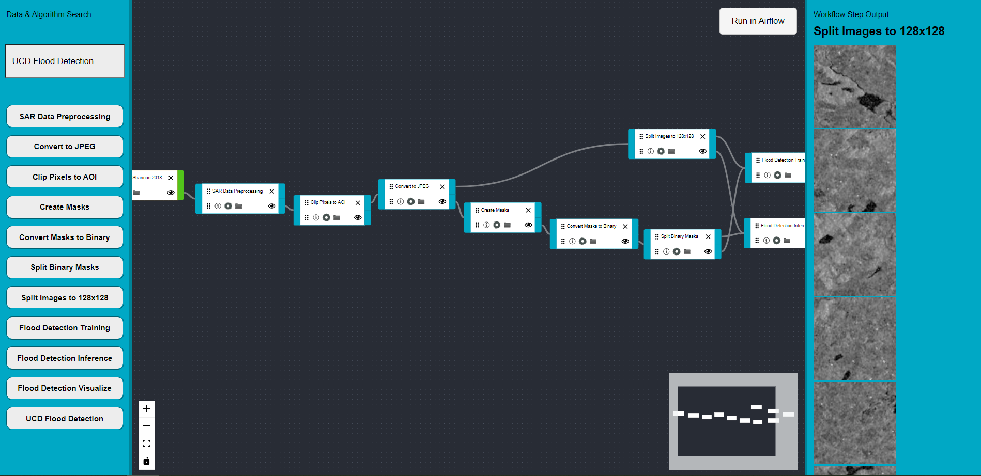

Aside: Pipeline Design Pattern
DAG Maker: EO Machine Learning Pipeline No Code Tool
Ex: Flood Detection Pipeline

Slide 9
Issues with Classical Pipeline (so far)
Vocabulary mismatch is a problem. The words chosen by the user may not match the words used in a relevant document.
polysemy: the same word can have different meanings (e.g. “bank”).
synonymy: two different words can have the same meaning (e.g. plane/airplane/aeroplane/aircraft).
How can we be confident that our choice of retrieval model is the best for each query?
Could we use a combination of ranking models instead of just one?

Slide 10
Issues with Classical Pipeline (so far)
Only the document contents are taken into account.
Particularly on the web, there is a lot more information available.
The link structure of the web:
Where does this page link to?
What other pages link to this page?
What text do other pages use in their links to this page (in their anchor text)?
The URL may contain useful information?
For a large search engines, they have query logs to record previous user’s behaviour when they give the same query.

Slide 11
Issues with Classical Pipeline
Doesn’t make use of recent advances in machine learning (especially deep learning) and Natural Language Processing (NLP) and Natural Language Understanding (NLU).
Machine Learning has transformed most data-processing and data-analysis tasks.
Large Language Models (LLMs) such as BERT (Google, 2018), T5 (Google, 2020), GPT-4 (OpenAI, 2023) have made huge progress in a variety of NLP, NLU and Machine Translation tasks.
BUT… Language models are slooooooow…

Slide 12
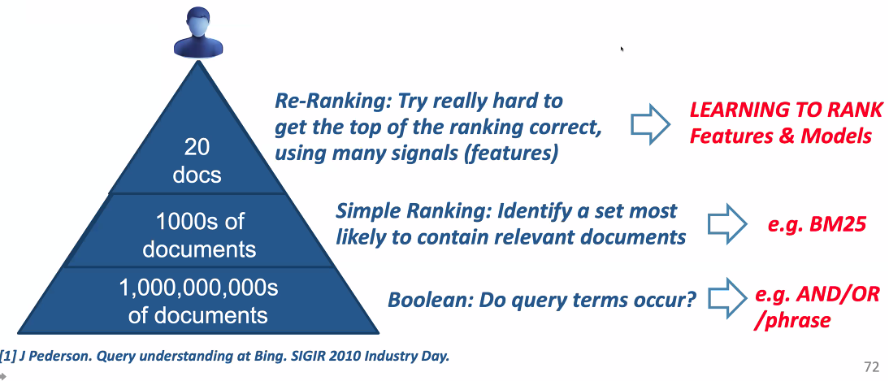
Speed is of the essence…
Speed is essential. According to Microsoft:
“Even a 100ms latency has been shown to invoke negative user reactions”¹
¹ Rosset, C., Jose, D., Ghosh, G., Mitra, B., & Tiwary, S. (2018). Optimizing Query Evaluations Using Reinforcement Learning for Web Search. SIGIR 2018. https://doi.org/10.1145/3209978.3210127

Slide 13
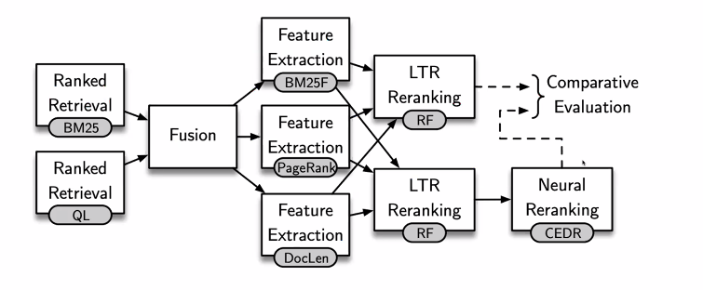
A More Complex IR Pipeline
Source: MacAvaney, S., McDonald, C., and Tonollotto, N., IR From Bag-of-words to BERT and Beyond through Practical Experiments, ECIR 2021.
Notes:
QL: Query Likelihood
RF: Random Forest
CEDR: Contextualized Embeddings for Document Ranking: (obsidian://open?vault=obsidian_notes&file=McAvaney2019)

Slide 14
Pseudo-Relevance Feedback
Relevance Feedback is when users are shown a set of documents in response to a query, and tell the system which ones are relevant.
The system can then use this information to re-run the search(with different term weights) and hopefully find more relevant documents that are similar to the ones the user has said are relevant.
However, users don’t like giving relevance feedback!
Pseudo-Relevance Feedback simulates relevance feedback by assuming that the top k ranked documents are relevant, and then re-running the search in the same way.
Why does this work? “[T]erms that occur consistently in relevant documents also tend to appear consistently in top ranked documents.”¹
But it’s not perfect: danger of query drift towards the topic of the top-ranked documents.
Information Retrieval of involves a ”conversation” where you align your model of what you are searching for with the machines model of what it thinks is relevant to your query….
¹ Zhao, L., and Callan, J., Term Necessity Prediction, CIKM 2010. https://doi.org/10.1145/1871437.1871474

Slide 15
Pseudo-Relevance Feedback
Relevance Feedback is when users are shown a set of documents in response to a query, and tell the system which ones are relevant.
The system can then use this information to re-run the search(with different term weights) and hopefully find more relevant documents that are similar to the ones the user has said are relevant.
However, users don’t like giving relevance feedback!
Pseudo-Relevance Feedback simulates relevance feedback by assuming that the top k ranked documents are relevant, and then re-running the search in the same way.
Why does this work? “[T]erms that occur consistently in relevant documents also tend to appear consistently in top ranked documents.”¹
But it’s not perfect: danger of query drift towards the topic of the top-ranked documents.
¹ Zhao, L., and Callan, J., Term Necessity Prediction, CIKM 2010. https://doi.org/10.1145/1871437.1871474

Slide 16
Pseudo-Relevance Feedback
Relevance Feedback is when users are shown a set of documents in response to a query, and tell the system which ones are relevant.
The system can then use this information to re-run the search(with different term weights) and hopefully find more relevant documents that are similar to the ones the user has said are relevant.
However, users don’t like giving relevance feedback!
Pseudo-Relevance Feedback simulates relevance feedback by assuming that the top k ranked documents are relevant, and then re-running the search in the same way.
Why does this work? “[T]erms that occur consistently in relevant documents also tend to appear consistently in top ranked documents.”¹
But it’s not perfect: danger of query drift towards the topic of the top-ranked documents.
What if I am interested in Jaguars?
¹ Zhao, L., and Callan, J., Term Necessity Prediction, CIKM 2010. https://doi.org/10.1145/1871437.1871474

Slide 17

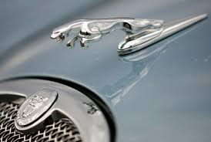

Pseudo-Relevance Feedback
Relevance Feedback is when users are shown a set of documents in response to a query, and tell the system which ones are relevant.
The system can then use this information to re-run the search(with different term weights) and hopefully find more relevant documents that are similar to the ones the user has said are relevant.
However, users don’t like giving relevance feedback!
Pseudo-Relevance Feedback simulates relevance feedback by assuming that the top k ranked documents are relevant, and then re-running the search in the same way.
Why does this work? “[T]erms that occur consistently in relevant documents also tend to appear consistently in top ranked documents.”¹
But it’s not perfect: danger of query drift towards the topic of the top-ranked documents.
What if I am interested in Jaguars?
A search could return documents related to:
Jacksonville Jaguars NFL Team
Jaguar Cars
Jaguar Cats
Which type of Jaguar could I be interested in?
¹ Zhao, L., and Callan, J., Term Necessity Prediction, CIKM 2010. https://doi.org/10.1145/1871437.1871474
Notes:
The problem here is: pseudo relevance depends on an assumption that the top X documents are relevant…

Slide 18

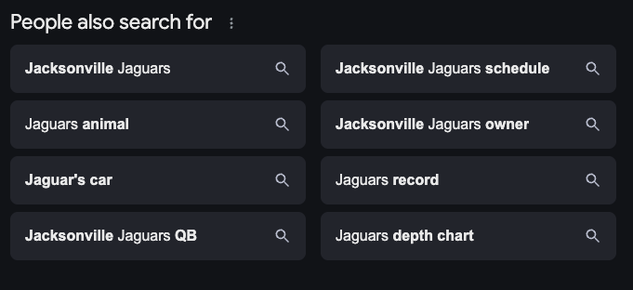
Pseudo-Relevance Feedback
Relevance Feedback is when users are shown a set of documents in response to a query, and tell the system which ones are relevant.
The system can then use this information to re-run the search(with different term weights) and hopefully find more relevant documents that are similar to the ones the user has said are relevant.
However, users don’t like giving relevance feedback!
Pseudo-Relevance Feedback simulates relevance feedback by assuming that the top k ranked documents are relevant, and then re-running the search in the same way.
Why does this work? “[T]erms that occur consistently in relevant documents also tend to appear consistently in top ranked documents.”¹
But it’s not perfect: danger of query drift towards the topic of the top-ranked documents.
What if I am interested in Jaguars?
A search could return documents related to:
Jacksonville Jaguar NFL Team
Jaguar Cars
Jaguar Cats
Search: Jaguar
Search: Jaguars
Which type of Jaguar could I be interested in?
¹ Zhao, L., and Callan, J., Term Necessity Prediction, CIKM 2010. https://doi.org/10.1145/1871437.1871474
Notes:
Note I get different results if I search for jaguar vs jaguars…

Slide 19
Pseudo-Relevance Feedback
Key Point: Topic Drift
Depending on what I search for, pseudo-relevance feedback can make incorrect choices about the type of information I want…
Relevance Feedback is when users are shown a set of documents in response to a query, and tell the system which ones are relevant.
The system can then use this information to re-run the search(with different term weights) and hopefully find more relevant documents that are similar to the ones the user has said are relevant.
However, users don’t like giving relevance feedback!
Pseudo-Relevance Feedback simulates relevance feedback by assuming that the top k ranked documents are relevant, and then re-running the search in the same way.
Why does this work? “[T]erms that occur consistently in relevant documents also tend to appear consistently in top ranked documents.”¹
But it’s not perfect: danger of query drift towards the topic of the top-ranked documents.
What if I am interested in Jaguars?
A search could return documents related to:
Jacksonville Jaguar NFL Team
Jaguar Cars
Jaguar Cats
Search: Jaguar
Search: Jaguars
Which type of Jaguar could I be interested in?
¹ Zhao, L., and Callan, J., Term Necessity Prediction, CIKM 2010. https://doi.org/10.1145/1871437.1871474
Notes:
Note I get different results if I search for jaguar vs jaguars…

Slide 20
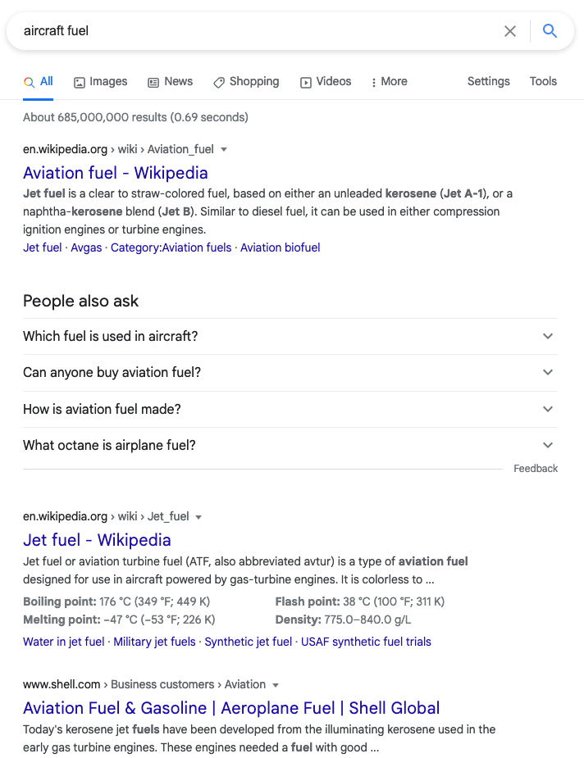
Query Expansion
Related terms are added to the query to increase the chance of matching relevant documents.
Many sources of related terms:
A manually-created thesaurus, such as WordNet¹.
An automatically-created thesaurus from some external corpus like a web crawl, or Wikipedia².
Word embeddings, where words are represented by vectors (e.g. word2vec, GloVe, ELMo and BERT-based embeddings).
¹ https://wordnet.princeton.edu/
² For example, through DBPedia (https://wiki.dbpedia.org/)

Slide 21
Query Expansion
Many sources of related terms:
Query Log mining, where a search engine looks at the behaviour of previous users who have given the same query.
Target-corpus based techniques, based on the document collection being searched. Two categories:
Distribution-based: compare the distribution (frequency) of terms in the (pseudo-) relevant documents compared to the whole corpus.
Association-based: select terms based on their association (co-occurrence) with the query terms.

Slide 22
Fusion
Input: a set of results (for one query) from several Ranked Retrieval systems.
Output: a single, combined set of results that are (hopefully) better than the input results in isolation.
Can be based on:
the scores calculated by the Ranked Retrieval systems;
the rank of the documents in each results list;
the probability of a document being relevant, based on past performance.
Notes:
QL: Query Likelihood – language model that assesses the likelihood that a query can be generated by a given document.

Slide 23
Learning to Rank
After the initial search has been done by a classic ranked retrieval model (e.g. BM25, or a fused result from several rankers).
Machine Learning used to re-rank the documents that have been retrieved.
Aim: improve the result by putting the most-relevant documents at the top of the ranked list of results.
Takes into account much more information than just the initial ranking score.
Each piece of information used is known as a feature in Machine Learning.

Slide 24
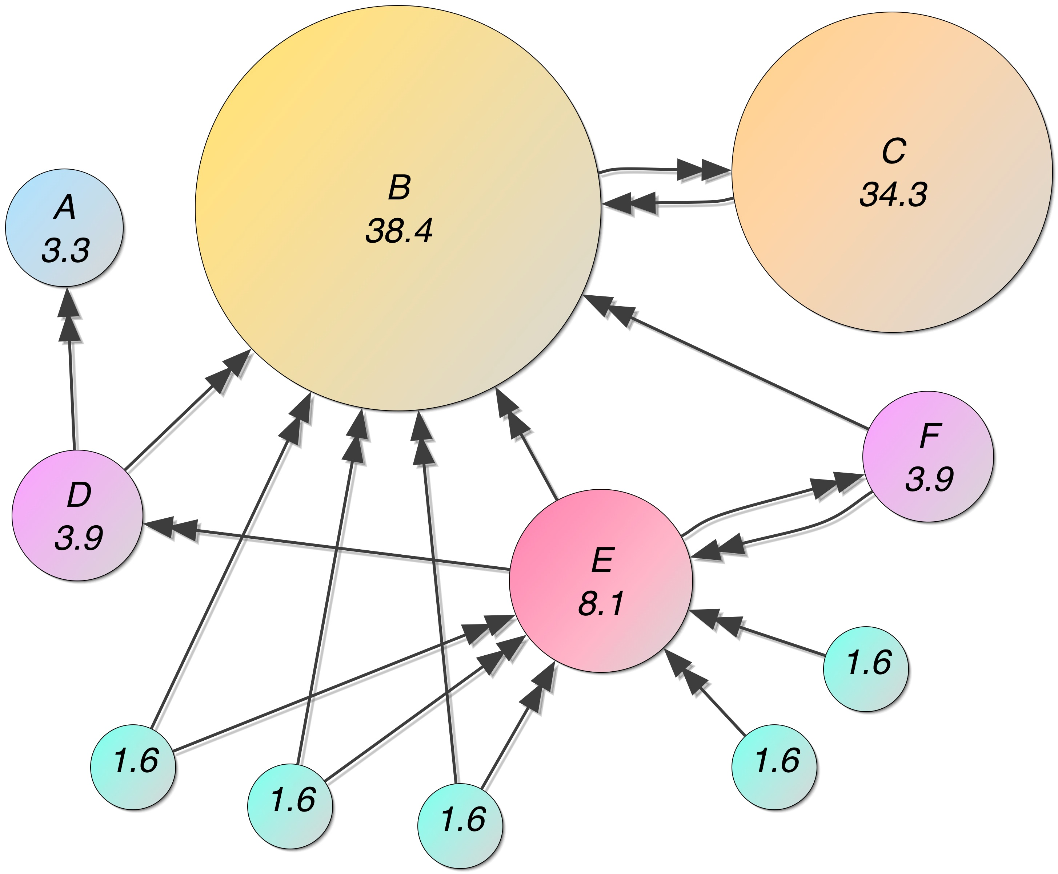
PageRank: Document Importance
One feature commonly used in Learning to Rank models is PageRank¹.
Developed by the founders of Google, and was a key part of Google’s success.
Measures the importance of a document based on the link structure of the web.
A document is considered to be important if:
Many pages link to it; or
Other important pages link to it.
¹ Page, L., Brin, S., Motwani, R., and Winograd, T . The PageRank Citation Ranking: Bringing Order to the Web. Technical Report. Stanford InfoLab. 2009.

Slide 25
Learning to Rank: Features
Some examples of features that can be used by Learning to Rank models¹
Textual Features:
Term occurrence/non-occurrence
Term frequency
Inverse Document Frequency
Document Length
Term Proximity
Non-Textual Features:
PageRank
URL Depth
Document Quality
Readability
Sentiment
Query Clarity
¹ Metzler, D. ,and Croft, W. B., Linear Feature-Based Models for Information Retrieval, 2007. https://doi.org/10.1007/s10791-006-9019-z
Notes:
URL depth = how far from the start page? Like TTL in packet routing. Lower URL depth == more important

Slide 26

Neural Language Models
Bidirectional Encoder Representations from Transformers (BERT) is a deep-learning based Large Language Model (LLM) for Natural Language Processing.
Developed by Google and released in 2018¹.
In simple terms, it learns the relationships between words to aid document understanding
It has revolutionised NLP, and has had great success on many NLP tasks.
As at 2020, it is used for almost all English-language queries in Google’s search engine².
¹ https://github.com/google-research/bert
² https://searchengineland.com/google-bert-used-on-almost-every-english-query-342193
Notes:
BERT NLP Tasks include Question Answering, Named Entity Recognition, Text Classfication
Decent summary: https://towardsdatascience.com/bert-explained-state-of-the-art-language-model-for-nlp-f8b21a9b6270
https://medium.com/@anmolkohli/my-notes-on-bert-tokenizer-and-model-98dc22d0b64
https://www.webfx.com/blog/internet/google-bert/#:~:text=With%20BERT%2C%20algorithms%20that%20affect,the%20content%20as%20featured%20snippets.

Slide 27
Neural Language Models
BERT is concerned with Natural Language Understanding (NLU)
Its goal is to improve context better understanding the relationship between the tokens in a sentence.
“A man was [MASK] on a river bank.”
Bidirectional Encoder Representations from Transformers (BERT) is a deep-learning based Large Language Model (LLM) for Natural Language Processing.
Developed by Google and released in 2018¹.
In simple terms, it learns the relationships between words to aid document understanding
It has revolutionised NLP, and has had great success on many NLP tasks.
As at 2020, it is used for almost all English-language queries in Google’s search engine².
¹ https://github.com/google-research/bert
² https://searchengineland.com/google-bert-used-on-almost-every-english-query-342193
Notes:
BERT NLP Tasks include Question Answering, Named Entity Recognition, Text Classfication
Decent summary: https://towardsdatascience.com/bert-explained-state-of-the-art-language-model-for-nlp-f8b21a9b6270
https://medium.com/@anmolkohli/my-notes-on-bert-tokenizer-and-model-98dc22d0b64
https://www.webfx.com/blog/internet/google-bert/#:~:text=With%20BERT%2C%20algorithms%20that%20affect,the%20content%20as%20featured%20snippets.

Slide 28
Neural Language Models
BERT is concerned with Natural Language Understanding (NLU)
Its goal is to improve context better understanding the relationship between the tokens in a sentence.
“A man was [MASK] on a river bank.”
Bidirectional Encoder Representations from Transformers (BERT) is a deep-learning based Large Language Model (LLM) for Natural Language Processing.
Developed by Google and released in 2018¹.
In simple terms, it learns the relationships between words to aid document understanding
It has revolutionised NLP, and has had great success on many NLP tasks.
As at 2020, it is used for almost all English-language queries in Google’s search engine².
ChatGPT is concerned with Natural Language Generation (NLG)
Its goal is to predict the next word in the sentence.
“Write a poem about a man fishing on a river
bank. Upon a [NEXT TOKEN]”
¹ https://github.com/google-research/bert
² https://searchengineland.com/google-bert-used-on-almost-every-english-query-342193
Notes:
BERT NLP Tasks include Question Answering, Named Entity Recognition, Text Classfication
Decent summary: https://towardsdatascience.com/bert-explained-state-of-the-art-language-model-for-nlp-f8b21a9b6270
https://medium.com/@anmolkohli/my-notes-on-bert-tokenizer-and-model-98dc22d0b64
https://www.webfx.com/blog/internet/google-bert/#:~:text=With%20BERT%2C%20algorithms%20that%20affect,the%20content%20as%20featured%20snippets.

Slide 29
Neural Language Models
BERT is concerned with Natural Language Understanding (NLU)
Its goal is to improve context better understanding the relationship between the tokens in a sentence.
“A man was [MASK] on a river bank.”
Bidirectional Encoder Representations from Transformers (BERT) is a deep-learning based Large Language Model (LLM) for Natural Language Processing.
Developed by Google and released in 2018¹.
In simple terms, it learns the relationships between words to aid document understanding
It has revolutionised NLP, and has had great success on many NLP tasks.
As at 2020, it is used for almost all English-language queries in Google’s search engine².
BIDIRECTIONAL
ChatGPT is concerned with Natural Language Generation (NLG)
Its goal is to predict the next word in the sentence.
“Write a poem about a man fishing on a river
bank. Upon a [NEXT TOKEN]”
UNIDIRECTIONAL
¹ https://github.com/google-research/bert
² https://searchengineland.com/google-bert-used-on-almost-every-english-query-342193
Notes:
BERT NLP Tasks include Question Answering, Named Entity Recognition, Text Classfication
Decent summary: https://towardsdatascience.com/bert-explained-state-of-the-art-language-model-for-nlp-f8b21a9b6270
https://medium.com/@anmolkohli/my-notes-on-bert-tokenizer-and-model-98dc22d0b64
https://www.webfx.com/blog/internet/google-bert/#:~:text=With%20BERT%2C%20algorithms%20that%20affect,the%20content%20as%20featured%20snippets.

Slide 30
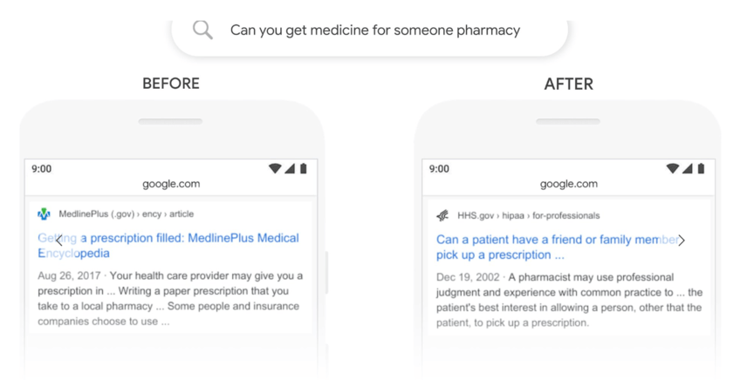
Neural Language Models
Bidirectional Encoder Representations from Transformers (BERT) is a deep-learning based Large Language Model (LLM) for Natural Language Processing.
Developed by Google and released in 2018¹.
In simple terms, it learns the relationships between words to aid document understanding
It has revolutionised NLP, and has had great success on many NLP tasks.
As at 2020, it is used for almost all English-language queries in Google’s search engine².
https://www.webfx.com/blog/internet/google-bert/
Notes:
BERT NLP Tasks include Question Answering, Named Entity Recognition, Text Classfication
Decent summary: https://towardsdatascience.com/bert-explained-state-of-the-art-language-model-for-nlp-f8b21a9b6270
https://medium.com/@anmolkohli/my-notes-on-bert-tokenizer-and-model-98dc22d0b64
https://www.webfx.com/blog/internet/google-bert/#:~:text=With%20BERT%2C%20algorithms%20that%20affect,the%20content%20as%20featured%20snippets.

Slide 31
What about ChatGPT?
Probably the most famous LLM is now ChatGPT, released in 2022 based on GPT-3.5 by OpenAI.
Now ChatGPT-Plus is based on GPT-4, released in 2023.
Microsoft have integrated ChatGPT into Bing search engine (announced February 2023).
It will be interesting to see how users respond in the longer term, compared to traditional web search.
LLMs are made by learning patterns and relationships between words/phrases from enormous quantities of text.
It is estimated to cost 27.5m RMB (4m USD) to train GPT-3, for example¹.
How does ChatGPT work?²
¹ https://www.cnbc.com/2023/03/13/chatgpt-and-generative-ai-are-booming-but-at-a-very-expensive-price.html
² https://www.zdnet.com/article/how-does-chatgpt-work/

Slide 32
What about ChatGPT?
Probably the most famous LLM is now ChatGPT, released in 2022 based on GPT-3.5 by OpenAI.
Now ChatGPT-Plus is based on GPT-4, released in 2023.
Microsoft have integrated ChatGPT into Bing search engine (announced February 2023).
It will be interesting to see how users respond in the longer term, compared to traditional web search.
LLMs are made by learning patterns and relationships between words/phrases from enormous quantities of text.
It is estimated to cost 27.5m RMB (4m USD) to train GPT-3, for example¹.
How does ChatGPT work?²
From a sustainability perspective Chat GPT is estimated to:
generates around 16k tonnes of of CO2 annually (equivalent to around 400M cups of tea; 1 cup = 40g of CO2)
uses around 1.7b gallons of water per year (would fill more than 2,500 Olympic size swimming pools), and
uses around 25MW of energy each time it is trained (that is enough to power around 20k homes)
Each ChatGPT query uses 4.32g of CO2…
16 queries is the same as boiling a kettle
139 queries is like doing the laundry
¹ https://www.cnbc.com/2023/03/13/chatgpt-and-generative-ai-are-booming-but-at-a-very-expensive-price.html
² https://www.zdnet.com/article/how-does-chatgpt-work/

Slide 33
What about ChatGPT?
In the context of IR, LLMs such as ChatGPT (and others: e.g. Bard by Google and LLaMa by Meta) have several serious problems.
“In simple terms, these models figure out what word is likely to come next, given a set of words or a phrase. In doing so, they are able to generate sentences, paragraphs and even pages that correspond to a query from a user.” ¹
It is not designed to provide knowledge and so it is often confidently wrong. The output can be plausible and believable, but might still be incorrect.
It cannot cite its sources, so you cannot find where it got its information from. If you ask it to provide citations, it will provide something that seems to be correct, but these will be artificial, because it is trained to know what a citation looks like, and not to understand any knowledge about a citation.
¹ https://theconversation.com/ai-information-retrieval-a-search-engine-researcher-explains-the-promise-and-peril-of-letting-chatgpt-and-its-cousins-search-the-web-for-you-200875

Slide 34
Conclusion
The Classical IR Pipeline has several limitations with regard to modern IR.
Several techniques are available that can be used to help improve the quality of retrieval, but response time is key given the huge amounts of data involved.
In the next few lectures, we will examine a few of these in more detail.

