Slide 1
"AxErd" Website
Application module documentation
for Developers, in
Microsoft Dynamics AX 2012 R2
GeneMi
2013/April
AxErd-Website-AppMod-DevDocs-AX6-2013April-b2.pptx

Slide 2
Audience – Help - Writers
Audience | Help | Writers
App users | App Docs | App writers
Developers | Dev Docs | Dev writers
System administrators | Sys Docs | Sys writers
Traditionally writers stay within their row, as shown above.
But maybe Dev writers could produce a new kind of Help.
Let’s produce Help that is a hybrid of Dev Docs & App Docs.
Let’s produce Dev Docs that are specific to one application module (one module at a time).

Slide 3
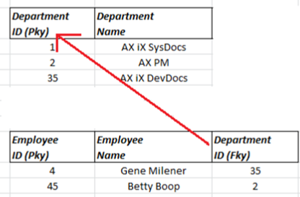
Foreign Key: Relationship between Two Tables
Child table’s “foreign key” column points to the parent table’s “primary key”.
Pky column supplies the allowable values to the Fky column.
Arrow always points from child/Fky column, to the parent/Pky column.

Slide 4
AOT is only One-Way for Fkys
AOT shows only parent tables, not child tables.
Developers need quick and easy access to both parent and child information.
Cross-reference feature provides child info in theory, but in practice it is almost unusable.

Slide 5
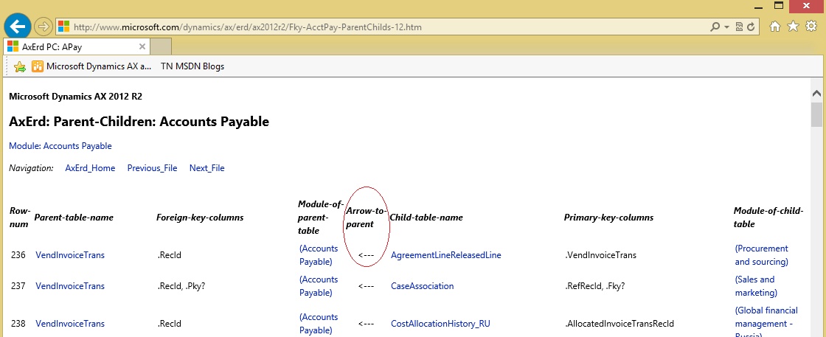
Live Example: Child Points to Parent

Slide 6
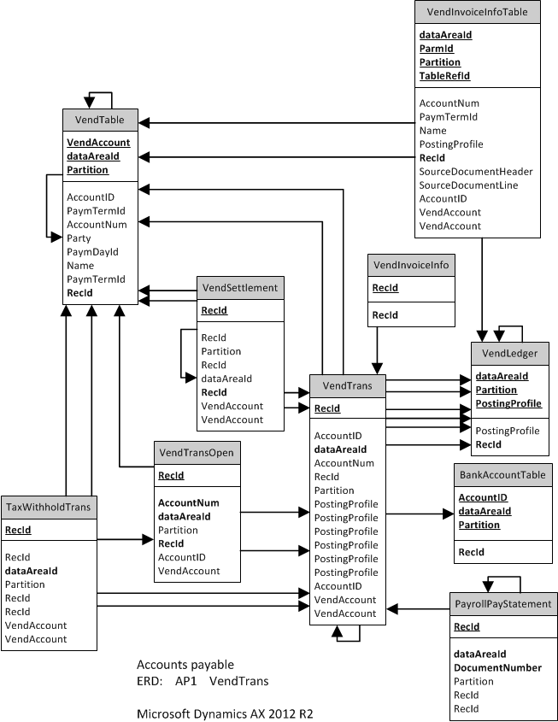
ERD: Built from Chains of Arrows

Slide 7
6 File Types (3 Pairs)
PC: Parent <--- Child
CP: Child ---> Parent
MT: For each module, a list of all its tables.
TM: An alphabetical list of all tables, each table tagged with its module name.
ERD Links: For each module, a page links to ERDs for that module.
ERD: An ERD image, plus its table names listed as searchable plain text.

Slide 8
Steps That Created AxErd: 1
Write X++ to…
Extract raw foreign key metadata from AX AOT, but only from child tables’ perspective.
Extract module name for each table.
Write C# to...
Organize the raw metadata.
Output hundreds of HTML files, each laden with links.

Slide 9
Steps That Created AxErd: 2
Use AxErd to create sensible lists of related tables as projects in AX, within each application module.
Export projects as .ERX files from AX (one .ERX per list).
Import .ERX into Visio 2010 (not 2013).
Manually uncross all relationship lines.
SiteMap.xml, waiting for Bing crawler.

Slide 10
Http URLs
http://www.microsoft.com/Dynamics/AX/ERD/ax2012r2/
http://go.microsoft.com/fwlink/p/?linkid=296623
http://blogs.msdn.com/b/x/
AX6 DxStudio topic:
"Database ERDs on the AxErd Website"

Slide 11

All Public Responses on AxErd Blogs

