Slide 1
Presentation
Exploring Quarto and PowerPoint Integration Your Name

Slide 2
Table of contents

Slide 3
Introduction
Overview: This presentation demonstrates how to create a PowerPoint presentation using Quarto and R.
Objectives:
Learn how to structure a presentation.
Use code, figures, and tables within slides.

Slide 4
Code Example
Here is an example of R code:
[1] 30

Slide 5
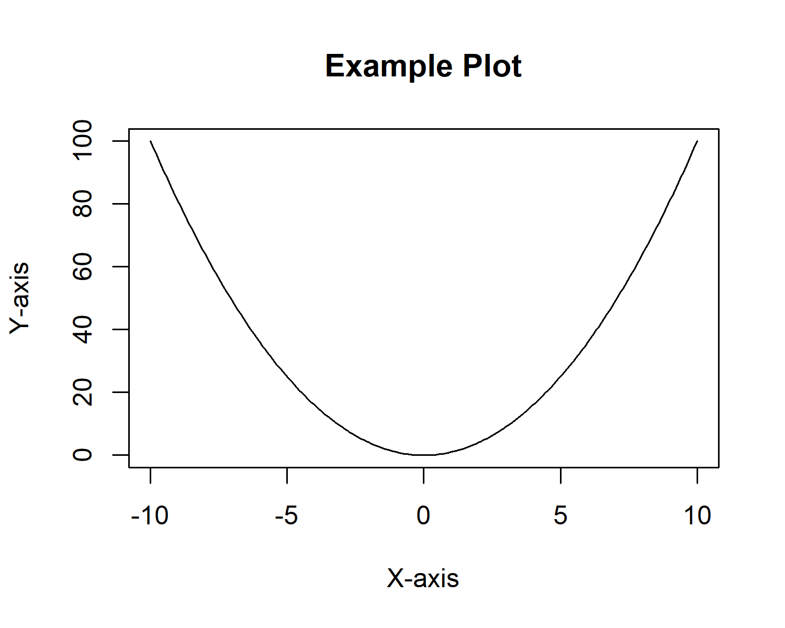
Figure Example

Slide 6
Table Example
Category | Value
A | 100
B | 200
C | 300

Slide 7
Formatting Examples: Text Styles
Bold Text Example: This text is bold for emphasis.
Italicized Text Example: This text is italicized for a softer emphasis.
Bold and Italicized Text Example: Combine bold and italics for stronger emphasis.
Underlined Text Example: This text is underlined (use sparingly).

Slide 8
Formatting Examples: More Styles
Strikethrough Example: This text is crossed out.
Font Color Example: This text is blue.
Font Size Example: This text is larger.
Highlight Example: This text is highlighted.

Slide 9
List Formatting Examples
Ordered List Example:
First item
Second item
Third item
Unordered List Example:
First bullet
Second bullet
Third bullet

Slide 10
More Formatting Examples
Nested List Example:
Parent Item
Child Item 1
Child Item 2

Slide 11
Inline Code and Monospace Font
Inline Code Example: Use inline code for technical terms or file paths.
Monospace Font Example: This text is in monospace font.

Slide 12
Alignment and Spacing
Left-Aligned Text (default)
Example of left-aligned text.
Center-Aligned Text:
This text is centered.
Right-Aligned Text:
This text is right-aligned.

Slide 13
Advanced Manipulations
Hyperlinks: Visit Quarto Documentation
Images with Captions: Example Image
Caption: A placeholder image with a caption.
Blockquotes: > “This is an example of a blockquote for emphasizing important quotes or ideas.”

