Slide 1
Zone of influence

Slide 2
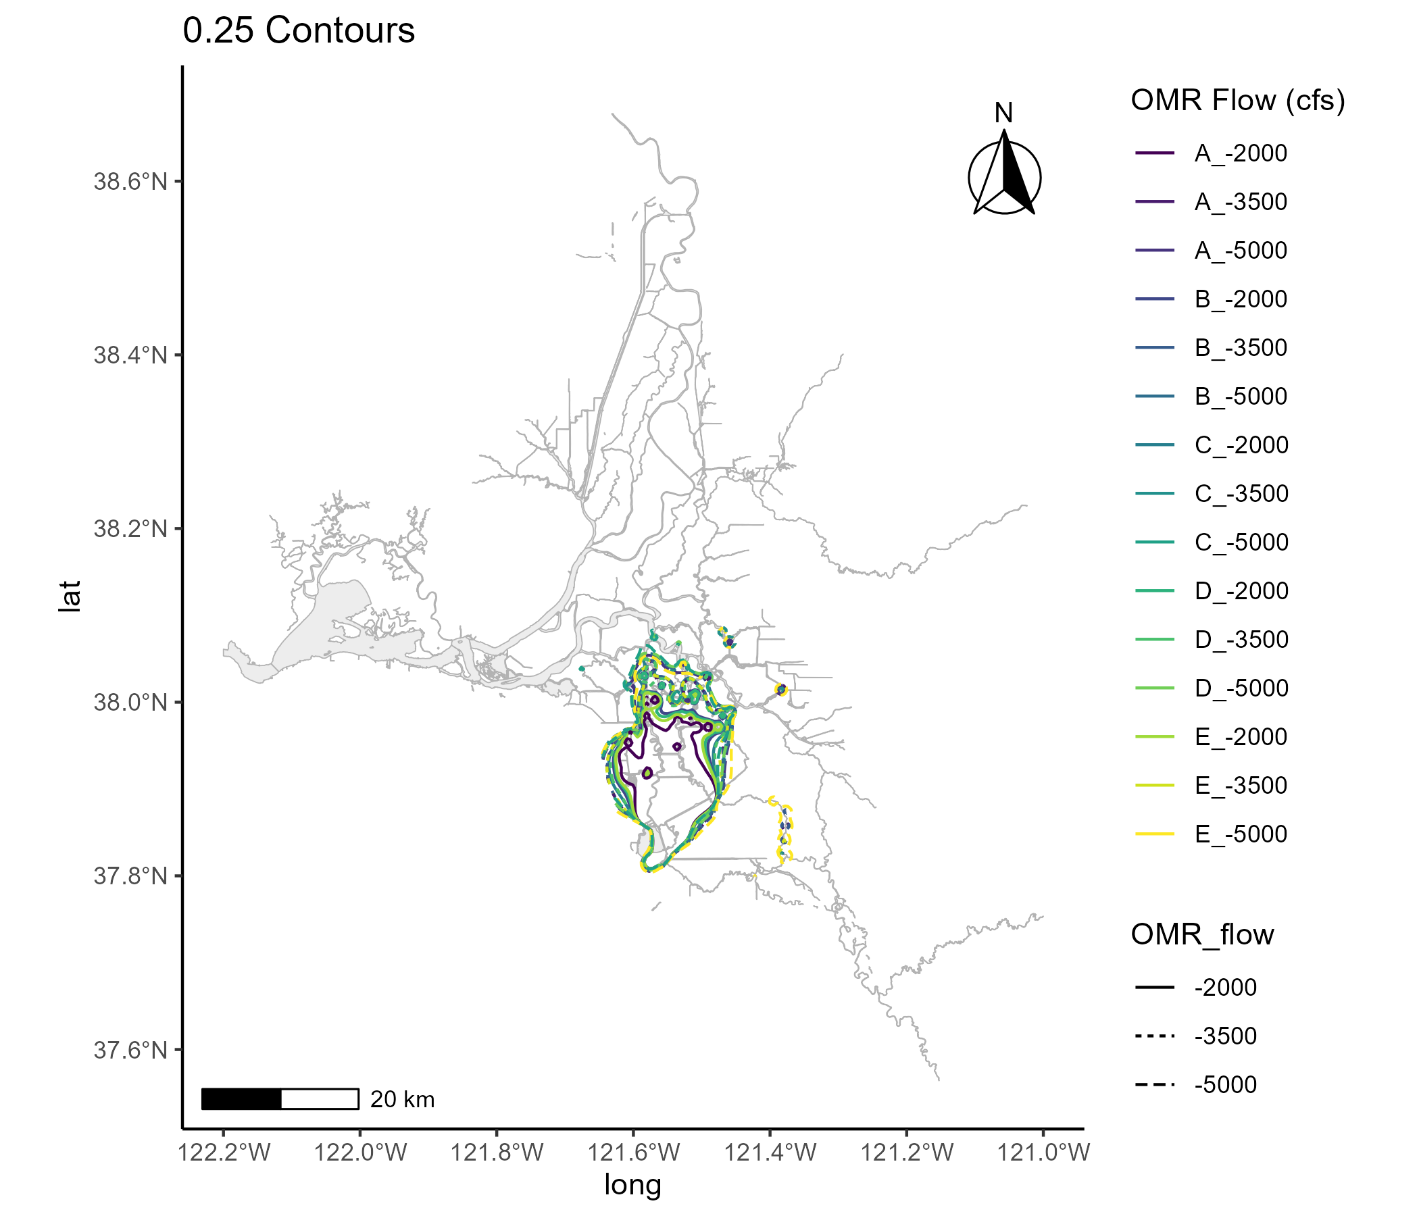
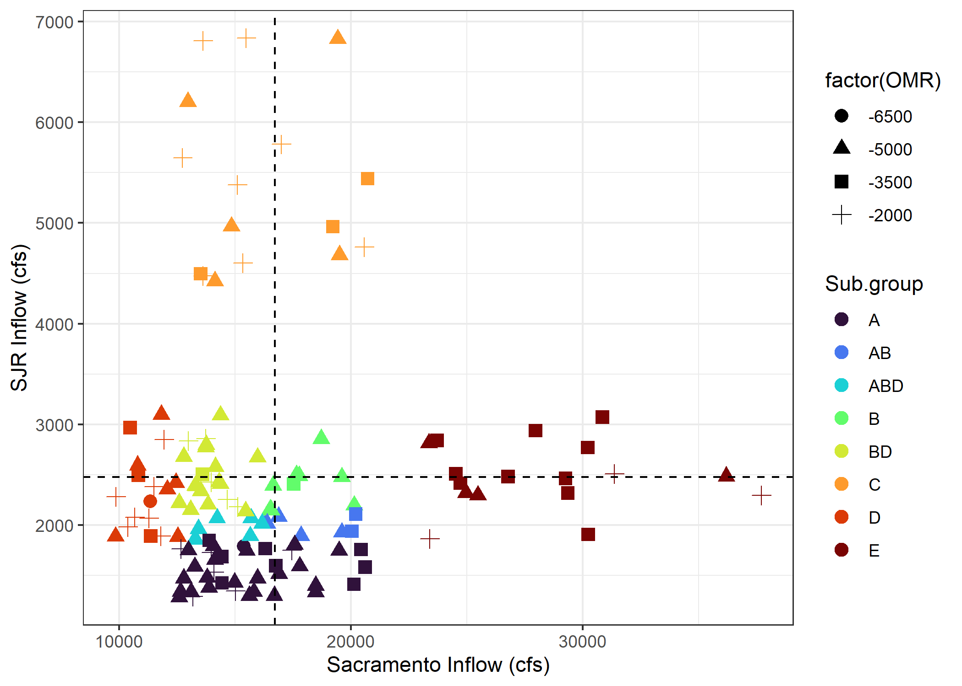
Zone up to 0.25 overlap (area most influenced by pumping)

Slide 3
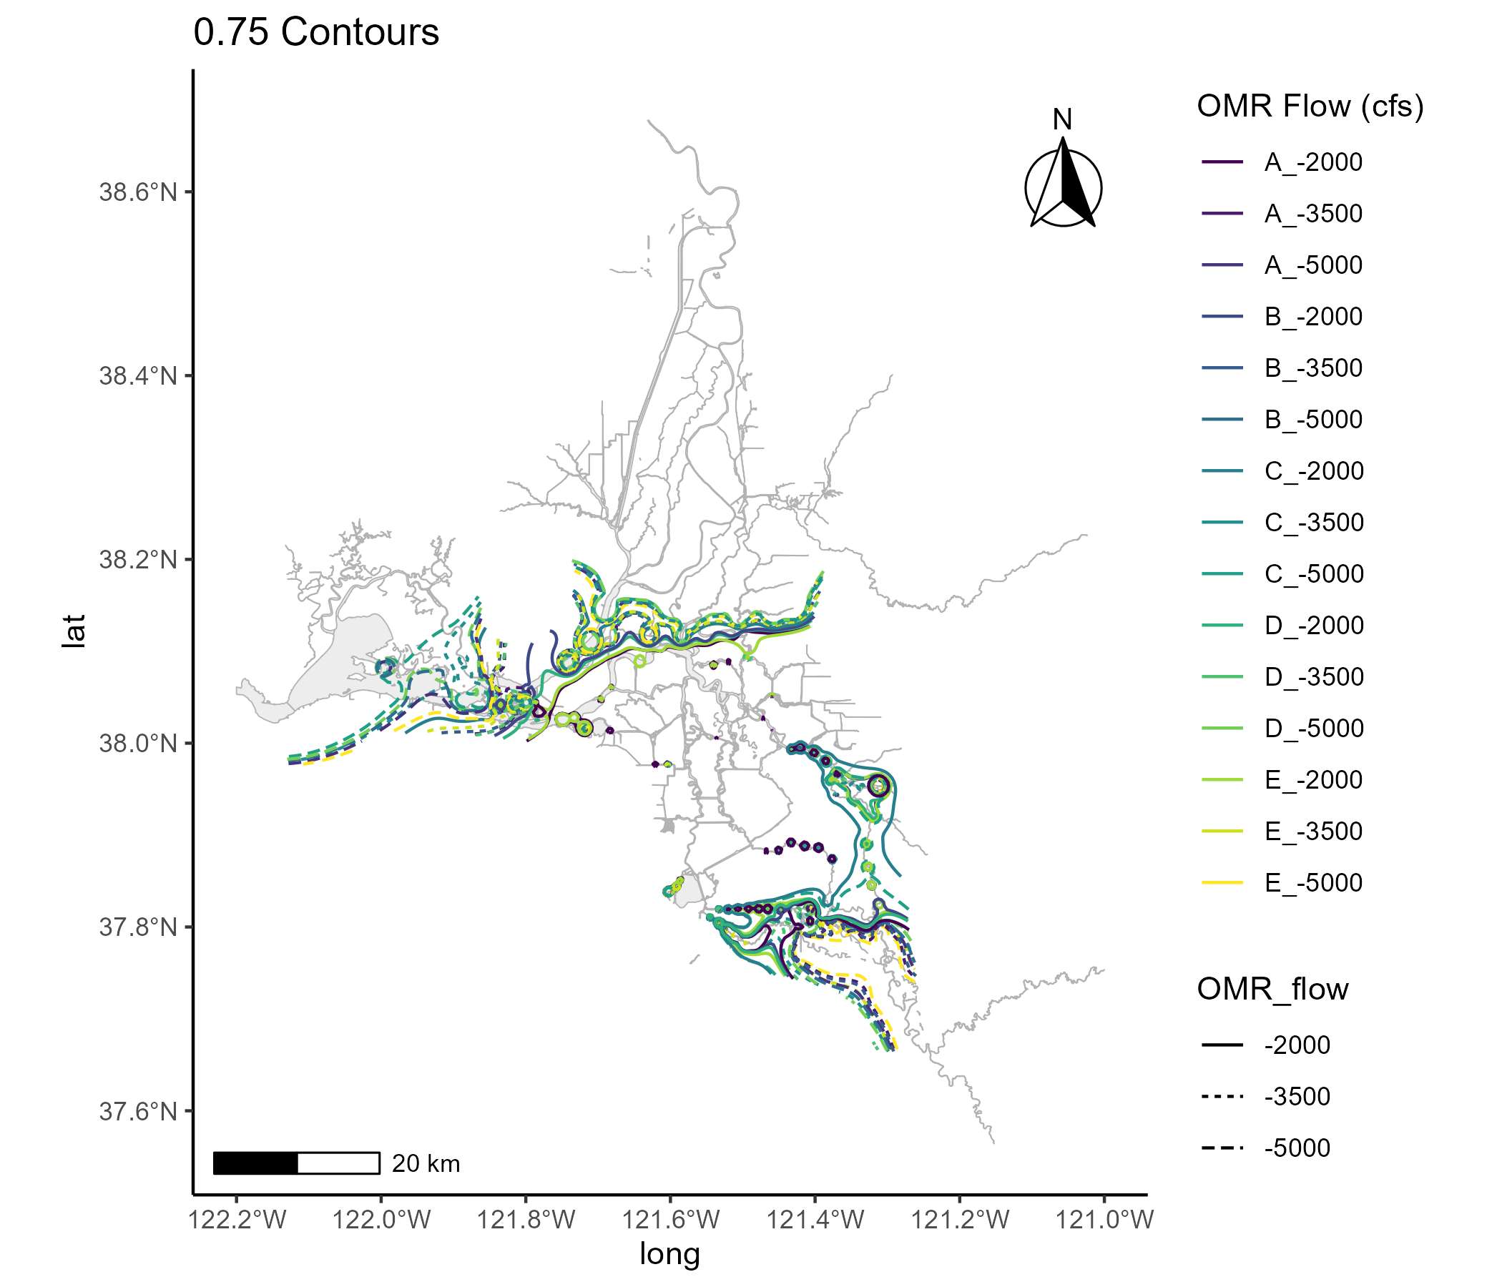
Zone up to 0.75 overlap (includes areas less influence by pumping)

Slide 4
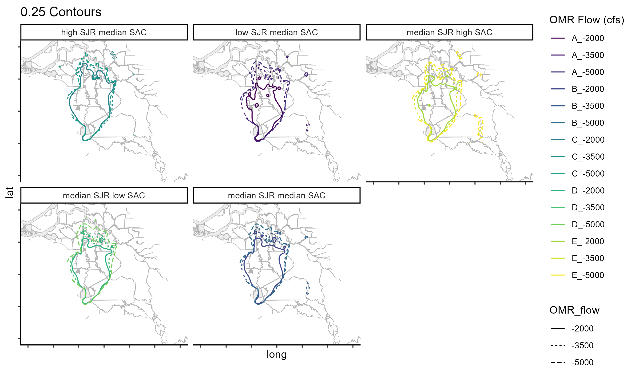

Slide 5
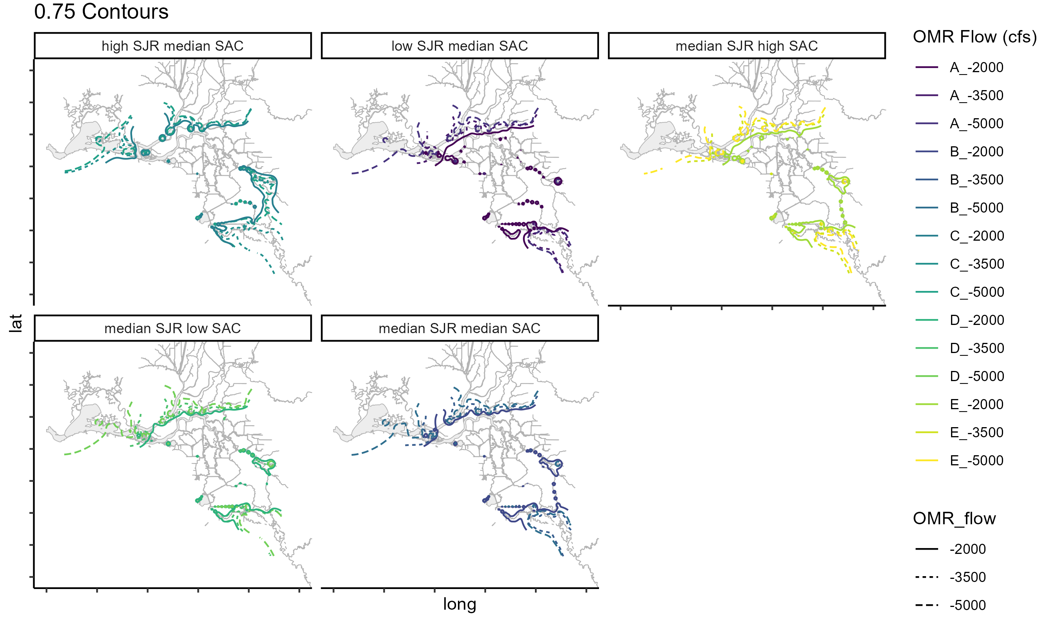

Slide 6
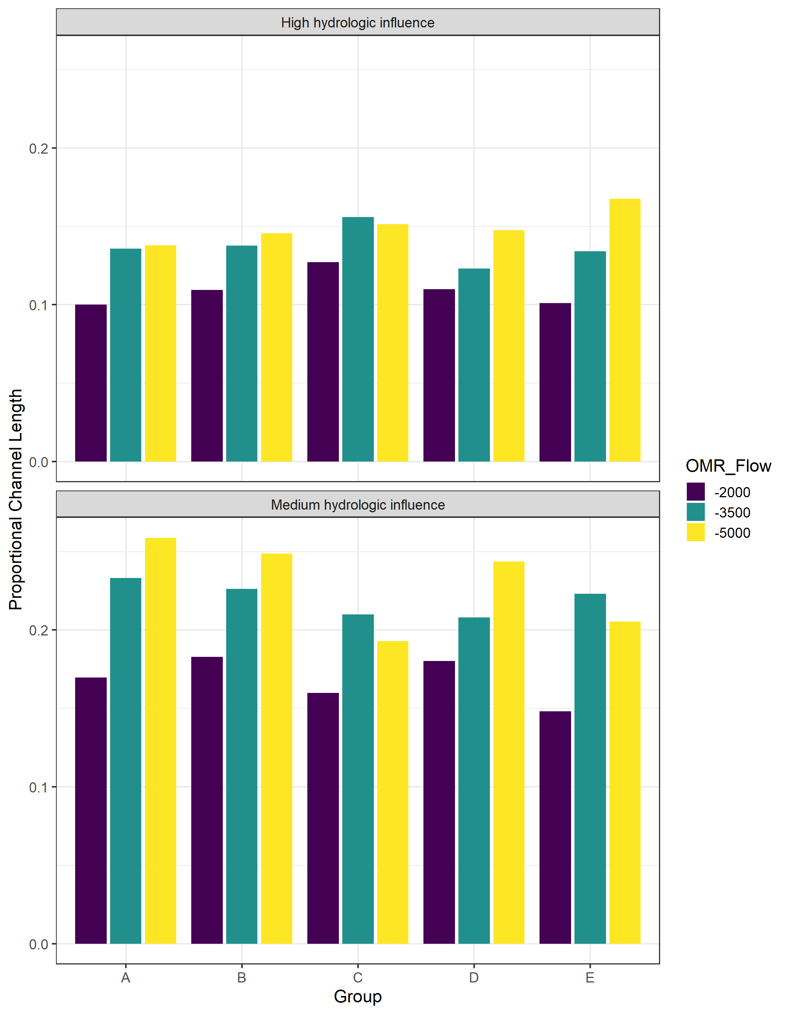
Proportion of DSM2 grid
<0.25 overlap
0.25 – 0.75 overlap

Slide 7
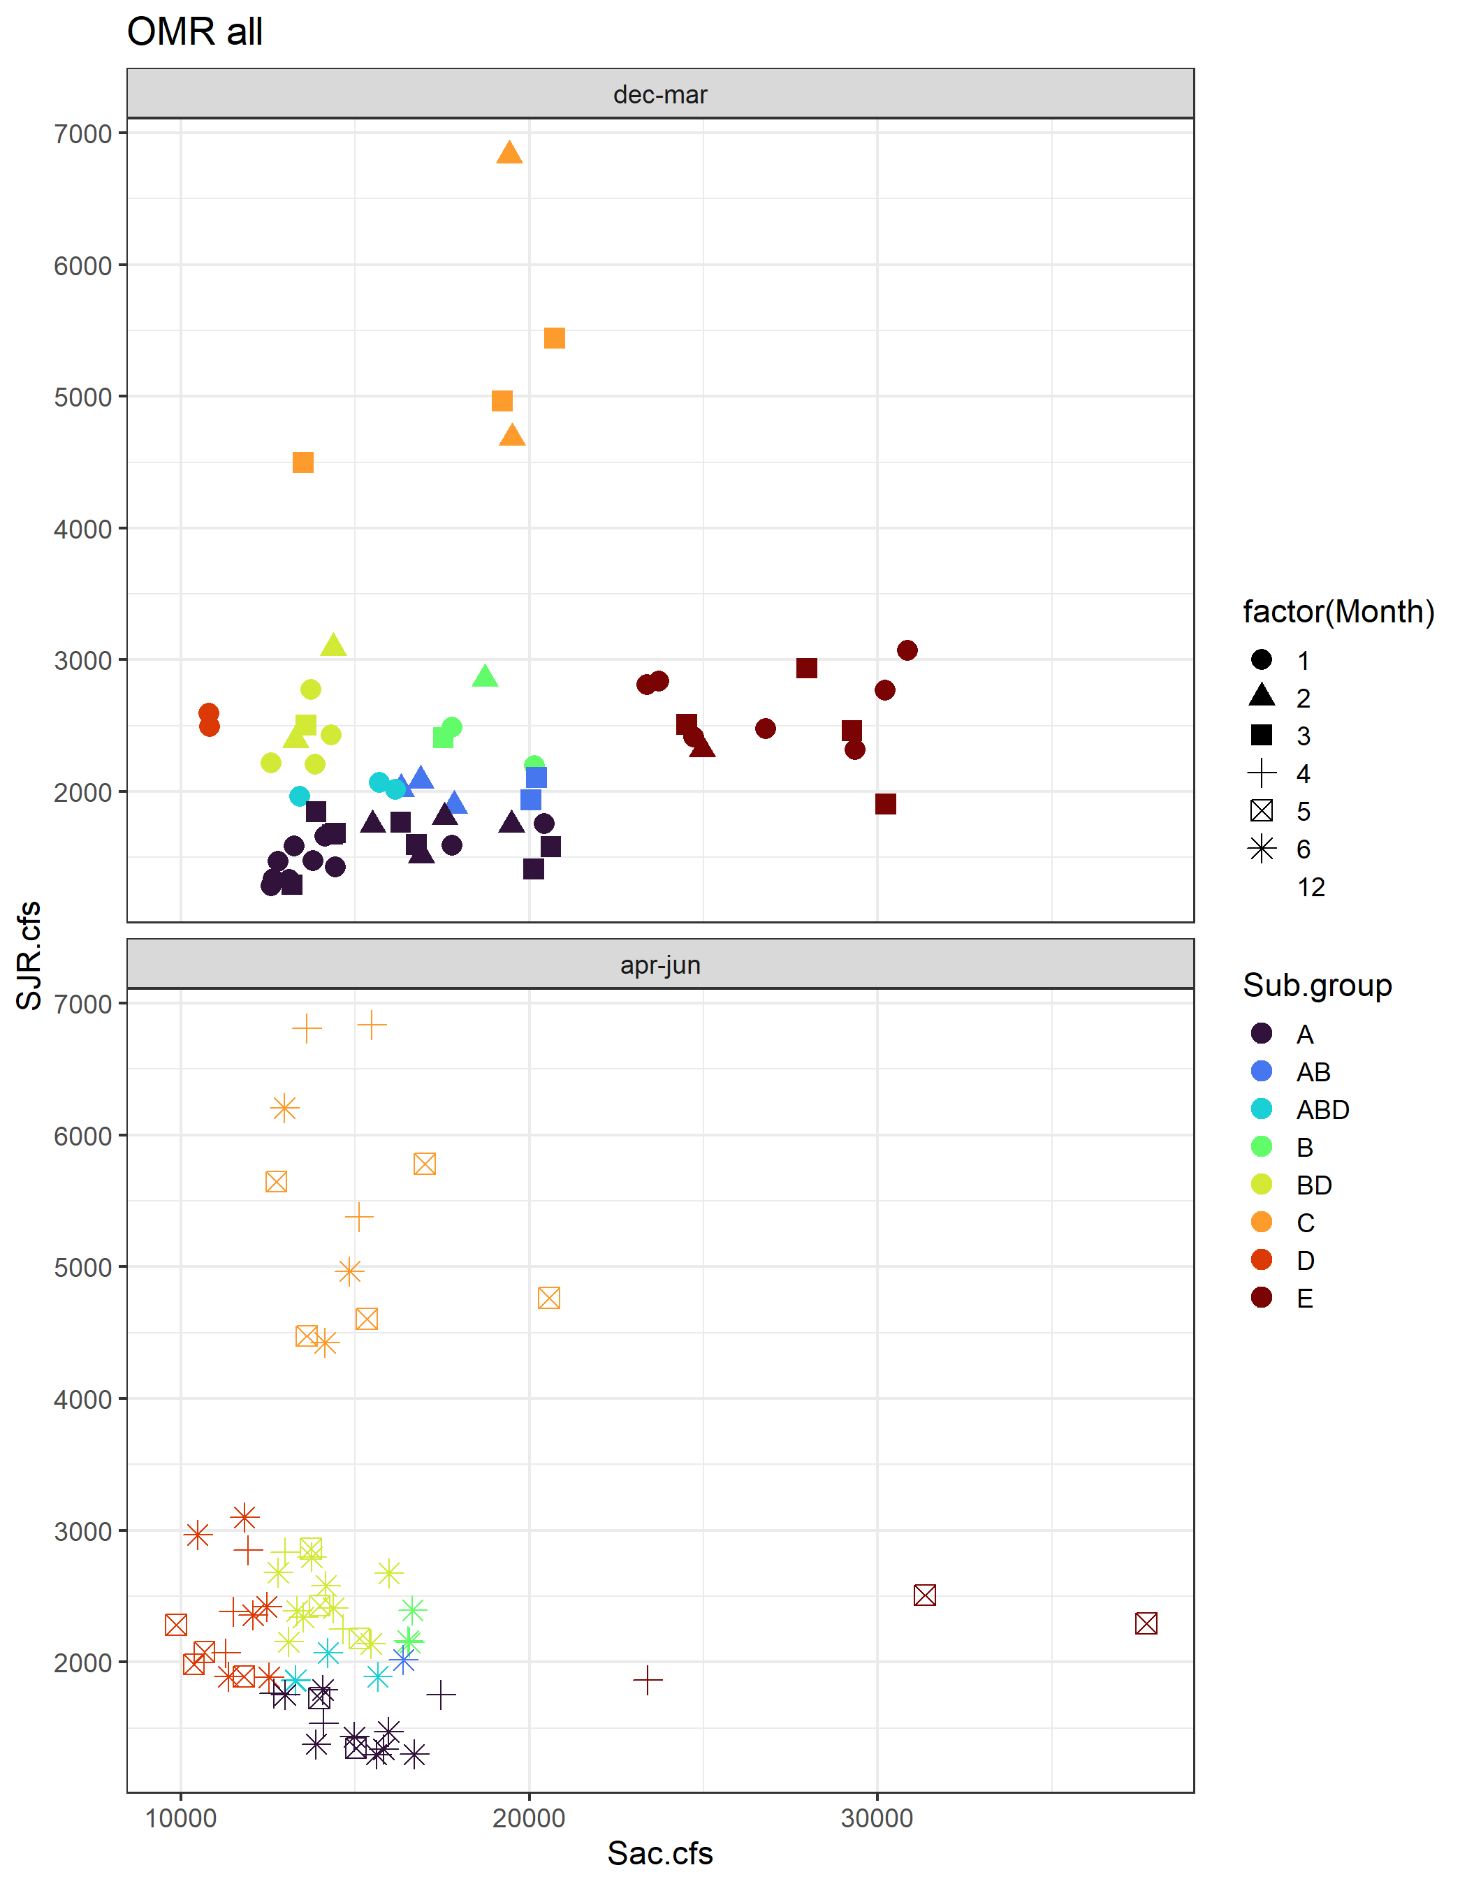

Slide 8
Other metrics

