Slide 1
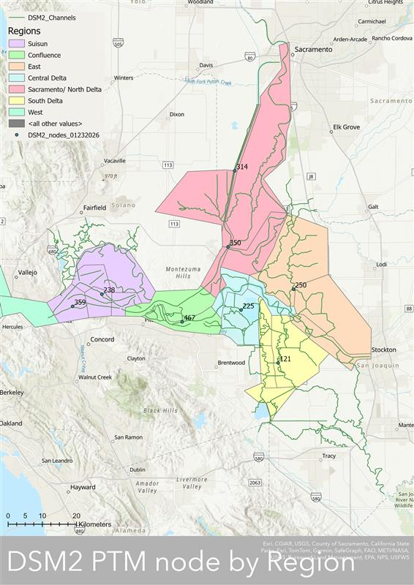
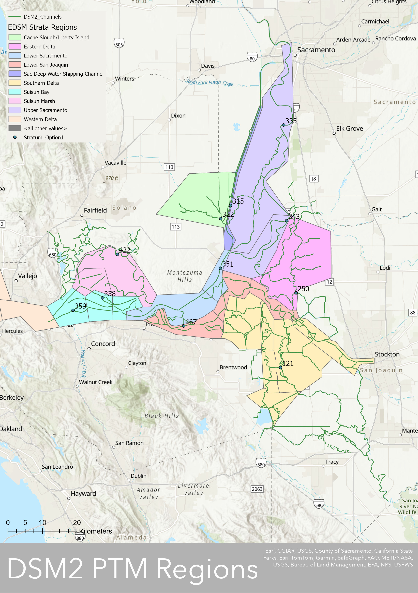
CURRENT MAP
EDSM MAP

Slide 2
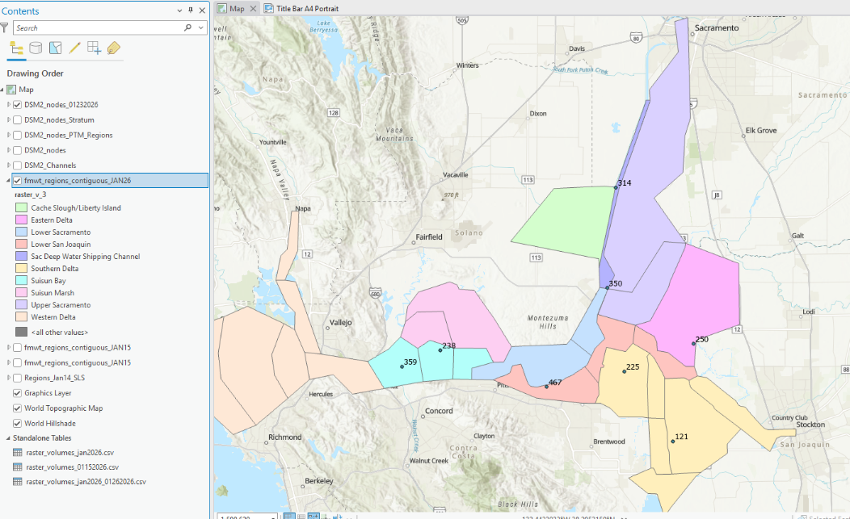

Slide 4
Proposed Option #1
 | EDSM Strata | Entrainment Analysis Region | DSM2 node adjustment?
1 | Cache Slough/ Liberty Island | Sacramento/North Delta
 | Upper Sacramento
 | Sac Deep Water Shipping Channel
2 | Eastern Delta | East Delta
3 | Suisun Bay | Suisun
 | Suisun Marsh
4 | Western Delta | Western Delta
5 | Lower Sacramento | Lower Sacramento
6 | Lower San Joaquin | Lower San Joaquin
7 | Southern Delta | Southern Delta
1
1
1
1
2
3
4
3
5
6
7

Slide 5
Proposed Option #2
 | EDSM Strata | Entrainment Analysis Region | DSM2 node adjustment?
1 | Cache Slough/ Liberty Island | Sacramento/North Delta
 | Upper Sacramento
 | Sac Deep Water Shipping Channel
 | Portion of Lower Sacramento
2 | Eastern Delta | East Delta
 | Portion of Southern Delta
3 | Suisun Bay | Suisun
 | Suisun Marsh
4 | Western Delta | West Delta
5 | Portion of Lower Sacramento | Confluence
 | Portion of Lower San Joaquin
6 | Portion of Lower San Joaquin | Central Delta
 | Portion of Lower San Joaquin
7 | Southern Delta | South Delta
1
1
1
1
2
3
1
6
4
3
5
6
2
5
6
7
7
2
7
7

Slide 6
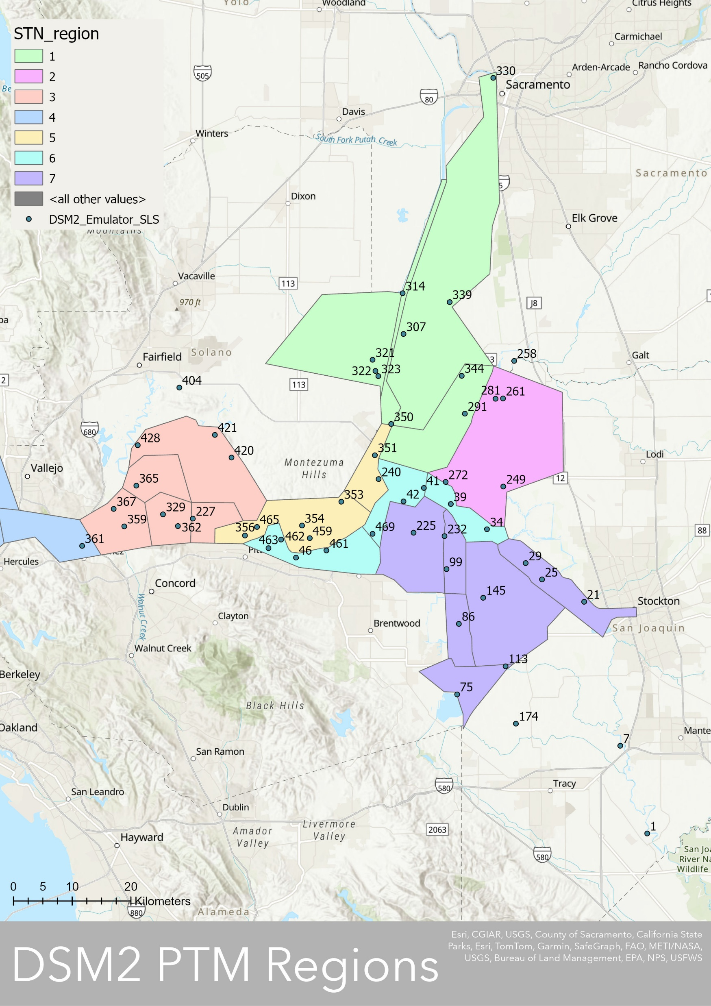
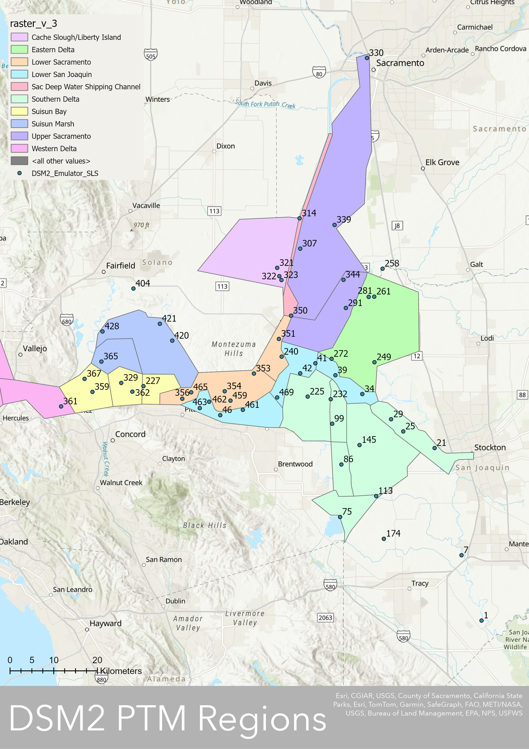
Proposed New Option
DSM2 | PTM emulator | SLS station
361 |  | 405
362 |  | 504
365 |  | 602
367 |  | 418
404 |  | 705
420 | x | 610
421 |  | 609
428 | x | 606
459 |  | 703
461 | x
462 |  | 801
463 |  | 520
465 | x | 513
469 | x | 809
NA |  | 404
NA |  | 401
NA |  | 338
NA |  | 336
NA |  | 323
NA |  | 330
NA |  | 322
NA |  | 311
NA |  | 329
NA |  | 335
NA |  | 328
NA |  | 327
NA |  | ?not visible
NA |  | ?not visible
NA |  | ?not visible
NA |  | 349
NA |  | 348
NA |  | 347
NA |  | 346
NA |  | 345
NA |  | 344
NA |  | 343
NA |  | 342
NA |  | 340
361 |  | 405
362 |  | 504
365 |  | 602
Sacramento/North Delta
DSM2 | PTM emulator | SLS station
1 | x
7 | x
21 | x | 912
25 | x
29 |  | 910
34 | x | 906
39 | x | 815
41 | x
42 |  | 812
46 |  | 804
75 | x | 918
86 | x | 915
99 | x | 902
113 | x
145 | x | 914
174 | x
225 |  | 901
227 |  | 519
232 | x
240 | x
249 | x | 919
258 | x
261 | x
272 | x
281 | x
291 | x
307 | x
314 | x
321 | x
323 | x | 723
322 | x | 716
329 |  | 501
330 | x
339 | x
344 | x
350 | x | 711
351 | x | 707
353 | x | 706
354 | x | 704
356 |  | 508
359 | x | 411
East Delta
Suisun
West Delta
Lower Sacramento
Lower San Joaquin
South Delta
No DSM2 nodes from before shown:
238 (Suisun)
467 (Confluence)
121 (South)
250 (East)

Slide 7
Proposed New Option
Sacramento/North Delta
East Delta
Suisun
West Delta
Lower Sacramento
Lower San Joaquin
South Delta
LFS Analysis Region | EDSM Region | DSM2 Node(s) | PTM Emulator | Corresponding SLS Station
Sacramento/ North Delta | Sac Deep Water Shipping Channel Cache Slough/Liberty Island Upper Sacramento | 314 323 350 | 314 323 350 | - 723 711
Eastern Delta | Eastern Delta | 249 261 | 249 261 | 919 -
Lower San Joaquin | Lower San Joaquin | 34 41 46 469 | 34 41 - 469 | 906 - 804 809
Lower Sacramento | Lower Sacramento | 465 353 | 465 353 | 513 706
South Delta | South Delta | 29 86 99 225 | - 86 99 - | 910 915 902 901
Suisun | Suisun Bay Suisun Marsh | 329 420 | - 420 | 501 610
Western Delta | Western Delta | 359 | 359 | 411

Slide 8
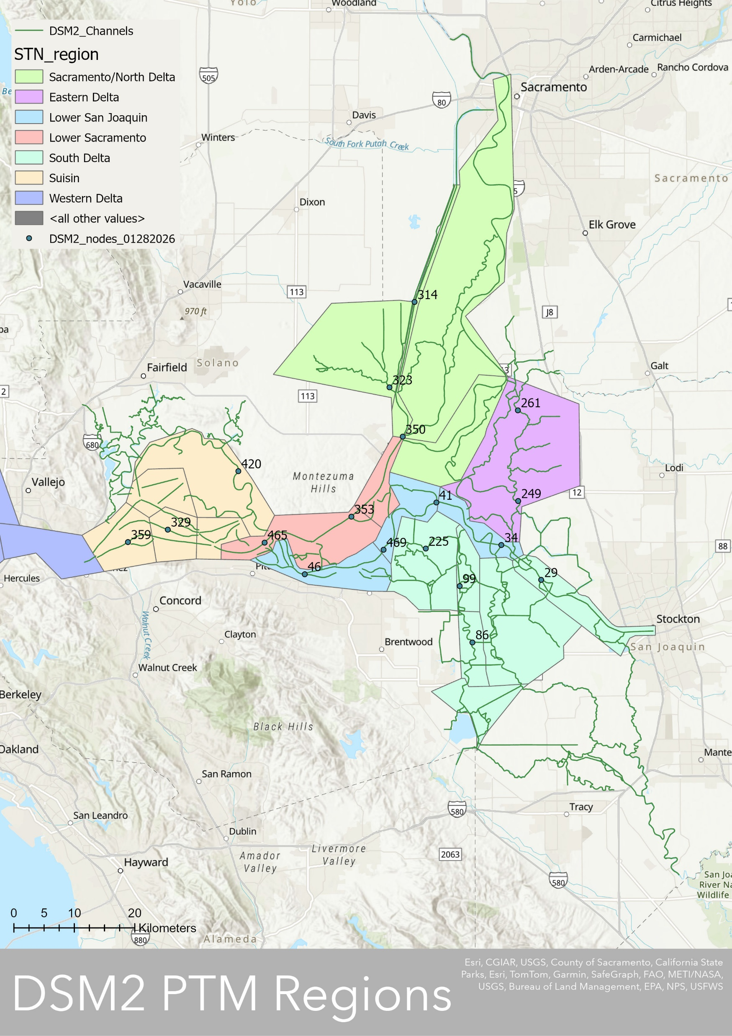
Previous MAP
New MAP

Slide 9
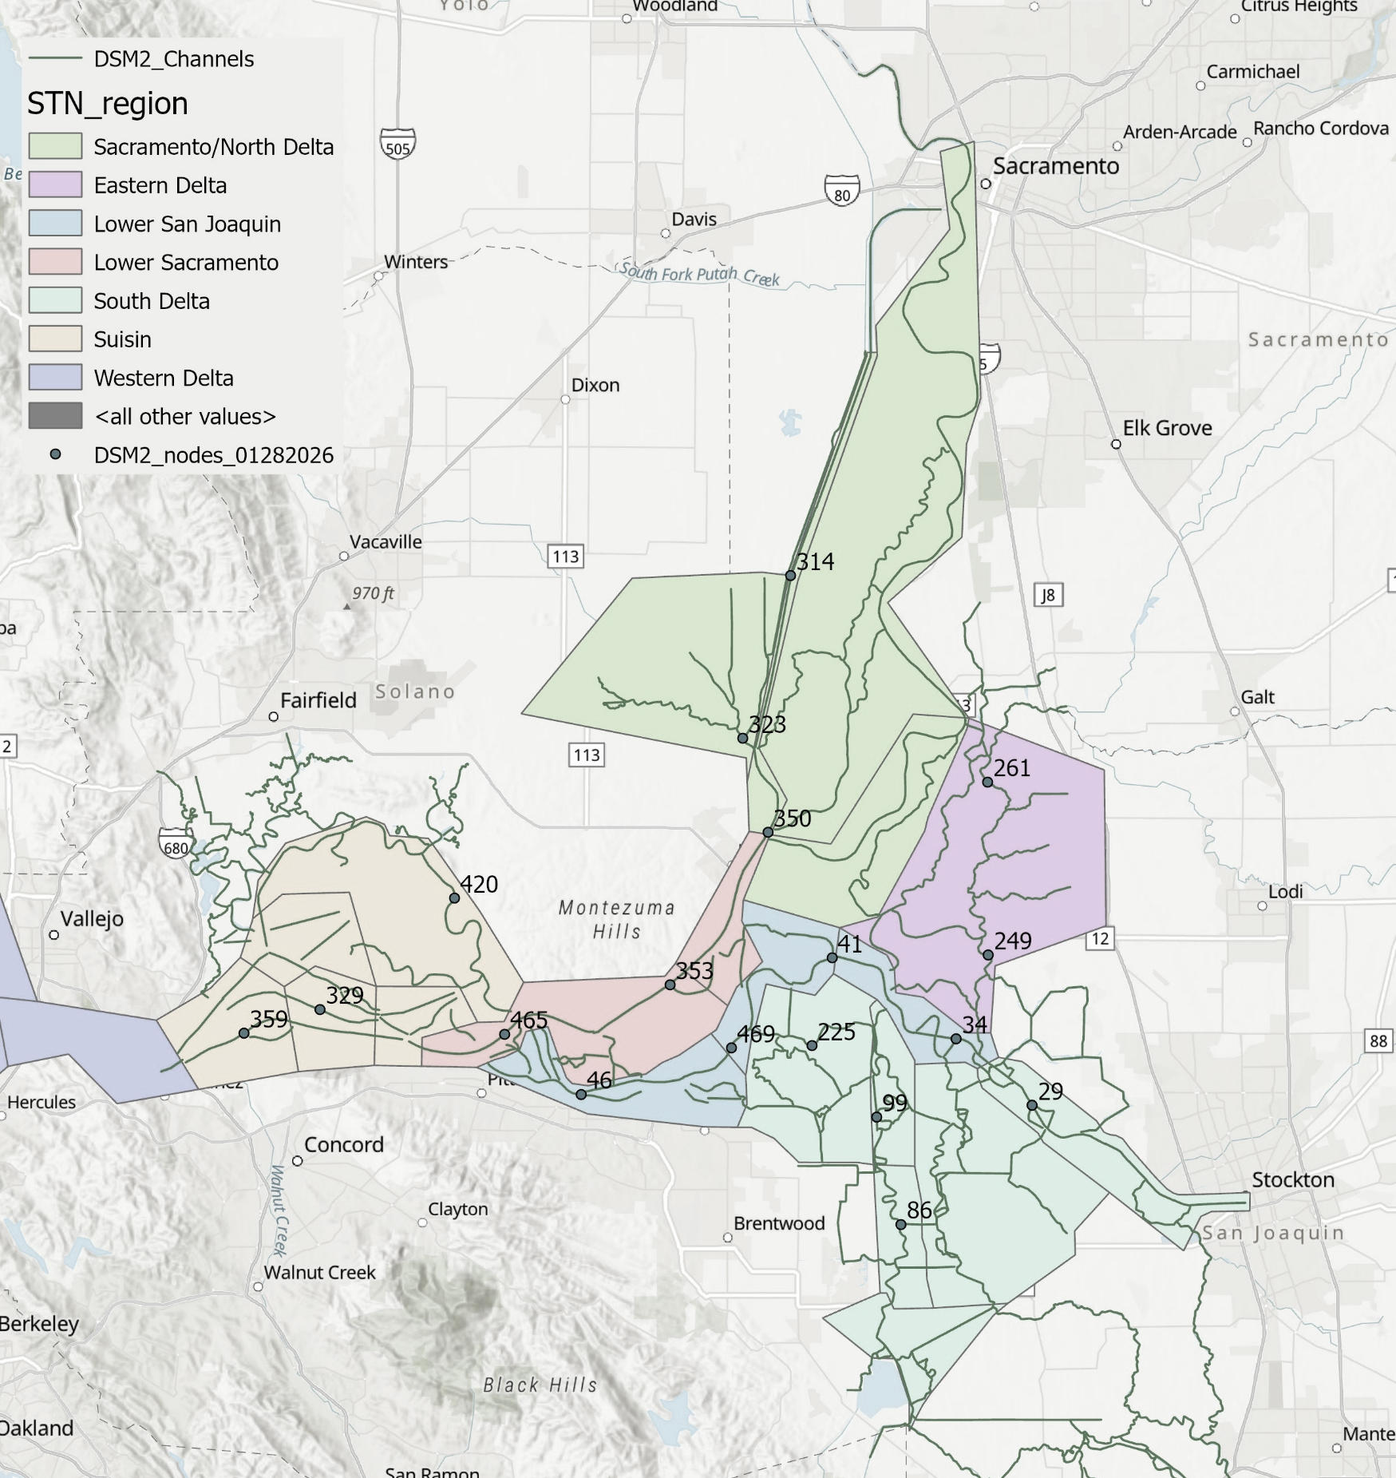
0
19.4
11.0
0
0.3
0
0.4

