Slide 1



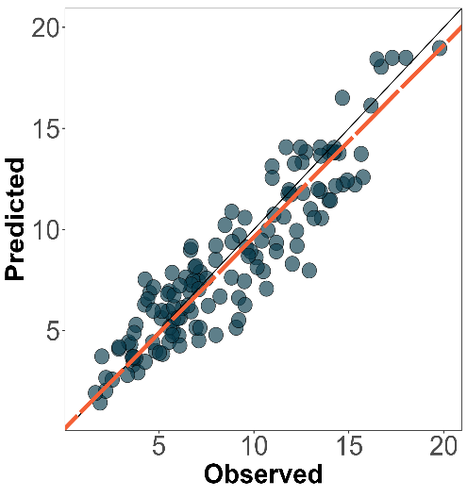
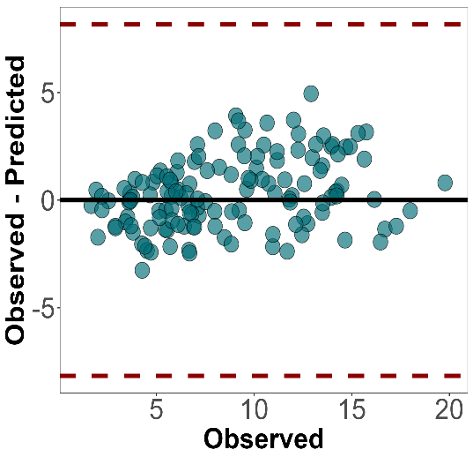
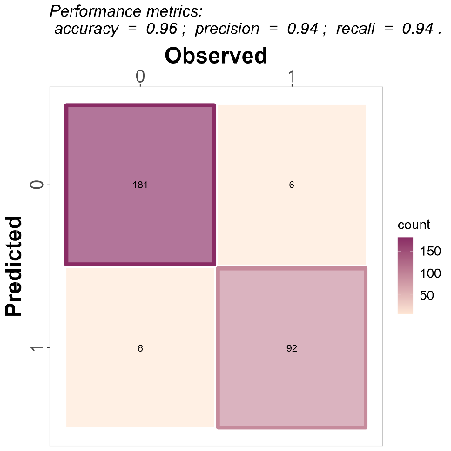
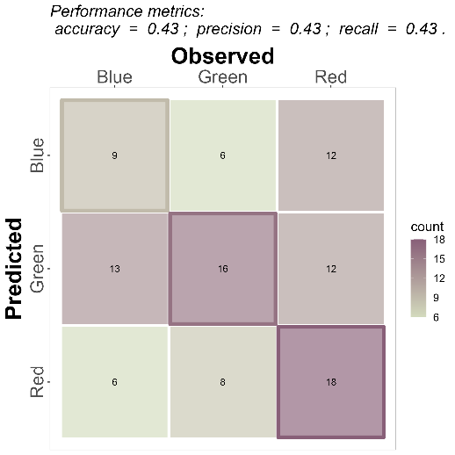
Prediction Performance with: : metrica
ShinyApp
Basics
Regression
Classification
metrica is a compilation of more than 80 functions designed to quantitatively and visually evaluate the prediction performance of regression (continuous) and classification (categorical) point-forecast models (e.g., APSIM, DSSAT, DNDC, Supervised Machine Learning).
bit.ly/3UwM40J
R2(data = wheat, obs = obs, pred=pred, tidy = TRUE)
#> R2
#> 1 0.8455538
accuracy(data=maize_phenology, obs=actual, pred=predicted)
#> $accuracy
#> [1] 0.8834951
Using the functions
RMSE(data = wheat, obs = obs, pred = pred)
#> $RMSE
#> [1] 1.666441
precision(data=maize_phenology, obs=actual, pred=predicted)
#> $precision
#> [1] 0.8335108
There are two basic arguments common to all metrica functions: (i) obs (Oi; observed, a.k.a. actual, measured, truth, target, label), and (ii) pred (Pi; predicted, a.k.a. simulated, fitted, modeled, estimate) values. Optional arguments include data that allows to call an existing data frame containing both observed and predicted vectors, and tidy, which controls the type of output as a list (tidy = FALSE) or as a data.frame (tidy = TRUE).
KGE(data = wheat, obs = obs, pred = pred)
#> $KGE
#> [1] 0.9106471
recall(data = maize_phenology, obs=actual, pred=predicted)
#> $recall
#> 1 0.8405168
Users can also calculate all (default) or a selected list of metrics at once using the function metrics_summary():
For classification, users can also apply the metrics_summary() function to obtain multiple metrics at once:
Installation
sel_r_metrics <- c("R2","MBE","RMSE", "RSR", "NSE", "KGE", "CCC")
metrics_summary(data = wheat,
obs = obs,
pred = pred,
type = "regression",
metrics_list = sel_r_metrics)
sel_c_metrics <- c("accuracy", "precision", "recall", "fscore")
metrics_summary(data = landcover,
obs = actual, pred = predicted,
type = "classification",
metrics_list = sel_c_metrics,
pos_level = 1)
install.packages("metrica")
You can install the development version from GitHub with:
#install.packages("devtools")
devtools::install_github("adriancorrendo/metrica")
Native datasets
Plots
Confusion matrix
The metrica package comes with four example datasets of continuous variables (regression) from the APSIM software:
Wheat: 137 data-points of wheat grain N
Barley: 69 data-points of barley grain number
Sorghum: 36 data-points of sorghum grain number
Chickpea: 39 data-points of chickpea aboveground dry mass
1. scatter_plot(data = wheat,
obs = obs, pred = pred)
confusion_matrix(data = .,
obs = labels, pred = predictions,
plot = TRUE,
unit="count")
2. bland_altman_plot(data = wheat,
obs = obs, pred = pred)
Binomial case
Multinomial case
1
2
In addition, metrica also provides two native examples for categorical variables (classification):
land_cover: binary dataset of land cover using satellite images. Values: 1=vegetation, 0 =other type of land cover.
maize_phenology: data set of maize (Zea mays L.) phenology (16 crop development stages).
Check the metrics documentation to find all the performance metrics and their details: metrica
RStudio® is a trademark of RStudio, Inc. • CC BY SA by Carlos Hernandez & Adrian A. Correndo • adriancorrendo.github.io/metrica/ Updated: 2023-01

