Slide 1
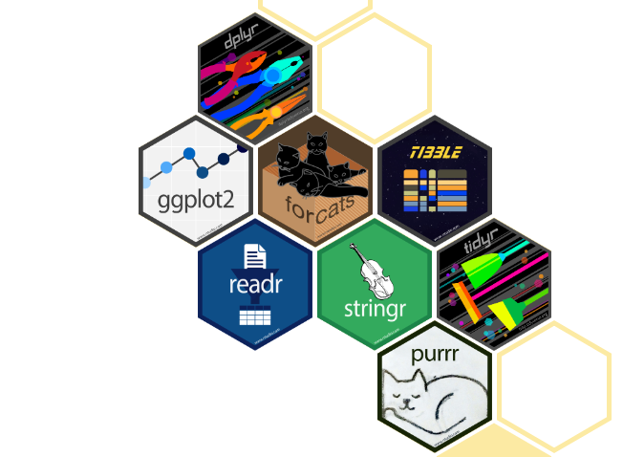
"Get Your Data in Shape: Tidyverse—The Gym for Your Data!"

Slide 2
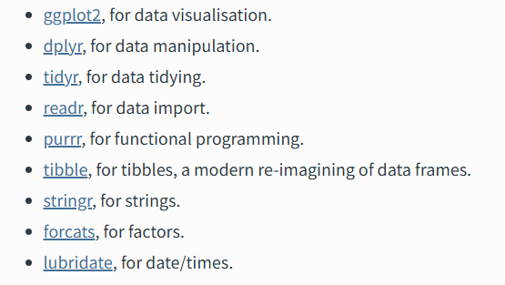

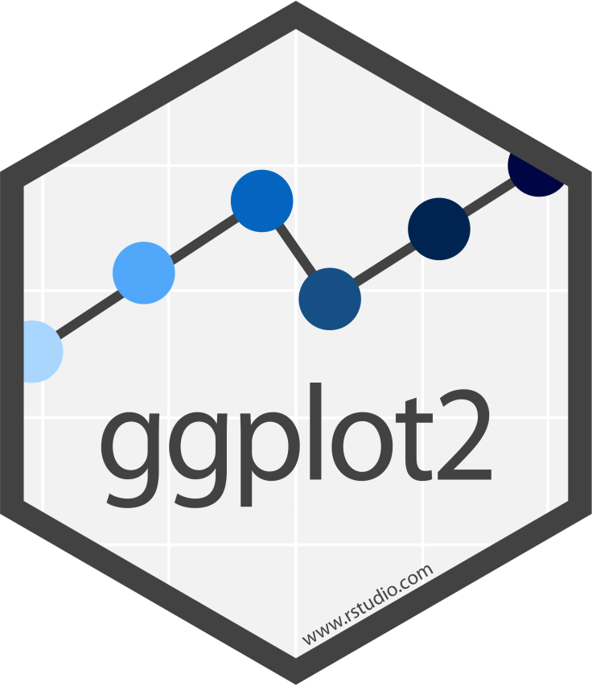
What is tidyverse?
Collection of R packages that share
High-level design philosophy
Low-level grammar and data structures
Learning one package makes it easier to learn the next
Encompassas repeated tasks with data in R
Data import
Data tidying
Data manipulation
Data visualization
Data programming

Slide 3
Tidyverse vs. Base R
Consistent and intuitive syntax
Unified syntax across packages
Pipeline Operator (%>%) or (|>)
Allow for clean readable workflows
Powerful Data Manipulation
Optimized functions that are faster and more intuitive than Base R functions
Especially with grouped operations
Easier Data Visualization
Ggplot2 has a flexible, layer-based approach to data viz
Produces more polished visuals by default

Slide 4
Some Example DPLYR and ggplot Code

Slide 5
Your own problem data summary problem?
Create a tibble with mean fork length for ad-clipped and non clipped females
Create a bar graph in ggplot comparing the fork lengths of each.

Slide 6
Resources
Helpful links to the two packages and cheat sheets
Dplyr:
Vignette: https://dplyr.tidyverse.org/
R chapter: https://r4ds.hadley.nz/data-transform
ggplot:
Vignette: https://ggplot2.tidyverse.org/
R chapter: https://r4ds.hadley.nz/data-visualize
Practice Projects and Challenges
Tidy Tuesday:
Weekly data project in R
https://github.com/rfordatascience/tidytuesday
Exercism.io:
Free R trainings
https://exercism.org/tracks/r

