Slide 1

GitHub Overview
R group
12/6/2024

Slide 2
General Information

Slide 3
DOI Talent Trainings
DGEC Introductory Training Write Role (GitHub) https://doitalent.ibc.doi.gov/enrol/index.php?id=20144
Git & GitHub: Working with Git Repositories (optional) https://doitalent.ibc.doi.gov/enrol/index.php?id=15058
Once the first training is complete, you can request a license:
Request a license here: https://apps.gov.powerapps.us/play/e/default-0693b5ba-4b18-4d7b-9341-f32f400a5494/a/36a8a424-404e-45e6-8577-0c886171a2ce?tenantId=0693b5ba-4b18-4d7b-9341-f32f400a5494 Please leave the license type as unknown.

Slide 4
Version Control Introduction
3 Session 3: Version Control with git and GitHub | Open Science Synthesis for the Delta Science Program: Week 1
Useful basic tutorial above, benefits of version control
Software
Git – version control software Git - Downloads
GitHub – online sharing
Create a username on GitHub GitHub
R Studio – you can link Git to R and operate mainly through the R interface

Slide 5
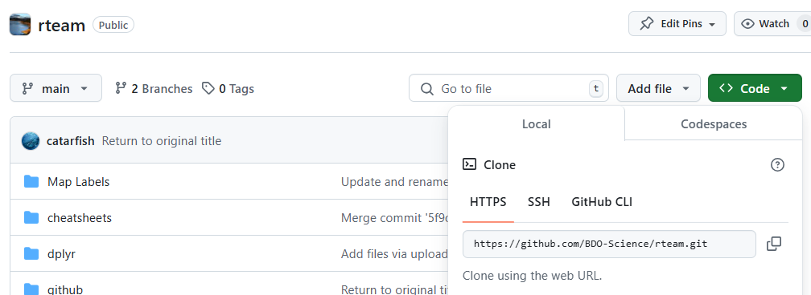
General Order of Operations
Create repository in GitHub (add readme, gitignore files)
readme: include descriptions of files, how to use the repository, other useful info for external users
gitignore file: list of files Git will not track (e.g. large files, sensitive info, items you are testing)
Clone repository to R
Create new R project
Select version control, Git
Copy link from GitHub URL
Navigate to directory you’d like to store
Can be useful to have one folder for all your GitHub repositories
Make edits to your file
Save edits
Before you commit files, look at the file size. Try not to commit anything >15MB.
For large files, try saving as .Rds and compressing the file first (compress = “xz”)
Add to .gitignore if you think you may accidentally try to commit the file
Pull – Commit – Push
Pulling will bring in edits from collaborators. Resolve any conflicts after you pull if necessary.
Write a useful commit message describing what you did as you may come back to this version in the future
Pushing will put your edits onto GitHub

Slide 6
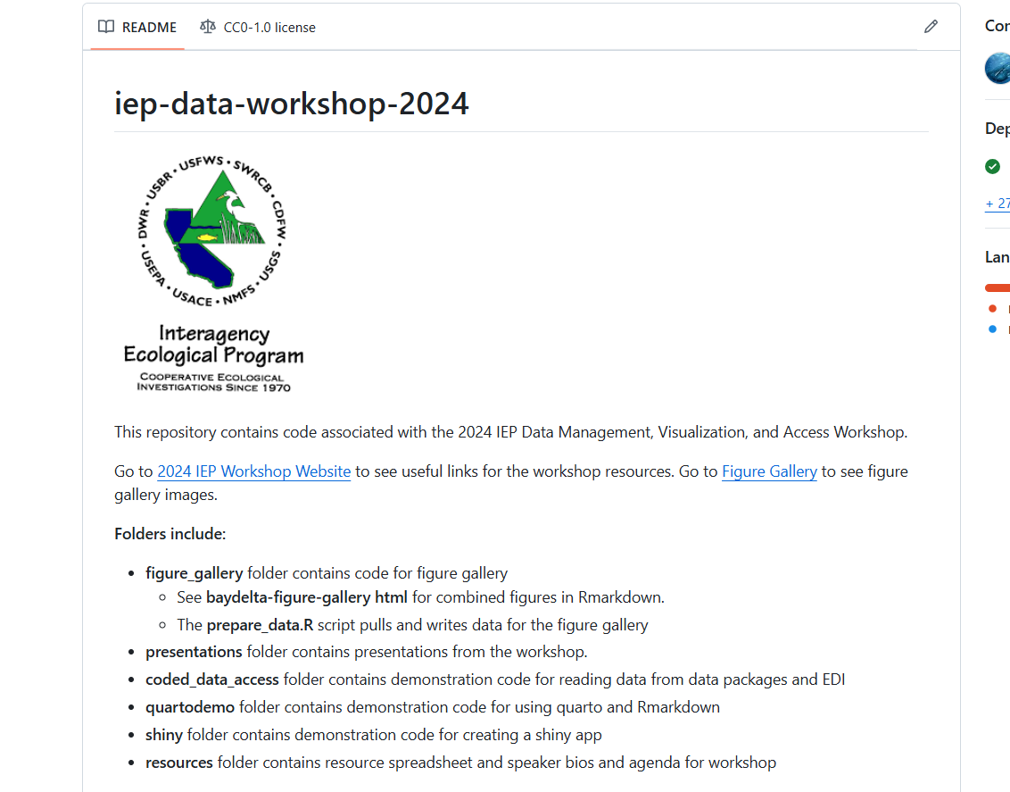
Project Organization
Organization
Project_folder/
data/
data_raw/ (original data)
data_processed (cleaned up data)
docs/ (documentation, protocols, notes)
scripts/
output/
figures/ or plots/
tables/
Documentation
Readme file (.md)
This is usually created in GitHub repository and will be displayed on the main page of your repository.
You can also create a readme in a .txt file
Scripts
Include a description at the top of each script detailing the goal of the script
Include author name and contact info
How to organize your analyses with R Studio Projects | R (for ecology)

Slide 7

Collaboration

Slide 8
Ways to collaborate
If multiple people are working on the same files, issues may arise.
A few ways to reduce issues:
Stay in constant communication when multiple people are making edits to the same file
Use branches to work on different versions of the file
Use pull requests

Slide 9
Branching and merging
Work in the terminal
Create a branch
git branch <branch name> OR
git checkout –b “new-branch-name” OR
Add a branch in the repository on GitHub, then pull changes
Merging branches
git checkout main main is default branch, this directs you to the main branch
git merge branch-name

Slide 10

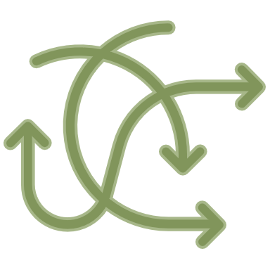
Other issues

Slide 11
When you have a lot of files to add:
It can be slow to manually click a bunch of files to add for commit, and sometimes there is a lag after you click
Navigate to the “Terminal” tab of the console window:
Check things are set up right
git config --global user.name
git config --global user.email
pwd print working directory
Add all files to commit
git add -A
git commit -m “write your commit message”
git status check the files that have been added, untracked, etc.
git remote -v check which repo you are pushing to. Should already be set up if you are already linked to a repo.
git pull
git push

Slide 12
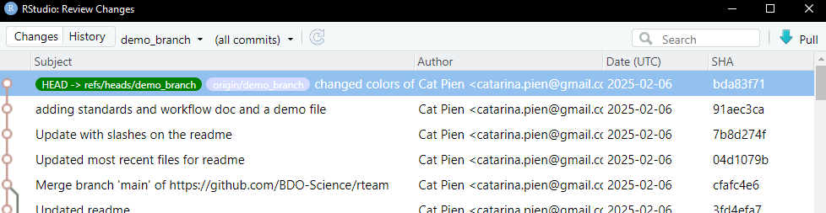
OH NO – I did not want to commit that!
How can I undo the last commit? | Learn Version Control with Git
amend: add to the last commit/change commit message
Work in the terminal
git reset --soft HEAD~1
Rewind by 1
Soft reset will keep the changes uncommitted
git reset --hard HEAD~1
Hard reset will remove any changes you made since the previous commit
git reset --hard SHA(e.g. 91aec3ca)
Go to an older version of the file

Slide 13
Go back to an older version of a file
Create a new branch
git checkout -b “new-branch-name”
Restore older files
git restore -source = file SHA
Get hash by clicking on the clock and find SHA (see example on previous slide)
Commit and push files
git add path/file
git commit -m “fixing things”
git push
Merge updated branch files back into the main branch
git checkout main or whatever the branch name is
git merge new-branch-name

Slide 14
Stashing
What is the intended use-case for git stash? - Stack Overflow
Save un-committed changes (record current wd, but want to go back to clean wd)
Work in the terminal
git stash
Save uncommitted changes
git stash list
List your stashes
git stash apply stash@{x}
apply the uncommitted changes (x = stash number)
git stash pop stash@{x}
Apply stash, remove from stash list
git stash apply stash@{x}
Apply stash, keep on stash list

Slide 15
GitHub pages
Shareable website for an organization or a project
Environmental Monitoring Program (organization website)
Brood Year 2021 Winter-Run Chinook Salmon Report (bookdown)
General Resources | 2024 IEP Data Management, Visualization, and Access Workshop
Create a folder to hold materials for your page in your repository (e.g. docs/)
Add files you want to include on the site
Use index.md, index.html, or README.md for the entry site page, must be in the top level of your docs folder
Configure page
Under repository, go to “Settings”
In “Code and automation”, go to “Pages”
Under “Build and deployment” click “Deploy from a branch”
Select the folder you are deploying from
You will see your webpage link after a bit at the top and can click “Visit site” (see following slide example)
Creating a GitHub Pages site - GitHub Docs

Slide 16
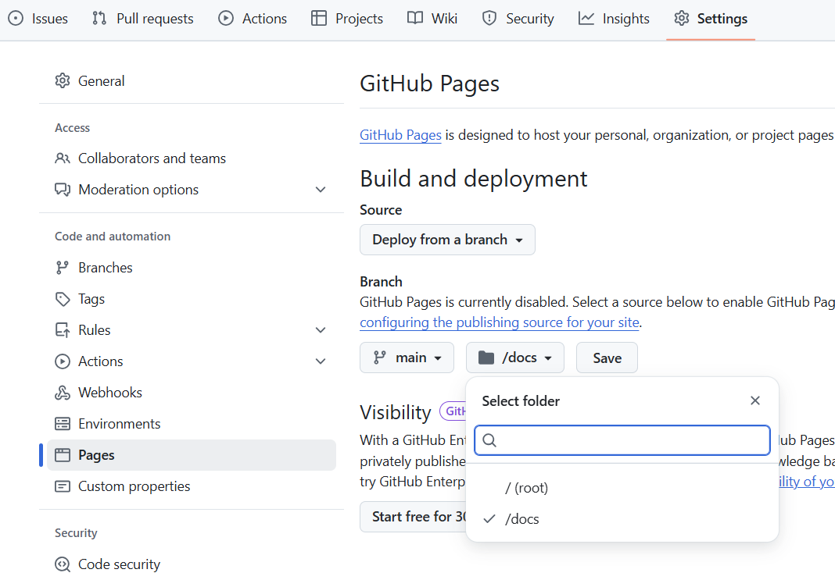

Slide 17
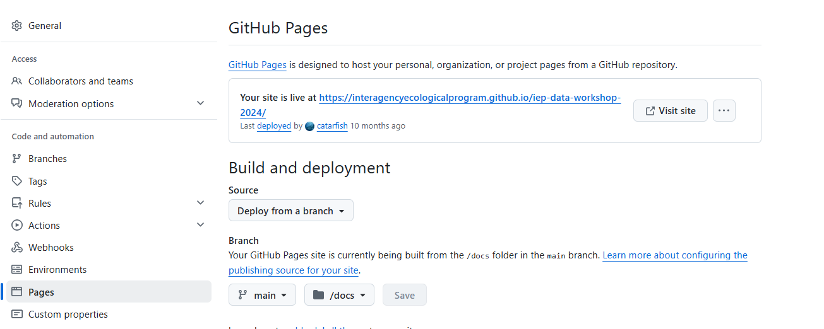

Slide 18
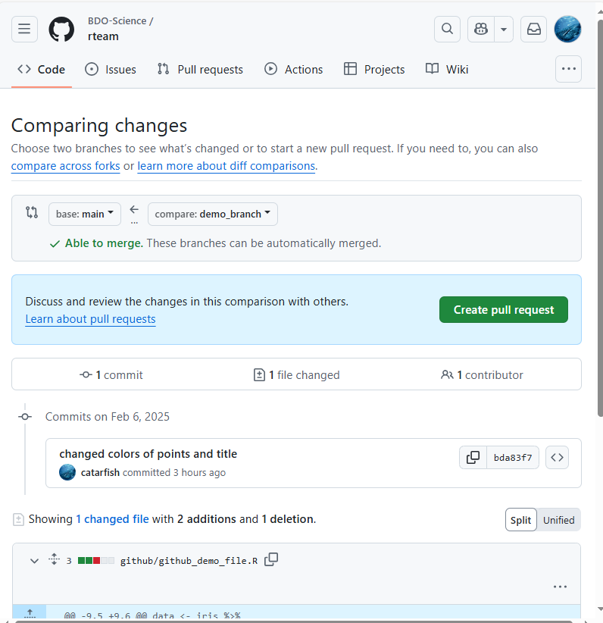
Pull requests
Collaboration technique
Submit requests for changing the code in a collaborative project
E.g. as a level of review when you are updating code
E.g. to suggest update to a package when you notice an error
Create a branch. Make changes in a branch, commit and push to repo.
On github, “Create pull request”
Compare main and branch
Click “Create pull request”
Add the people you want to review your request, and add any comments to describe the request
The reviewers will get a notification in their email about the request.
They can then go into the pull request, make suggested changes, or approve and merge the request.
Once merged, your updated code will be in the main branch of the repository.
You can now delete your branch.

