Slide 1



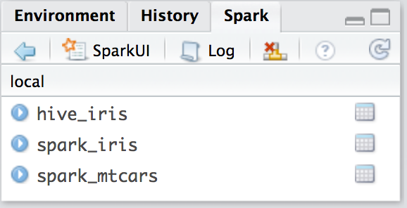

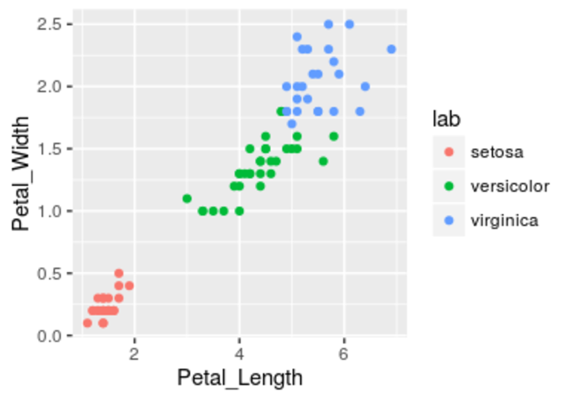






Data Science in Spark
with sparklyr
Cheat Sheet
Data Science Toolchain with Spark + sparklyr
Using sparklyr
fd
Understand
A brief example of a data analysis using Apache Spark, R and sparklyr in local mode
Import
fd
fd
fd
Communicate
Tidy
Transform
Visualize
Collect data into R
Share plots, documents, and apps
Export an R DataFrame
Read a file
Read existing Hive table
dplyr verb
Direct Spark SQL (DBI)
SDF function (Scala API)
Transformer function
Collect data into R for plotting
library(sparklyr); library(dplyr); library(ggplot2); library(tidyr);
set.seed(100)
spark_install("2.0.1")
sc <- spark_connect(master = "local")
import_iris <- copy_to(sc, iris, "spark_iris",
overwrite = TRUE)
partition_iris <- sdf_partition(
import_iris,training=0.5, testing=0.5)
sdf_register(partition_iris, c("spark_iris_training","spark_iris_test"))
tidy_iris <- tbl(sc,"spark_iris_training") %>%
select(Species, Petal_Length, Petal_Width)
model_iris <- tidy_iris %>%
ml_decision_tree(response="Species",
features=c("Petal_Length","Petal_Width"))
test_iris <- tbl(sc,"spark_iris_test")
pred_iris <- sdf_predict(
model_iris, test_iris) %>%
collect
pred_iris %>%
inner_join(data.frame(prediction=0:2,
lab=model_iris$model.parameters$labels)) %>%
ggplot(aes(Petal_Length, Petal_Width, col=lab)) +
geom_point()
spark_disconnect(sc)
fd
Install Spark locally
Wrangle
Model
R for Data Science, Grolemund & Wickham
Spark MLlib
H2O Extension
Connect to local version
Intro
Getting started
sparklyr is an R interface for
Apache Spark™, it provides a
complete dplyr backend and
the option to query directly
using Spark SQL statement. With sparklyr, you can orchestrate distributed machine learning using either Spark’s MLlib or H2O Sparkling Water.
Local Mode
On a YARN Managed Cluster
Easy setup; no cluster required
1. Install RStudio Server or RStudio Pro on one
of the existing nodes, preferably an edge
node
Copy data to Spark memory
1. Install a local version of Spark:
spark_install ("2.0.1")
2. Open a connection
Partition data
sc <- spark_connect (master = "local")
2. Locate path to the cluster’s Spark Home
Directory, it normally is “/usr/lib/spark”
Starting with version 1.044, RStudio Desktop, Server and Pro include integrated support for the sparklyr package. You can create and manage connections to Spark clusters and local Spark instances from inside the IDE.
On a Mesos Managed Cluster
3. Open a connection
spark_connect(master=“yarn-client”, version = “1.6.2”, spark_home = [Cluster’s Spark path])
Create a hive metadata for each partition
1. Install RStudio Server or Pro on one of the
existing nodes
2. Locate path to the cluster’s Spark directory
On a Spark Standalone Cluster
RStudio Integrates with sparklyr
3. Open a connection
Spark ML Decision Tree Model
Open connection log
Disconnect
spark_connect(master=“[mesos URL]”, version = “1.6.2”, spark_home = [Cluster’s Spark path])
1. Install RStudio Server or RStudio Pro on
one of the existing nodes or a server in the
same LAN
Open the Spark UI
Using Livy (Experimental)
2. Install a local version of Spark:
spark_install (version = “2.0.1")
Create reference to Spark table
1. The Livy REST application should be running
on the cluster
3. Open a connection
Preview 1K rows
2. Connect to the cluster
spark_connect(master=“spark://host:port“, version = "2.0.1", spark_home = spark_home_dir())
Spark & Hive Tables
sc <- spark_connect(master = “http://host:port” , method = “livy")
Bring data back into R memory for plotting
Cluster Deployment
Tuning Spark
Cluster Deployment Options
Example Configuration
Important Tuning Parameters with defaults continued
Managed Cluster
Stand Alone Cluster
config <- spark_config()
config$spark.executor.cores <- 2
config$spark.executor.memory <- "4G"
sc <- spark_connect (master = "yarn-client", config = config, version = "2.0.1")
Cluster Manager
Worker Nodes
Worker Nodes
spark.executor.heartbeatInterval
spark.network.timeout
spark.executor.memory
spark.executor.cores
spark.executor.extraJavaOptions
spark.executor.instances
sparklyr.shell.executor-memory
sparklyr.shell.driver-memory
10s
Driver Node
fd
Driver Node
fd
120s
fd
fd
1g
YARN
1
or
Important Tuning Parameters
with defaults
Mesos
fd
fd
spark.yarn.am.cores
spark.yarn.am.memory
Disconnect
RStudio® is a trademark of RStudio, Inc. • CC BY RStudio • info@rstudio.com • 844-448-1212 • rstudio.com
512m
Learn more at spark.rstudio.com • package version 0.5 • Updated: 12/21/16
1

Slide 2
Model (MLlib)
ml_als_factorization(x, rating.column = "rating", user.column = "user", item.column = "item", rank = 10L, regularization.parameter = 0.1, iter.max = 10L, ml.options = ml_options())
ml_linear_regression(x, response, features, intercept = TRUE, alpha = 0, lambda = 0, iter.max = 100L, ml.options = ml_options())
Same for: ml_logistic_regression
Perform alternating least squares
ml_multilayer_perceptron(x, response, features, layers, iter.max = 100, seed = sample(.Machine$integer.max, 1), ml.options = ml_options())
ml_generalized_linear_regression(x, response, features, intercept = TRUE, family = gaussian(link = "identity"), iter.max = 100L, ml.options = ml_options())
ml_naive_bayes(x, response, features, lambda = 0, ml.options = ml_options())
ml_gradient_boosted_trees(x, response, features, max.bins = 32L, max.depth = 5L, type = c("auto", "regression", "classification"), ml.options = ml_options())
ml_one_vs_rest(x, classifier, response, features, ml.options = ml_options())
Same for : ml_decision_tree
ml_pca(x, features = dplyr::tbl_vars(x), ml.options = ml_options())
ml_kmeans(x, centers, iter.max = 100, features = dplyr::tbl_vars(x), compute.cost = TRUE, tolerance = 1e-04, ml.options = ml_options())
ml_random_forest(x, response, features, max.bins = 32L, max.depth = 5L, num.trees = 20L, type = c("auto", "regression", "classification"), ml.options = ml_options())
ml_lda(x, features = dplyr::tbl_vars(x), k = length(features), alpha = (50/k) + 1, beta = 0.1 + 1, ml.options = ml_options())
ml_survival_regression(x, response, features, intercept = TRUE,censor = "censor", iter.max = 100L, ml.options = ml_options())
Import
Visualize & Communicate
Model (MLlib)
Copy a DataFrame into Spark
Spark SQL commands
Download data to R memory
ml_decision_tree(my_table , response=“Species", features= c(“Petal_Length" , "Petal_Width"))
sdf_copy_to(sc, iris, "spark_iris")
DBI::dbWriteTable( sc, "spark_iris", iris)
r_table <- collect(my_table)
plot(Petal_Width~Petal_Length, data=r_table)
sdf_copy_to(sc, x, name, memory, repartition, overwrite)
DBI::dbWriteTable(conn, name, value)
dplyr::collect(x)
ml_als_factorization(x, rating.column = "rating", user.column =
"user", item.column = "item", rank = 10L, regularization.parameter =
0.1, iter.max = 10L, ml.options = ml_options())
Download a Spark DataFrame to an R DataFrame
Import into Spark from a File
From a table in Hive
sdf_read_column(x, column)
ml_decision_tree(x, response, features, max.bins = 32L, max.depth
= 5L, type = c("auto", "regression", "classification"), ml.options =
ml_options())
Arguments that apply to all functions:
sc, name, path, options = list(), repartition = 0, memory = TRUE, overwrite = TRUE
my_var <- tbl_cache(sc, name= "hive_iris")
Returns contents of a single column to R
Save from Spark to File System
Same options for: ml_gradient_boosted_trees
CSV
spark_read_csv( header = TRUE, columns = NULL, infer_schema = TRUE, delimiter = ",", quote = "\"", escape = "\\", charset = "UTF-8", null_value = NULL)
tbl_cache(sc, name, force = TRUE)
Arguments that apply to all functions: x, path
ml_generalized_linear_regression(x, response, features,
intercept = TRUE, family = gaussian(link = "identity"), iter.max =
100L, ml.options = ml_options())
Loads the table into memory
CSV
spark_read_csv( header = TRUE, delimiter = ",", quote = "\"", escape = "\\", charset = "UTF-8", null_value = NULL)
my_var <- dplyr::tbl(sc, name= "hive_iris")
ml_kmeans(x, centers, iter.max = 100, features = dplyr::tbl_vars(x),
compute.cost = TRUE, tolerance = 1e-04, ml.options = ml_options())
JSON
spark_read_json()
dplyr::tbl(scr, …)
JSON
spark_read_json(mode = NULL)
PARQUET
spark_read_parquet()
Creates a reference to the table without loading it into memory
PARQUET
spark_read_parquet(mode = NULL)
ml_lda(x, features = dplyr::tbl_vars(x), k = length(features), alpha =
(50/k) + 1, beta = 0.1 + 1, ml.options = ml_options())
Wrangle
Reading & Writing from Apache Spark
ml_linear_regression(x, response, features, intercept = TRUE,
alpha = 0, lambda = 0, iter.max = 100L, ml.options = ml_options())
Spark SQL via dplyr verbs
ML Transformers
sdf_copy_to
tbl_cache
Same options for: ml_logistic_regression
Translates into Spark SQL statements
ft_binarizer(my_table,input.col=“Petal_Length”, output.col="petal_large", threshold=1.2)
dplyr::copy_to
dplyr::tbl
ml_multilayer_perceptron(x, response, features, layers, iter.max
= 100, seed = sample(.Machine$integer.max, 1), ml.options =
ml_options())
my_table <- my_var %>%
filter(Species=="setosa") %>%
sample_n(10)
DBI::dbWriteTable
Arguments that apply to all functions:
x, input.col = NULL, output.col = NULL
spark_read_<fmt>
ml_naive_bayes(x, response, features, lambda = 0, ml.options =
ml_options())
sdf_collect
File System
ml_one_vs_rest(x, classifier, response, features, ml.options =
ml_options())
Direct Spark SQL commands
dplyr::collect
my_table <- DBI::dbGetQuery( sc , ”SELECT * FROM iris LIMIT 10")
ft_binarizer(threshold = 0.5)
sdf_read_column
spark_write_<fmt>
ml_pca(x, features = dplyr::tbl_vars(x), ml.options = ml_options())
Assigned values based on threshold
ml_random_forest(x, response, features, max.bins = 32L,
max.depth = 5L, num.trees = 20L, type = c("auto", "regression",
"classification"), ml.options = ml_options())
DBI::dbGetQuery(conn, statement)
ft_bucketizer(splits)
Extensions
Numeric column to discretized column
Scala API via SDF functions
ft_discrete_cosine_transform(inverse = FALSE)
Create an R package that calls the full Spark API &
provide interfaces to Spark packages.
ml_survival_regression(x, response, features, intercept =
TRUE,censor = "censor", iter.max = 100L, ml.options =
ml_options())
sdf_mutate(.data)
Time domain to frequency domain
Core Types
ft_elementwise_product(scaling.col)
spark_connection()
Works like dplyr mutate function
Element-wise product between 2 columns
Connection between R and the Spark shell process
ml_binary_classification_eval(predicted_tbl_spark, label,
score, metric = "areaUnderROC")
sdf_partition(x, ..., weights = NULL, seed = sample (.Machine$integer.max, 1))
spark_jobj()
ft_index_to_string()
Instance of a remote Spark object
ml_classification_eval(predicted_tbl_spark, label, predicted_lbl,
metric = "f1")
Instance of a remote Spark DataFrame object
sdf_partition(x, training = 0.5, test = 0.5)
Index labels back to label as strings
spark_dataframe()
sdf_register(x, name = NULL)
ft_one_hot_encoder()
ml_tree_feature_importance(sc, model)
Continuous to binary vectors
Call Spark from R
Gives a Spark DataFrame a table name
ft_quantile_discretizer( n.buckets = 5L)
invoke()
sdf_sample(x, fraction = 1, replacement = TRUE, seed = NULL)
Call a method on a Java object
spark_jobj()
invoke_new()
Continuous to binned categorical values
Create a new object by invoking a constructor
sparklyr is an R interface for
sdf_sort(x, columns)
spark_dataframe()
ft_sql_transformer(sql)
invoke_static()
Sorts by >=1 columns in ascending order
ft_string_indexer( params = NULL)
Call a static method on an object
sdf_with_unique_id(x, id = "id")
Column of labels into a column of label indices.
Machine Learning Extensions
Add unique ID column
ft_vector_assembler()
ml_create_dummy_variables()
ml_options()
sdf_predict(object, newdata)
Combine vectors into a single row-vector
ml_prepare_dataframe()
ml_model()
Spark DataFrame with predicted values
ml_prepare_response_features_intercept()
RStudio® is a trademark of RStudio, Inc. • CC BY RStudio • info@rstudio.com • 844-448-1212 • rstudio.com
Learn more at spark.rstudio.com • package version 0.5 • Updated: 12/21/16

