Slide 1

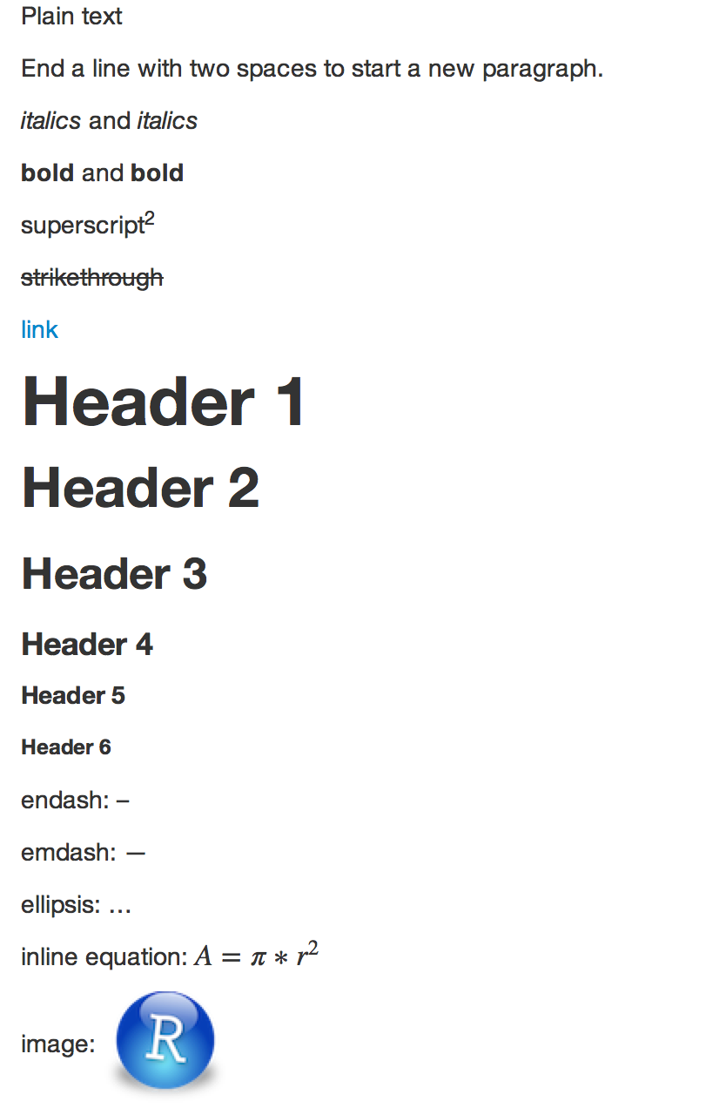
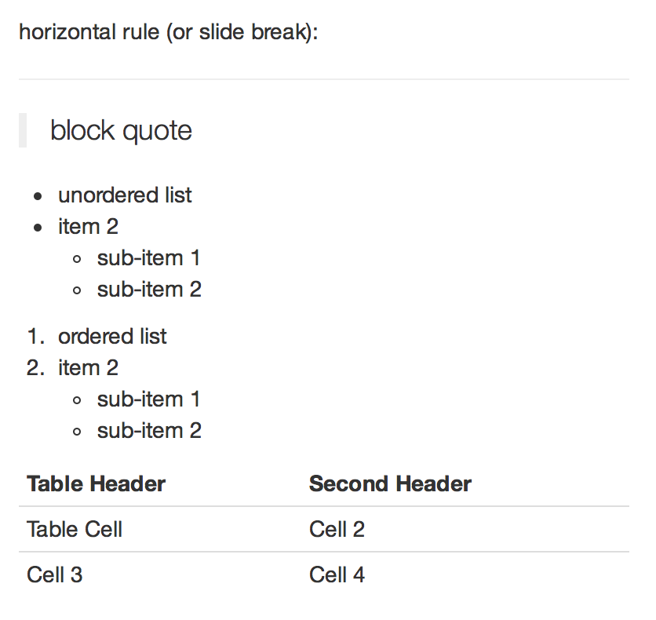

R Markdown Reference Guide
Learn more about R Markdown at rmarkdown.rstudio.com
Learn more about Interactive Docs at shiny.rstudio.com/articles
Contents:
Markdown Syntax
Knitr chunk options
Pandoc options
Syntax
Becomes
Plain text
End a line with two spaces
to start a new paragraph.
*italics* and _italics_
**bold** and __bold__
superscript^2^
~~strikethrough~~
[link](www.rstudio.com)
# Header 1
## Header 2
### Header 3
#### Header 4
##### Header 5
###### Header 6
endash: --
emdash: ---
ellipsis: ...
inline equation: $A = \pi*r^{2}$
image: ![](path/to/smallorb.png)
horizontal rule (or slide break):
***
> block quote
* unordered list
* item 2
+ sub-item 1
+ sub-item 2
1. ordered list
2. item 2
+ sub-item 1
+ sub-item 2
Table Header | Second Header
------------- | -------------
Table Cell | Cell 2
Cell 3 | Cell 4
Updated 10/30/2014
© 2014 RStudio, Inc. CC BY RStudio.
1

Slide 2
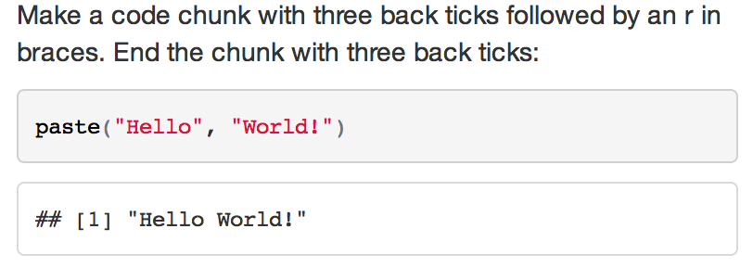

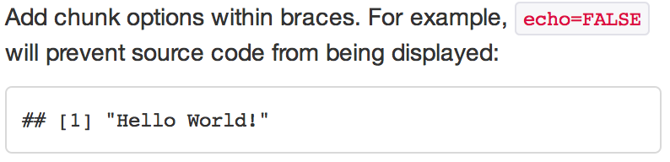
R Markdown Reference Guide
Learn more about R Markdown at rmarkdown.rstudio.com
Learn more about Interactive Docs at shiny.rstudio.com/articles
Contents:
Markdown Syntax
Knitr chunk options
Pandoc options
Syntax
Becomes
Make a code chunk with three back ticks followed by an r in braces. End the chunk with three back ticks:
```{r}
paste("Hello", "World!")
```
Place code inline with a single back ticks. The first back tick must be followed by an R, like this `r paste("Hello", "World!")`.
Add chunk options within braces. For example, `echo=FALSE` will prevent source code from being displayed:
```{r eval=TRUE, echo=FALSE}
paste("Hello", "World!")
```
Learn more about chunk options at http://yihui.name/knitr/options
Chunk options
option | default value | description
Code evaluation
child | NULL | A character vector of filenames. Knitr will knit the files and place them into the main document.
code | NULL | Set to R code. Knitr will replace the code in the chunk with the code in the code option.
engine | 'R' | Knitr will evaluate the chunk in the named language, e.g. engine = 'python'. Run names(knitr::knit_engines$get()) to see supported languages.
eval | TRUE | If FALSE, knitr will not run the code in the code chunk.
include | TRUE | If FALSE, knitr will run the chunk but not include the chunk in the final document.
purl | TRUE | If FALSE, knitr will not include the chunk when running purl() to extract the source code.
Results
collapse | FALSE | If TRUE, knitr will collapse all the source and output blocks created by the chunk into a single block.
echo | TRUE | If FALSE, knitr will not display the code in the code chunk above it’s results in the final document.
results | 'markup' | If 'hide', knitr will not display the code’s results in the final document. If 'hold', knitr will delay displaying all output pieces until the end of the chunk. If 'asis', knitr will pass through results without reformatting them (useful if results return raw HTML, etc.)
error | TRUE | If FALSE, knitr will not display any error messages generated by the code.
message | TRUE | If FALSE, knitr will not display any messages generated by the code.
warning | TRUE | If FALSE, knitr will not display any warning messages generated by the code.
Code Decoration
comment | '##' | A character string. Knitr will append the string to the start of each line of results in the final document.
highlight | TRUE | If TRUE, knitr will highlight the source code in the final output.
prompt | FALSE | If TRUE, knitr will add > to the start of each line of code displayed in the final document.
strip.white | TRUE | If TRUE, knitr will remove white spaces that appear at the beginning or end of a code chunk.
tidy | FALSE | If TRUE, knitr will tidy code chunks for display with the tidy_source() function in the formatR package.
Updated 10/30/2014
© 2014 RStudio, Inc. CC BY RStudio.
2

Slide 3
R Markdown Reference Guide
Learn more about R Markdown at rmarkdown.rstudio.com
Learn more about Interactive Docs at shiny.rstudio.com/articles
Contents:
Markdown Syntax
Knitr chunk options
Pandoc options
Chunk options (Continued)
option | default value | description
Chunks
opts.label | NULL | The label of options set in knitr:: opts_template() to use with the chunk.
R.options | NULL | Local R options to use with the chunk. Options are set with options() at start of chunk. Defaults are restored at end.
ref.label | NULL | A character vector of labels of the chunks from which the code of the current chunk is inherited.
Cache
autodep | FALSE | If TRUE, knitr will attempt to figure out dependencies between chunks automatically by analyzing object names.
cache | FALSE | If TRUE, knitr will cache the results to reuse in future knits. Knitr will reuse the results until the code chunk is altered.
cache.comments | NULL | If FALSE, knitr will not rerun the chunk if only a code comment has changed.
cache.lazy | TRUE | If TRUE, knitr will use lazyload() to load objects in chunk. If FALSE, knitr will use load() to load objects in chunk.
cache.path | 'cache/' | A file path to the directory to store cached results in. Path should begin in the directory that the .Rmd file is saved in.
cache.vars | NULL | A character vector of object names to cache if you do not wish to cache each object in the chunk.
dependson | NULL | A character vector of chunk labels to specify which other chunks a chunk depends on. Knitr will update a cached chunk if its dependencies change.
Animation
anipots | 'controls,loop' | Extra options for animations (see the animate package).
interval | 1 | The number of seconds to pause between animation frames.
Plots
dev | 'png' | The R function name that will be used as a graphical device to record plots, e.g. dev='CairoPDF'.
dev.args | NULL | Arguments to be passed to the device, e.g. dev.args=list(bg='yellow', pointsize=10).
dpi | 72 | A number for knitr to use as the dots per inch (dpi) in graphics (when applicable).
external | TRUE | If TRUE, knitr will externalize tikz graphics to save LaTex compilation time (only for the tikzDevice::tikz() device).
fig.align | 'default' | How to align graphics in the final document. One of 'left', 'right', or 'center'.
fig.cap | NULL | A character string to be used as a figure caption in LaTex.
fig.env | 'figure' | The Latex environment for figures.
fig.ext | NULL | The file extension for figure output, e.g. fig.ext='png'.
fig.height, fig.width | 7 | The width and height to use in R for plots created by the chunk (in inches).
fig.keep | 'high' | If 'high', knitr will merge low-level changes into high level plots. If 'all', knitr will keep all plots (low-level changes may produce new plots). If 'first', knitr will keep the first plot only. If 'last', knitr will keep the last plot only. If 'none', knitr will discard all plots.
fig.lp | 'fig:' | A prefix to be used for figure labels in latex.
fig.path | 'figure/' | A file path to the directory where knitr should store the graphics files created by the chunk.
fig.pos | '' | A character string to be used as the figure position arrangement in LaTex.
fig.process | NULL | A function to post-process a figure file. Should take a filename and return a filename of a new figure source.
fig.retina | 1 | Dpi multiplier for displaying HTML output on retina screens.
fig.scap | NULL | A character string to be used as a short figure caption.
fig.subcap | NULL | A character string to be used as captions in sub-figures in LaTex.
fig.show | 'asis' | If 'hide', knitr will generate the plots created in the chunk, but not include them in the final document. If 'hold', knitr will delay displaying the plots created by the chunk until the end of the chunk. If 'animate', knitr will combine all of the plots created by the chunk into an animation.
fig.showtext | NULL | If TRUE, knitr will call showtext::showtext.begin() before drawing plots.
out.extra | NULL | A character string of extra options for figures to be passed to LaTex or HTML.
out.height, out.width | NULL | The width and height to scale plots to in the final output. Can be in units recognized by output, e.g. 8\\linewidth, 50px
resize.height, resize.width | NULL | The width and height to resize tike graphics in LaTex, passed to \resizebox{}{}.
sanitize | FALSE | If TRUE, knitr will sanitize tike graphics for LaTex.
Updated 10/30/2014
© 2014 RStudio, Inc. CC BY RStudio.
3

Slide 4
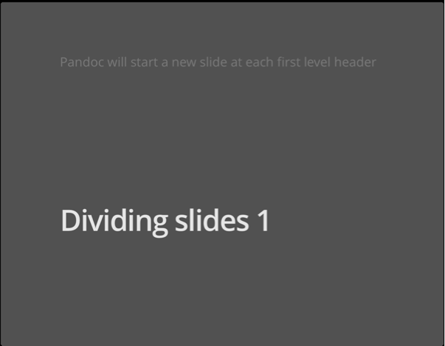
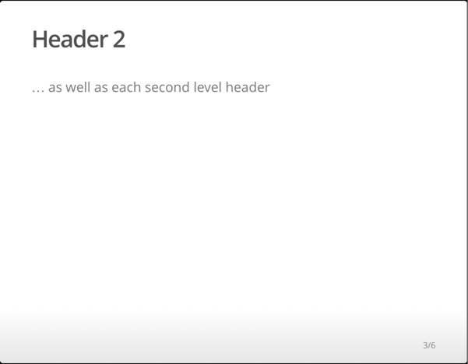
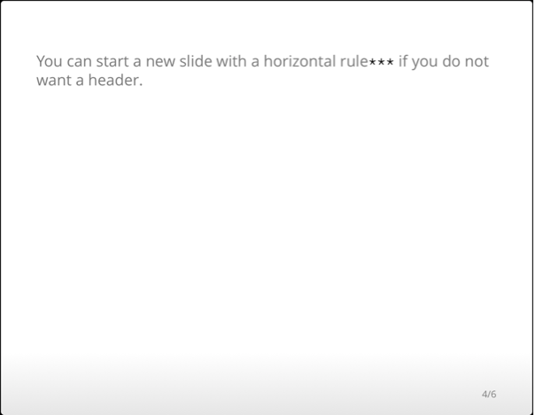
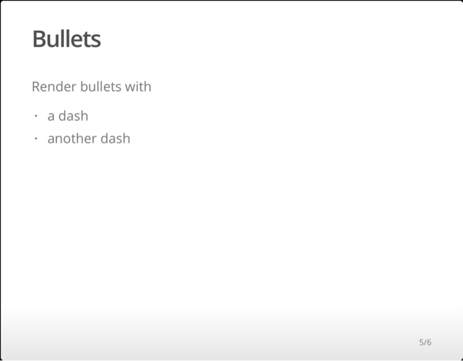
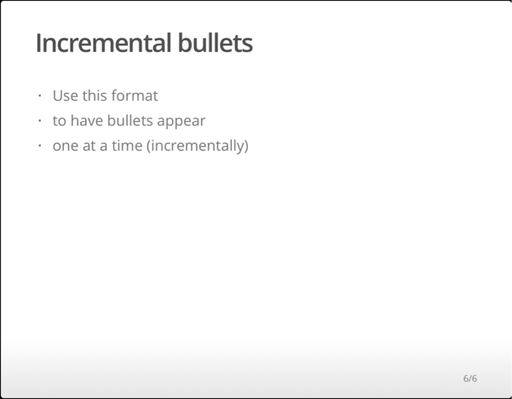
R Markdown Reference Guide
Learn more about R Markdown at rmarkdown.rstudio.com
Learn more about Interactive Docs at shiny.rstudio.com/articles
Contents:
Markdown Syntax
Knitr chunk options
Pandoc options
Templates
Basic YAML
Template options
Latex options
Interactive Docs
html_document
pdf_document
word_document
md_document
ioslides_presentation
slidy_presentation
beamer_presentation
---
title: "A Web Doc"
author: "John Doe"
date: "May 1, 2015"
output: md_document
---
---
title: "Chapters"
output:
html_document:
toc: true
toc_depth: 2
---
---
title: "My PDF"
output: pdf_document
fontsize: 11pt
geometry: margin=1in
---
---
title: "Slides"
output:
slidy_presentation:
incremental: true
runtime: shiny
---
Syntax for slide formats (ioslides, slidy, beamer)
# Dividing slides 1
Pandoc will start a new slide at each first level header
## Header 2
… as well as each second level header
***
You can start a new slide with a horizontal rule`***` if you do not want a header.
## Bullets
Render bullets with
- a dash
- another dash
## Incremental bullets
>- Use this format
>- to have bullets appear
>- one at a time (incrementally)
becomes
Slide display modes
ioslides
Press a key below during presentation to enter display mode. Press esc to exit display mode.
slidy
f
w
o
h
p
-
-
-
-
-
enable fullscreen mode
toggle widescreen mode
enable overview mode
enable code highlight mode
show presenter notes
C
F
A
S
B
-
-
-
-
-
show table of contents
toggle display of the footer
toggle display of current vs all slides
make fonts smaller
make fonts bigger
Top level options to customize LaTex (pdf) output
option | description
lang | Document language code
fontsize | Font size (e.g. 10pt, 11pt, 12 pt)
documentclass | Latex document class (e.g. article)
classoption | Option for document class (e.g. oneside); may be repeated
geometry | Options for geometry class (e.g. margin=1in); may be repeated
mainfont, sansfont, monofont, mathfont | Document fonts (works only with xelatex and lualatex, see the latex_engine option)
linkcolor, urlcolor, citecolor | Color for internal, external, and citation links (red, green, magenta, cyan, blue, black)
Updated 10/30/2014
© 2014 RStudio, Inc. CC BY RStudio.
4

Slide 5
R Markdown Reference Guide
Learn more about R Markdown at rmarkdown.rstudio.com
Learn more about Interactive Docs at shiny.rstudio.com/articles
Contents:
Markdown Syntax
Knitr chunk options
Pandoc options
option |  |  |  |  |  |  |  | description
colortheme |  |  |  |  |  |  | X | Beamer color theme to use (e.g., colortheme: "dolphin").
css | X |  |  |  | X | X |  | Filepath to CSS style to use to style document (e.g., css: styles.css).
duration |  |  |  |  |  | X |  | Add a countdown timer (in minutes) to footer of slides (e.g., duration: 45).
fig_caption | X | X | X |  | X | X | X | Should figures be rendered with captions?
fig_crop |  | X |  |  |  |  | X | Should pdfcrop utility be automatically applied to figures (when available)?
fig_height | X | X | X | X | X | X | X | Default figure height (in inches) for document.
fig_retina | X |  |  | X | X | X |  | Scaling to perform for retina displays (e.g., fig_retina: 2).
fig_width | X | X | X | X | X | X | X | Default figure width (in inches) for document.
font_adjustment |  |  |  |  |  | X |  | Increase or decrease font size for entire presentation (e.g., font_adjustment: -1).
fonttheme |  |  |  |  |  |  | X | Beamer font theme to use (e.g., fonttheme: "structurebold").
footer |  |  |  |  |  | X |  | Text to add to footer of each slide (e.g., footer: "Copyright (c) 2014 RStudio").
highlight | X | X |  |  |  | X | X | Syntax highlighting style (e.g. "tango", "pygments", "kate", "zenburn", and "textmate")
includes | X | X |  | X | X | X | X | See below
-in_header | X | X |  |  | X | X | X | File of content to place in document header (e.g., in_header: header.html).
-before_body | X | X |  |  | X | X | X | File of content to place before document body (e.g., before_body: doc_prefix.html).
-after_body | X | X |  |  | X | X | X | File of content to place after document body (e.g., after_body: doc_suffix.html).
incremental |  |  |  |  | X | X | X | Should bullets appear one at a time (on presenter mouse clicks)?
keep_md | X |  |  |  | X | X |  | Save a copy of .md file that contains knitr output (in addition to the .Rmd and HTML files)?
keep_tex |  | X |  |  |  |  | X | Save a copy of .tex file that contains knitr output (in addition to the .Rmd and PDF files)?
latex_engine |  | X |  |  |  |  |  | Engine to render latex. Should be one of "pdflatex", "xelatex", and "lualatex".
lib_dir | X |  |  |  | X | X |  | Directory of dependency files to use (Bootstrap, MathJax, etc.) (e.g., lib_dir: libs).
logo |  |  |  |  | X |  |  | File path to a logo (at least 128 x 128) to add to presentation (e.g., logo: logo.png).
mathjax | X |  |  |  | X | X |  | Set to local or a URL to use a local/URL version of MathJax to render equations
number_sections | X | X |  |  |  |  |  | Add section numbering to headers (e.g., number_sections: true).
pandoc_args | X | X | X | X | X | X | X | Arguments to pass to Pandoc (e.g., pandoc_args: ["--title-prefix", "Foo"]).
preserve_yaml |  |  |  | X |  |  |  | Preserve YAML front matter in final document?
reference_docx |  |  | X |  |  |  |  | A .docx file whose styles should be copied to use (e.g., reference_docx: mystyles.docx).
self_contained | X |  |  |  | X | X |  | Embed dependencies into the doc? Set to false to keep dependencies in external files.
slide_level |  |  |  |  |  |  | X | The lowest heading level that defines individual slides (e.g., slide_level: 2).
smaller |  |  |  |  | X |  |  | Use the smaller font size in the presentation?
smart | X |  |  |  | X | X |  | Convert straight quotes to curly, dashes to em-dashes, … to ellipses, and so on?
template | X | X |  |  |  | X | X | Pandoc template to use when rendering file (e.g., template: quarterly_report.html).
theme | X |  |  |  |  |  | X | Bootswatch or Beamer theme to use for page. Valid bootswatch themes include "cerulean", "journal", "flatly", "readable", "spacelab", "united", and "cosmo".
toc | X | X |  | X |  |  | X | Add a table of contents at start of document? (e.g., toc: true).
toc_depth | X | X |  | X |  |  |  | The lowest level of headings to add to table of contents (e.g., toc_depth: 2).
transition |  |  |  |  | X |  |  | Speed of slide transitions should be "slower", "faster" or a number in seconds.
variant |  |  |  | X |  |  |  | The flavor of markdown to use; one of "markdown", "markdown_strict", "markdown_github", "markdown_mmd", and "markdown_phpextra"
widescreen |  |  |  |  | X |  |  | Display presentation in widescreen format?
html
pdf
word
ioslides
beamer
md
slidy
Updated 10/30/2014
© 2014 RStudio, Inc. CC BY RStudio.
5

