Slide 1












Data Science in Spark with sparklyr : : CHEAT SHEET
Connect
KUBERNETES
Use the following to obtain the Host and Port
system2("kubectl", "cluster-info")
Open a connection
sc <- spark_connect(config =
spark_config_kubernetes(
"k8s://https://[HOST]>:[PORT]",
account = "default",
image = "docker.io/owner/repo:version"
))
Import
Visualize
DATABRICKS CONNECT (v2)
Open your .Renviron file: usethis::edit_r_environ()
In the .Renviron file add your Databricks Host Url and Token (PAT):
DATABRICKS_HOST = [Your Host URL]
DATABRICKS_TOKEN = [Your PAT]
Install extension: install.packages("pysparklyr")
Open connection: sc <- spark_connect( cluster_id = "[Your cluster’s ID]", method = "databricks_connect" )
From R (copy_to())
Read a file (spark_read_)
Read Hive table (tbl())
Communicate
Collect result, plot in R
Collect results into R share using Quarto
Model
Wrangle
Spark MLlib (ml_)
H2O Extension
FEATURE TRANSFORMERS
dplyr verb
tidyr commands
Feature transformer (ft_)
Direct Spark SQL (DBI)
0
ft_binarizer() - Assigned values based on threshold
ft_bucketizer() - Numeric column to discretized column
ft_count_vectorizer() - Extracts a vocabulary from document
ft_discrete_cosine_transform() - 1D discrete cosine transform of a real vector
ft_elementwise_product() - Element- wise product between 2 cols
ft_hashing_tf() - Maps a sequence of terms to their term frequencies using the hashing trick.
LOCAL MODE
No cluster required. Use for learning purposes only
Install a local version of Spark: spark_install()
Open a connection
sc <- spark_connect(master="local")
0
1
1
0
R for Data Science, Wickham, Çetinkaya-Rundel, Grolemund
2
= Supported in Databricks Connect v2
a
b
0,1
1,1
CLOUD
Azure - spark_connect(method = "synapse")
Qubole- spark_connect(method = "qubole")
b
b
0
2
STANDALONE CLUSTER
Install RStudio Server on one of the existing nodes or a server in the same LAN
Open a connection
spark_connect(master="spark://host:port",
version = "3.2",
spark_home = [path to Spark])
R DATA FRAME INTO SPARK
dplyr::copy_to(dest, df, name)
Apache Arrow accelerates data transfer between R and Spark. To use, simply load the library
x
x
x
Import
library(sparklyr)
library(arrow)
x
a
b
a
b
b
b
1
1
Push Compute
0
2
YARN CLIENT
Install RStudio Server on an edge node
Locate path to the cluster’s Spark Home Directory, it normally is “/usr/lib/spark”
Basic configuration example
conf <- spark_config()
conf$spark.executor.memory <- "300M"
conf$spark.executor.cores <- 2
conf$spark.executor.instances <- 3
conf$spark.dynamicAllocation.enabled<-"false"
Open a connection
sc <- spark_connect(master = "yarn",
spark_home = "/usr/lib/spark/",
version = "2.1.0", config = conf)
Wrangle
ft_idf() - Compute the Inverse Document Frequency (IDF) given a collection of documents.
ft_imputer() - Imputation estimator for completing missing values, uses the mean or the median of the columns.
ft_index_to_string() - Index labels back to label as strings
ft_interaction() - Takes in Double and Vector columns and outputs a flattened vector of their feature interactions.
ft_max_abs_scaler() - Rescale each feature individually to range [-1, 1]
Import
Collect
Results
Source
DPLYR VERBS
Import data into Spark, not R
Translates into Spark SQL statements
READ A FILE INTO SPARK
copy_to(sc, mtcars) |>
mutate(trm = ifelse(am == 0,
"auto", "man")) |>
group_by(trm) |>
summarise_all(mean)
Arguments that apply to all functions:
sc, name, path, options=list(), repartition=0, memory=TRUE, overwrite=TRUE
0
a
1
c
1
c
CSV
spark_read_csv( header = TRUE, columns=NULL, infer_schema=TRUE, delimiter = ",", quote= "\"", escape = "\\", charset = "UTF-8", null_value = NULL)
TIDYR
2,3
4,2
8,6
X
A
1
pivot_longer() - Collapse several columns into two.
pivot_wider() - Expand two columns into several.
JSON
spark_read_json()
X
B
2
0
YARN CLUSTER
Make sure to have copies of the yarn-site.xml and hive-site.xml files in the RStudio Server
Point environment variables to the correct paths
Sys.setenv(JAVA_HOME="[Path]")
Sys.setenv(SPARK_HOME ="[Path]")
Sys.setenv(YARN_CONF_DIR ="[Path]")
Open a connection
sc <- spark_connect(master = "yarn-cluster")
Y
A
3
-1
PARQUET
spark_read_parquet()
Y
B
4
A
B
1
ft_min_max_scaler() - Rescale each feature to a common range [min, max] linearly
ft_ngram() - Converts the input array of strings into an array of n-grams
TEXT
spark_read_text()
X
1
2
1-4
2
DELTA
spark_read_delta()
Y
3
4
1
nest() / unnest() - Convert groups of cells into list-columns, and vice versa.
unite() / separate() - Split a single column into several columns, and vice versa.
fill() - Fill NA with the previous value
4
FROM A TABLE
dplyr::tbl(scr, …) - Creates a reference to the table without loading its data into memory
0
a
0a
SPAR
K
dbplyr::in_catalog() - Enables a three part table address
1
a
1a
ft_bucketed_random_projection_lsh()
ft_minhash_lsh() - Locality Sensitive Hashing functions for Euclidean distance and Jaccard distance (MinHash)
1
b
1b
x <- tbl(sc,in_catalog("catalog", "schema", "table"))
NA
NA
CC BY SA Posit Software, PBC • info@posit.co • posit.co • Learn more at spark.posit.co • sparklyr 1.8.6 • Updated: 2024-05

Slide 2
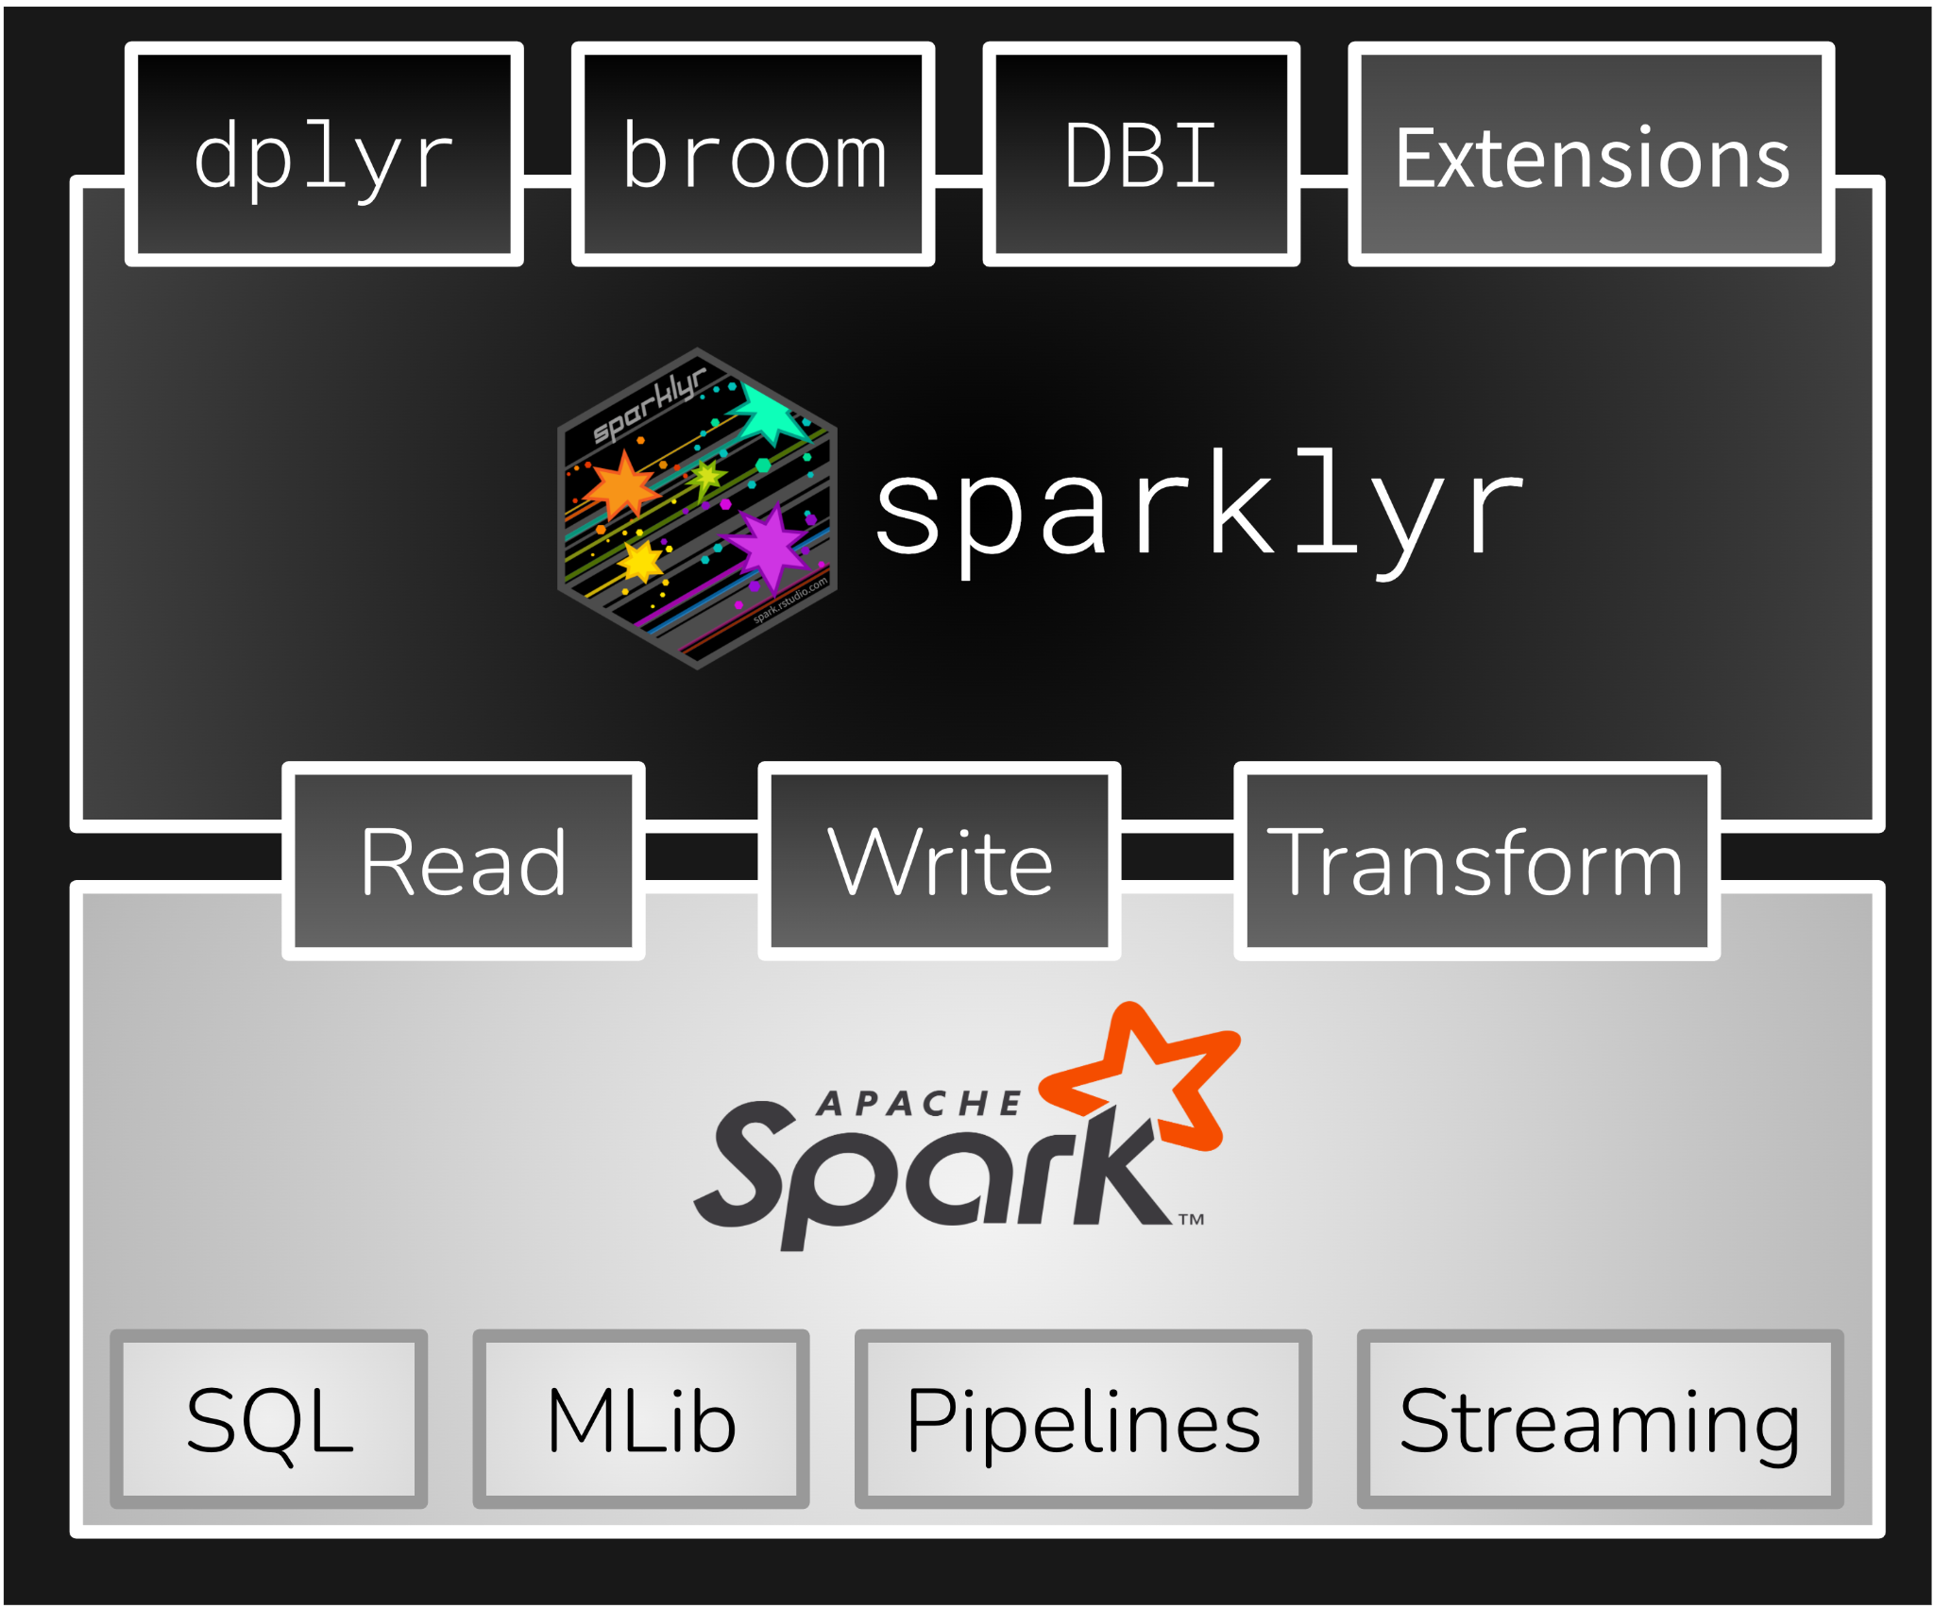
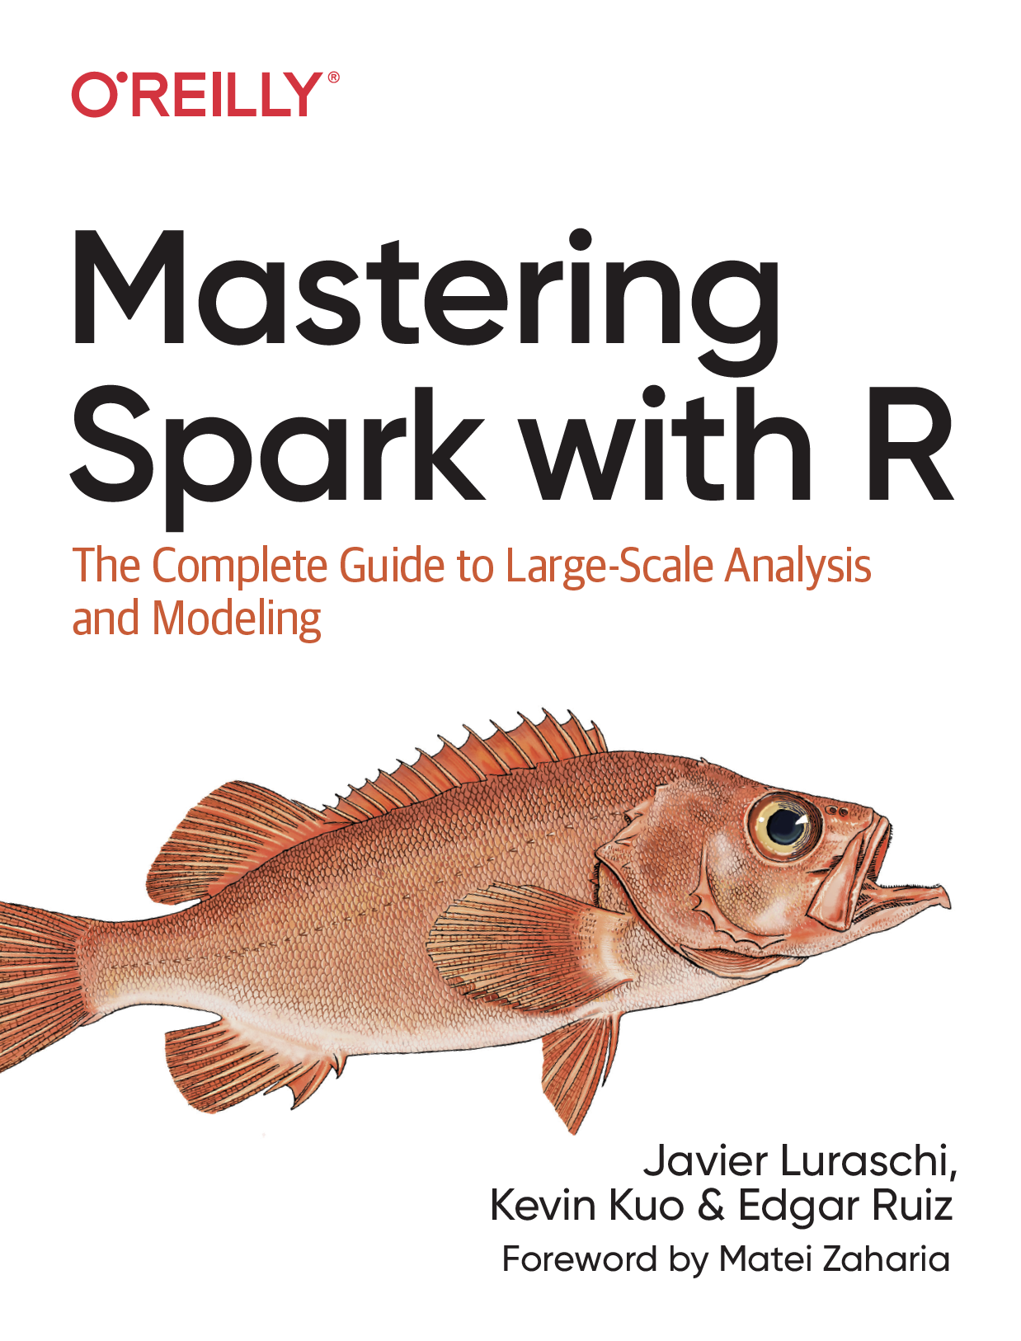

Data Science in Spark with sparklyr : : CHEAT SHEET
p = x
p = 2
ft_normalizer() - Normalize a vector to have unit norm using the given p-norm
ft_one_hot_encoder()- Continuous to binary vectors
Modeling
ml_kmeans() | ml_compute_cost() |ml_compute_silhouette_measure() - Clustering with support for k-means
ml_power_iteration() - For clustering vertices of a graph given pairwise similarities as edge properties.
RECOMMENDATION
ml_als() | ml_recommend() - Recommendation using Alternating Least Squares matrix factorization
EVALUATION
ml_clustering_evaluator() - Evaluator for clustering
ml_evaluate() - Compute performance metrics
ml_binary_classification_evaluator() | ml_binary_classification_eval() | ml_classification_eval() - A set of functions to calculate performance metrics for prediction models.
FREQUENT PATTERN
ml_fpgrowth() | ml_association_rules() | ml_freq_itemsets() - A parallel FP-growth algorithm to mine frequent itemsets.
ml_freq_seq_patterns() | ml_prefixspan() - PrefixSpan algorithm for mining frequent itemsets.
STATS
ml_summary() - Extracts a metric from the summary object of a Spark ML model
ml_corr() - Compute correlation matrix
REGRESSION
ml_linear_regression() - Linear regression.
ml_aft_survival_regression() - Parametric survival regression model named accelerated failure time (AFT) model
ml_generalized_linear_regression() - GLM
ml_isotonic_regression() - Uses parallelized pool adjacent violators algorithm.
ml_random_forest_regressor() - Regression using random forests.
CLASSIFICATION
ml_linear_svc() - Classification using linear support vector machines
ml_logistic_regression() - Logistic regression
ml_multilayer_perceptron_classifier() - Based on the Multilayer Perceptron.
ml_naive_bayes() - It supports Multinomial NB which can handle finitely supported discrete data
ml_one_vs_rest() - Reduction of Multiclass, performs reduction using one against all strategy.
TREE
ml_decision_tree_classifier()|ml_decision_tree()|ml_decision_tree_regressor() - Classification and regression using decision trees
ml_gbt_classifier()|ml_gradient_boosted_trees() | ml_gbt_regressor() - Binary classification and regression using gradient boosted trees
ml_random_forest_classifier() - Classification and regression using random forests.
ml_feature_importances() | ml_tree_feature_importance() - Feature Importance for Tree Models
CLUSTERING
ml_bisecting_kmeans() - A bisecting k-means algorithm based on the paper
ml_lda() | ml_describe_topics() | ml_log_likelihood() | ml_log_perplexity() | ml_topics_matrix() - LDA topic model designed for text documents.
ml_gaussian_mixture() - Expectation maximization for multivariate Gaussian Mixture Models (GMMs)
1
0
0
1
ft_pca() - Project vectors to a lower dimensional space of top k principal components.
ft_quantile_discretizer() - Continuous to binned categorical values.
ft_regex_tokenizer() - Extracts tokens either by using the provided regex pattern to split the text.
ML Pipelines
Easily create a formal Spark Pipeline models using R. Save the Pipeline in native Sacala. It will have no dependencies on R.
0
0
INITIALIZE AND TRAIN
ml_pipeline() - Initializes a new Spark Pipeline
ml_fit() - Trains the model, outputs a Spark Pipeline Model.
SAVE AND RETRIEVE
ml_save() - Saves into a format that can be read by Scala and PySpark .
ml_read() - Reads Spark object into sparklyr.
1
A B
a
b
(x - median) / (p75 - p25)
ft_robust_scaler() - Removes the median and scales according to standard scale.
ft_standard_scaler() - Removes the
mean and scaling to unit variance
using column summary statistics
ft_stop_words_remover() - Filters out stop words from input
ft_string_indexer() - Column of labels into a column of label indices.
ft_tokenizer() - Converts to lowercase and then splits it by white spaces
𝞼 = x
𝞼= 0
no
ft_dplyr_transformer()
ml_linear_regression()
ml_pipeline()
ml_fit()
ml_save()
a
0
ft_bucketizer()
c
1
c
1
spark.posit.co/guides/pipelines
A B
a
b
Distributed R
0
a
0,a
ft_vector_assembler() - Combine vectors into single row-vector
ft_vector_indexer() - Indexing categorical feature columns in a dataset of Vector
ft_vector_slicer() - Takes a feature vector and outputs a new feature vector with a subarray of the original features
ft_word2vec() - Word2Vec transforms a word into a code
1
a
1,a
1
b
1,b
Run arbitrary R code at scale inside your cluster with spark_apply(). Useful when there you need functionality only available in R, and to solve ‘embarrassingly parallel problems’
0
a
0,0
1
a
1,0
1
b
1,1
0,a
a
spark_apply(x, f, columns = NULL, memory = TRUE, group_by = NULL, name = NULL, barrier = NULL, fetch_result_as_sdf = TRUE)
1,a
a
FEATURE
ml_chisquare_test(x,features,label) - Pearson's independence test for every feature against the label
ml_default_stop_words() - Loads the default stop words for the given language
1,b
b
boo
copy_to(sc, mtcars) |>
spark_apply(
nrow, # R only function
group_by = "am",
columns = "am double, x long"
)
too
next
Visualize
DPLYR + GGPLOT2
UTILITIES
ml_call_constructor() - Identifies the associated sparklyr ML constructor for the JVM
ml_model_data() - Extracts data associated with a Spark ML model
ml_standardize_formula() - Generates a formula string from user inputs
ml_uid() - Extracts the UID of an ML object.
copy_to(sc, mtcars) |>
group_by(cyl) |>
summarise(mpg_m = mean(mpg)) |>
collect() |>
ggplot() +
geom_col(aes(cyl, mpg_m))
More Info
Summarize in Spark
Collect results in R
Create plot
spark.posit.co
therinspark.com
CC BY SA Posit Software, PBC • info@posit.co • posit.co • Learn more at spark.posit.co • sparklyr 1.8.6 • Updated: 2024-05

