Slide 1

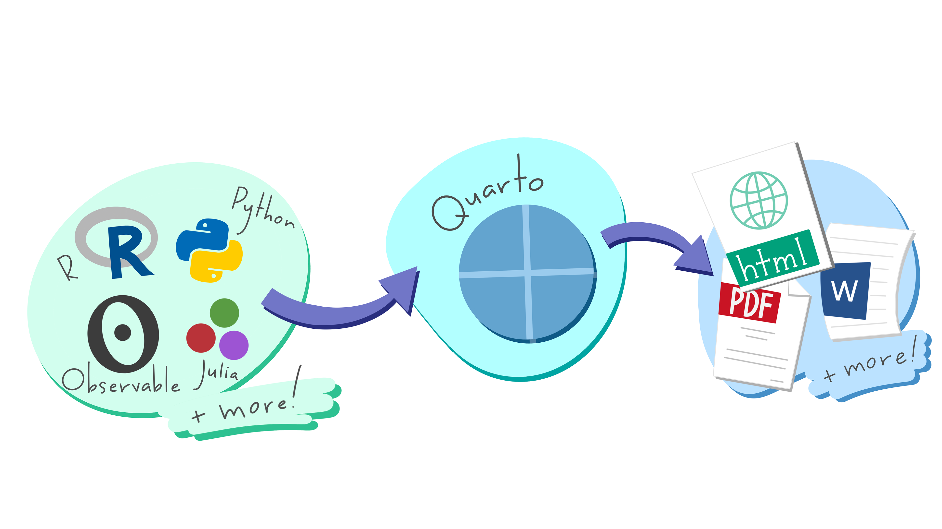
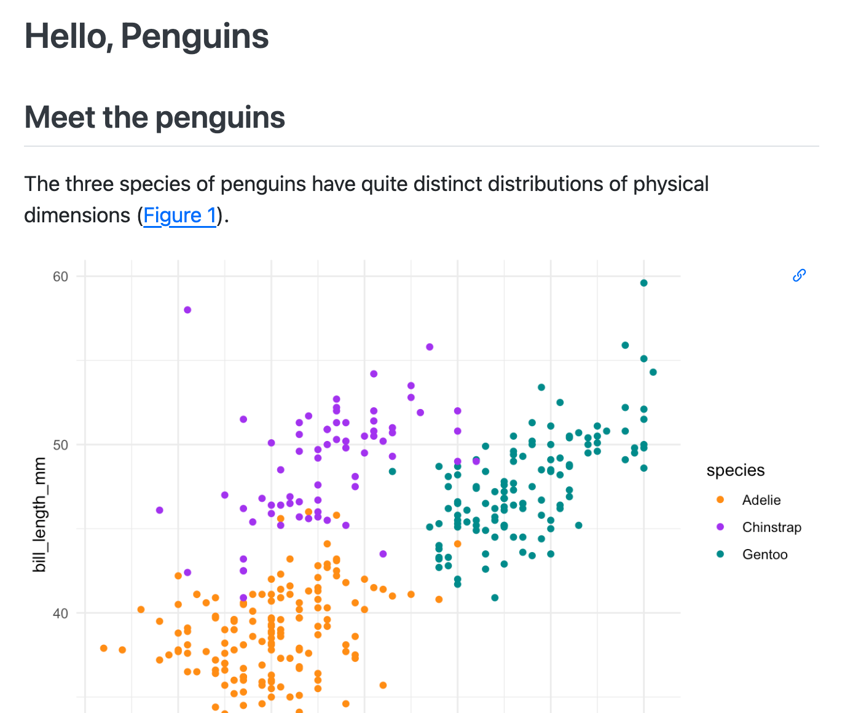









Publish and Share with Quarto : : CHEATSHEET
Author
Render
Publish
Write and Code in Plain Text
GENERATE Documents, Presentations and More
Share your work with the world
Get Quarto
https://quarto.org/docs/download/
Or use version bundled with RStudio
Get Started
https://quarto.org/docs/get-started/
Author documents as .qmd files or Jupyter notebooks. Write in a rich Markdown syntax.
Produce HTML, PDF, MS Word reveal.js, MS Powerpoint, Beamer Websites, blogs, books...
Quickly deploy to GitHub Pages, Netlify, Quarto Pub, Posit Cloud, or Posit Connect
Author
Render
Publish
Source File: hello.qmd
Rendered Output: hello.html
Terminal
---
title: "Hello, Penguins"
format: html
execute:
echo: false
---
## Meet the penguins
The `penguins` data contains size measurements for penguins from three islands in the Palmer Archipelago, Antarctica.
The three species of penguins have quite distinct distributions of physical dimensions (@fig-penguins).
```{r}
#| label: fig-penguins
#| fig-cap: "Dimensions of penguins across three species."
#| warning: false
library(tidyverse, quietly = TRUE)
library(palmerpenguins)
penguins |>
ggplot(aes(x = flipper_length_mm, y = bill_length_mm)) +
geom_point(aes(color = species)) +
scale_color_manual( values = c("darkorange", "purple", "cyan4")) +
quarto publish {venue} hello.qmd
Set format(s) and options
Use YAML Syntax
{venue}: quarto-pub, connect, gh-pages, netlify, confluence, posit-cloud
Use Publish button
## Write with **Markdown**
RStudio: Help > Markdown Quick Reference
Free publishing service for Quarto content.
Features for scientific publishing
Cross references, citations, equations, and more
Cloud-hosted, control access to project and output.
Use Visual Editor
Include code
R, Python, Julia, Observable, or any language with a Jupyter kernel
Org-hosted, control access, schedule updates.
Output integrated into document
Control how output appears with special comments in your code
Quarto Projects
Create websites, books, and more
A directory of Quarto documents + a configuration file (_quarto.yml)
See examples at https://quarto.org/docs/gallery/
Get started from the command line:
USE A Tool with A Rich Editing Experience
Save, then render to preview the document output.
Behind the Scenes
When you render a document, Quarto:
Runs the code and embeds results and text into an .md file with: Knitr, if any {r} cells or, Jupyter, if any other cells.
Converts the .md file into the output format with Pandoc.
Terminal
Or any text editor
quarto create project {type}
RStudio
Quarto documents (.qmd) can be edited in any tool that edits text.
Terminal
{type}: default, website, blog, book, confluence, manuscript
Visual Studio Code + Quarto extension
quarto preview hello.qmd
Terminal
Run code cells as you write
Apply formatting in Visual Editor. Saved as Markdown in source.
Insert elements like code cells, cross references, and more.
Use Render button
Use File > New Project
Render with a button or keyboard shortcut
Use Preview button
Edit Quarto documents with a Visual Editor
The resulting HTML/PDF/MS Word/etc. document will be created and saved in the same directory as the source .qmd file.
Artwork from "Hello, Quarto" keynote by Julia Lowndes and Mine Çetinkaya-Rundel, presented at RStudio Conference 2022. Illustrated by Allison Horst.
CC BY SA Posit Software, PBC • info@posit.co • posit.co • Learn more at quarto.org • HTML cheatsheets at pos.it/cheatsheets • Quarto 1.4 • Updated: 2024-05

Slide 2

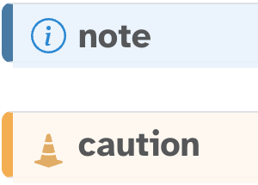
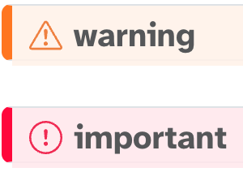
Include Code
Set Format and Options
html/revealjs
pdf/beamer
docx/pptx
Code Cells
Set FORMAT options
Multiple FORMATs
^{Option} |  |  |  | ^{Description}
toc | X | X | X | Add a table of contents (true or false)
toc-depth | X | X | X | Lowest level of headings to add to table of contents (e.g. 2, 3)
anchor-sections | X |  |  | Show section anchors on mouse hover (true or false)
highlight-style | X | X | X | Syntax highlighting theme (e.g. arrow, pygments, kate, zenburn)
mainfont, monofont | X | X |  | Font name. HTML: sets CSS font-family; LaTeX: via fontspec package
theme | X |  |  | Bootswatch theme name (e.g. cosmo, darkly, solar etc.)
css | X |  |  | CSS or SCSS file to use to style the document (e.g. "style.css")
reference-doc |  |  | X | docx/pptx file containing template styles (e.g. file.docx, file.pptx)
include-in-header | X | X |  | Files of content to include in header of output document, also include-before-body, include-after-body
keep-md | X | X | X | Keep intermediate markdown (true or false), also keep-ipynb, keep-tex
documentclass |  | X |  | LaTeX document class, set document class options with classoption
pdf-engine |  | X |  | LaTeX engine to produce PDF output (xelatex, pdflatex, lualatex)
cite-method |  | X |  | Method used to format citations (citeproc, natbib, biblatex)
code-fold | X |  |  | Let readers toggle the display of R code (false, true, or show)
code-tools | X |  |  | Add menu for hiding, showing, and downloading code (true or false)
code-overflow | X |  |  | Display of wide code (scroll, or wrap)
fig-align | X | X | / | Alignment of figures (default, left, right, or center)
fig-width, fig-height | X | X | X | Default width and height for figures in inches
fig-format | X | X | X | Format for Matplotlib or R figures (retina, png, jpeg, svg, or pdf)
Code cells start with ```{language} and end with ```.
---
title: "My Document"
format:
html:
code-fold: true
toc: true
---
---
title: "My Document"
toc: true
format:
html:
code-fold: true
pdf: default
---
Nav



Use Insert Code Chunk/Cell
```{r}
#| label: chunk-id
library(tidyverse)
```
```{python}
#| label: chunk-id
import pandas as pd
```
Style
Other languages: {julia}, {ojs}
Indent options 4 spaces
Also use in code cells
Add code cell options with #| comments.
Indent format 2 spaces
Top-level options apply to all formats
Cell options control execution, figures, tables, layout and more. See them all at: https://quarto.org/docs/reference/cells
Common formats: html, pdf, docx, odt, rtf, gfm, pptx, revealjs, beamer
LaTeX
Execution Options
Render all formats:
OPTION | DEFAULT | EFFECTS
echo | true | false: hide code fenced: include code cell syntax
eval | true | false: don’t run code
include | true | false: don’t include code or results
output | true | false: don’t include results asis: treat results as raw markdown
warning | true | false: don’t include warnings in output
error | false | true: include error in output and continue with render
Terminal
Code
quarto render hello.qmd
Render a specific format:
Figures
Knitr
Terminal
quarto render hello.qmd --to pdf
Visit https://quarto.org/docs/reference/ to see all options by format
Add Content
Tables 
COMPUTATION Output a Markdown table or an HTML table from your code
MARKDOWN
KNITR
JUPYTER
Add Markdown()to Markdown output:
Set execution options at the cell level:
Figures 
MARKDOWN
|object | radius|
|:------|------:|
|Sun | 696000|
|Earth | 6371|
: CAPTION {#tbl-LABEL}
Use knitr::kable() to produce Markdown:
```{python}
#| label: tbl-LABEL
#| tbl-cap: CAPTION
import pandas as pd, tabulate
from IPython.display import Markdown
df = pd.DataFrame({"A": [1, 2],
"B": [1, 2]})
Markdown(df.to_markdown(index=False))
```
```{r}
#| echo: false
```
```{python}
#| echo: false
```
![CAP](image.png){#fig-LABEL fig-alt="ALT"}
```{r}
#| label: tbl-LABEL
#| tbl-cap: CAPTION
knitr::kable(head(cars))
```
COMPUTATION
Or, globally in the YAML header with the execute option:
```{python}
#| label: fig-LABEL
#| fig-cap: CAP
#| fig-alt: ALT
{{ plot code here }}
```
Or {r}
Also see the R packages: gt, flextable, kableExtra.
---
execute:
echo: false
---
Set options in code cells with #| comments and YAML syntax:
key: value
Use Insert Table in the Visual Editor
Callouts
Citations
1. Add a bibliography file to the YAML header:
::: {.callout-tip}
## Title
Text
:::
Instead of tip use one of: note, caution, warning, or important.
Inline Code
Use computed values directly in text sections. Code is evaluated at render and results appear as text.
---
bibliography: references.bib
---
Cross References
Add labels Code cell: add option label: prefix-LABEL Markdown: add attribute #prefix-LABEL
Add references @prefix-LABEL, e.g.
KNITR | JUPYTER | OUTPUT
Value is `r 2 + 2`. | Value is `{python} 2 + 2`. | Value is 4.
You can see in @fig-scatterplot, that...
2. Add citations: [@citation], or @citation
Prefix | Renders | Prefix | Renders
fig- | Figure 1 | eq- | Equation 1
tbl- | Table 1 | sec- | Section 1
Use Insert Citations dialog in the Visual Editor
SHORTCODES
Build your bibliography file from your Zotero library, DOI, Crossref, DataCite, or PubMed
{{< include _file.qmd >}}
{{< embed file.ipynb#id >}}
{{< video video.mp4 >}}
CC BY SA Posit Software, PBC • info@posit.co • posit.co • Learn more at quarto.org • HTML cheatsheets at pos.it/cheatsheets • Quarto 1.3 • Updated: 2023-07

