Slide 1

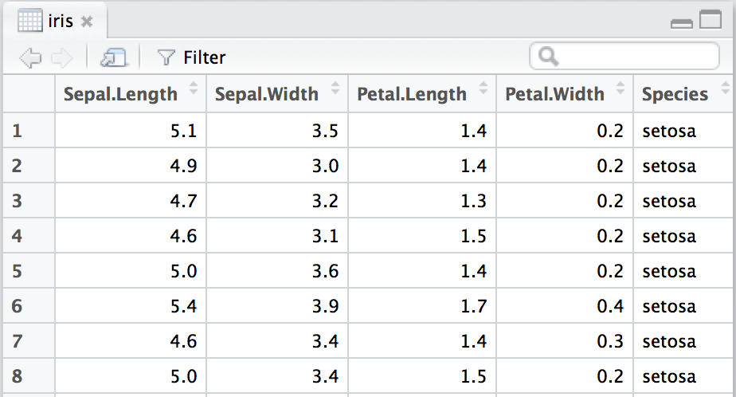
Data Wrangling
with dplyr and tidyr
Cheat Sheet
Tidy Data - A foundation for wrangling in R
In a tidy data set:
F | M | A
&
F | M | A
Tidy data complements R’s vectorized operations. R will automatically preserve observations as you manipulate variables. No other format works as intuitively with R.
M
*
A
F
Each variable is saved in its own column
Each observation is saved in its own row
M * A
Syntax - Helpful conventions for wrangling
Reshaping Data - Change the layout of a data set
dplyr::tbl_df(iris)
Converts data to tbl class. tbl’s are easier to examine than data frames. R displays only the data that fits onscreen:
 | wind | wind
 | wwindind | wind
 | wwindind | wind
 | Allison | 1005
 | Allison | 1013
 | Arlene | 1010
 | Arthur | 1010
 | wind | wind
 | wwindind | wind
 | wwindind | wind
 | Allison | 1005
 | Allison | 1013
 | Arlene | 1010
 | Arthur | 1010
dplyr::data_frame(a = 1:3, b = 4:6)
Combine vectors into data frame (optimized).
dplyr::arrange(mtcars, mpg)
Order rows by values of a column (low to high).
dplyr::arrange(mtcars, desc(mpg))
Order rows by values of a column (high to low).
dplyr::rename(tb, y = year)
Rename the columns of a data frame.
Source: local data frame [150 x 5]
Sepal.Length Sepal.Width Petal.Length
1 5.1 3.5 1.4
2 4.9 3.0 1.4
3 4.7 3.2 1.3
4 4.6 3.1 1.5
5 5.0 3.6 1.4
.. ... ... ...
Variables not shown: Petal.Width (dbl),
Species (fctr)
tidyr::gather(cases, "year", "n", 2:4)
Gather columns into rows.
tidyr::spread(pollution, size, amount)
Spread rows into columns.
wind | wind | pressure
110 | 110 | 1007
45 | 45 | 1009
wind | wind | pressure
110 | 110 | 1007
45 | 45 | 1009
wind | wind | pressure
110 | 110 | 1007
45 | 45 | 1009
wind | wind | pressure
110 | 110 | 1007
45 | 45 | 1009
tidyr::separate(storms, date, c("y", "m", "d"))
Separate one column into several.
tidyr::unite(data, col, ..., sep)
Unite several columns into one.
dplyr::glimpse(iris)
Information dense summary of tbl data.
utils::View(iris)
View data set in spreadsheet-like display (note capital V).
Subset Observations (Rows)
Subset Variables (Columns)
wind | wind | wind | wind | wind
110 | 110 | 110 | 110 | 110
wind | wind | wind | wind | wind
wind | pressure | pressure | wind
110 | 1007 | 1007 | 110
45 | 1009 | 1009 | 45
dplyr::filter(iris, Sepal.Length > 7)
Extract rows that meet logical criteria.
dplyr::distinct(iris)
Remove duplicate rows.
dplyr::sample_frac(iris, 0.5, replace = TRUE)
Randomly select fraction of rows.
dplyr::sample_n(iris, 10, replace = TRUE)
Randomly select n rows.
dplyr::slice(iris, 10:15)
Select rows by position.
dplyr::top_n(storms, 2, date)
Select and order top n entries (by group if grouped data).
dplyr::select(iris, Sepal.Width, Petal.Length, Species)
Select columns by name or helper function.
Helper functions for select - ?select
select(iris, contains("."))
Select columns whose name contains a character string.
select(iris, ends_with("Length"))
Select columns whose name ends with a character string.
select(iris, everything())
Select every column.
select(iris, matches(".t."))
Select columns whose name matches a regular expression.
select(iris, num_range("x", 1:5))
Select columns named x1, x2, x3, x4, x5.
select(iris, one_of(c("Species", "Genus")))
Select columns whose names are in a group of names.
select(iris, starts_with("Sepal"))
Select columns whose name starts with a character string.
select(iris, Sepal.Length:Petal.Width)
Select all columns between Sepal.Length and Petal.Width (inclusive).
select(iris, -Species)
Select all columns except Species.
dplyr::%>%
Passes object on left hand side as first argument (or . argument) of function on righthand side.
x %>% f(y) is the same as f(x, y)
y %>% f(x, ., z) is the same as f(x, y, z )
Logic in R - ?Comparison, ?base::Logic
"Piping" with %>% makes code more readable, e.g.
iris %>%
group_by(Species) %>%
summarise(avg = mean(Sepal.Width)) %>%
arrange(avg)
< | Less than | != | Not equal to
> | Greater than | %in% | Group membership
== | Equal to | is.na | Is NA
<= | Less than or equal to | !is.na | Is not NA
>= | Greater than or equal to | &,|,!,xor,any,all | Boolean operators
RStudio® is a trademark of RStudio, Inc. • CC BY RStudio • info@rstudio.com • 844-448-1212 • rstudio.com
devtools::install_github("rstudio/EDAWR") for data sets
Learn more with browseVignettes(package = c("dplyr", "tidyr")) • dplyr 0.4.0• tidyr 0.2.0 • Updated: 1/15

Slide 2
Summarise Data
Make New Variables
Combine Data Sets
a
b
x1 | x2
A | 1
B | 2
C | 3
+
x1 | x3
A | T
B | F
D | T
=
dplyr::summarise(iris, avg = mean(Sepal.Length))
Summarise data into single row of values.
dplyr::summarise_each(iris, funs(mean))
Apply summary function to each column.
dplyr::count(iris, Species, wt = Sepal.Length)
Count number of rows with each unique value of variable (with or without weights).
dplyr::mutate(iris, sepal = Sepal.Length + Sepal. Width)
Compute and append one or more new columns.
dplyr::mutate_each(iris, funs(min_rank))
Apply window function to each column.
dplyr::transmute(iris, sepal = Sepal.Length + Sepal. Width)
Compute one or more new columns. Drop original columns.
Mutating Joins
x1 | x2 | x3
A | 1 | T
B | 2 | F
C | 3 | NA
dplyr::left_join(a, b, by = "x1")
Join matching rows from b to a.
x1 | x3 | x2
A | T | 1
B | F | 2
D | T | NA
dplyr::right_join(a, b, by = "x1")
Join matching rows from a to b.
x1 | x2 | x3
A | 1 | T
B | 2 | F
dplyr::inner_join(a, b, by = "x1")
Join data. Retain only rows in both sets.
summary
function
window
function
dplyr::lead
Copy with values shifted by 1.
dplyr::lag
Copy with values lagged by 1.
dplyr::dense_rank
Ranks with no gaps.
dplyr::min_rank
Ranks. Ties get min rank.
dplyr::percent_rank
Ranks rescaled to [0, 1].
dplyr::row_number
Ranks. Ties got to first value.
dplyr::ntile
Bin vector into n buckets.
dplyr::between
Are values between a and b?
dplyr::cume_dist
Cumulative distribution.
dplyr::cumall
Cumulative all
dplyr::cumany
Cumulative any
dplyr::cummean
Cumulative mean
cumsum
Cumulative sum
cummax
Cumulative max
cummin
Cumulative min
cumprod
Cumulative prod
pmax
Element-wise max
pmin
Element-wise min
x1 | x2 | x3
A | 1 | T
B | 2 | F
C | 3 | NA
D | NA | T
dplyr::full_join(a, b, by = "x1")
Join data. Retain all values, all rows.
Summarise uses summary functions, functions that take a vector of values and return a single value, such as:
Mutate uses window functions, functions that take a vector of values and return another vector of values, such as:
dplyr::first
First value of a vector.
dplyr::last
Last value of a vector.
dplyr::nth
Nth value of a vector.
dplyr::n
# of values in a vector.
dplyr::n_distinct
# of distinct values in a vector.
IQR
IQR of a vector.
min
Minimum value in a vector.
max
Maximum value in a vector.
mean
Mean value of a vector.
median
Median value of a vector.
var
Variance of a vector.
sd
Standard deviation of a vector.
Filtering Joins
dplyr::semi_join(a, b, by = "x1")
All rows in a that have a match in b.
x1 | x2
A | 1
B | 2
x1 | x2
C | 3
dplyr::anti_join(a, b, by = "x1")
All rows in a that do not have a match in b.
y
z
x1 | x2
A | 1
B | 2
C | 3
+
x1 | x2
B | 2
C | 3
D | 4
=
Set Operations
x1 | x2
B | 2
C | 3
dplyr::intersect(y, z)
Rows that appear in both y and z.
Group Data
x1 | x2
A | 1
B | 2
C | 3
D | 4
dplyr::union(y, z)
Rows that appear in either or both y and z.
dplyr::group_by(iris, Species)
Group data into rows with the same value of Species.
dplyr::ungroup(iris)
Remove grouping information from data frame.
iris %>% group_by(Species) %>% summarise(…)
Compute separate summary row for each group.
x1 | x2
A | 1
dplyr::setdiff(y, z)
Rows that appear in y but not z.
Binding
iris %>% group_by(Species) %>% mutate(…)
Compute new variables by group.
x1 | x2
A | 1
B | 2
C | 3
B | 2
C | 3
D | 4
dplyr::bind_rows(y, z)
Append z to y as new rows.
iris %>% group_by(Species) %>% mutate(…) Compute variable in group-wise fashion. | iris %>% group_by(Species) %>% mutate(…)
 | Compute variable in group-wise fashion.
dplyr::bind_cols(y, z)
Append z to y as new columns.
Caution: matches rows by position.
x1 | x2 | x1 | x2
A | 1 | B | 2
B | 2 | C | 3
C | 3 | D | 4
RStudio® is a trademark of RStudio, Inc. • CC BY RStudio • info@rstudio.com • 844-448-1212 • rstudio.com
devtools::install_github("rstudio/EDAWR") for data sets
Learn more with browseVignettes(package = c("dplyr", "tidyr")) • dplyr 0.4.0• tidyr 0.2.0 • Updated: 1/15

