Slide 1
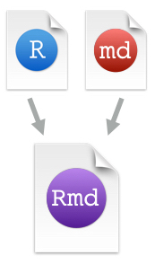






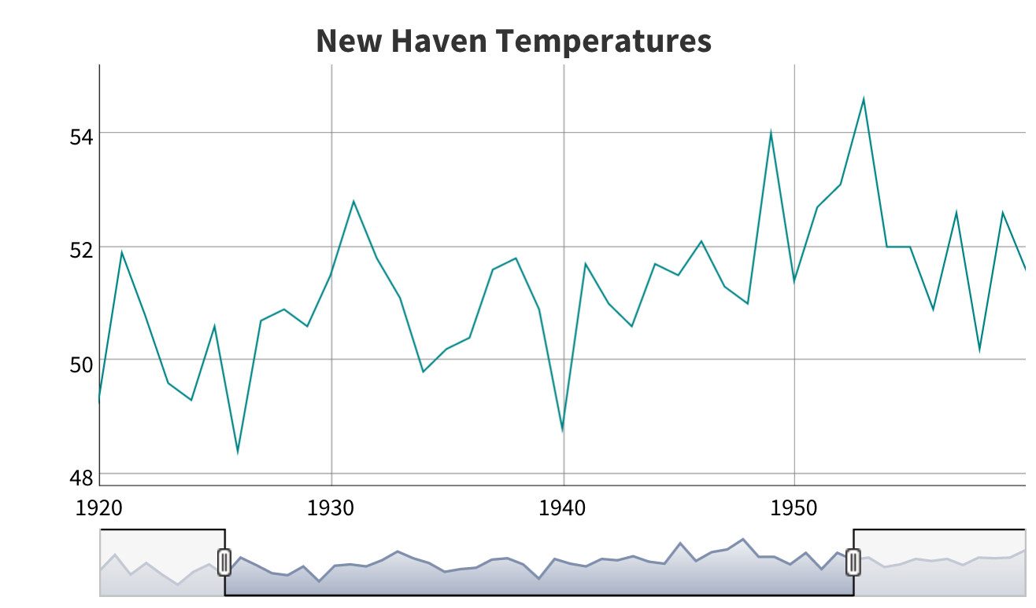

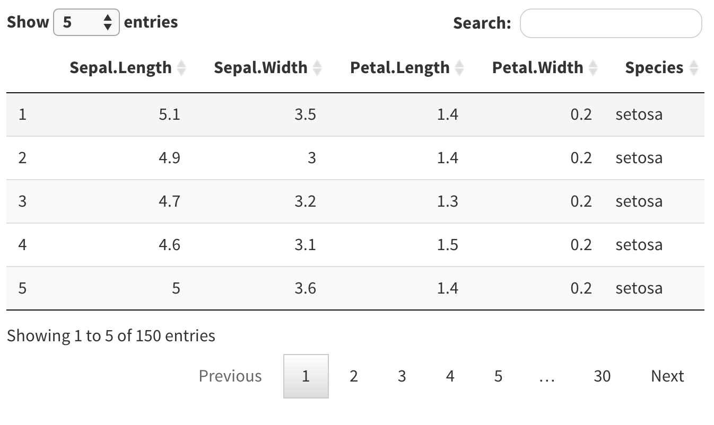

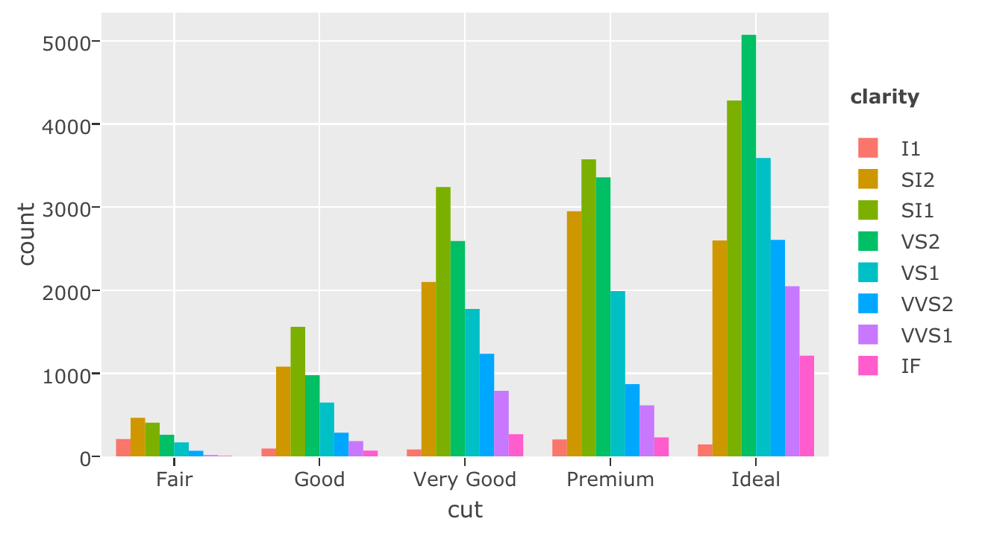

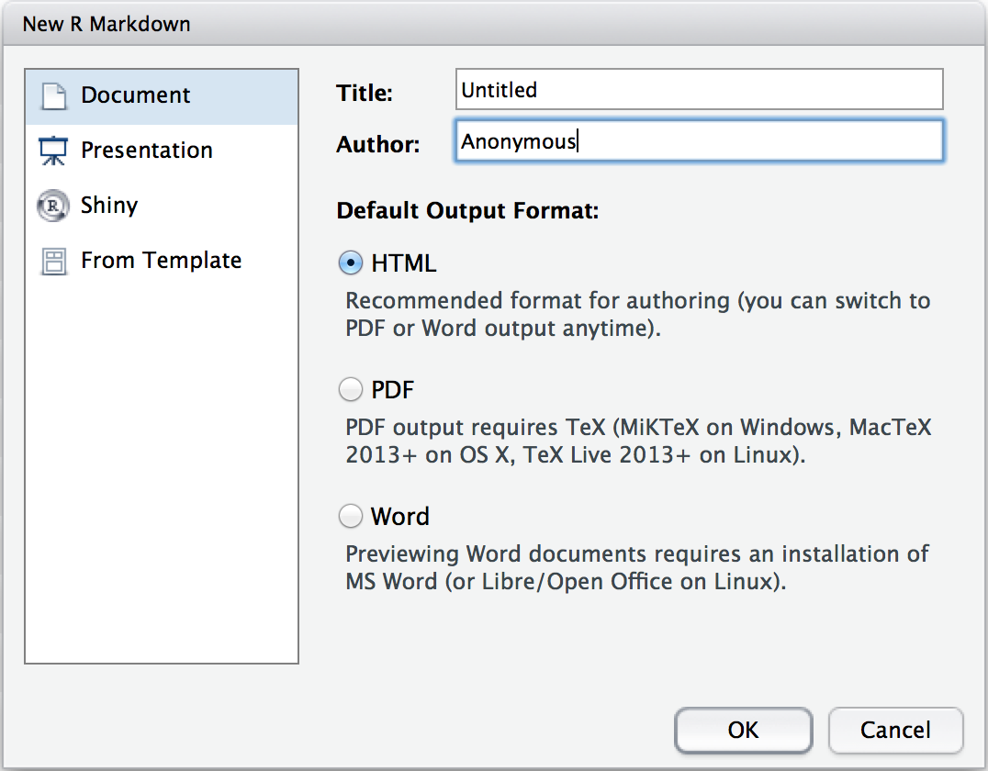
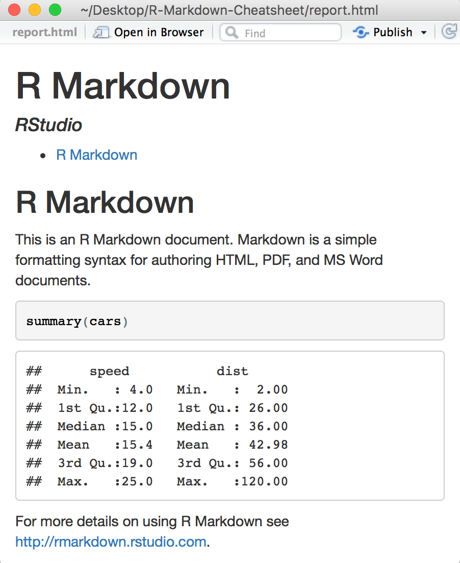
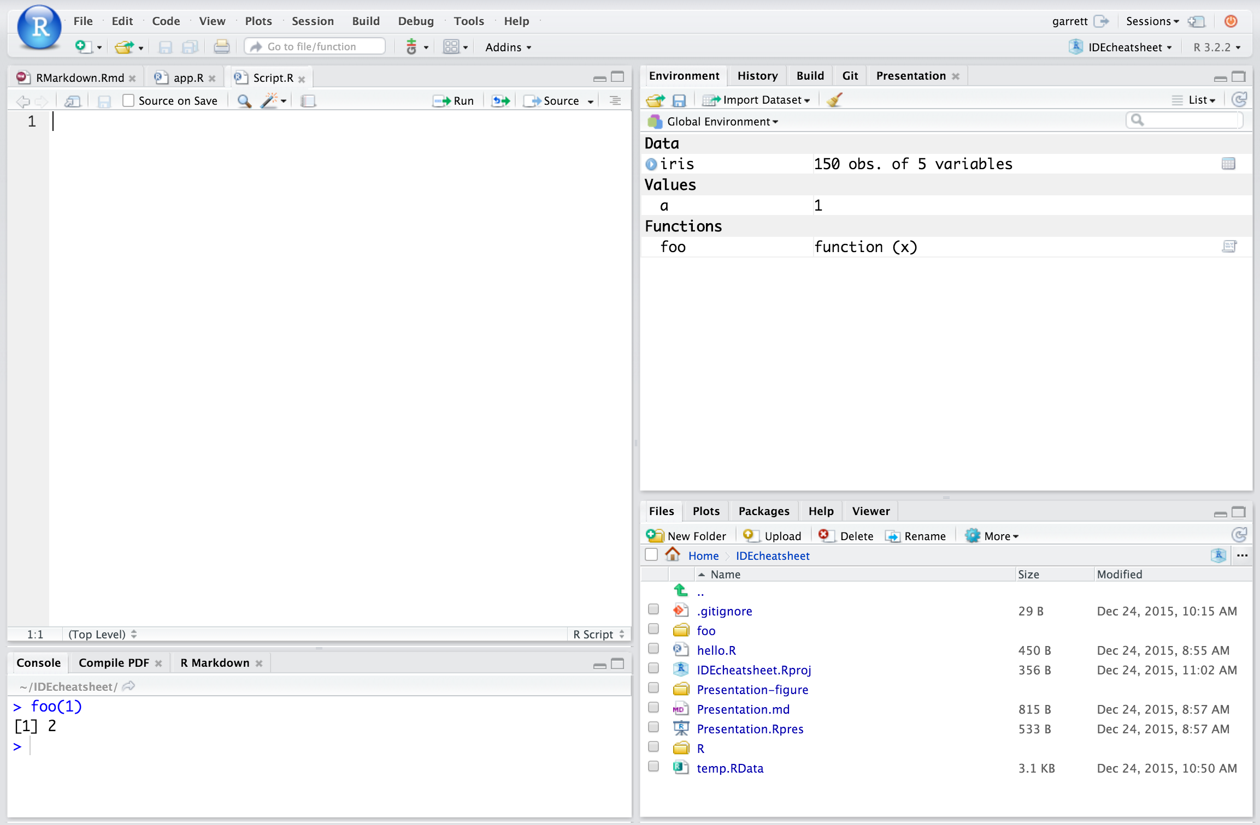
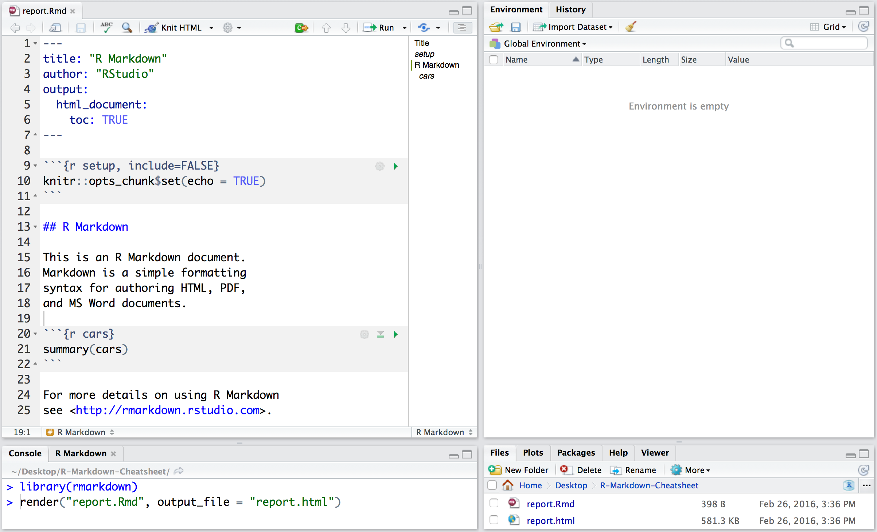
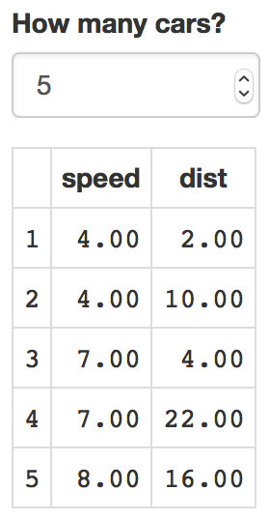
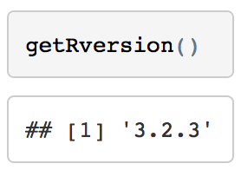


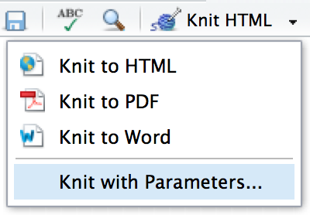
R Markdown Cheat Sheet
.Rmd files
An R Markdown (.Rmd) file is a record of your research. It contains the code that a scientist needs to reproduce your work along with the narration that a reader needs to understand your work.
Rmd
Reproducible Research
At the click of a button, or the type of a command, you can rerun the code in an R Markdown file to reproduce your work and export the results as a finished report.
Dynamic Documents
You can choose to export the finished report as a html, pdf, MS Word, ODT, RTF, or markdown document; or as a html or pdf based slide show.
learn more at rmarkdown.rstudio.com
Rmd
RStudio Pro Features
Workflow
Interactive Documents
Open a new .Rmd file at File ▶︎ New File ▶︎ R Markdown. Use the wizard that opens to pre-populate the file with a template
Write document by editing template
Knit document to create report
Use knit button or render() to knit
Preview Output
in IDE window
Publish (optional) to web or server
Debug Mode
1
2
3
4
5
Turn your report into an interactive Shiny document in 4 steps
Open in window
Save
Spell Check
Find and replace
Publish
Show outline
Synch publish button to accounts at
rpubs.com,
shinyapps.io
RStudio Connect
1
Add runtime: shiny to the
YAML header.
2
Call Shiny input functions to embed input objects.
Reload document
3
Find in document
Call Shiny render functions to embed reactive output.
File path to output document
.Rmd structure
Set preview location
Insert code chunk
Go to code chunk
Run code chunk(s)
6
Examine build log
in R Markdown console
4
Render with rmarkdown::run or click Run Document in RStudio IDE
YAML Header
Optional section of render (e.g. pandoc) options written as key:value pairs (YAML).
At start of file
Between lines of - - -
7
Use output file that is saved alongside .Rmd
---
output: html_document
runtime: shiny
---
```{r, echo = FALSE}
numericInput("n",
"How many cars?", 5)
renderTable({
head(cars, input$n)
})
```
Modify chunk options
Run all previous chunks
Run current chunk
render()
Text
Use rmarkdown::render() to render/knit at cmd line. Important args:
input - file to render
output_format
output_options - List of render options (as in YAML)
output_file
output_dir
params - list of params to use
envir - environment to evaluate code chunks in
encoding - of input file
Narration formatted with markdown, interspersed with:
Code chunks
Chunks of embedded code. Each chunk:
Begins with ```{r}
ends with ```
R Markdown will run the code and append the results to the doc.
Embed a complete app into your document with shiny::shinyAppDir()
* Your report will rendered as a Shiny app, which means you must choose an html output format, like html_document, and serve it with an active R Session.
Debug Mode
Embed code with knitr syntax
Parameters
Inline code
Code chunks
Global options
Debug Mode
Insert with `r <code>`. Results will appear as text without code.
One or more lines surrounded with ```{r} and ```. Place chunk options within curly braces, after r. Insert with
Set with knitr::opts_chunk$set(), e.g.
Parameterize your documents to reuse with different inputs (e.g., data sets, values, etc.)
```{r include=FALSE}
knitr::opts_chunk$set(echo = TRUE)
```
1
Add parameters
---
params:
n: 100
d: !r Sys.Date()
---
Built with
`r getRversion()`
```{r echo=TRUE}
getRversion()
```
Create and set parameters in the header as sub-values of params
Indent 2 spaces
Important chunk options
2
cache = FALSE
cache results for future knits
cache.path = "cache/"
directory to save cached results in
child = NULL
file(s) to knit and then include
collapse = FALSE
collapse all output into single block
comment = '##'
prefix for each line of results
dependson = NULL
chunk dependencies for caching
echo = TRUE
Display code in output document
engine = 'R'
code language used in chunk
error = TRUE
stop render when error occurs
eval = TRUE
Run code in chunk
fig.align = 'default'
'left', 'right', or 'center'
fig.cap = NULL
figure caption as character string
fig.height, fig.width
Dimensions of plots in inches
highlight = TRUE
highlight source code
include = TRUE
Include chunk after running
message = TRUE
display code messages in document
results = 'markup'
'asis' - passthrough results
'hide' - do not display results
'hold' - put all results below all code
tidy = FALSE
tidy code for display
warning = TRUE
display code warnings in document
Call parameters
Call parameter values in code as params$<name>
Today’s date
is `r params$d`
3
Set parameters
Set values wth Knit with parameters or the params argument of render():
render("doc.Rmd",
params = list(n = 1, d = as.Date("2015-01-01"))
RStudio® is a trademark of RStudio, Inc. • CC BY RStudio • info@rstudio.com • 844-448-1212 • rstudio.com
More cheat sheets at http://www.rstudio.com/resources/cheatsheets/
Learn more at support.rstudio.com • RStudio IDE 0.99.879 • Updated: 02/16

Slide 2
R Markdown Cheat Sheet
.Rmd files
An R Markdown (.Rmd) file is a record of your research. It contains the code that a scientist needs to reproduce your work along with the narration that a reader needs to understand your work.
Rmd
Reproducible Research
At the click of a button, or the type of a command, you can rerun the code in an R Markdown file to reproduce your work and export the results as a finished report.
Dynamic Documents
You can choose to export the finished report as a html, pdf, MS Word, ODT, RTF, or markdown document; or as a html or pdf based slide show.
learn more at rmarkdown.rstudio.com
Rmd
RStudio Pro Features
Workflow
Interactive Documents
Open a new .Rmd file at File ▶︎ New File ▶︎ R Markdown. Use the wizard that opens to pre-populate the file with a template
Write document by editing template
Knit document to create report
Use knit button or render() to knit
Preview Output
in IDE window
Publish (optional) to web or server
Debug Mode
1
2
3
4
5
Turn your report into an interactive Shiny document in 4 steps
Open in window
Save
Spell Check
Find and replace
Publish
Show outline
Synch publish button to accounts at
rpubs.com,
shinyapps.io
RStudio Connect
1
Add runtime: shiny to the
YAML header.
2
Call Shiny input functions to embed input objects.
Reload document
3
Find in document
Call Shiny render functions to embed reactive output.
File path to output document
.Rmd structure
Set preview location
Insert code chunk
Go to code chunk
Run code chunk(s)
6
Examine build log
in R Markdown console
4
Render with rmarkdown::run or click Run Document in RStudio IDE
YAML Header
Optional section of render (e.g. pandoc) options written as key:value pairs (YAML).
At start of file
Between lines of - - -
Use output file that is saved alongside .Rmd
7
---
output: html_document
runtime: shiny
---
```{r, echo = FALSE}
numericInput("n",
"How many cars?", 5)
renderTable({
head(cars, input$n)
})
```
Text
Modify chunk options
Run all previous chunks
Run current chunk
render()
Narration formatted with markdown, mixed with:
Use rmarkdown::render() to render/knit at cmd line. Important args:
input - file to render
output_format
output_options - List of render options (as in YAML)
output_file
output_dir
params - list of params to use
envir - environment to evaluate code chunks in
encoding - of input file
Code chunks
Chunks of embedded code. Each chunk:
Begins with ```{r}
ends with ```
R Markdown will run the code and append the results to the doc.
It will use the location of the .Rmd file as the working directory
Embed a complete app into your document with shiny::shinyAppDir()
* Your report will rendered as a Shiny app, which means you must choose an html output format, like html_document, and serve it with an active R Session.
Debug Mode
Embed code with knitr syntax
Parameters
Inline code
Code chunks
Global options
Debug Mode
Insert with `r <code>`. Results appear as text without code.
One or more lines surrounded with ```{r} and ```. Place chunk options within curly braces, after r. Insert with
Set with knitr::opts_chunk$set(), e.g.
Parameterize your documents to reuse with different inputs (e.g., data sets, values, etc.)
Built with
`r getRversion()`
```{r echo=TRUE}
getRversion()
```
```{r include=FALSE}
knitr::opts_chunk$set(echo = TRUE)
```
1
Add parameters
---
params:
n: 100
d: !r Sys.Date()
---
Create and set parameters in the header as sub-values of params
Indent 2 spaces
Important chunk options
cache - cache results for future knits (default = FALSE)
cache.path - directory to save cached results in (default = "cache/")
child - file(s) to knit and then include (default = NULL)
collapse - collapse all output into single block (default = FALSE)
comment - prefix for each line of results (default = '##')
dependson - chunk dependencies for caching (default = NULL)
echo - Display code in output document (default = TRUE)
engine - code language used in chunk (default = 'R')
error - Display error messages in doc (TRUE) or stop render when errors occur (FALSE) (default = FALSE)
eval - Run code in chunk (default = TRUE)
fig.align - 'left', 'right', or 'center' (default = 'default')
fig.cap - figure caption as character string (default = NULL)
fig.height, fig.width - Dimensions of plots in inches
highlight - highlight source code (default = TRUE)
include - Include chunk in doc after running (default = TRUE)
message - display code messages in document (default = TRUE)
results (default = 'markup')
'asis' - passthrough results
'hide' - do not display results
'hold' - put all results below all code
tidy - tidy code for display (default = FALSE)
warning - display code warnings in document (default = TRUE)
2
Call parameters
Call parameter values in code as params$<name>
Today’s date
is `r params$d`
3
Set parameters
Set values wth Knit with parameters or the params argument of render():
Options not listed above: R.options, aniopts, autodep, background, cache.comments, cache.lazy, cache.rebuild, cache.vars, dev, dev.args, dpi, engine.opts, engine.path, fig.asp, fig.env, fig.ext, fig.keep, fig.lp, fig.path, fig.pos, fig.process, fig.retina, fig.scap, fig.show, fig.showtext, fig.subcap, interval, out.extra, out.height, out.width, prompt, purl, ref.label, render, size, split, tidy.opts
render("doc.Rmd",
params = list(n = 1, d = as.Date("2015-01-01"))
RStudio® is a trademark of RStudio, Inc. • CC BY RStudio • info@rstudio.com • 844-448-1212 • rstudio.com
More cheat sheets at http://www.rstudio.com/resources/cheatsheets/
Learn more at rmarkdown.rstudio.com • RStudio IDE 0.99.879 • Updated: 02/16

Slide 3
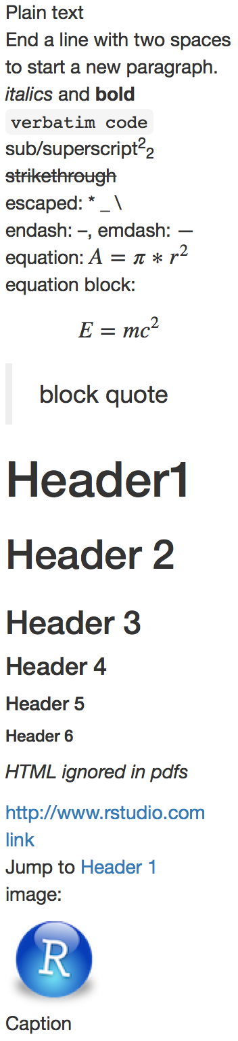

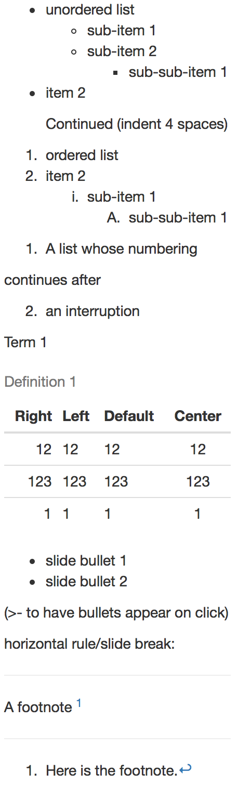
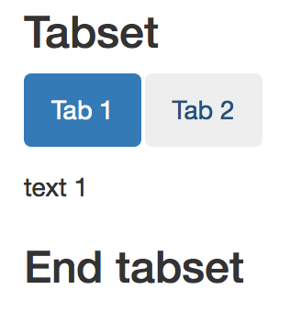
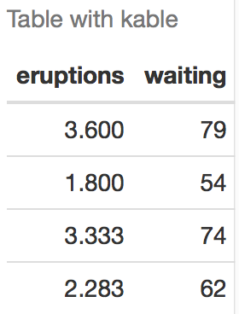
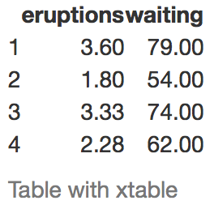
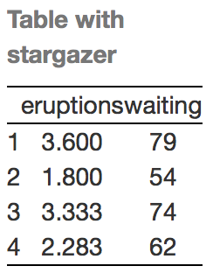
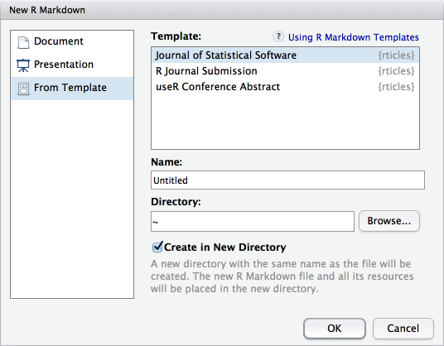
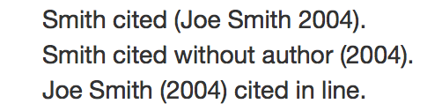
Debug Mode
Pandoc’s Markdown
Debug Mode
Set render options with YAML
Write with syntax on the left to create effect on right (after render)
When you render, R Markdown
runs the R code, embeds results and text into .md file with knitr
then converts the .md file into the finished format with pandoc
sub-option | description
citation_package | The LaTeX package to process citations, natbib, biblatex or none |  | X |  |  |  | X |  |  |  | X
code_folding | Let readers to toggle the display of R code, "none", "hide", or "show" | X
colortheme | Beamer color theme to use |  |  |  |  |  |  |  |  |  | X
css | CSS file to use to style document | X |  |  |  |  |  |  | X | X
dev | Graphics device to use for figure output (e.g. "png") | X | X |  |  |  | X | X | X | X | X
duration | Add a countdown timer (in minutes) to footer of slides |  |  |  |  |  |  |  |  | X
fig_caption | Should figures be rendered with captions? | X | X | X | X |  |  |  | X | X | X
fig_height, fig_width | Default figure height and width (in inches) for document | X | X | X | X | X | X | X | X | X | X
highlight | Syntax highlighting: "tango", "pygments", "kate","zenburn", "textmate" | X | X | X |  |  |  |  |  | X | X
includes | File of content to place in document (in_header, before_body, after_body) | X | X |  | X |  | X | X | X | X | X
incremental | Should bullets appear one at a time (on presenter mouse clicks)? |  |  |  |  |  |  |  | X | X | X
keep_md | Save a copy of .md file that contains knitr output | X |  | X | X | X |  |  | X | X
keep_tex | Save a copy of .tex file that contains knitr output |  | X |  |  |  |  |  |  |  | X
latex_engine | Engine to render latex, "pdflatex", "xelatex", or "lualatex" |  | X |  |  |  |  |  |  |  | X
lib_dir | Directory of dependency files to use (Bootstrap, MathJax, etc.) | X |  |  |  |  |  |  | X | X
mathjax | Set to local or a URL to use a local/URL version of MathJax to render equations | X |  |  |  |  |  |  | X | X
md_extensions | Markdown extensions to add to default definition or R Markdown | X | X | X | X | X | X | X | X | X | X
number_sections | Add section numbering to headers | X | X
pandoc_args | Additional arguments to pass to Pandoc | X | X | X | X | X | X | X | X | X | X
preserve_yaml | Preserve YAML front matter in final document? |  |  |  |  |  | X
reference_docx | docx file whose styles should be copied when producing docx output |  |  | X
self_contained | Embed dependencies into the doc | X |  |  |  |  |  |  | X | X
slide_level | The lowest heading level that defines individual slides |  |  |  |  |  |  |  |  |  | X
smaller | Use the smaller font size in the presentation? |  |  |  |  |  |  |  | X
smart | Convert straight quotes to curly, dashes to em-dashes, … to ellipses, etc. | X |  |  |  |  |  |  | X | X
template | Pandoc template to use when rendering file quarterly_report.html). | X | X |  | X |  |  |  |  | X | X
theme | Bootswatch or Beamer theme to use for page | X |  |  |  |  |  |  |  |  | X
toc | Add a table of contents at start of document | X | X | X |  | X | X | X |  |  | X
toc_depth | The lowest level of headings to add to table of contents | X | X | X |  | X | X | X
toc_float | Float the table of contents to the left of the main content | X
html
pdf
word
odt
rtf
md
gituhb
ioslides
slidy
Plain text
End a line with two spaces
to start a new paragraph.
*italics* and **bold**
`verbatim code`
sub/superscript^2^~2~
~~strikethrough~~
escaped: \* \_ \\
endash: --, emdash: ---
equation: $A = \pi*r^{2}$
equation block:
$$E = mc^{2}$$
> block quote
# Header1 {#anchor}
## Header 2 {#css_id}
### Header 3 {.css_class}
#### Header 4
##### Header 5
###### Header 6
<!--Text comment-->
\textbf{Tex ignored in HTML}
<em>HTML ignored in pdfs</em>
<http://www.rstudio.com>
[link](www.rstudio.com)
Jump to [Header 1](#anchor)
image:
![Caption](smallorb.png)
* unordered list
+ sub-item 1
+ sub-item 2
- sub-sub-item 1
* item 2
Continued (indent 4 spaces)
1. ordered list
2. item 2
i) sub-item 1
A. sub-sub-item 1
(@) A list whose numbering
continues after
(@) an interruption
Term 1
: Definition 1
| Right | Left | Default | Center |
|------:|:-----|---------|:------:|
| 12 | 12 | 12 | 12 |
| 123 | 123 | 123 | 123 |
| 1 | 1 | 1 | 1 |
- slide bullet 1
- slide bullet 2
(>- to have bullets appear on click)
horizontal rule/slide break:
***
A footnote [^1]
[^1]: Here is the footnote.
beamer
Set a document’s default output format in the YAML header:
---
output: html_document
---
# Body
output value | creates
html_document | html
pdf_document | pdf (requires Tex )
word_document | Microsoft Word (.docx)
odt_document | OpenDocument Text
rtf_document | Rich Text Format
md_document | Markdown
github_document | Github compatible markdown
ioslides_presentation | ioslides HTML slides
slidy_presentation | slidy HTML slides
beamer_presentation | Beamer pdf slides (requires Tex)
Customize output with sub-options (listed at right):
---
output:
html_document:
code_folding: hide
toc_float: TRUE
---
# Body
Indent 2 spaces
Indent 4 spaces
html tabsets
Use .tabset css class to place sub-headers into tabs
# Tabset {.tabset .tabset-fade .tabset-pills}
## Tab 1
text 1
## Tab 2
text 2
### End tabset
Options not listed: extra_dependencies, fig_crop, fig_retina, font_adjustment, font_theme, footer, logo, html_preview, reference_odt, transition, variant, widescreen
Debug Mode
Create a Reusable template
Debug Mode
Table suggestions
Debug Mode
1
Several functions format R data into tables
Citations and Bibliographies
Create a new package with a
inst/rmarkdown/templates directory
Create citations with .bib, .bibtex, .copac, .enl, .json,
.medline, .mods, .ris, .wos, and .xml files
2
1
Set bibliography file and CSL 1.0 Style file (optional) in the YAML header
In the directory, Place a folder that contains:
template.yaml (see below)
skeleton.Rmd (contents of the template)
any supporting files
---
bibliography: refs.bib
csl: style.csl
---
3
Install the package
data <- faithful[1:4, ]
2
```{r results = 'asis'}
knitr::kable(data, caption = "Table with kable")
```
Use citation keys in text
4
Access template in wizard at File ▶︎ New File ▶︎
R Markdown
Smith cited [@smith04].
Smith cited without author [-@smith04].
@smith04 cited in line.
```{r results = "asis"}
print(xtable::xtable(data, caption = "Table with xtable"),
type = "html", html.table.attributes = "border=0"))
```
3
Render. Bibliography will be added to end of document
template.yaml
```{r results = "asis"}
stargazer::stargazer(data, type = "html",
title = "Table with stargazer")
```
Learn more in
the stargazer, xtable, and
knitr packages.
---
name: My Template
---
RStudio® is a trademark of RStudio, Inc. • CC BY RStudio • info@rstudio.com • 844-448-1212 • rstudio.com
More cheat sheets at http://www.rstudio.com/resources/cheatsheets/
Learn more at rmarkdown.rstudio.com • RStudio IDE 0.99.879 • Updated: 02/16

Slide 4
Debug Mode
Pandoc’s Markdown
Debug Mode
Set render options with YAML
Write with syntax on the left to create effect on right (after render)
When you render, R Markdown
runs the R code, embeds results and text into .md file with knitr
then converts the .md file into the finished format with pandoc
sub-option | description
citation_package | The LaTeX package to process citations, natbib, biblatex or none |  | X |  |  |  | X |  |  |  | X
code_folding | Let readers to toggle the display of R code, "none", "hide", or "show" | X
colortheme | Beamer color theme to use |  |  |  |  |  |  |  |  |  | X
css | CSS file to use to style document | X |  |  |  |  |  |  | X | X
dev | Graphics device to use for figure output (e.g. "png") | X | X |  |  |  | X | X | X | X | X
duration | Add a countdown timer (in minutes) to footer of slides |  |  |  |  |  |  |  |  | X
fig_caption | Should figures be rendered with captions? | X | X | X | X |  |  |  | X | X | X
fig_height, fig_width | Default figure height and width (in inches) for document | X | X | X | X | X | X | X | X | X | X
highlight | Syntax highlighting: "tango", "pygments", "kate","zenburn", "textmate" | X | X | X |  |  |  |  |  | X | X
includes | File of content to place in document (in_header, before_body, after_body) | X | X |  | X |  | X | X | X | X | X
incremental | Should bullets appear one at a time (on presenter mouse clicks)? |  |  |  |  |  |  |  | X | X | X
keep_md | Save a copy of .md file that contains knitr output | X |  | X | X | X |  |  | X | X
keep_tex | Save a copy of .tex file that contains knitr output |  | X |  |  |  |  |  |  |  | X
latex_engine | Engine to render latex, "pdflatex", "xelatex", or "lualatex" |  | X |  |  |  |  |  |  |  | X
lib_dir | Directory of dependency files to use (Bootstrap, MathJax, etc.) | X |  |  |  |  |  |  | X | X
mathjax | Set to local or a URL to use a local/URL version of MathJax to render equations | X |  |  |  |  |  |  | X | X
md_extensions | Markdown extensions to add to default definition or R Markdown | X | X | X | X | X | X | X | X | X | X
number_sections | Add section numbering to headers | X | X
pandoc_args | Additional arguments to pass to Pandoc | X | X | X | X | X | X | X | X | X | X
preserve_yaml | Preserve YAML front matter in final document? |  |  |  |  |  | X
reference_docx | docx file whose styles should be copied when producing docx output |  |  | X
self_contained | Embed dependencies into the doc | X |  |  |  |  |  |  | X | X
slide_level | The lowest heading level that defines individual slides |  |  |  |  |  |  |  |  |  | X
smaller | Use the smaller font size in the presentation? |  |  |  |  |  |  |  | X
smart | Convert straight quotes to curly, dashes to em-dashes, … to ellipses, etc. | X |  |  |  |  |  |  | X | X
template | Pandoc template to use when rendering file quarterly_report.html). | X | X |  | X |  |  |  |  | X | X
theme | Bootswatch or Beamer theme to use for page | X |  |  |  |  |  |  |  |  | X
toc | Add a table of contents at start of document | X | X | X |  | X | X | X |  |  | X
toc_depth | The lowest level of headings to add to table of contents | X | X | X |  | X | X | X
toc_float | Float the table of contents to the left of the main content | X
html
pdf
word
odt
rtf
md
gituhb
ioslides
slidy
Plain text
End a line with two spaces
to start a new paragraph.
*italics* and **bold**
`verbatim code`
sub/superscript^2^~2~
~~strikethrough~~
escaped: \* \_ \\
endash: --, emdash: ---
equation: $A = \pi*r^{2}$
equation block:
$$E = mc^{2}$$
> block quote
# Header1 {#anchor}
## Header 2 {#css_id}
### Header 3 {.css_class}
#### Header 4
##### Header 5
###### Header 6
<!--Text comment-->
\textbf{Tex ignored in HTML}
<em>HTML ignored in pdfs</em>
<http://www.rstudio.com>
[link](www.rstudio.com)
Jump to [Header 1](#anchor)
image:
![Caption](smallorb.png)
* unordered list
+ sub-item 1
+ sub-item 2
- sub-sub-item 1
* item 2
Continued (indent 4 spaces)
1. ordered list
2. item 2
i) sub-item 1
A. sub-sub-item 1
(@) A list whose numbering
continues after
(@) an interruption
Term 1
: Definition 1
| Right | Left | Default | Center |
|------:|:-----|---------|:------:|
| 12 | 12 | 12 | 12 |
| 123 | 123 | 123 | 123 |
| 1 | 1 | 1 | 1 |
- slide bullet 1
- slide bullet 2
(>- to have bullets appear on click)
horizontal rule/slide break:
***
A footnote [^1]
[^1]: Here is the footnote.
beamer
Set a document’s default output format in the YAML header:
---
output: html_document
---
# Body
output value | creates
html_document | html
pdf_document | pdf (requires Tex )
word_document | Microsoft Word (.docx)
odt_document | OpenDocument Text
rtf_document | Rich Text Format
md_document | Markdown
github_document | Github compatible markdown
ioslides_presentation | ioslides HTML slides
slidy_presentation | slidy HTML slides
beamer_presentation | Beamer pdf slides (requires Tex)
Customize output with sub-options (listed at right):
---
output:
html_document:
code_folding: hide
toc_float: TRUE
---
# Body
Indent 2 spaces
Indent 4 spaces
html tabsets
Use .tabset css class to place sub-headers into tabs
# Tabset {.tabset .tabset-fade .tabset-pills}
## Tab 1
text 1
## Tab 2
text 2
### End tabset
Options not listed: extra_dependencies, fig_crop, fig_retina, font_adjustment, font_theme, footer, logo, html_preview, reference_odt, transition, variant, widescreen
Debug Mode
Create a Reusable template
Debug Mode
Table suggestions
Debug Mode
1
Several functions format R data into tables
Citations and Bibliographies
Create a new package with a
inst/rmarkdown/templates directory
Create citations with .bib, .bibtex, .copac, .enl, .json,
.medline, .mods, .ris, .wos, and .xml files
2
1
Set bibliography file and CSL 1.0 Style file (optional) in the YAML header
In the directory, Place a folder that contains:
template.yaml (see below)
skeleton.Rmd (contents of the template)
any supporting files
---
bibliography: refs.bib
csl: style.csl
---
3
Install the package
data <- faithful[1:4, ]
2
```{r results = 'asis'}
knitr::kable(data, caption = "Table with kable")
```
Use citation keys in text
4
Access template in wizard at File ▶︎ New File ▶︎
R Markdown
Smith cited [@smith04].
Smith cited without author [-@smith04].
@smith04 cited in line.
```{r results = "asis"}
print(xtable::xtable(data, caption = "Table with xtable"),
type = "html", html.table.attributes = "border=0"))
```
3
Render. Bibliography will be added to end of document
template.yaml
```{r results = "asis"}
stargazer::stargazer(data, type = "html",
title = "Table with stargazer")
```
Learn more in
the stargazer, xtable, and
knitr packages.
---
name: My Template
---
RStudio® is a trademark of RStudio, Inc. • CC BY RStudio • info@rstudio.com • 844-448-1212 • rstudio.com
More cheat sheets at http://www.rstudio.com/resources/cheatsheets/
Learn more at support.rstudio.com • RStudio IDE 0.99.879 • Updated: 02/16

Slide 5
R Markdown Cheat Sheet
.Rmd files
An R Markdown (.Rmd) file is a record of your research. It contains the code that a scientist needs to reproduce your work along with the narration that a reader needs to understand your work.
Rmd
Reproducible Research
At the click of a button, or the type of a command, you can rerun the code in an R Markdown file to reproduce your work and export the results as a finished report.
Dynamic Documents
You can choose to export the finished report as a html, pdf, MS Word, ODT, RTF, or markdown document; or as a html or pdf based slide show.
learn more at rmarkdown.rstudio.com
Rmd
RStudio Pro Features
Workflow
Embed code with knitr syntax
Debug Mode
1
Open a new .Rmd file with File ▶︎ New File ▶︎ R Markdown. Use the wizard that opens to pre-populate the file with a template
2
Write document by editing template
3
Knit document to create report
Use knit button or render() to knit
4
Preview Output
in IDE window
5
Publish (optional) to web or server
Inline code
Insert with `r <code>`. Results will appear as text.
Open in window
Save
Spell Check
Find and replace
Publish
Show outline
Synch publish button to accounts at
rpubs.com,
shinyapps.io
RStudio Connect
Built with
`r getRversion()`
Code chunks
Reload document
Insert with . or by surrounding lines with ```{r} and ```. Place chunk options within curly braces.
Find in document
```{r echo=TRUE}
getRversion()
```
File path to output document
.Rmd structure
Set preview location
Insert code chunk
Go to code chunk
Run code chunk(s)
6
Examine build log
in R Markdown console
Set global options with knitr::opts_chunk$set(), e.g.
YAML Header
Optional section of render (e.g. pandoc) options written as key:value pairs (YAML).
At start of file
Between lines of - - -
7
Use output file that is saved alongside .Rmd
```{r include=FALSE}
knitr::opts_chunk$set(echo = TRUE)
```
Modify chunk options
Run all previous chunks
Run current chunk
Important chunk options
render()
cache = FALSE
cache results for future knits
child = NULL
file(s) to knit and then include
collapse = FALSE
collapse all output into single block
comment = '##'
prefix for each line of results
dependson = NULL
chunk dependencies for caching
echo = TRUE
Display code in output document
engine = 'R'
code language used in chunk
error = TRUE
stop render when error occurs
eval = TRUE
Run code in chunk
fig.align = 'default'
'left', 'right', or 'center'
fig.cap = NULL
figure caption as character string
fig.height, fig.width
Dimensions of plots in inches
include = TRUE
Include chunk after running
message = TRUE
display code messages in document
results = 'markup'
'asis' - passthrough results
'hide' - do not display results
'hold' - put all results below all code
tidy = FALSE
tidy code for display
warning = TRUE
display code warnings in document
Text
Use rmarkdown::render() to render/knit at cmd line. Important args:
input - file to render
output_format
output_options - List of render options (as in YAML)
output_file
output_dir
params - list of params to use
envir - environment to evaluate code chunks in
encoding - of input file
Narration formatted with markdown, interspersed with:
Code chunks
Chunks of embedded code. Each chunk:
Begins with ```{r}
ends with ```
R Markdown will run the code and append the results to the doc.
Debug Mode
Interactive Documents
Debug Mode
Parameters
Turn your report into an interactive Shiny document in 4 steps
Embed a complete app into your document with shiny::shinyAppDir()
Parameterize your documents to reuse with different inputs (e.g., data sets, values, etc.)
1
1
Add parameters
---
params:
n: 100
d: !r Sys.Date()
---
Add runtime: shiny to the
YAML header.
---
output: html_document
runtime: shiny
---
```{r, echo = FALSE}
numericInput("n",
"How many cars?", 5)
renderTable({
head(cars, input$n)
})
```
Create and set parameters in the header as sub-values of params
2
Call Shiny input functions to embed input objects.
2
Call parameters
3
Call Shiny render functions to embed reactive output.
Call parameter values in code as params$<name>
Today’s date
is `r params$d`
3
Set parameters
4
Render with rmarkdown::run or click Run Document in RStudio IDE
Set values wth Knit with parameters or the params argument of render():
* Your report will rendered as a Shiny app, which means you must choose an html output format, like html_document or ioslides_presentation, and serve it with an active R Session.
render("doc.Rmd",
params = list(n = 1, d = as.Date("2015-01-01"))
RStudio® is a trademark of RStudio, Inc. • CC BY RStudio • info@rstudio.com • 844-448-1212 • rstudio.com
More cheat sheets at http://www.rstudio.com/resources/cheatsheets/
Learn more at support.rstudio.com • RStudio IDE 0.99.879 • Updated: 02/16

Slide 6
option | description
citation_package |  |  | X |  |  |  | X |  |  | X
code_folding |  | X
colortheme | Beamer color theme to use (e.g., colortheme: "dolphin"). |  |  |  |  |  |  |  |  | X
css | Filepath to CSS style to use to style document (e.g., css: styles.css). | X |  |  |  |  |  | X | X
dev |  | X |  |  |  |  |  | X | X | X
duration | Add a countdown timer (in minutes) to footer of slides (e.g., duration: 45). |  |  |  |  |  |  |  | X
extra_dependencies |  | X
fig_caption | Should figures be rendered with captions? | X | X | X | X |  |  | X | X | X
fig_crop | Should pdfcrop utility be automatically applied to figures (when available)? |  | X |  |  |  |  |  |  | X
fig_height | Default figure height (in inches) for document. | X | X | X | X | X | X | X | X | X
fig_retina | Scaling to perform for retina displays (e.g., fig_retina: 2). | X |  |  |  |  | X | X | X
fig_width | Default figure width (in inches) for document. | X | X | X | X | X | X | X | X | X
font_adjustment | Increase or decrease font size for entire presentation (e.g., font_adjustment: -1). |  |  |  |  |  |  |  | X
fonttheme | Beamer font theme to use (e.g., fonttheme: "structurebold"). |  |  |  |  |  |  |  |  | X
footer | Text to add to footer of each slide (e.g., footer: "Copyright (c) 2014 RStudio"). |  |  |  |  |  |  |  | X
highlight | Syntax highlighting style (e.g. "tango", "pygments", "kate", "zenburn", and "textmate") | X | X |  |  |  |  |  | X | X
includes | See below | X | X |  | X |  | X | X | X | X
-in_header | File of content to place in document header (e.g., in_header: header.html). | X | X |  |  |  |  | X | X | X
-before_body | File of content to place before document body (e.g., before_body: doc_prefix.html). | X | X |  |  |  |  | X | X | X
-after_body | File of content to place after document body (e.g., after_body: doc_suffix.html). | X | X |  |  |  |  | X | X | X
incremental | Should bullets appear one at a time (on presenter mouse clicks)? |  |  |  |  |  |  | X | X | X
keep_md | Save a copy of .md file that contains knitr output (in addition to the .Rmd and HTML files)? | X |  |  | X | X |  | X | X
keep_tex | Save a copy of .tex file that contains knitr output (in addition to the .Rmd and PDF files)? |  | X |  |  |  |  |  |  | X
latex_engine | Engine to render latex. Should be one of "pdflatex", "xelatex", and "lualatex". |  | X |  |  |  |  |  |  | X
lib_dir | Directory of dependency files to use (Bootstrap, MathJax, etc.) (e.g., lib_dir: libs). | X |  |  |  |  |  | X | X
logo | File path to a logo (at least 128 x 128) to add to presentation (e.g., logo: logo.png). |  |  |  |  |  |  | X
mathjax | Set to local or a URL to use a local/URL version of MathJax to render equations | X |  |  |  |  |  | X | X
md_extensions |  | X |  |  | X | X |  | X | X | X
number_sections | Add section numbering to headers (e.g., number_sections: true). | X | X
pandoc_args | Arguments to pass to Pandoc (e.g., pandoc_args: ["--title-prefix", "Foo"]). | X | X | X | X | X | X | X | X | X
preserve_yaml | Preserve YAML front matter in final document? |  |  |  |  |  | X
reference_docx | A .docx file whose styles should be copied to use (e.g., reference_docx: mystyles.docx). |  |  | X
reference_odt |  |  |  |  | X
self_contained | Embed dependencies into the doc? Set to false to keep dependencies in external files. | X |  |  |  |  |  | X | X
slide_level | The lowest heading level that defines individual slides (e.g., slide_level: 2). |  |  |  |  |  |  |  |  | X
smaller | Use the smaller font size in the presentation? |  |  |  |  |  |  | X
smart | Convert straight quotes to curly, dashes to em-dashes, … to ellipses, and so on? | X |  |  |  |  |  | X | X
template | Pandoc template to use when rendering file (e.g., template: quarterly_report.html). | X | X |  | X |  |  |  | X | X
theme | Bootswatch or Beamer theme to use for page. Valid bootswatch themes include "cerulean", "journal", "flatly", "readable", "spacelab", "united", and "cosmo". | X |  |  |  |  |  |  |  | X
toc | Add a table of contents at start of document? (e.g., toc: true). | X | X |  |  | X | X |  |  | X
toc_depth | The lowest level of headings to add to table of contents (e.g., toc_depth: 2). | X | X |  |  | X | X
toc_float |  | X
transition | Speed of slide transitions should be "slower", "faster" or a number in seconds. |  |  |  |  |  |  | X
variant | The flavor of markdown to use; one of "markdown", "markdown_strict", "markdown_github", "markdown_mmd", and "markdown_phpextra" |  |  |  |  |  | X
widescreen | Display presentation in widescreen format? |  |  |  |  |  |  | X
Debug Mode
Table suggestions
Debug Mode
Several functions format R data into tables
Table suggestions
data <- faithful[1:4, ]
Several functions format R data into tables
data <- faithful[1:4, ]
```{r}
knitr::kable(data,
caption = "Table with kable")
```
```{r results = "asis"}
print(xtable::xtable(data,
caption = "Table with xtable"),
type = "html",
html.table.attributes = "border=0"))
```
```{r}
knitr::kable(data, caption = "Table with kable")
```
```{r results = "asis"}
print(xtable::xtable(data, caption = "Table with xtable"),
type = "html", html.table.attributes = "border=0"))
```
```{r results = "asis"}
stargazer::stargazer(data, type = "html",
title = "Table with stargazer")
```
```{r results = "asis"}
stargazer::stargazer(data, title = "Table with stargazer",
type = "html")
```

