Slide 1

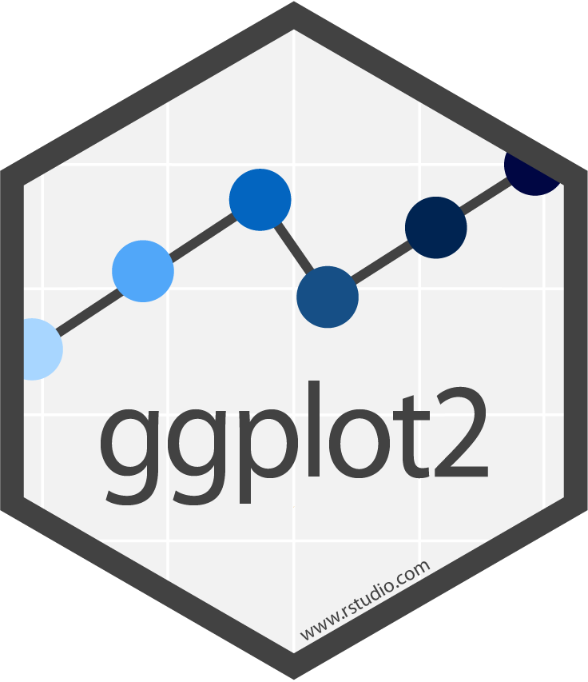






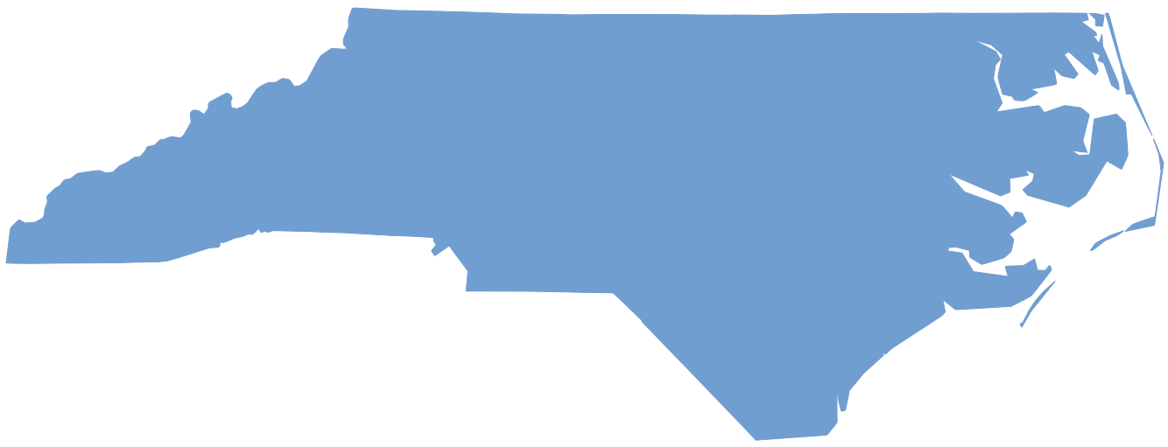

Data visualization with ggplot2 : : CHEATSHEET
Basics
Geoms
Use a geom function to represent data points, use the geom’s aesthetic properties to represent variables. Each function returns a layer.
ggplot2 is based on the grammar of graphics, the idea that you can build every graph from the same components: a data set, a coordinate system, and geoms—visual marks that represent data points.
GRAPHICAL PRIMITIVES
TWO VARIABLES
both continuous
e <- ggplot(mpg, aes(cty, hwy))
continuous bivariate distribution
h <- ggplot(diamonds, aes(carat, price))
a <- ggplot(economics, aes(date, unemploy))
b <- ggplot(seals, aes(x = long, y = lat))
F | M | A
+
=
a + geom_blank() and a + expand_limits() Ensure limits include values across all plots.
b + geom_curve(aes(yend = lat + 1, xend = long + 1), curvature = 1) - x, xend, y, yend, alpha, angle, color, curvature, linetype, size
a + geom_path(lineend = "butt", linejoin = "round", linemitre = 1) x, y, alpha, color, group, linetype, size
a + geom_polygon(aes(alpha = 50)) - x, y, alpha, color, fill, group, subgroup, linetype, size
b + geom_rect(aes(xmin = long, ymin = lat, xmax = long + 1, ymax = lat + 1)) - xmax, xmin, ymax, ymin, alpha, color, fill, linetype, size
a + geom_ribbon(aes(ymin = unemploy - 900, ymax = unemploy + 900)) - x, ymax, ymin, alpha, color, fill, group, linetype, size
e + geom_label(aes(label = cty), nudge_x = 1, nudge_y = 1) - x, y, label, alpha, angle, color, family, fontface, hjust, lineheight, size, vjust
e + geom_point() x, y, alpha, color, fill, shape, size, stroke
e + geom_quantile() x, y, alpha, color, group, linetype, size, weight
e + geom_rug(sides = “bl") x, y, alpha, color, linetype, size
e + geom_smooth(method = lm) x, y, alpha, color, fill, group, linetype, size, weight
e + geom_text(aes(label = cty), nudge_x = 1, nudge_y = 1) - x, y, label, alpha, angle, color, family, fontface, hjust, lineheight, size, vjust
h + geom_bin2d(binwidth = c(0.25, 500)) x, y, alpha, color, fill, linetype, size, weight
h + geom_density_2d() x, y, alpha, color, group, linetype, size
h + geom_hex() x, y, alpha, color, fill, size
data
geom
x = F · y = A
coordinate system
plot
To display values, map variables in the data to visual properties of the geom (aesthetics) like size, color, and x and y locations.
F | M | A
continuous function
i <- ggplot(economics, aes(date, unemploy))
+
=
i + geom_area() x, y, alpha, color, fill, linetype, size
i + geom_line() x, y, alpha, color, group, linetype, size
i + geom_step(direction = "hv") x, y, alpha, color, group, linetype, size
data
geom
x = F · y = A
color = F
size = A
coordinate system
plot
Complete the template below to build a graph.
LINE SEGMENTS
common aesthetics: x, y, alpha, color, linetype, size
required
ggplot (data = <DATA> ) +
<GEOM_FUNCTION> (mapping = aes( <MAPPINGS> ),
stat = <STAT> , position = <POSITION> ) +
<COORDINATE_FUNCTION> +
<FACET_FUNCTION> +
<SCALE_FUNCTION> +
<THEME_FUNCTION>
one discrete, one continuous
f <- ggplot(mpg, aes(class, hwy))
visualizing error
df <- data.frame(grp = c("A", "B"), fit = 4:5, se = 1:2)
j <- ggplot(df, aes(grp, fit, ymin = fit - se, ymax = fit + se))
Not required, sensible defaults supplied
b + geom_abline(aes(intercept = 0, slope = 1))
b + geom_hline(aes(yintercept = lat))
b + geom_vline(aes(xintercept = long))
b + geom_segment(aes(yend = lat + 1, xend = long + 1))
b + geom_spoke(aes(angle = 1:1155, radius = 1))
f + geom_col() x, y, alpha, color, fill, group, linetype, size
f + geom_boxplot() x, y, lower, middle, upper, ymax, ymin, alpha, color, fill, group, linetype, shape, size, weight
f + geom_dotplot(binaxis = "y", stackdir = “center") x, y, alpha, color, fill, group
f + geom_violin(scale = “area") x, y, alpha, color, fill, group, linetype, size, weight
j + geom_crossbar(fatten = 2) - x, y, ymax, ymin, alpha, color, fill, group, linetype, size
j + geom_errorbar() - x, ymax, ymin, alpha, color, group, linetype, size, width Also geom_errorbarh().
j + geom_linerange() x, ymin, ymax, alpha, color, group, linetype, size
j + geom_pointrange() - x, y, ymin, ymax, alpha, color, fill, group, linetype, shape, size
ggplot(data = mpg, aes(x = cty, y = hwy)) Begins a plot that you finish by adding layers to. Add one geom function per layer.
last_plot() Returns the last plot.
ggsave("plot.png", width = 5, height = 5) Saves last plot as 5’ x 5’ file named "plot.png" in working directory. Matches file type to file extension.
ONE VARIABLE continuous
c <- ggplot(mpg, aes(hwy)); c2 <- ggplot(mpg)
c + geom_area(stat = "bin") x, y, alpha, color, fill, linetype, size
c + geom_density(kernel = "gaussian") x, y, alpha, color, fill, group, linetype, size, weight
c + geom_dotplot() x, y, alpha, color, fill
c + geom_freqpoly() x, y, alpha, color, group, linetype, size
c + geom_histogram(binwidth = 5) x, y, alpha, color, fill, linetype, size, weight
c2 + geom_qq(aes(sample = hwy)) x, y, alpha, color, fill, linetype, size, weight
both discrete
g <- ggplot(diamonds, aes(cut, color))
maps
Draw the appropriate geometric object depending on the simple features present in the data. aes() arguments:
map_id, alpha, color, fill, linetype, linewidth.
Aes
Common aesthetic values.
g + geom_count() x, y, alpha, color, fill, shape, size, stroke
e + geom_jitter(height = 2, width = 2) x, y, alpha, color, fill, shape, size
color and fill - string ("red", "#RRGGBB")
linetype - integer or string (0 = "blank", 1 = "solid", 2 = "dashed", 3 = "dotted", 4 = "dotdash", 5 = "longdash", 6 = "twodash")
size - integer (in mm for size of points and text)
linewidth - integer (in mm for widths of lines)
shape - integer/shape name or a single character ("a")
nc <- sf::st_read(system.file("shape/nc.shp", package = "sf"))
ggplot(nc) +
geom_sf(aes(fill = AREA))
THREE VARIABLES
seals$z <- with(seals, sqrt(delta_long^2 + delta_lat^2)); l <- ggplot(seals, aes(long, lat))
discrete d <- ggplot(mpg, aes(fl))
l + geom_contour(aes(z = z)) x, y, z, alpha, color, group, linetype, size, weight
l + geom_contour_filled(aes(fill = z)) x, y, alpha, color, fill, group, linetype, size, subgroup
l + geom_raster(aes(fill = z), hjust = 0.5, vjust = 0.5, interpolate = FALSE) x, y, alpha, fill
l + geom_tile(aes(fill = z)) x, y, alpha, color, fill, linetype, size, width
d + geom_bar() x, alpha, color, fill, linetype, size, weight
CC BY SA Posit Software, PBC • info@posit.co • posit.co • Learn more at ggplot2.tidyverse.org • HTML cheatsheets at pos.it/cheatsheets • ggplot2 3.5.1 • Updated: 2024-05

Slide 2




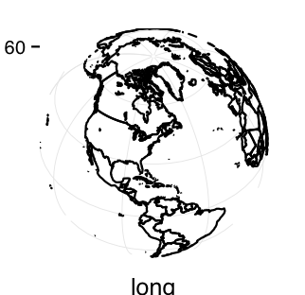



















Stats
Scales
Coordinate Systems
Faceting
An alternative way to build a layer.
Override defaults with scales package.
A stat builds new variables to plot (e.g., count, prop).
Scales map data values to the visual values of an aesthetic. To change a mapping, add a new scale.
r <- d + geom_bar()
r + coord_cartesian(xlim = c(0, 5)) - xlim, ylim
The default cartesian coordinate system.
r + coord_fixed(ratio = 1/2)
ratio, xlim, ylim - Cartesian coordinates with Fixed
aspect ratio between x and y units.
r + coord_flip()
Flip cartesian coordinates by switching
x and y aesthetic mappings.
r + coord_polar(theta = "x", direction=1)
theta, start, direction - Polar coordinates.
r + coord_trans(y = “sqrt") - x, y, xlim, ylim
Transformed cartesian coordinates. Set xtrans
and ytrans to the name of a window function.
π + coord_sf() - xlim, ylim, crs. Ensures all layers
use a common Coordinate Reference System.
Facets divide a plot into subplots based on the values of one or more discrete variables.
t <- ggplot(mpg, aes(cty, hwy)) + geom_point()
t + facet_grid(. ~ fl)
Facet into columns based on fl.
t + facet_grid(year ~ .)
Facet into rows based on year.
t + facet_grid(year ~ fl)
Facet into both rows and columns.
t + facet_wrap(~ fl)
Wrap facets into a rectangular layout.
Set scales to let axis limits vary across facets.
t + facet_grid(drv ~ fl, scales = "free") x and y axis limits adjust to individual facets: "free_x" - x axis limits adjust "free_y" - y axis limits adjust
Set labeller to adjust facet label:
t + facet_grid(. ~ fl, labeller = label_both)
t + facet_grid(fl ~ ., labeller = label_bquote(alpha ^ .(fl)))
fl | cty | cyl
x | count
+
=
n <- d + geom_bar(aes(fill = fl))
data
stat
geom
x = x · y = count
coordinate system
plot
scale_
aesthetic to adjust
prepackaged scale to use
scale-specific arguments
n + scale_fill_manual(
values = c("skyblue", "royalblue", "blue", "navy"),
limits = c("d", "e", "p", "r"), breaks =c("d", "e", "p", “r"),
name = "fuel", labels = c("D", "E", "P", "R"))
Visualize a stat by changing the default stat of a geom function, geom_bar(stat="count") or by using a stat function, stat_count(geom="bar"), which calls a default geom to make a layer (equivalent to a geom function).
Use after_stat(name) syntax to map the stat variable name to an aesthetic.
range of values to include in mapping
title to use in legend/axis
labels to use in legend/axis
breaks to use in legend/axis
geom to use
stat function
geommappings
GENERAL PURPOSE SCALES
Use with most aesthetics
scale_*_continuous() - Map cont’ values to visual ones.
scale_*_discrete() - Map discrete values to visual ones.
scale_*_binned() - Map continuous values to discrete bins.
scale_*_identity() - Use data values as visual ones.
scale_*_manual(values = c()) - Map discrete values to manually chosen visual ones.
scale_*_date(date_labels = "%m/%d"), date_breaks = "2 weeks") - Treat data values as dates.
scale_*_datetime() - Treat data values as date times. Same as scale_*_date(). See ?strptime for label formats.
i + stat_density_2d(aes(fill = after_stat(level)),
geom = "polygon")
variable created by stat
c + stat_bin(binwidth = 1, boundary = 10) x, y | count, ncount, density, ndensity
c + stat_count(width = 1) x, y | count, prop
c + stat_density(adjust = 1, kernel = "gaussian") x, y | count, density, scaled
e + stat_bin_2d(bins = 30, drop = T) x, y, fill | count, density
e + stat_bin_hex(bins = 30) x, y, fill | count, density
e + stat_density_2d(contour = TRUE, n = 100) x, y, color, size | level
e + stat_ellipse(level = 0.95, segments = 51, type = "t")
l + stat_contour(aes(z = z)) x, y, z, order | level
l + stat_summary_hex(aes(z = z), bins = 30, fun = max) x, y, z, fill | value
l + stat_summary_2d(aes(z = z), bins = 30, fun = mean) x, y, z, fill | value
f + stat_boxplot(coef = 1.5) x, y | lower, middle, upper, width , ymin, ymax
f + stat_ydensity(kernel = "gaussian", scale = "area") x, y | density, scaled, count, n, violinwidth, width
e + stat_ecdf(n = 40) x, y | x, y
e + stat_quantile(quantiles = c(0.1, 0.9), formula = y ~ log(x), method = "rq") x, y | quantile
e + stat_smooth(method = "lm", formula = y ~ x, se = T, level = 0.95) x, y | se, x, y, ymin, ymax
ggplot() + xlim(-5, 5) + stat_function(fun = dnorm, n = 20, geom = “point”) x | x, y
ggplot() + stat_qq(aes(sample = 1:100)) x, y, sample | sample, theoretical
e + stat_sum() x, y, size | n, prop
e + stat_summary(fun.data = "mean_cl_boot")
h + stat_summary_bin(fun = "mean", geom = "bar")
e + stat_identity()
e + stat_unique()
Position Adjustments
fl: c
fl: d
fl: e
fl: p
fl: r
X & Y LOCATION SCALES
Use with x or y aesthetics (x shown here)
scale_x_log10() - Plot x on log10 scale.
scale_x_reverse() - Reverse the direction of the x axis.
scale_x_sqrt() - Plot x on square root scale.
Position adjustments determine how to arrange geoms that would otherwise occupy the same space.
s <- ggplot(mpg, aes(fl, fill = drv))
s + geom_bar(position = "dodge")
Arrange elements side by side.
s + geom_bar(position = "fill")
Stack elements on top of one
another, normalize height.
e + geom_point(position = "jitter")
Add random noise to X and Y position of
each element to avoid overplotting.
e + geom_label(position = "nudge")
Nudge labels away from points.
s + geom_bar(position = "stack")
Stack elements on top of one another.
Each position adjustment can be recast as a function with manual width and height arguments:
s + geom_bar(position = position_dodge(width = 1))
COLOR AND FILL SCALES (DISCRETE)
n + scale_fill_brewer(palette = "Blues")
For palette choices:
RColorBrewer::display.brewer.all()
n + scale_fill_grey(start = 0.2,
end = 0.8, na.value = "red")
Labels and Legends
Use labs() to label the elements of your plot.
t + labs(x = "New x axis label", y = "New y axis label", title ="Add a title above the plot", subtitle = "Add a subtitle below title", caption = "Add a caption below plot", alt = "Add alt text to the plot",
<aes> = "New <aes> legend title")
t + annotate(geom = "text", x = 8, y = 9, label = “A") Places a geom with manually selected aesthetics.
p + guides(x = guide_axis(n.dodge = 2)) Avoid crowded or overlapping labels with guide_axis(n.dodge or angle).
n + guides(fill = “none") Set legend type for each aesthetic: colorbar, legend, or none (no legend).
n + theme(legend.position = "bottom") Place legend at "bottom", "top", "left", or “right”.
n + scale_fill_discrete(name = "Title", labels = c("A", "B", "C", "D", "E")) Set legend title and labels with a scale function.
<AES>
<AES>
COLOR AND FILL SCALES (CONTINUOUS)
o <- c + geom_dotplot(aes(fill = x))
o + scale_fill_distiller(palette = “Blues”)
o + scale_fill_gradient(low="red", high=“yellow")
o + scale_fill_gradient2(low = "red", high = “blue”,
mid = "white", midpoint = 25)
o + scale_fill_gradientn(colors = topo.colors(6))
Also: rainbow(), heat.colors(), terrain.colors(),
cm.colors(), RColorBrewer::brewer.pal()
Themes
r + theme_bw()
White background
with grid lines.
r + theme_gray()
Grey background
(default theme).
r + theme_dark()
Dark for contrast.
r + theme_classic()
r + theme_light()
r + theme_linedraw()
r + theme_minimal()
Minimal theme.
r + theme_void()
Empty theme.
SHAPE AND SIZE SCALES p <- e + geom_point(aes(shape = fl, size = cyl))
p + scale_shape() + scale_size()
p + scale_shape_manual(values = c(3:7))
p + scale_radius(range = c(1,6))
p + scale_size_area(max_size = 6)
Zooming
Without clipping (preferred):
t + coord_cartesian(xlim = c(0, 100), ylim = c(10, 20))
With clipping (removes unseen data points):
t + xlim(0, 100) + ylim(10, 20)
t + scale_x_continuous(limits = c(0, 100)) +
scale_y_continuous(limits = c(0, 100))
r + theme() Customize aspects of the theme such as axis, legend, panel, and facet properties. r + ggtitle(“Title”) + theme(plot.title.postion = “plot”) r + theme(panel.background = element_rect(fill = “blue”))
CC BY SA Posit Software, PBC • info@posit.co • posit.co • Learn more at ggplot2.tidyverse.org • HTML cheatsheets at pos.it/cheatsheets • ggplot2 3.5.1 • Updated: 2024-05

